Slide 1
Ędwadewayę:sta⁷ (en dwa day wa yenhs ta) We all are Learning
Collin Keye and Brandy Lynn Thomas

Slide 2
Dagawaęnt, hni⁷ gya:sǫh, Oswe:gę⁷ dwagahdęgyǫ:⁷ , Otahyǫn:ni: niwagesyaǫdę:⁷ , Ganyę⁷geho:nǫ⁷ niwagohwęjo⁷de:⁷ , I:⁷ sheǫ:nyęh Gayogoho:no⁷ ne⁷ Stoneridge Gaeksasho:ah Odadrihǫhnyanih. Collin Keye is my given name, my traditional name given to me at birth is Dagawaęnt meaning A sudden strong wind. I am from Six Nations, my clan is Wolf, and I am from the Mohawk Nation. I teach Cayuga Language at Stoneridge Children’s Centre as the Culture and Language Instructor.

Slide 3
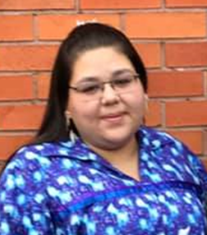
Brandy Lynn Thomas. RECE (Registered Early Childhood Educator) from Stoneridge Children’s Centre Deyohwęjado:́ge: . My English name is Brandy Lynn Thomas, I’m Mohawk, Turtle Clan, From Six Nations Reserve. Studied Early Childhood Education & Graduated from Fanshawe College in 2017 Married my best friend (Jim) in 2008, I have 2 Amazing Children, Gawenageho he’s 15 and Gastodrase 10. Their English Names are Ethan & Tyra. I have 2 doggies whom are just like my own children, koko & Dallas. Have been Currently employed with Stoneridge Children’s Centre Since June 2018, I have worked in the Infant program, The Preschool Program and am currently in the Toddler program.

Slide 4
Ędwadewayę:sta⁷ (en dwa day wa yenhs ta) We all are Learning
The presentation is going to be about how we are providing the Cayuga Language and the Haudenosaunee culture to our children in the early years before they begin their journeys into the education systems.
Also about how we have a unique partnership with families working together in keeping our languages thriving and strong for the faces yet to come

Slide 5
Ganohonyohk (giving of thanks address)
We recite this address each morning once all of the children and all of the Staff have arrived to open our day and to bring all of our minds in as one.
At the end of the day we also recite the gaehwehodo (closing of the matters) it is also called the releasing of the minds. Just like in the ganohonyohk in this picture that you would first see coming into our centre, it shows all that we have been provided by our Creator Shogwayadihsoh , and how we are as one here on earth.

Slide 6
Background of Presenters:
Dagawaent (sudden strong wind) I am from The Ganyegeho:no Mohawk Nation Otahyoni: wolf.
I started my journey into the world of early learning in 2005 and began working on the job in 2007 in a great Aboriginal Head start program before coming back to my home community of Six Nations as an RECE.
There I worked for at that position for nearly 12 years until I moved on the Culture and Language Centre).
I am truly in my dream Job where i have the opportunity to teach and learn from the children and now I get to teach and learn with Our languages and incorporate our culture.
Brandy
Our supervisor at the time, she has since gone on Mat-leave, discussed with us some of the information , along with other supervisors, discovered how there is not much visual elements of culture in our centres.
Upon more consultation and discussion Brandy and Myself asked if we could set up a classroom dedicated to the culture of our people. So this some of the things we came up with.

Slide 7
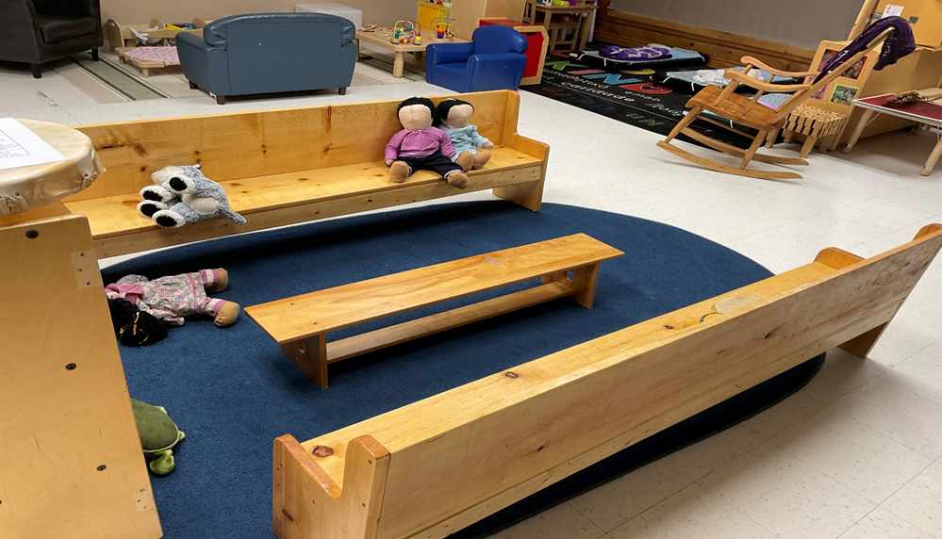

Slide 8
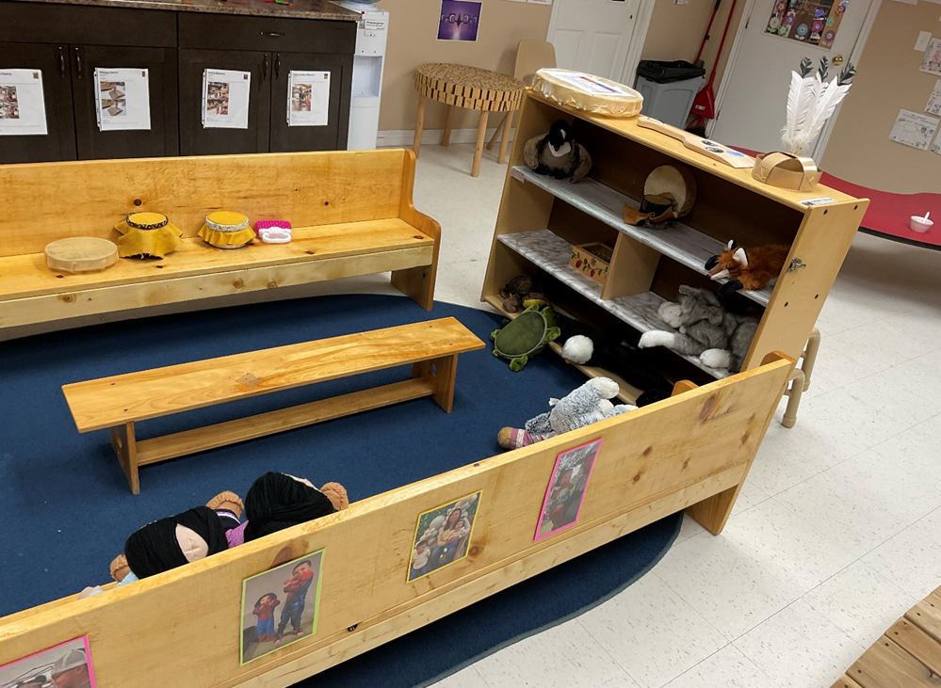

Slide 9
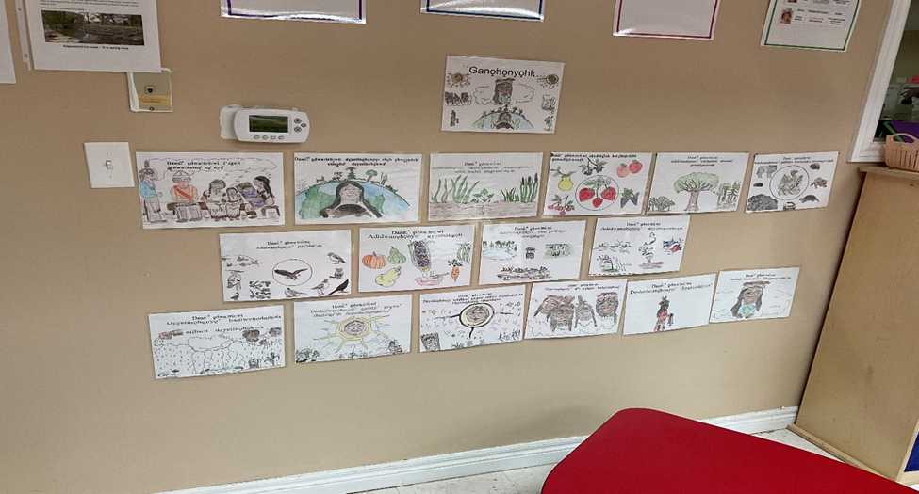

Slide 10
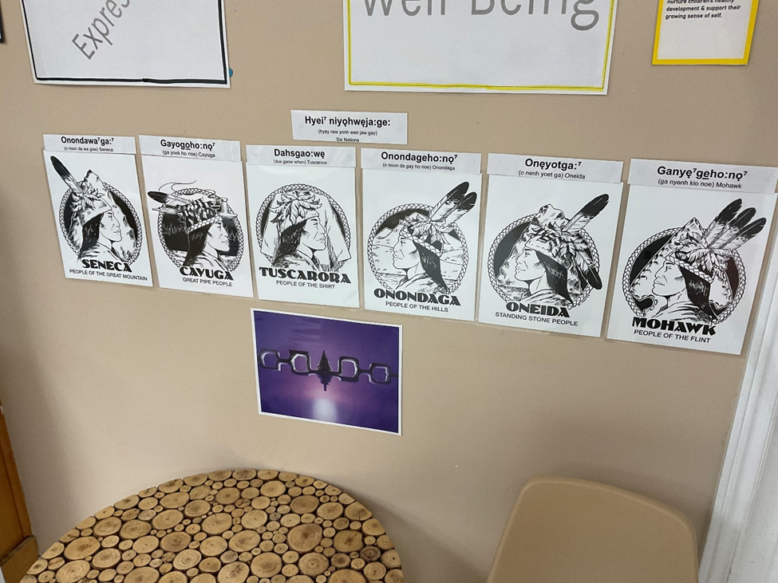

Slide 11
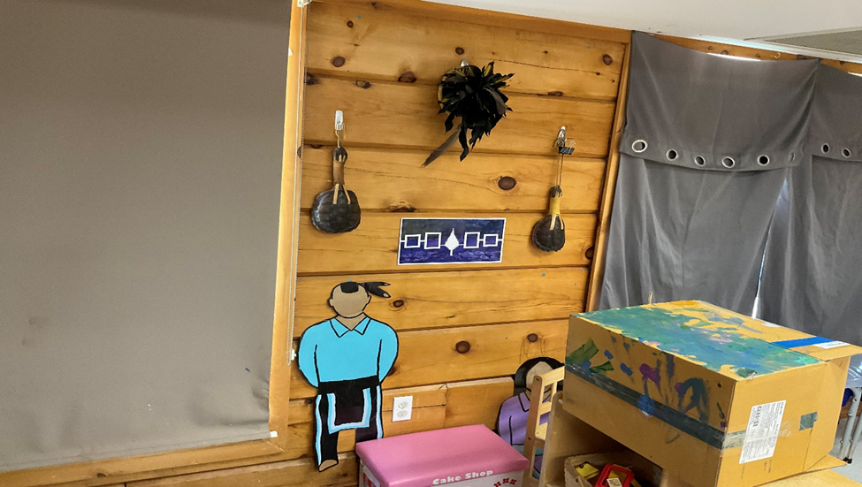

Slide 12
To be able to teach one’s culture you have to live it.
To the best of my abilities everyday I try to do this in my home, life and in my world at Stoneridge.
I consider myself lucky to be immersed in the language and culture since birth.
On my mothers side of my family both my grandparents were leaders faith keepers of the longhouse, speakers of our languages my Grandfather was able to speak all six of our languages.
On my fathers side they too were always going to longhouse and always using our languages to communicate.
I was lucky enough to be around the languages when Reg and Marge Henry developed the Henry orthography, the writing system we use now for the gayogoho:no language.
If we are to look at the Cayuga language. Unless you are familiar with the writing systems it will be quite difficult to understand.
Then throw in teaching the language to early learners it can be even tougher.
So what I tell people to do is to write it out how it sounds to you because it may sound a bit different from what I hear as teacher.

Slide 13
During Play Tiime
English | Cayuga | Pronounced
Do you want to play? | Ise gęh ęsatgahnye:⁷ | ee say genh enh sat gah nyay
Do you want to go outside? | Ise gęh ahsdeh hęhse:⁷ | ee say genh ahs dahy henh say
You two) share | Dehsnihs | dayh sneehs
You play | Satgahnye⁷ | sut guh nyay
You play nice | Desadewayehǫhs | day sa day wai hoehs
You walk | Desatahahk | day saht ta huk
You jump | Desęnasgwahk | day sen a sgwuk
Don’t play with (that) | Ahgwih ęsatgahi⁷t | awk gweeh enh sut ga heet
Be careful | Sni goha:k | snee kwawk

Slide 14
At School Odadrihonyani⁷ta⁷geh
English | Cayuga | Pronounced
Book | 0hyadohsro:do⁷ | 0 hyat sroen donh
Paper | Gahyadohsra⁷ | Kyaht sra
Pencil | Ehyadohkwa⁷ | Ay hyat kwa
Pen | Gahne:ga ehyadohkwa⁷ | Knay ga ay hyat kwa
Crayon | Ohsohta⁷ | Onh soh ta
Chalk | Osdehe⁷ehyadohkwa⁷ | 0hs denh henh ay hyat kwa
Paint | Degahnegayehsdoh oh sohts⁷ | Day gahnay gaihs dinh 0nh soh ta
Paint brush | Ohsohgwa⁷ eya:ta⁷ | 0hsohgwa ay yaw ta
Chair | Akyedahkwa | A Kyent kwa
Desj | Okyadohsrahahkwa⁷ | 0hn kyat sra ha kwa
Glue | Etsehsda:ta⁷ Ea⁷nedajdahkwa⁷ | Ay cheys daw ta ayyaw nan duk tkwa
Scissors | Dagahena⁷ tra⁷ se⁷ | Day ga hey na tra say
Clock | Gahwihsd⁷aehs | Kweeh staehs

Slide 15
When writing out wordlists we use in the classrooms I will write out the word or use pictures, then write it using the writing system, then I will write it out how it sounds when spoken. Working with Brandy on lots of the language resources she made up a table that is an easier read so to speak.
With our language resources we have created them in this manner of how it is written and how it sounds when spoken. A message of their availability was sent out to the families over the Hi mama app. Whenever we were asked to set up an information booth at different events we bring all of this information and pictures showing what we are doing with the children and what we have to offer the community. If we use the languages everyday even if it is just one word or to we are going to help to ensure our future as nations and future stays strong and bright.

Slide 16
It also shown me how it is ok to ask for help when you are in need. This past fall I took a major hit in my life My father was called home then almost a month to the day our manager, supervisor friend and mentor was called home also.
It was at this time when my people stepped to care for me lifted me up and helped me through that hard grieving process. They showed me they were not just my colleagues and friends, they were a part of my family. This is just one example of how we live our culture each day. It also shows how we have to work together to make things work. It shows how we should continue to do what we do for the children. How it takes the entire village to raise our children.
Recently I have also been asked by outside agencies to help deliver programs with the languages through song and nursery rhymes with SN Polytechnic, as well as doing culture workshops with Association Native Child and Family Service Agencies of Ontario.
I have also been lucky enough to partner up with Gahwajiyade’ Detangwa’ta’ – Family Gathering facilitating their Immersion school readiness camp. All of these great opportunities have shown how it takes a village to raise a child.

Slide 18
In closing
we do not inherit the earth from our ancestors we borrow it from the children. Gaehwehodo’

