Slide 1
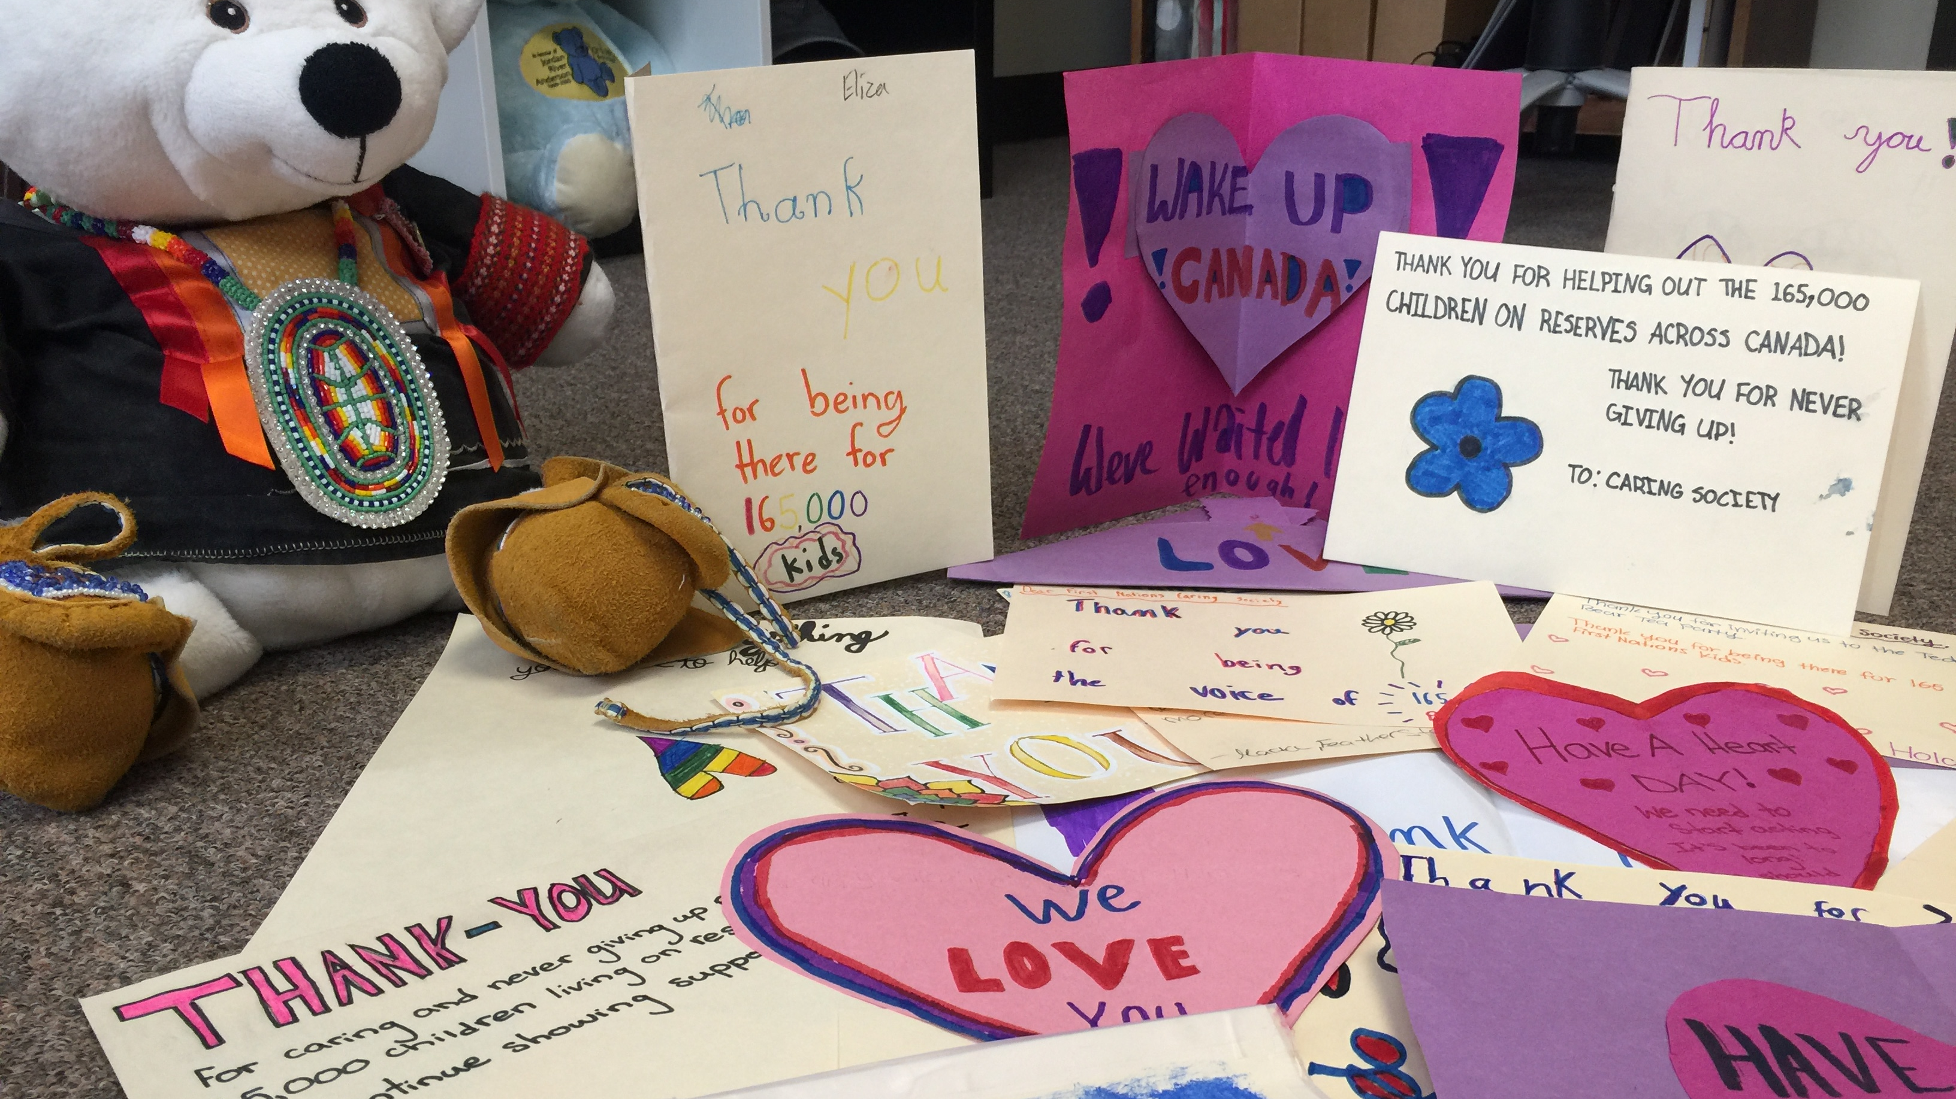
Equity+ Culture+ Self-Determination= Real Hope!
Chiefs of Ontario
May 20, 2021
Cindy Blackstock, PhD

Slide 2

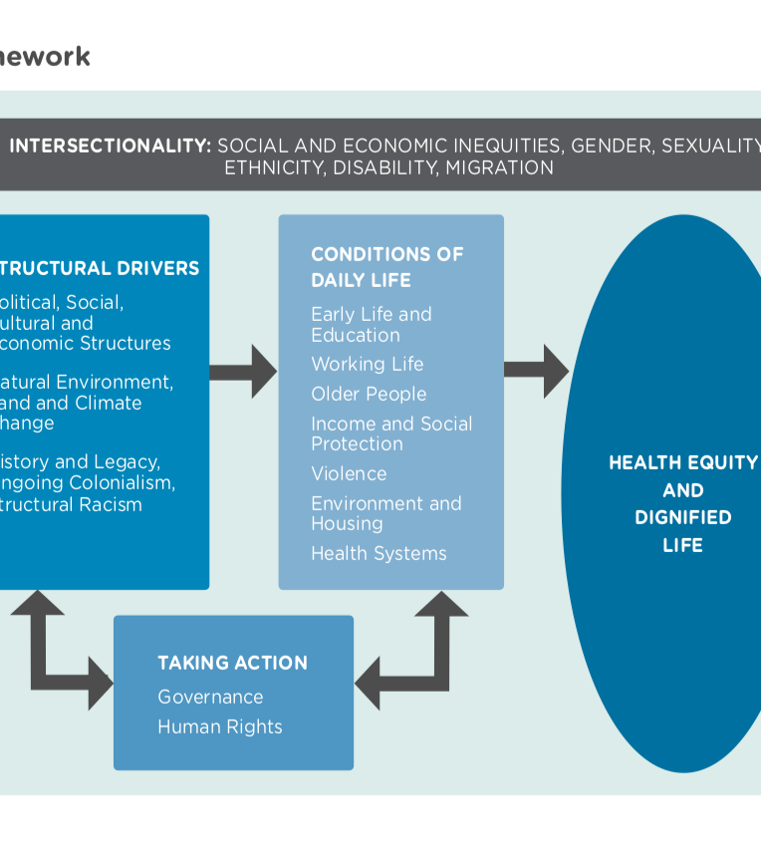
Equity + Culture = Dignified Life

Slide 3
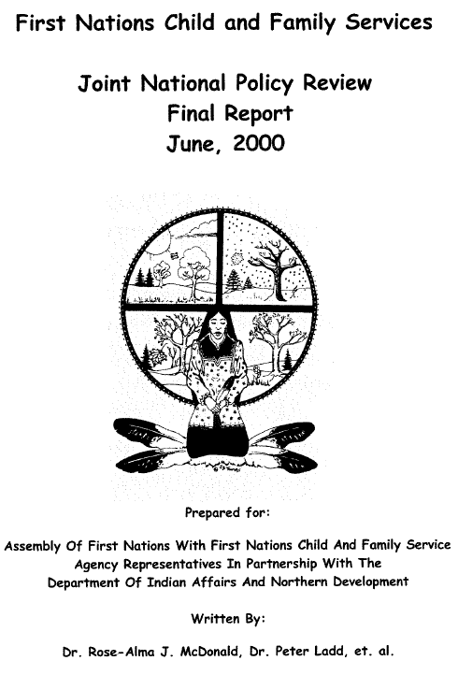
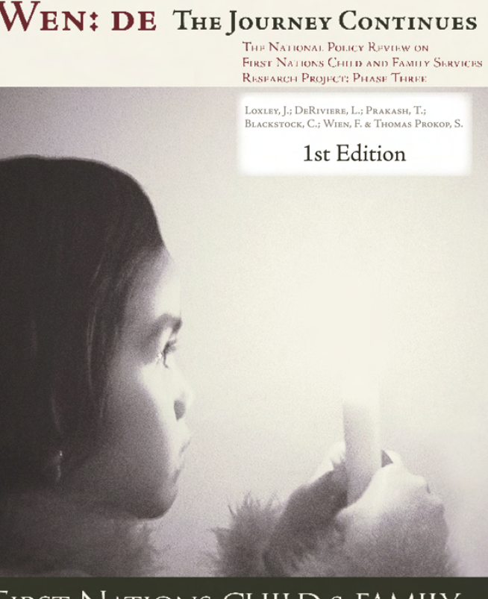
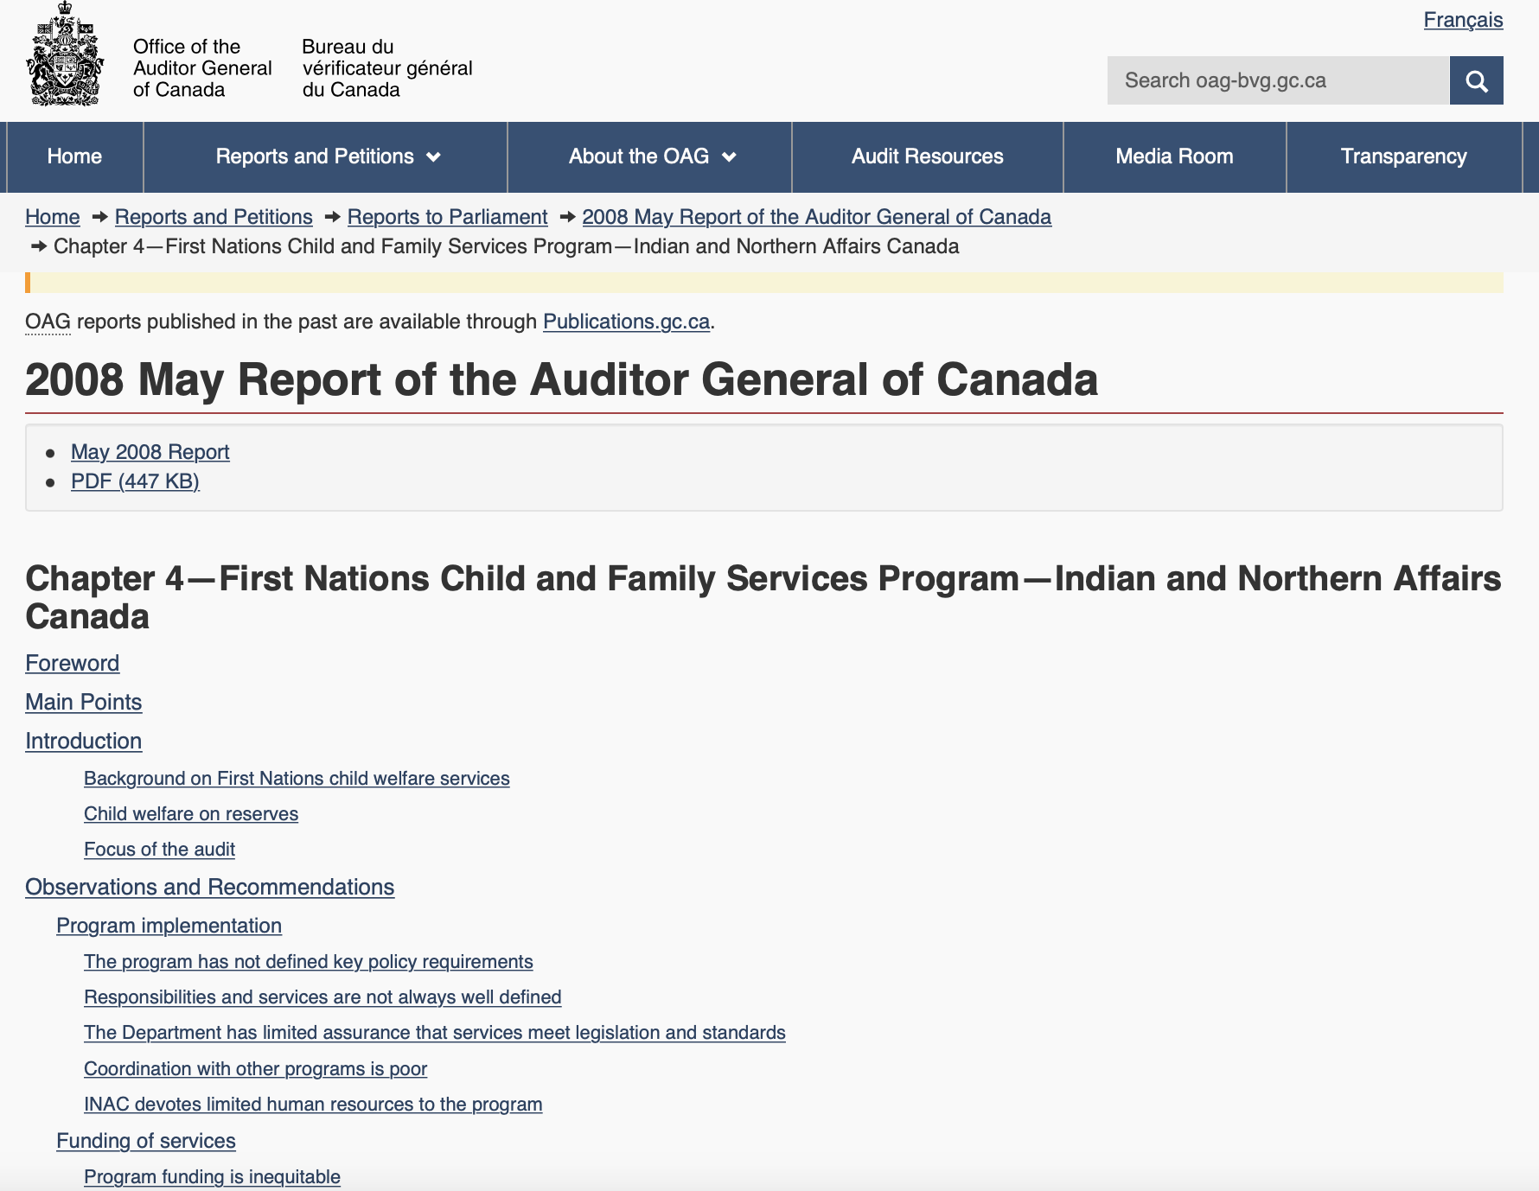
2000
2005
2008

Slide 4
Child welfare IS poverty, poor housing, addictions, mental health and family violence
Poverty
Poor Housing
Mental Health and Addictions
Higher risk for child welfare intervention

Slide 5
FN/CIS-2019 METHODS
Barbara Fallon, PhD et. al.,
First Nations CIS Advisory Committee, 2021
Survey collects a range of clinical information routinely collected during the investigation and is completed at the conclusion of an investigation
Data collected directly from investigating child welfare workers about new/re-opened investigations from a three-month sampling period (Oct 1 – Dec 31, 2019)
  Data was combined with OIS-2018 (Oct 1 – Dec 31, 2019) and Quebec administrative data (Jan 1 – Dec 31, 2019)
Uses a case file review process and data reflects the FN/CIS definitional framework and workers’ clinical assessments
Streamlined process – web-based survey for data collection

Slide 6
FN/CIS-2019 FINDINGS
Families Living On or Off Reserve in Investigations Involving First Nations Children

Slide 7
FN/CIS-2019 FINDINGS
Caregiver Risk Factors Among Investigated Families
At least one caregiver risk factor identified in
73% of FN child investigations
vs.
57% of Non-Indigenous child investigations

Slide 8
FN/CIS-2019 FINDINGS
Child Functioning Concerns Among Investigated Families
At least one child functioning concern identified in
37% of FN child investigations
vs.
32% of Non-Indigenous child investigations

Slide 9
FN/CIS-2019 FINDINGS
Socio-demographic Risk Factors

Slide 10
Children’s Supports by Sector
Off reserve
On reserve
Non-Profit
Corporate
Government
Non-Profit:
Negligible
Corporate limited due to Indian Act
Government: Broad sweeping inequity

Slide 11
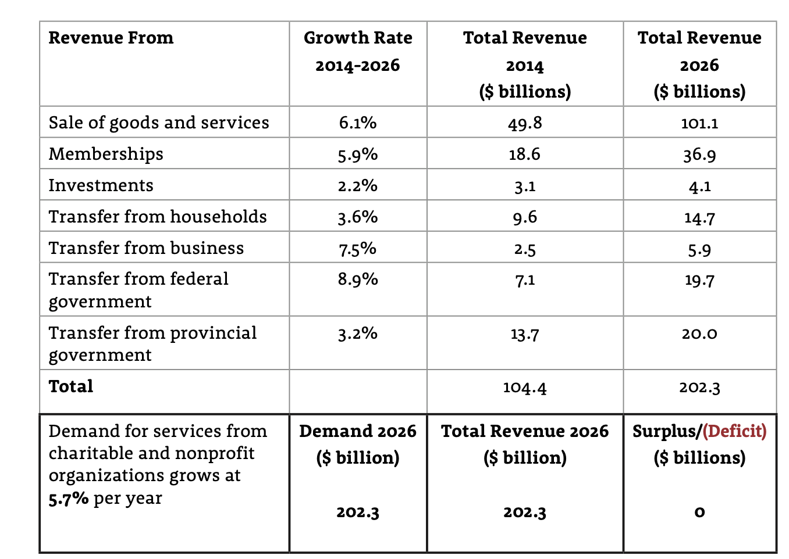
Non-Profit funding: the missing sector
Off reserve
(total value: 151 Billion/8.6% of GDP)
On reserve
Negligible
Very little direct service delivery
Most fed/prov. funding for non-profits directed to political organizations
20.8 Billion rising to 39.7 Billion
Source: Imagine Canada (2016)

Slide 12

Canadian Human Rights Tribunal (2016 CHRT 2)
Ordered Canada to cease its discriminatory conduct in First Nations child and family services AND
To ensure that the discrimination does not recur
Both funding amounts AND the structure are vital to achieving these goals

Slide 13
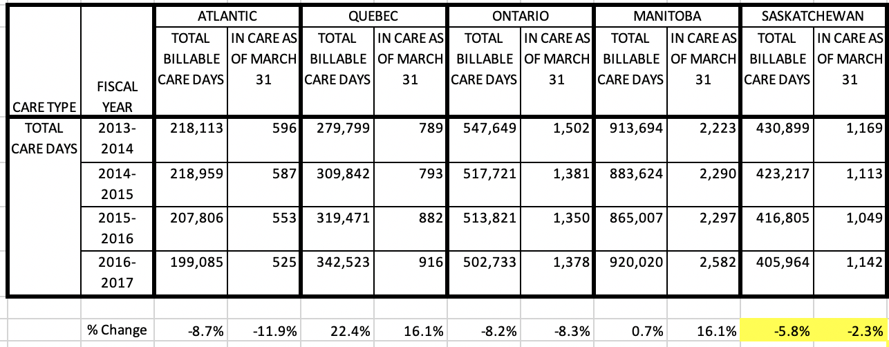
Number of days in care on reserve dropping

Slide 14
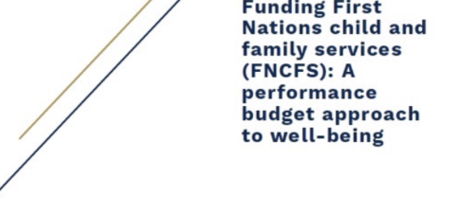
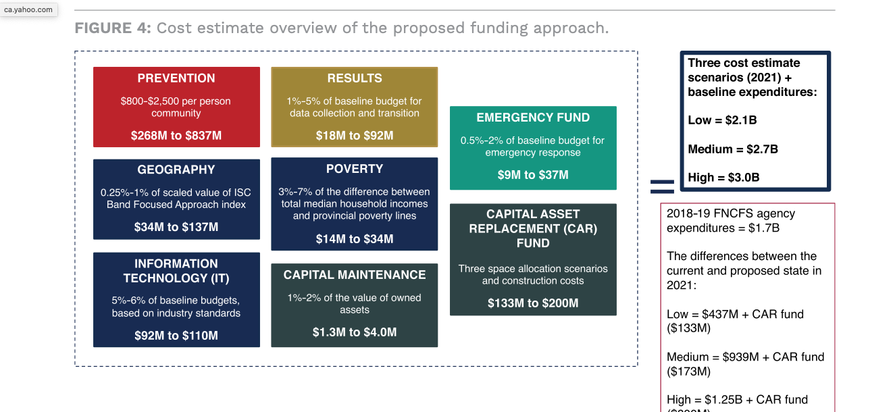
Enabling First Nations children to thrive

Slide 15

Jordan’s Principle: equality by application?

Slide 16
What changed for kids because of the CHRT case?
Nearly 800,000 services, products and supports provided to First Nations children that they would have otherwise not received.
First Nations child welfare budget doubled with an annual increase of about 600 million. Some First Nations agencies in BC received their first increase in the prevention budget in 28 years.

Slide 17
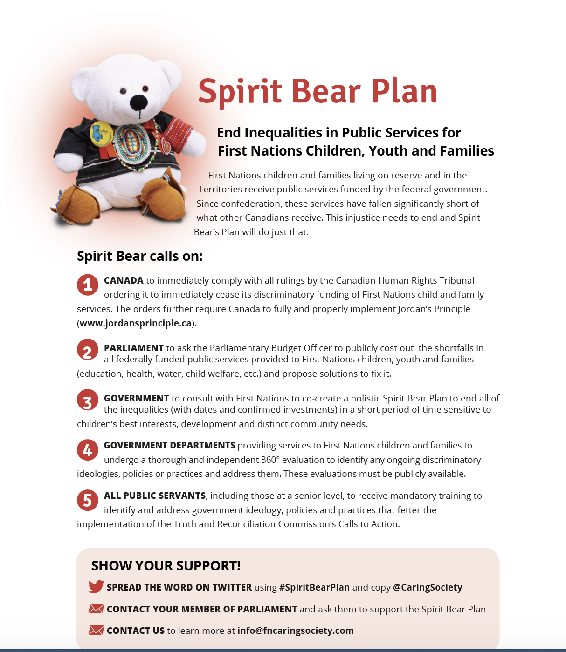
Spirit Bear Plan to end all inequalities in First Nations public services

Slide 18
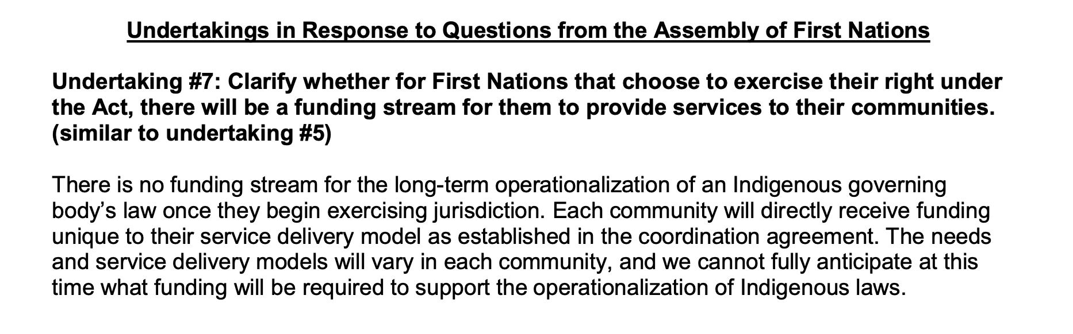
Canada’s position on the Act Respecting First Nations, Metis and Inuit Children, Youth and Families and the CHRT orders

Slide 19
Areas requiring clarification with C-92
Will Canada implement the Spirit Bear Plan to plug the inequaliites that fuel the drivers of over-representation?
How will Canada be held accountable for substantively equal, needs based, sustainable resources in its funding levels and funding levels?
Will the feds fund off reserve if the province will not?
Will Canada fund a First Nation to affirm jurisdiction per Section 35?

Slide 20
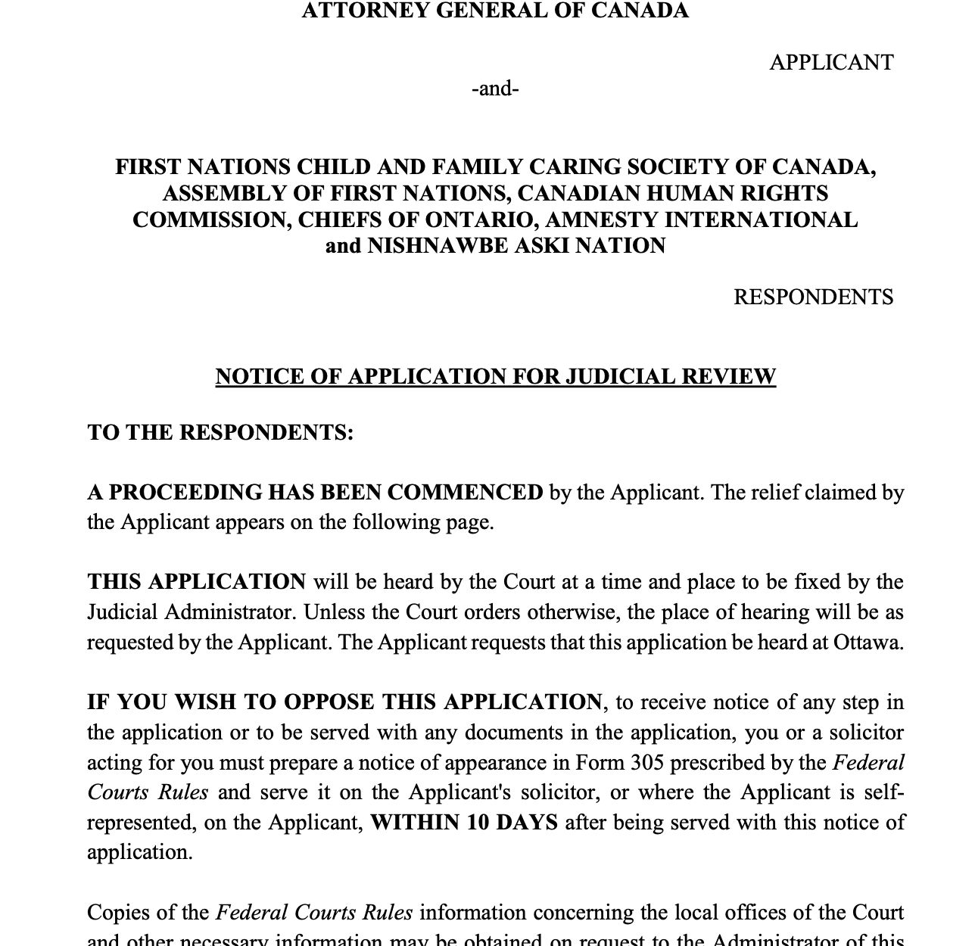
Canada seeks to quash a September 2019 CHRT order for compensation to victims
Canada argues individual victims of systemic discrimination should not be compensated under the Canadian Human Rights Act.
Justice Favel assigned by the Federal Court
AFN, Caring Society, COO, NAN and Amnesty International Canada all filed notice of appearance
Hearing scheduled for June 14 -18, 2021

Slide 21
Canada files for Judicial Review on Jordan’s Principle:
CHRT order ensures that non-status First Nations children off reserve who are recognized by their Nations should get help under Jordan’s Principle
Canada says it wants to talk to First Nations and that is why it is seeking to quash the order
Justice Favel assigned by the Federal Court
AFN, Caring Society, COO, NAN and Amnesty International Canada all filed notice of appearance
Congress of Aboriginal Peoples applied for, and was granted intervenor status
Hearing scheduled the week of June 14-18, 2021

Slide 22
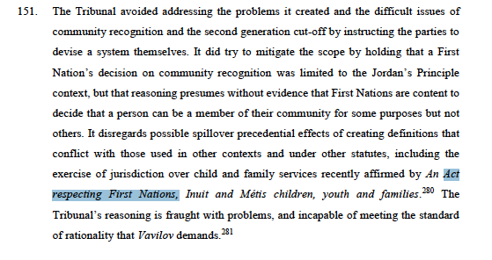
Canada cites C-92 in appeals v. First Nations kids

Slide 23

Spirit Bear and Children Make History (2020)
Produced by Spotted Fawn Productions
Based on the true story of how children of all diversities came together to stand for justice during the Canadian Human Rights Tribunal.
Shares the story of Jordan’s Principle
For more information contact info@fncaringsociety.com

Slide 24


Slide 25
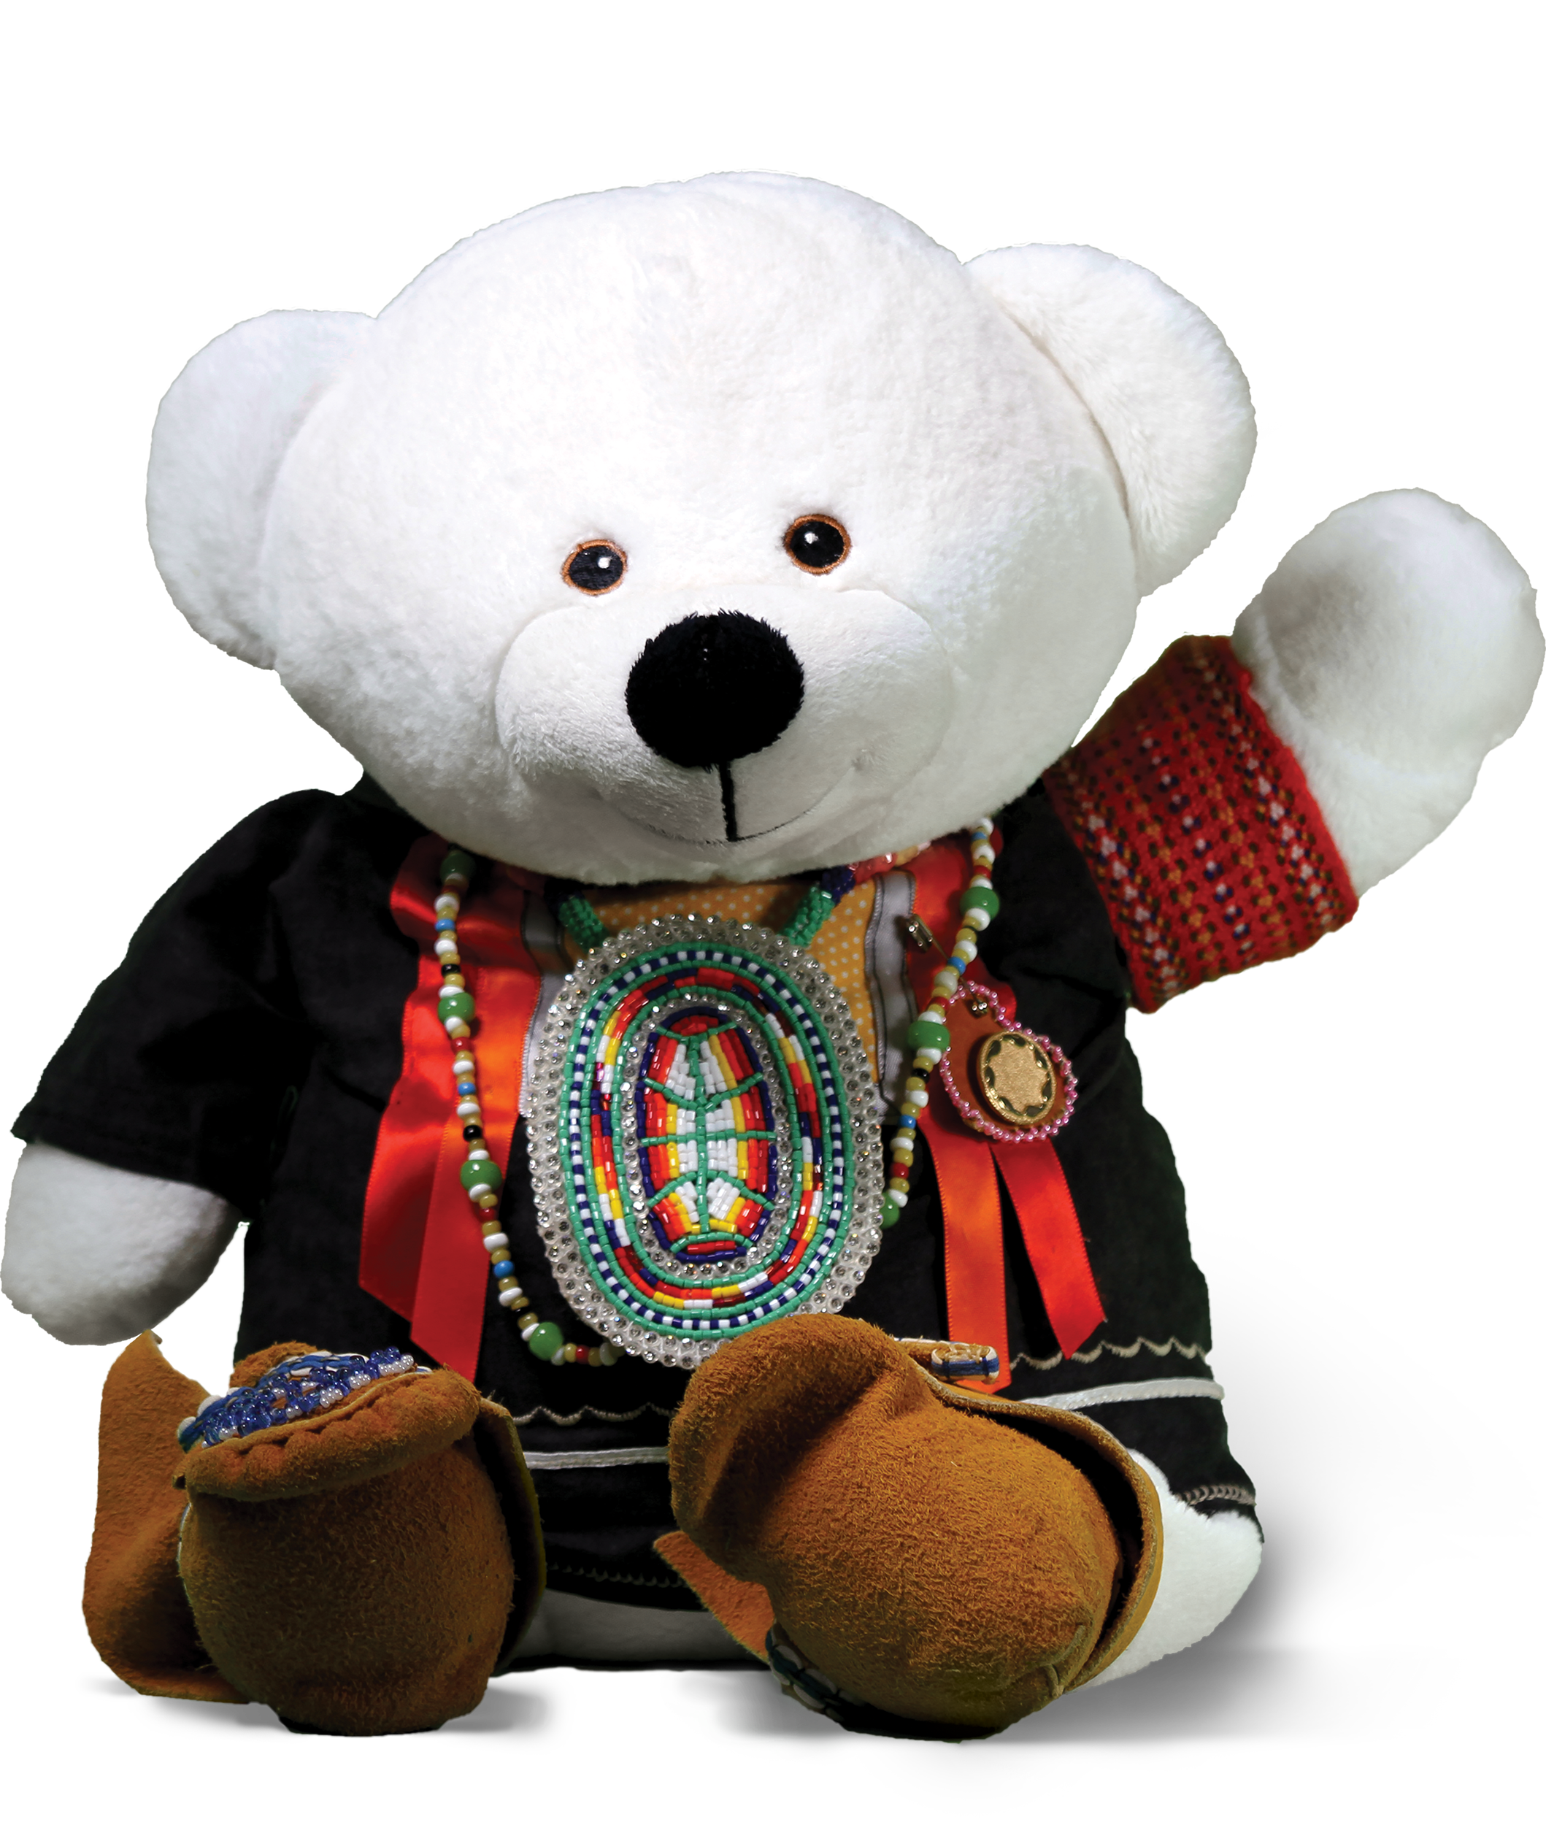
fncaringsociety.com
@CaringSociety
CaringSociety
fncaringsociety
spiritbearandfriends
@SpiritBear

