Slide 1
Annual Chiefs Assembly
Chiefs of Ontario presents
Moving Forward: Strengthening
Relationships for Future Generations
June 13-15, 2023
For more information, please visit: www.ChiefsMeeting.com
Notes:
Title. Do not alter.

Slide 2
Rights Assertions Update
Technical Committee on Rights Assertions
Notes:
Add Introductory Title.

Slide 3
Mandate
Resolution 09/44 Rejection of Métis Engagement on Ontario Revenue and Resource Benefits Sharing (Dec 2009)
Resolution 10/30 COO – MNO Political Protocol (Nov 2010)
Resolution 11/21 Aboriginal Community Energy Plans – Métis (April 2011)
Resolution 27/18 Framework Agreement on Métis Harvesting (June 2018)
Resolution 31/18 Support for Algonquins of Pikwakanagan First Nation (June 2018)
Resolution 21/44 Support Matachewan First Nation’s Plan to Commence Legal Action Challenging MNO’s Asserted Métis Rights in Treaty Territory (Nov 2021)
Resolution 22/25A Métis Nation of Ontario (June 2022)
Resolution 22/26A Métis Nation of Ontario Rights Assertions (June 2022)
Confidential resolution (Sept 2022) ** mandate to report back to the Chiefs-in-Assembly on the status of the resolution at the June 2023 ACA
Resolution 22/31S First Nations in Ontario’s Opposition to Canada’s Recognition of the Métis Nation of Ontario’s Self-Governance (Sept 2022)

Slide 4
Background
June 2022 – Chiefs-in-Assembly passed Resolution 22/25A Métis Nation of Ontario
July 2022 – Technical Committee established
August 2022 – Technical Committee met three times to develop draft Advocacy Strategy
September 2022 – Special Chiefs Assembly on Rights Assertions (Virtual)
Resolution passed supporting Advocacy Strategy
October 2022 to Present – Implementation of Advocacy Strategy
Notes:
To add more slides, right click on slide, click ‘Duplicate Slide’

Slide 5
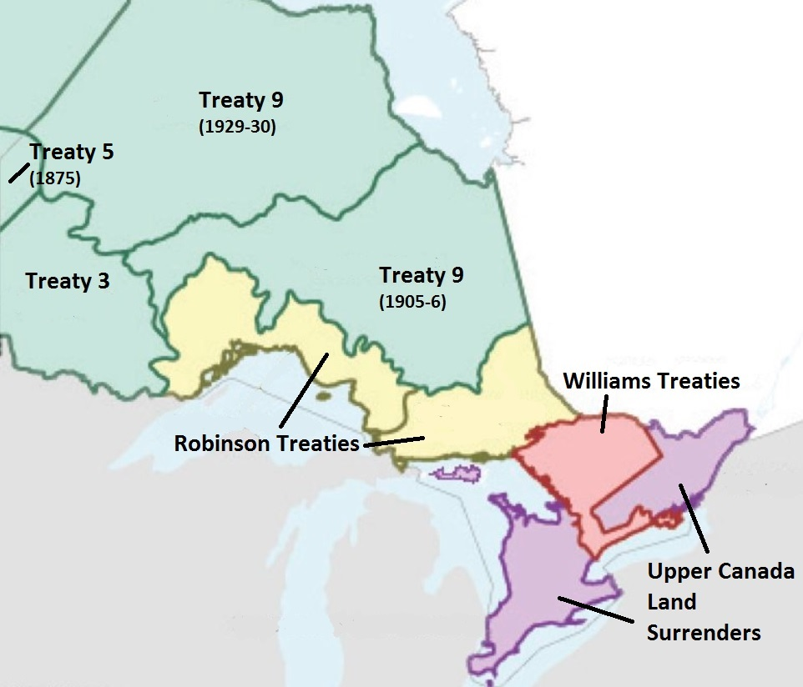
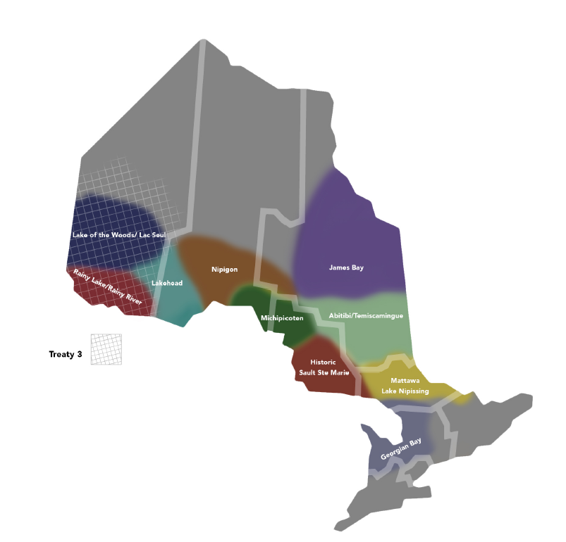
Notes:
Why have an Advocacy Strategy? The maps on the screen are a good illustration: What you see on the left is a map of First Nation Treaties in the Ontario region; the map on the right are MNO “traditional harvesting territories”. As you can see, their claims and assertions almost completely overlap Treaty territories and the entire province of Ontario.

Slide 6
Rights Assertions Advocacy Strategy
Political
Communications
Legal
Research
Notes:
To add more slides, right click on slide, click ‘Duplicate Slide’

Slide 7
Roles
First Nations, Political Territorial Organizations, and First Nations organizations play a leading role in implementing the Advocacy Strategy. Regional and local approaches will be key in the implementation process.
The Chiefs of Ontario Secretariat and Political Office’s role is to provide technical coordination and support, and facilitate the sharing of information, and facilitate any political items such as meetings with politicians, delegations or letters.

Slide 8
Political Component
September 2022 – Execution of letter campaign
To our knowledge, there were 15 letters sent to both Canada and Ontario from Nations, including from the Regional Chief
No response was received
December 2022 – Follow up letters sent. No response from Ontario.
February 2023 – Response from Canada (CIRNAC)
April 2023 – Ontario Caucus meeting with Ministers Miller and Hajdu – AFN SCA
May 2023 – Media statements
May 2023 – Outreach to other Nations across Canada
July 2023 – Potential joint statement AFN AGA – July 2023 (Resolution submitted)
Notes:
To add more slides, right click on slide, click ‘Duplicate Slide’

Slide 9
Communications Component
Media toolkit and coordination with media
Development of key messaging
Sharing information and resources
Media statements
Development of further background materials
Maintaining momentum
Notes:
To add more slides, right click on slide, click ‘Duplicate Slide’

Slide 10
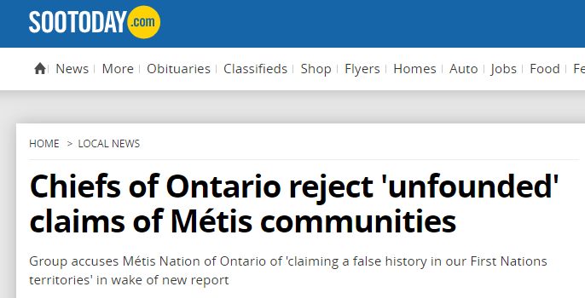
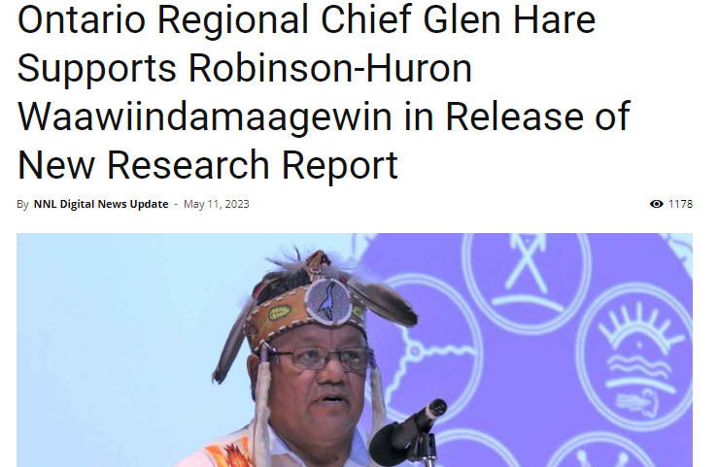
Solidarity In The News
Notes:
To add more slides, right click on slide, click ‘Duplicate Slide’

Slide 11
Legal Component
Wabun challenge to MNO Agreement late March
Judicial review of Canada’s decision to enter into the Agreement
The decision was incorrect and unreasonable
Lack of procedural fairness to First Nations
Minister failed to consult and violated Honour of the Crown
Also seeking injunction to prevent implementation of the Agreement
We aren’t able to legally prevent the introduction of the legislation itself
Notes:
To add more slides, right click on slide, click ‘Duplicate Slide’

Slide 12
Legal Component
Parties seeking to intervene
RHW, Anishinabek Nation, Assembly of Manitoba Chiefs
Metis Nation of Alberta
Next steps
Written motions on the interventions (decision - end of July)
MNO has brought motion to strike out – says court has no jurisdiction (hearing in August)
Injunction hearing (likely November)
Canada refusing to provide “Record” decision was based on – says it is secret (hearing TBD)
Notes:
To add more slides, right click on slide, click ‘Duplicate Slide’

Slide 13
Legal Component
What comes next?
Situation changes once legislation is passed
Possible challenges to legislation itself
Future litigation about territorial scope of MNO rights
Notes:
To add more slides, right click on slide, click ‘Duplicate Slide’

Slide 14
Research Component
September 2022 – Wabun report released
May 2023 – Robinson-Huron Waawiindamaagewin report released
As of June 2023, 6 of the 7 so-called “historic Métis communities” in the Ontario region have been examined. One “community” is outstanding (in red below):
Sault Ste. Marie
Georgian Bay
Killarney
Mattawa
Abitibi-Inland
Northern Lake Superior
Rainy River/Lake of the Woods/Treaty 3

Slide 15
Current Status
Focus on roll out of Communications Strategy
Educating the broader public about this issue, gaining support from the public
Building relationships with other Nations across Canada who have similar concerns – unified stance against false claims to Indigenous identity
Federal legislation is expected any time
CIRNAC remains committed to proceeding despite calls from First Nations to not move forward with the implementation of the MNO Self-Government legislation
Notes:
To add more slides, right click on slide, click ‘Duplicate Slide’

Slide 16
Looking Ahead
Continue to challenge Ontario’s recognition of the MNO’s “historic Métis communities” in the Ontario region
Strengthening messaging and relationships with media to accurately share First Nations perspectives
Reclaiming Ancestors, sharing histories of kinship
Reclaiming Non-Status members through Bill S-3 and looking at First Nation citizenship models
Notes:
To add more slides, right click on slide, click ‘Duplicate Slide’

Slide 17
For further information, please contact:
Jackie Lombardi
Director of Justice
jackie.lombardi@coo.org
Notes:
Insert Sector and Director contact information.

