Slide 1
Nishnawbe Aski Nation Social Services
Presented by: Bobby Narcisse, Director of Social Services
May 20, 2021

Slide 2
Outline of Presentation
Nishnawbe Aski Nation
Chiefs Committee on Children, Youth and Family (CCCYF)
Canadian Human Rights Tribunal
Band Representatives Services
C 92, Act Respecting First Nation, Inuit and Metis Children, youth and families

Slide 3
Nishnawbe Aski Nation
Political territorial organization representing 49 First Nation communities within northern Ontario.
Represents the legitimate, socioeconomic, and political aspirations of its First Nation members of Northern Ontario to all levels of government in order to allow local self-determination while establishing spiritual, cultural, social, and economic independence.

Slide 4
Chiefs Committee on Children, Youth and Families
The Chiefs Committee on Children Youth and Families (CCCYF) is mandated by Nishnawbe Aski Nation (NAN) Resolution 13/06: Ontario Aboriginal Child and Youth Strategy.
The mandate of the CCCYF is to develop a NAN specific Aboriginal Child and Youth Strategy with respect to Social Services, Child Welfare, Special Needs, Jurisdiction, and other areas as identified through the Strategy, while providing guidance and direction to the Department.

Slide 5
CCCYF Key Objectives
Act respecting First Nation, Inuit and Métis Children, Youth and Families
- First Nations jurisdiction over child welfare (federal and provincial processes)
Implementation of the Family Well-Being program (FWBP)
Income Assistance Reform
Issues to Accessing Government Issued Identification
NAN as Intervener in The First Nations Caring Society Case with the Canadian Human Rights Tribunal

Slide 6
Resolution 16-14: Inherent Jurisdiction over Children Wherever they Reside

Slide 7
Best Interest of the Child
CCCYF submitted a document to the Standing Committee on Indigenous and Northern Affairs re. Bill C-92: Promising Purposes, Problematic Provisions on May 9, 2019
November 2018, the CCCYF carefully reviewed the use of the term “best interests of the child” and determined that continued use of the term would risk perpetuating similar abuses by federal and/or provincial decision-makers.
the “best interests” provisions in Bill C-92 keeps alive a colonial and paternalistic notion that we cannot be trusted to make the best decisions for our children. They do not reflect lessons learned from the disastrous effects that have flown when Canada and the provinces have defined what is in our children’s “best interests”.

Slide 8
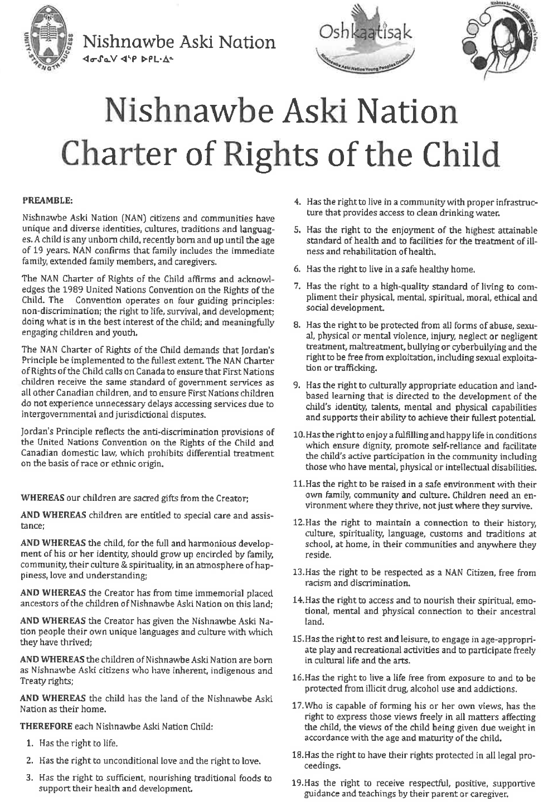

Slide 9
Canadian Human Rights Tribunal
In January 2016, the Canadian Human Rights Tribunal (“the Tribunal”) issued a landmark decision which found that Canada is racially discriminating against First Nation children by not providing adequate funding for child and family services on-reserve, and the failure to implement Jordan’s Principle
May 2016, NAN was granted intervenor status in order to ensure that remedies address the unique challenges of service delivery to remote communities.

Slide 10
Canadian Human Rights Tribunal – Remoteness Quotient (RQ)
The CHRT issued a consent order to establish the Remoteness Quotient Table made up of NAN and ISC representatives with the purpose of developing a child centered approach to comprehensive child welfare reform that includes research on remoteness costs
May 2016, NAN was granted intervenor status in order to ensure that remedies address the unique challenges of service delivery to remote communities.
NAN developed the concept of the Remoteness Quotient (RQ) to address the issue of inadequate funding mechanisms that fail to address the increased costs of service delivery to remote communities.
NAN and Canada continue to meet at an established RQ Table, this work is active.

Slide 11
Band Representative Funding
Definition of a Band Representative
ISC vs. First Nations
Collaboration of Band Representatives and other agencies/ programs
First Nations Child and Family Services
Payukotayno James and Hudson Bay Family Services
Family Wellbeing program, Healthy Babies Healthy Children, Jordans Principle, etc.

Slide 12
Act Respecting First Nations, Inuit & Metis Children, Youth and Families
NAN will be hosting regional Forums to provide information to First Nations regarding C-92. This will also provide First Nation stakeholders a platform to engage each other and experts as well as to determine how they would like to implement their inherent jurisdiction

Slide 13
Discussion

