Slide 1

YOUTH REFLECTIONS ON
POST-MAJORITY SUPPORTS AND CAPITAL NEEDS
NOVEMBER 8, 2022
CHIEFS OF ONTARIO
POST-MAJORITY SUPPORT SERVICES CONFERENCE

Slide 2
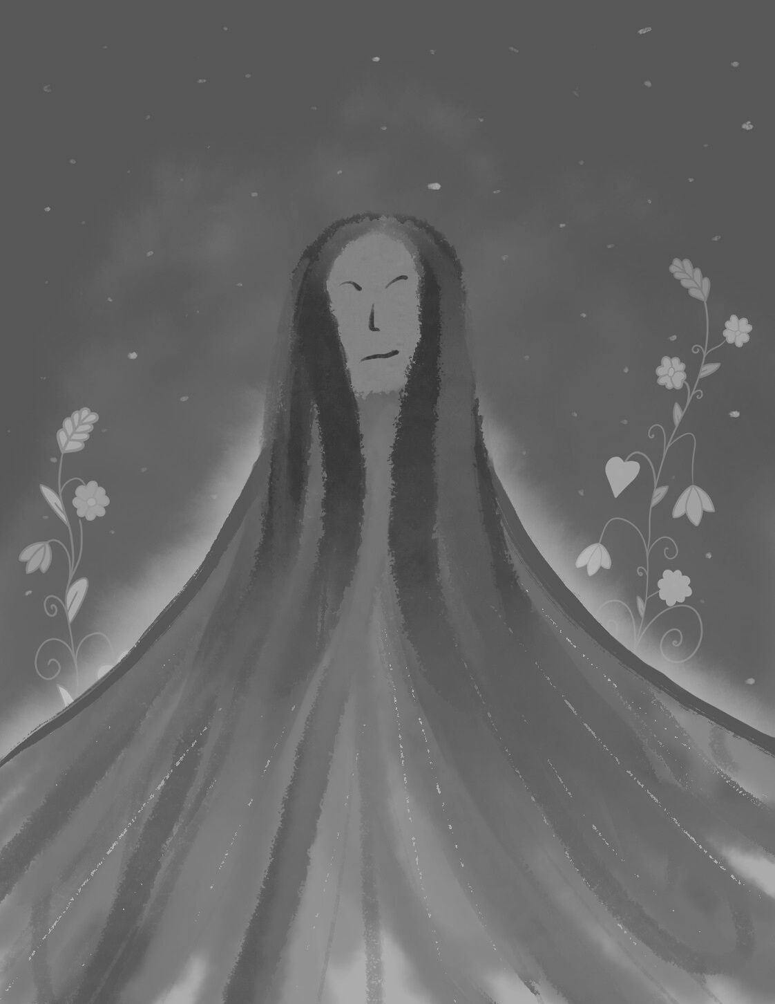
TODAY'S DISCUSSION
Oveview
Youth in Transition
  What We Heard: Barriers to Transition
  What We Did: “Bill C-92... so what?”
  Where We Go: Envisioning a Support System

Slide 3

WHAT WE HEARD
YOUTH EXPERIENCES WITH TRANSITION
Housing
Mental Health
Space
  Transitional housing with skills building
  Affordable housing
  Limited youth outreach for existing supports
  Lengthy wait times to access services
  Substance dependency
  Limited to no safe spaces for youth to gather or “escape”
  Limited safe homes
Community
Safety
Continuity
  Racism and discrimination
  Isolation from community, workers, families
  Human trafficking
  Need for ongoing supports and follow-up
  Where do youth go after graduation?

Slide 4
WHAT WE DID: BILL C-92... SO WHAT?
YOUTH-LED SOLUTIONS
Bill C-92... so what?
Abinoojii Inakonigewin Youth Advocate
The toolkit is intended to increase awareness about the different child welfare laws that apply to youth, such as Bill C-92 or Abinoojii Inakonigewin, which is Treaty #3’s child welfare law.
Our goal is to build a living resource for youth that provides practical resources aimed at supporting youth in transition.
The role of the Abinoojii Inakonigewin Youth Advocate is to provide a direct advocacy link for youth to the political territorial organization, to provide engagement opportunities for youth to share their experiences and identify priorities. and to ensure youth voices are prioritized in the development of the Abiinoojii Inakonigewin law.

Slide 5
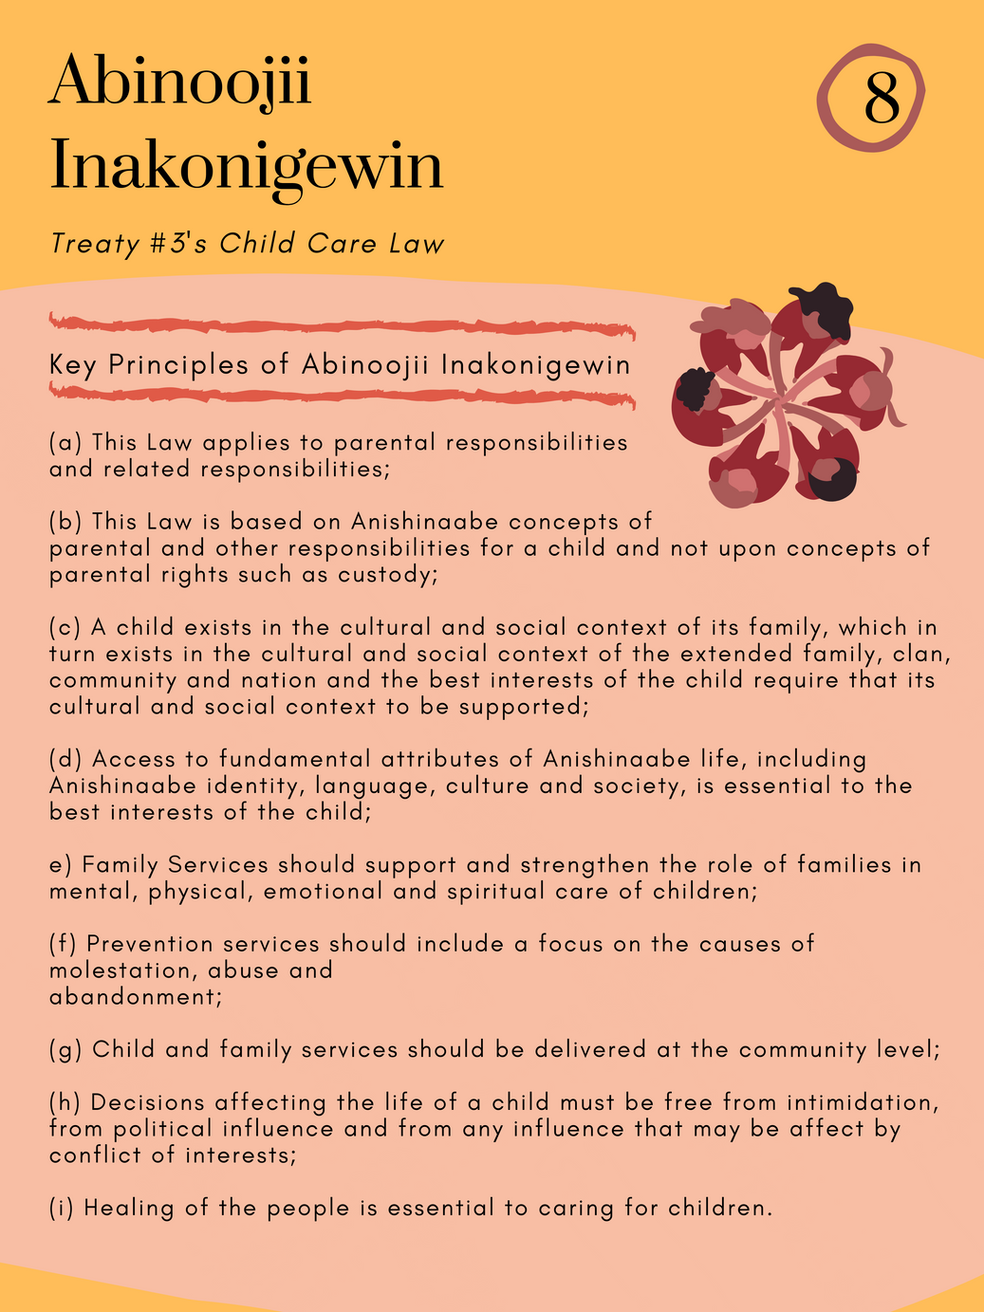
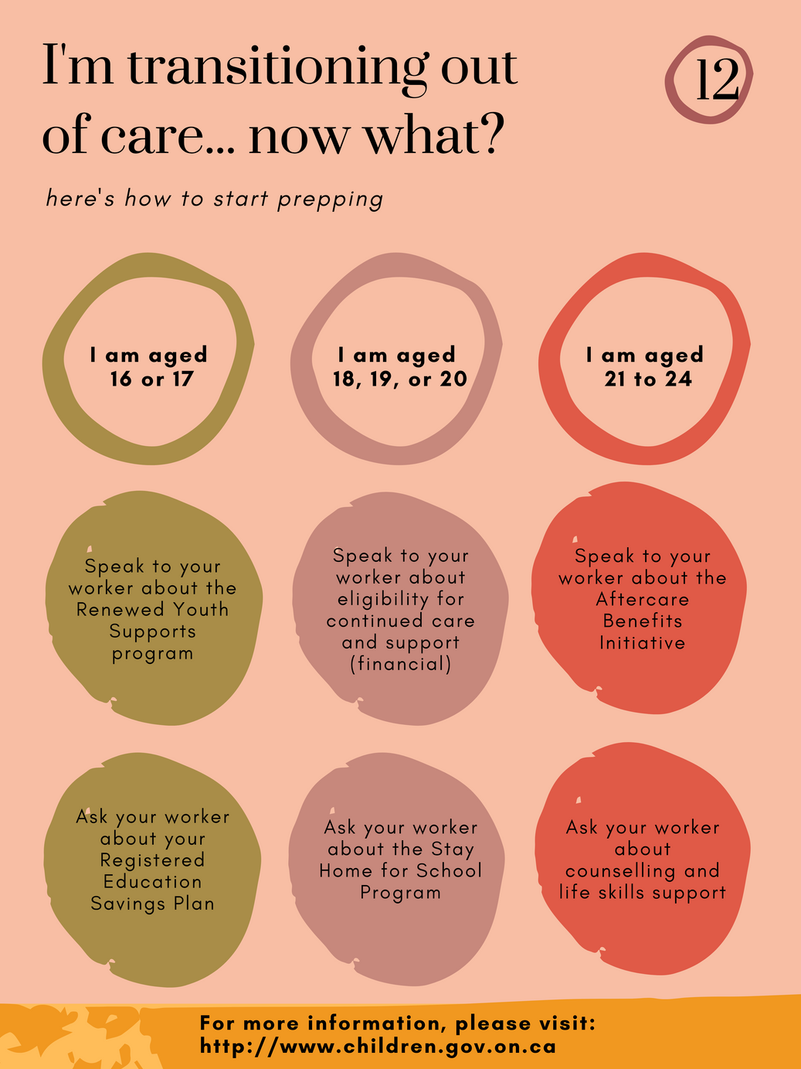
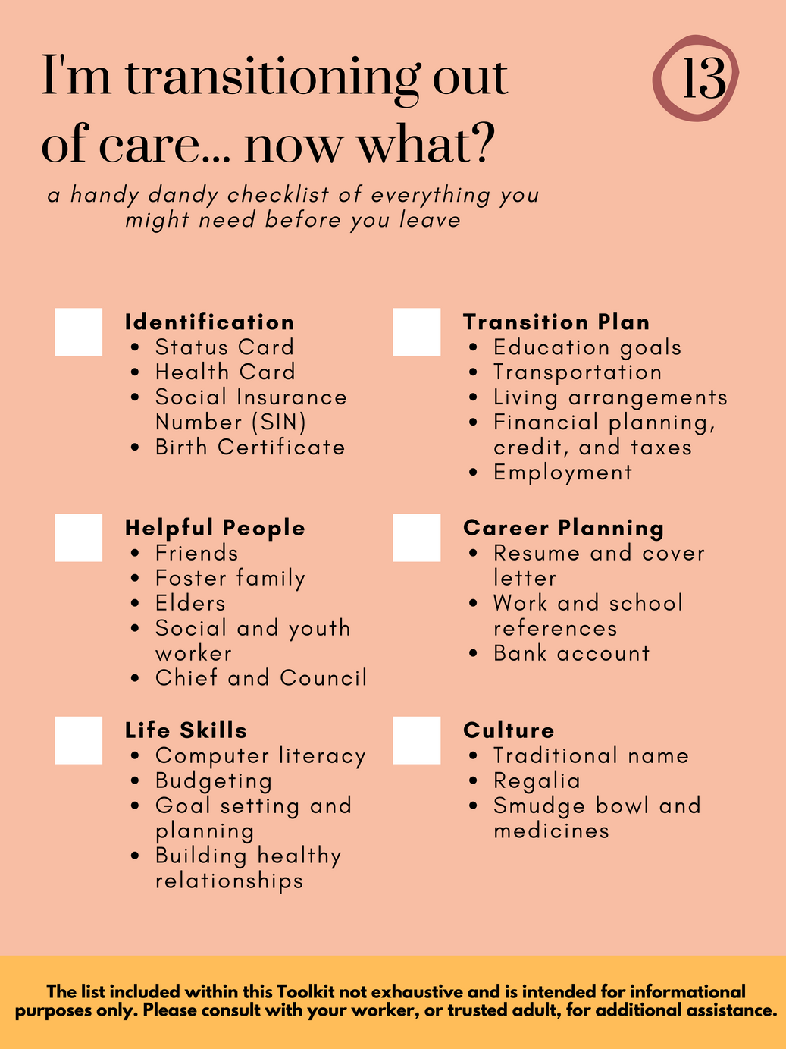
WHAT WE DID: BILL C-92... SO WHAT?

Slide 6
WHERE WE GO
Envisioning a Support System
by the youth, for the youth

Slide 7
RECOMMENDATIONS
Transitional Housing
Cultural Spaces and Programming
Inter-Agency Coordination
  Transitional building or apartment-style complex with 24-hour staff onsite
  Affordable housing that is geared toward multiple household structures, such as single, family
  Access to ceremony and spaces for ceremony to be held, such as sweat lodges, shake tent, pow wows, naming ceremony, etc.
  Cultural activities for youth, including sewing, beading, painting, regalia making, quill work, hunting.
  Ongoing collaboration between organizations, agencies, and/or governments to communicate ongoing changes in legislation, funding, programming, or other initiatives relevant to youth transitions.
  Holistic support teams to provide ongoing, and regular, follow up meetings with youth and workers.
  Community liaison or navigator to assist, or connect, youth with appropriate support services.
Youth-Oriented Training
  Train the trainer style programming for youth in transition workers and related support services
  Life skills training, managing trauma and grief, developing healthy coping strategies, and self-care.
Youth Advocacy
  Give space to include youth voices within agencies and organizations through youth councils, mentored work placements, or similar.

Slide 8
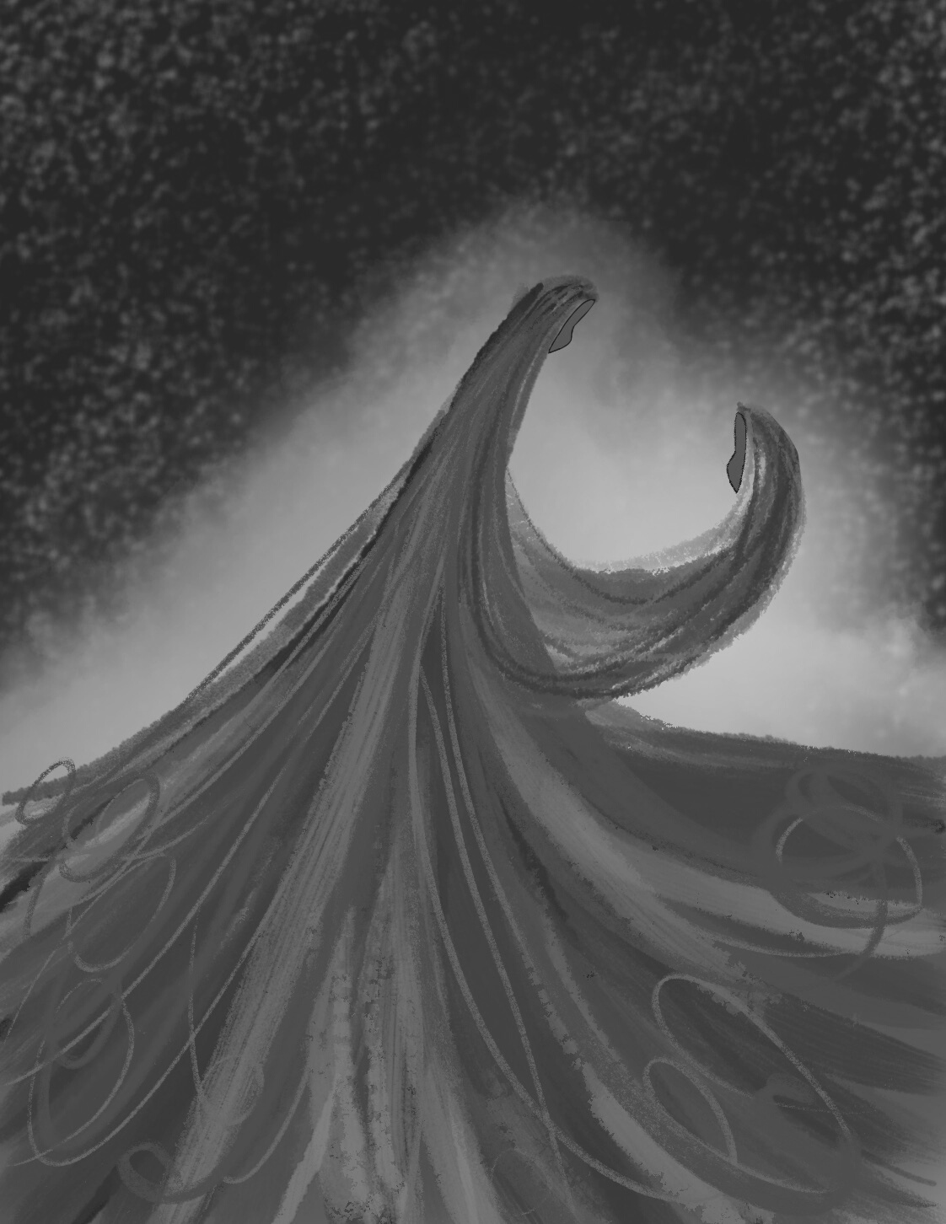

Zhoo-meeng-when-ih-daa Noon-gum
ZHOOMIINGWENIDAA NOONGOM
Let's all smile today :)

