Slide 1
First Nations Wellness Conference . March 21, 2024
Chiefs of Ontario

Slide 2
Transfer of Care and Control of Housing
Notes:
Add Introductory Title. Example: if you are providing an update on a specific file, place file name here.

Slide 3
What is the Transfer of Care and Control?
Indigenous Services Canada (ISC) has a mandate to transfer control of housing and related infrastructure programs to First Nations
First Nations and/or First Nation organizations to deliver their own programs and services based on a transfer agreement with ISC
COO has been provided funding to engage on a way forward for First Nations in Ontario
There are no prescribed timelines but there are prerequisites to transfer
Notes:
To add more slides, right click on slide 2, click ‘Duplicate Slide’

Slide 4
Prerequisites to Transfer
Chiefs and technicians have clearly stated that there are several non negotiable prerequisites to the transfer of care and control
This means that transfer would not be feasible until certain criteria are met, including:
Filling the housing backlog to ensure First Nations aren’t put in a position where they are “managing their own poverty”
Ensuring the required infrastructure is in place to keep pace with housing stock increases, including sufficient serviced lots with access to hydro, electrical, roads, sewage, etc.
Policy and structural changes are required to ensure First Nations are able to meet their housing needs (ATR, tax regimes, etc.)
Notes:
To add more slides, right click on slide 2, click ‘Duplicate Slide’

Slide 5
Housing Backlog
Notes:
To add more slides, right click on slide 2, click ‘Duplicate Slide’

Slide 6
Chiefs of Ontario Mandate
The COO Chiefs-in-Assembly Resolution No. 20/10 mandates the COO and CCOHI to conduct and report on engagement regarding the transfer of care and control of housing to First Nations in Ontario
Funding was provided by ISC to support engagement for Ontario First Nations to address the transfer of care and control of housing and infrastructure
At last year’s Fall Chiefs Assembly, a resolution was passed mandating COO to further build out three models or the transfer of care and control
Notes:
To add more slides, right click on slide 2, click ‘Duplicate Slide’

Slide 7
Forging a Path Forward
Step 1: Information Sharing
Five workshops
One “Housing Sovereignty Summit”
Step 2: Develop Housing Models
“No” to Ontario Regional Housing Authority
“Yes” to Regional Housing Organizations
Housing Options Paper
Step 3: Engagement
19 different political and technical engagement sessions
PTO Chiefs Councils, Chief and Council, COO Assemblies, Technical Meetings
Adapting the models as we went
Notes:
To add more slides, right click on slide 2, click ‘Duplicate Slide’

Slide 8
Forging a Path Forward
Step 4: Vote
Chiefs-in-Assembly voted to consider 3 out of the 5 models
Step 5: Costing
Currently working with the Institute of Fiscal Studies and Democracy
How much will the different models cost?
What are the pros and cons?
Step 6: Vote
Chiefs-in-Assembly will vote on which housing model would best suit the Ontario region
Notes:
To add more slides, right click on slide 2, click ‘Duplicate Slide’

Slide 9
Regional Housing Organizations
Basis for all three housing models
How will Regional Housing Organizations be formed?
Some Large First Nations might want their own
Some Tribal Councils might want their own
Some PTOs might want their own
Will Regional Housing Organizations be mandatory?
No, it will be for First Nations to decide how to proceed
First Nations can always choose to continue getting programs and services delivered by ISC
Notes:
To add more slides, right click on slide 2, click ‘Duplicate Slide’

Slide 10
What Will RHOs Do?
Needs Assessments and Data Collection: A systematic approach will be taken to assess the housing needs within the community, including the current state of housing and infrastructure, population demographics, and projected growth. Data collection will be ongoing to inform policy development and the prioritization of projects.
Development and Implementation of Housing Policies: Policies such as building codes, housing allocation by-laws, and maintenance standards will be crafted in alignment with best practices and community values. The organization will be responsible for the implementation of these policies, ensuring that housing services are delivered consistently and to a high standard.
Trades Training (Electrical, Plumbing, Carpentry, etc.): The organization will develop a trades training program that will provide members of the community with the necessary skills in various construction trades. This initiative will support self-sufficiency, create local employment opportunities, and ensure that the community the workforce required to meet its housing construction and maintenance needs.
Advocacy and Procurement: The organization will actively advocate for the housing interests of the community at all levels of government and in various forums. In procurement, the organization will leverage its collective bargaining power to secure materials and services at competitive prices, ensuring cost effectiveness without compromising quality.
Notes:
To add more slides, right click on slide 2, click ‘Duplicate Slide’

Slide 11
Collective Action
What will be the relationship between RHOs?
Are there benefits to working together at the Ontario level?
How can First Nations maintain control and sovereignty over housing while at the same time working together?
Notes:
To add more slides, right click on slide 2, click ‘Duplicate Slide’

Slide 12
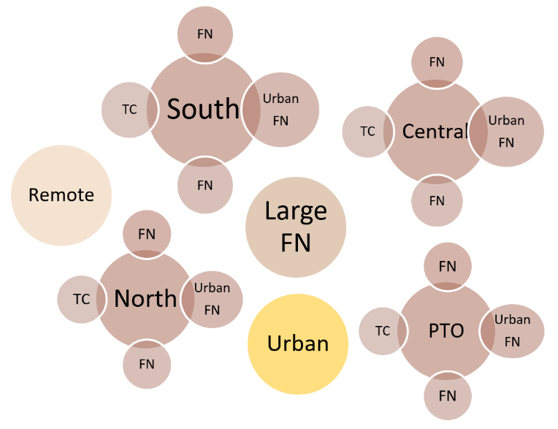
Decentralized Model
Notes:
To add more slides, right click on slide 2, click ‘Duplicate Slide’

Slide 13
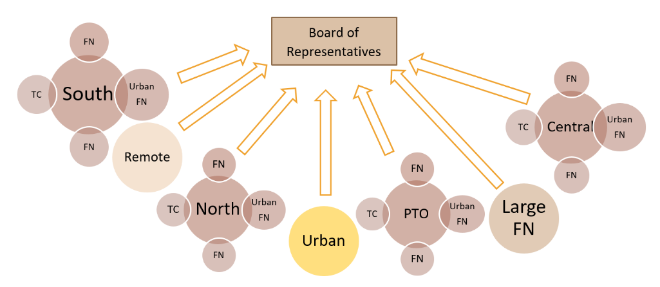
Board of Representatives Model
Notes:
To add more slides, right click on slide 2, click ‘Duplicate Slide’

Slide 14
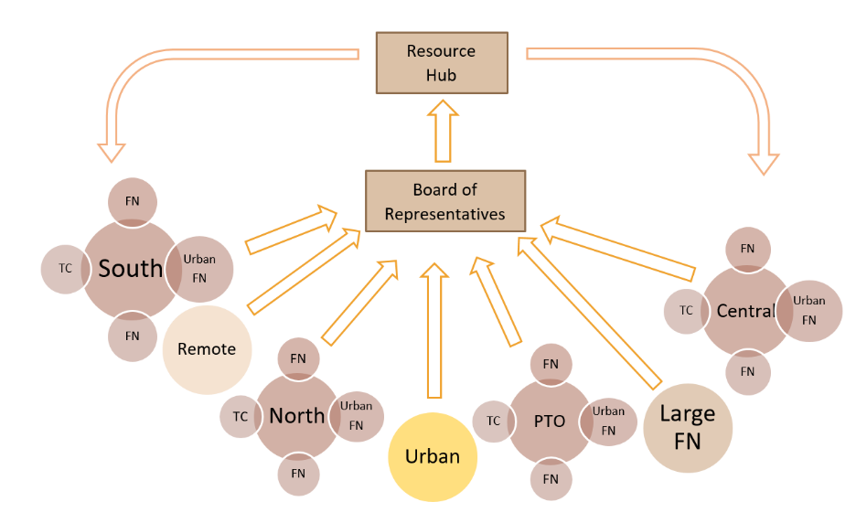
Resource Hub Model
Notes:
To add more slides, right click on slide 2, click ‘Duplicate Slide’

Slide 15
Next Steps
Finalizing the costing exercise with IFSD
Engagement Process 2024:
First Nations
First Nation Organizations/Political Territorial Organizations
Technical Organizations
Chiefs of Ontario Assemblies
Deliver final report to Chiefs-in-Assembly in Fall 2024
Notes:
To add more slides, right click on slide 2, click ‘Duplicate Slide’

Slide 16
Thank You
For further information, please contact:
Chris Hoyos, Director of Policy and Communications chris.hoyos@coo.org
Notes:
Insert Sector and Director contact information.

