Slide 1
FUNDING FIRST NATIONS CHILD WELFARE IN ONTARIO: SHOW ME THE SHOONIYAA
Prepared by Maggie Wente, OKT LLP, mwente@oktlaw.com
Current to May 2021. Reader should note the information is not legal advice and is subject to change.

Slide 2
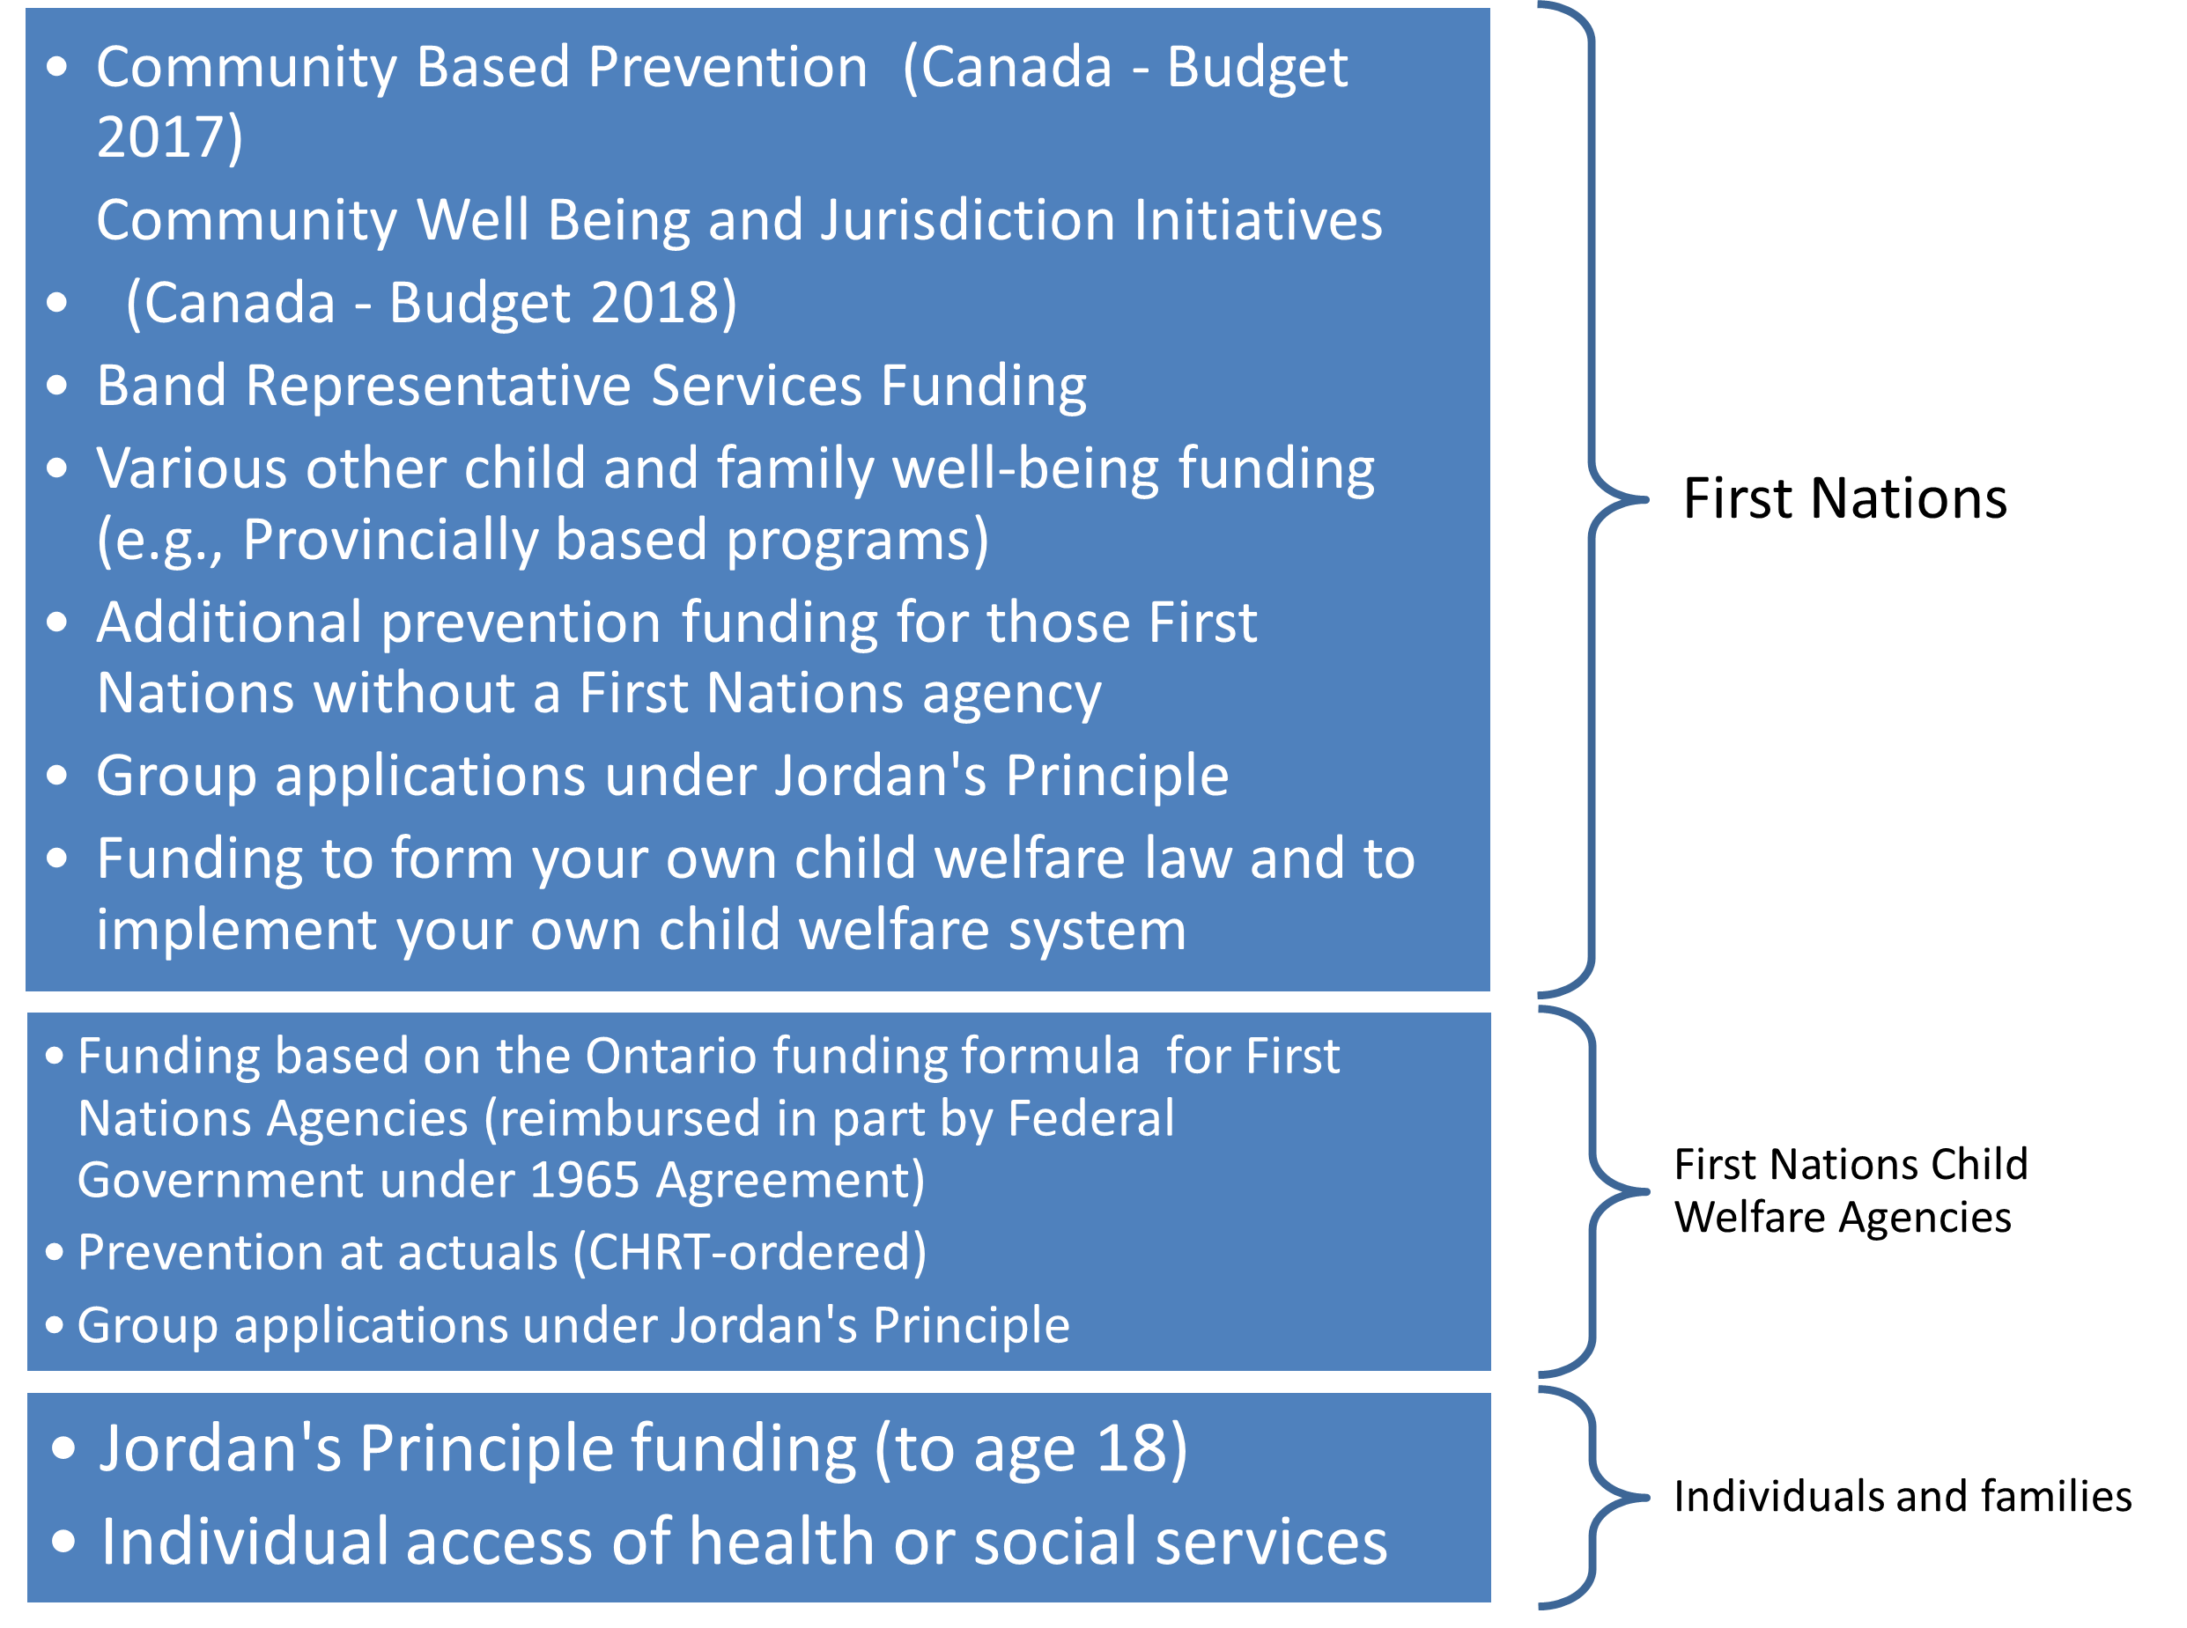

Slide 3
Funding Stream | Brief Description | Funding for Ontario | Status | Comments
Community Based Prevention | Community Based Prevention funding supports prevention-based approaches and activities to address community priorities for children and families. Nationally, this funding is provided to First Nations Child and Family Services agencies; however, In Ontario, it is disbursed directly to First Nations. | $15,901,512.00 | Based on formula decided by Chiefs in Assembly | This is given to First Nations directly from ISC. Subject to ISC Terms and Conditions.

Slide 4
Funding Stream | Brief Description | Funding for Ontario | Status | Comments
Community Well-Being and Jurisdiction Initiatives | The Community Well-Being and Jurisdiction funding supports First Nations communities to lead the development and delivery of prevention services and to assert greater control over the well-being of their children and families. | $22,020,326.00 | Distributed to First Nations directly. | This is given to First Nations directly from ISC. Subject to ISC Terms and Conditions.

Slide 5
Funding Stream | Brief Description | Funding for Ontario | Status | Comments
1965 Agreement – First Nations Child and Family Services | Additional funding provided through the 1965 Agreement to the Ontario Ministry of Children, Community and Social Services for the additional anticipated costs for children in care, including those aging out of care for COVID purposes. | $3,000,000.00 | Chiefs have been informed of additional resources, but this goes to Agencies directly.

Slide 6
Funding Stream | Brief Description | Funding for Ontario | Status | Comments
Band Rep Order | As per 2018 CHRT 2, Canada to fund Band Representative services at actual costs incurred. ISC currently limits this to its terms and conditions |  |  | Available to First Nations, PTOs, or agencies delivering “Band Representative Services”. Subject to the New Ontario Funding guide being finalized.

Slide 7
Funding Stream | Brief Description | Funding for Ontario | Status | Comments
Prevention At Actuals Order | Pursuant to 2018 CHRT 2, First Nations Agencies can access funding to provide prevention services at actual costs of providing, subject to ISC terms and conditions. Can also access for intake/investigation, legal fees, minor capital (building repairs). |  |  | Only available to agencies. NB: First Nations can enter into a contract with an agency to deliver community-level prevention. Agency can apply for “actuals” money for this.

Slide 8
Funding Stream | Brief Description | Funding for Ontario | Status | Comments
Prevention Funding for First Nations not working with a First Nations Agency | Ordered 2020 CHRT 12 Funding for prevention programming for those First Nations who do not work with a First Nations Child and Family Services Agency funding. There will be a formula that approximates how much prevention funding these. | To be distributed to those First Nations based on the agreed up on formula | TBD

Slide 9
Funding Stream | Brief Description | Funding for Ontario | Status | Comments
Jordan’s Principle Funding | Available to individuals, groups. Parents, agencies, First Nations can apply on behalf of children. Group requests can be used to fill unmet needs.

