Slide 1
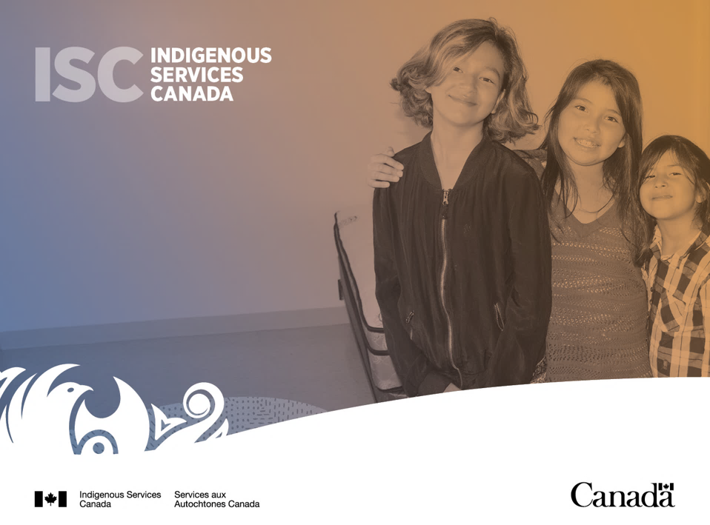
Progress toward reform in Ontario: prevention, family preservation and well-being, community wellness; jurisdiction.
May 20, 2021

Slide 2

An Act respecting First Nations, Inuit and Métis children, youth and families
On January 1, 2020, An Act respecting First Nations, Inuit and Métis children, youth and families (the Act) came into force.
    The Act affirms the inherent right of self-government, recognized and affirmed by
    section 35 of the Constitution Act, 1982 , including jurisdiction in relation to child and family services.
    The Act and its minimum standards must be applied by any agency, whether directly by provinces and territories, or by First Nations, Inuit, or Métis, when child and family services are being provided in relation to Indigenous children.

Slide 3

National and Regional Landscape
A list of Indigenous governing bodies that have sent notice to Canada and the relevant provincial or territorial governments is publicly available on the ISC website.
As of April 12, 2021, ISC’s website indicates 29 notices of intent and requests from Indigenous governing bodies have been received under Section 20 of the Act.
  Seven Ontario First Nations have sent notices under
  section 20(1).
  Two Ontario First Nations have submitted requests under section 20(2), and coordination agreement discussion tables have been established.
Nationally, there are currently 14 active coordination agreement discussion tables.

Slide 4


Funding
On November 27, 2020, Prime Minister Trudeau announced over $542 million in funding nationally over five years to support implementation of An Act respecting First Nations, Inuit and Métis children, youth and families, committed as part of the July 2020 Economic and Fiscal Snapshot. It includes:
    $425 million over five years for capacity building funding to support the development of legislation, community consultation, engaging with experts, it is not intended for program or service delivery;
    Nearly $73 million over five years for coordination agreement discussions; and
    Nearly $10 million over two years for governance engagement mechanisms (GEMs).
$542 million
over five years
Budget 2021 proposes to provide $1 billion over five years, starting in 2021-22, with $118.7 million ongoing to increase funding under the First Nations Child and Family Services Program. Proposed funding would:
Provide increased support to First Nations not served by a delegated First Nation agency for prevention activities to help First Nations children and families stay together, within their communities, through the Community Well-Being and Jurisdiction Initiative (CWJI); and
Ensure that First Nations youth who reach the age of majority receive the supports that they need, for up to two additional years, to successfully transition to independence.

Slide 5
Funding Continued
Funding is available in the following key areas to support the implementation the Act:
Capacity Building
Funding prior to entering coordination agreement discussions to:
Funding begins after an Indigenous governing body sends a request to enter into a tripartite coordination agreement discussions under section 20(2).
Implementation and Operationalization
Predictable, stable, sustainable, needs-based and consistent with the principle of substantive equality, in order to secure long-term positive outcomes for Indigenous children, and families.
Coordination Agreement Discussions
Discussed through the coordination agreement discussions tables, and will vary depending on the proposed model.
Capital not subject to $1.5 million limit.
Eligible activities: research, honoraria, professional fees, travel, meeting costs, legal advice, hardware and software, analysis and reporting, administrative costs, communications, community consultations and engagement.
Single-year and multi-year proposals accepted.
undertake community consultation;
explore readiness to exercise jurisdiction; and
develop Indigenous child and family services legislation, systems, and programs.

Slide 6

Capacity Building
$425
million
over five years
As part of Canada’s funding commitment to support implementation of the Act, ISC’s Child and Family Services Reform Engagement sector has recently launched a formal call for proposals for capacity building funding for the 2021-2022 fiscal year.
Proposals may be single-year or multi-year. Multi-year proposals will be reviewed every year and funding may be allocated on an annual basis.
Future opportunities to access funding will be available regularly over the next four years. We are committed to evolving this process over time, based on lessons learned and feedback from partners.
Eligible Activities include:
community self-assessment
community engagement
planning
research
child and family services program development
drafting of child and family services legislation and policies
data gathering
professional consulting fees
policy development activities
legislation development
travel and accommodations
communications
IT systems design
hardware and software needed to support data collection, analysis and reporting

Slide 7


Governance Engagement Mechanisms (GEMs)
$10
Million
over 2 years
Indigenous Services Canada is committed to an
Ontario-specific process to implement An Act respecting First Nations, Inuit and Métis children, youth and families in Ontario and will continue to collaborate with partners.
Governance Engagement Mechanisms are distinctions-based, in-depth conversations that will explore issues in a detailed manner.
GEMs will be organized by Indigenous partners and will make recommendations to governments on issues such as regulations, governance,
capacity-building, funding models, and a data and reporting strategy.
Voices to be Heard
S.35 rights holders
Experts in child and family services
Elders
Youth
Those with lived experience

Slide 8
Other Funding
In 2021-2022, $39 million is available to First Nations in Ontario:
  $15.9 million in Community-Based Prevention (CBP) funding
  $23.1 million in Community Well-Being and Jurisdiction Initiatives (CWJI) funding
Canadian Human Rights Tribunal (CHRT) Orders
Currently, Canada is continuing to implement:
CHRT Order 411 by reimbursing First Nations child and family services agencies’ actual costs in four areas: prevention, intake and investigation, legal fees, and building repairs; and
CHRT Order 427 by reimbursing claims of actual costs incurred related to the provision of Band Representative Services, by First Nations, Tribal Councils, and First Nations child and family services agencies in Ontario only. These claims can include salary and benefits, travel costs, legal fees, dues, subscriptions, licenses, memberships, office supplies, training, recruitment, advertising, communications, assessments, court costs, etc.

Slide 9

Regional Contacts
Catherine Thai, Director Catherine.Thai@canada.ca
Assistant: Saveena Rai Saveena.Rai2@canada.ca
Taia Tarvainen, A/Regional Program Manager Taia.Tarvainen@canada.ca
Aanchal Sharma, Regional Program Development Advisor Aanchal.Sharma@canada.ca
Marissa Owen, Senior Program Officer Marissa.Owen@canada.ca

