Slide 1
Chiefs of Ontario
Fall Chiefs Assembly
November 21-23, 2023 Toronto, Ontario
For more information, please visit: www.ChiefsMeeting.com
Notes:
Title. Do not alter.

Slide 2
Chiefs of Ontario Women’s Initiatives
Notes:
Add Introductory Title.

Slide 3
Chiefs of Ontario Women’s Initiatives
The Women’s Initiatives Sector was established in 2021
WHAT WE DO: Promote the safety, wellbeing and empowerment of First Nations women, girls, Two Spirit- gender diverse people, and First Nations communities
HOW: Provide technical support to the Chiefs of Ontario First Nations Women’s Council on strategic approaches to ending gender-based violence and lifting up women, girls, 2SLGBTQ+, and vulnerable groups in First Nations communities
Safety, wellbeing and empowerment of First Nations women, girls, 2S/gender diverse and communities
COO Women’s Initiatives sector –
https://chiefs-of-ontario.org/priorities/womens-initiatives/
Notes:
To add more slides, right click oFirst Natin slide, click ‘Duplicate Slide’

Slide 4
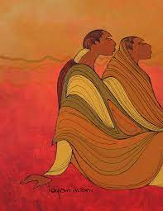
Chiefs of Ontario First Nations Women’s Council
Chiefs of Ontario First Nations Women’s Council (FNWC): Advisory Council to the Chiefs in Assembly
Permanent entity in the COO Charter, along with the Knowledge Keepers Council and Ontario First Nations Young Peoples Council
Established by motion of Leadership Council in 2011
Purpose: Develop community-based strategies for ending violence against First Nations women and girls; act as a First Nations-specific caucus on a provincial joint working group on violence against Indigenous women
Image: Maxine Noel. From Walking Together: Ontario’s Long-Term Strategy to End Violence Against Indigenous Women. Year Two report, 2018.
Notes:
To add more slides, right click on slide, click ‘Duplicate Slide’

Slide 5
Chiefs of Ontario First Nations Women’s Council
COO FNWC Representatives: Nishnawbe Aski Nation, Grand Council Treaty #3, Anishinabek Nation, Association of Iroquois and Allied Indians, Independent First Nations, Mohawk Council of Akwesasne and Six Nations of the Grand River
Mandate: To support the collective work of Ontario First Nations to promote community safety and well-being (Terms of Reference updated in 2022)
Recommend community-based strategies for ending violence against our women, girls, and community members, as well as promote healthy relationships and gender-balanced approaches
Notes:
To add more slides, right click on slide, click ‘Duplicate Slide’

Slide 6
Chiefs of Ontario First Nations Women’s Council
COO First Nations Women’s Council Representatives:
Elder/Knowledge Keeper: Donna Debassige
DGC Anna Betty Achneepineskum, Nishnawbe Aski Nation
Loretta Sheshequin, Nishnawbe Aski Nation
Rebecca Timms, Anishinabek Nation
Debbie Lipscombe, Grand Council Treaty #3
Sydney Lockwood, Association of Iroquois & Allied Indians
Lyndia Jones, Independent First Nations
Chief JoAnn Swamp, Mohawk Council of Akwesasne
Chief Sarah Diabo, Mohawk Council of Akwesasne
Sandra Montour, Six Nations of the Grand River
Notes:
To add more slides, right click on slide, click ‘Duplicate Slide’

Slide 7
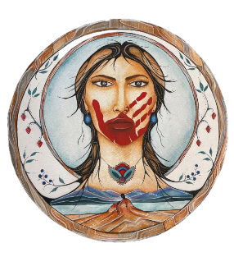

We honour and commemorate
all of our missing and murdered

Slide 8
Missing and Murdered Indigenous Women and Girls
Chiefs in Assembly Resolutions:
10-31 - Called on Canada to support women's shelters and services for victims of violence and family members. Called for a public inquiry into MMIWG
13-04 - Chiefs’ Declaration to support ending violence and abuse in communities
14-19 - First Nations Women’s Council to conduct research and compile data on issues related to MMIWG for First Nations Leadership
39-18 – Support for family gatherings and that men and boys be included
29-19 – Called on Canada/Ontario to: provide Ontario-based implementation plan for the MMIWG Calls for Justice; support the First Nations Women’s Council and an Indigenous-led research entity and data steward; and support a healing fund for MMIWG families
Notes:
To add more slides, right click on slide, click ‘Duplicate Slide’

Slide 9
Missing and Murdered Indigenous Women and Girls
FNWC conducted two family gatherings during the National Inquiry into Missing and Murdered Indigenous Women and Girls to support Ontario First Nations families and survivors
FNWC assisted Assembly of First Nations to coordinate regional engagement sessions with Ontario First Nations families and survivors in 2021 to inform the National Action Plan on MMIWG2S+ - https://drive.google.com/file/d/1g9B1WAfFLWJfrLCl2-vk2GVrjS3vZ_VH/view?usp=sharing
FNWC and COO WI sector coordinated a third Family Gathering with Ontario First Nations MMIWG2S in January 2022 and development of an Ontario First Nations Gender-Based Violence Action Plan - https://drive.google.com/file/d/1T-o0G_c57bmSXp0pzbCAUiuaUbIuHHin/view
Notes:
To add more slides, right click on slide, click ‘Duplicate Slide’

Slide 11
MMIWG2S+ National Action Plan
Ontario First Nations Recommendations: Decolonizing Systems
Land-based and culturally informed community services and school curriculum
Safe, inclusive, supportive community programs/services
Harm reduction approaches and cultural safety training
24/7 crisis support line
Affordable, safe transportation
Support in navigating health care and legal systems
Safety in media, industry, child welfare, housing, and community infrastructure
* https://drive.google.com/file/d/1g9B1WAfFLWJfrLCl2-vk2GVrjS3vZ_VH/view?usp=sharing
Notes:
To add more slides, right click on slide, click ‘Duplicate Slide’

Slide 12
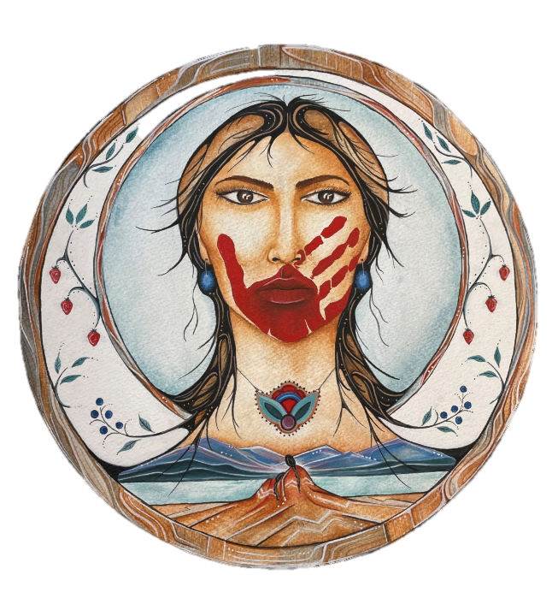
MMIWG2S+ Family Gathering 2022
ARTIST’S STATEMENT: The piece entitled “Etinǫhkwa”(a Cayuga word meaning “We all love her”), is a thoughtful representation of MMIWG and their families. The woman stands in strength and love while her family and loved ones remember her. The elements, which are represented in the water, the earth, and the wind in her hair, are symbolic of the universal energy that flows through all of us. She is encircled by berries, as the women traditionally hold the responsibility of gathering and berry picking. This piece is emblematic of the symbiotic relationship we have with all of creation and a reminder that our loved ones who have been taken from us will never be gone, as they live all around us and within us. Commissioned for the Ontario First Nations MMIWG2S Family Gathering, 2022.
ARTIST: Charlene Hemlock, Cayuga, Wolf Clan, Six Nations of the Grand River.
Notes:
To add more slides, right click on slide, click ‘Duplicate Slide’

Slide 13
Priority: MMIWG2S+
Ontario First Nations Gender Based Violence Action Plan Priorities
Human trafficking awareness and prevention
2SLGBTQQIA+ gender diversity awareness
Enhanced victim advocacy and support services; trauma-informed services
Culture-based programming & land-based programs
Men’s healing programs
Youth life skills programs, cultural programs, access to Elders/teachings
Enhanced cultural safety training for police, health care, justice systems
Enhanced family healing supports & access to police and coroners during and post-investigations
Grief and loss programming
Notes:
To add more slides, right click on slide, click ‘Duplicate Slide’

Slide 14
Accomplishments
and Updates
Notes:
Add Introductory Title.

Slide 15
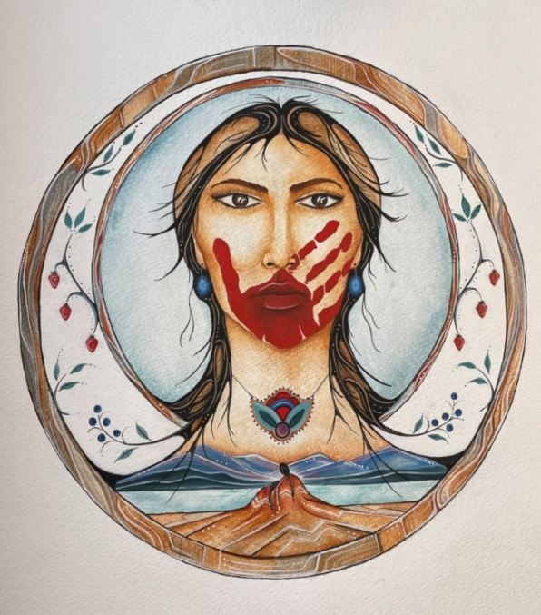
Priority: Addressing Gender-Based Violence
An Ontario First Nations Gender-Based Violence (GBV) Action Plan was developed based on the input of Ontario First Nations MMIWG2S survivors, families and front-line workers
The action plan was approved by Leadership Council in April 2022, and includes priorities such as developing First Nations toolkits on human trafficking awareness and 2SLGBTQQIA+ identities and advocating for men’s healing supports
Notes:
To add more slides, right click on slide, click ‘Duplicate Slide’

Slide 16
Priority: MMIWG2S+
ONTARIO FIRST NATIONS ACTIVITY
Gender-Based Violence Action Plan – PRIORITIES:
Current:
  GBV definitions, statistics, trends
  Two Spirit and gender diversity (LGBTQQIA+) awareness
  Human trafficking awareness prevention
  Men’s healing program supports; Safe Space campaign
Notes:
To add more slides, right click on slide, click ‘Duplicate Slide’

Slide 17
Priority: MMIWG2S+
Additional:
  Culture and land-based programs
  Enhanced cultural safety training for police/health/justice systems
  More family healing supports
  Access to police and coroners during and post-investigations
  Grief and loss programming
  Trauma-informed services
  More victim support/advocacy
  Youth life skills programs, cultural programs, and access to Elders
Notes:
To add more slides, right click on slide, click ‘Duplicate Slide’

Slide 18
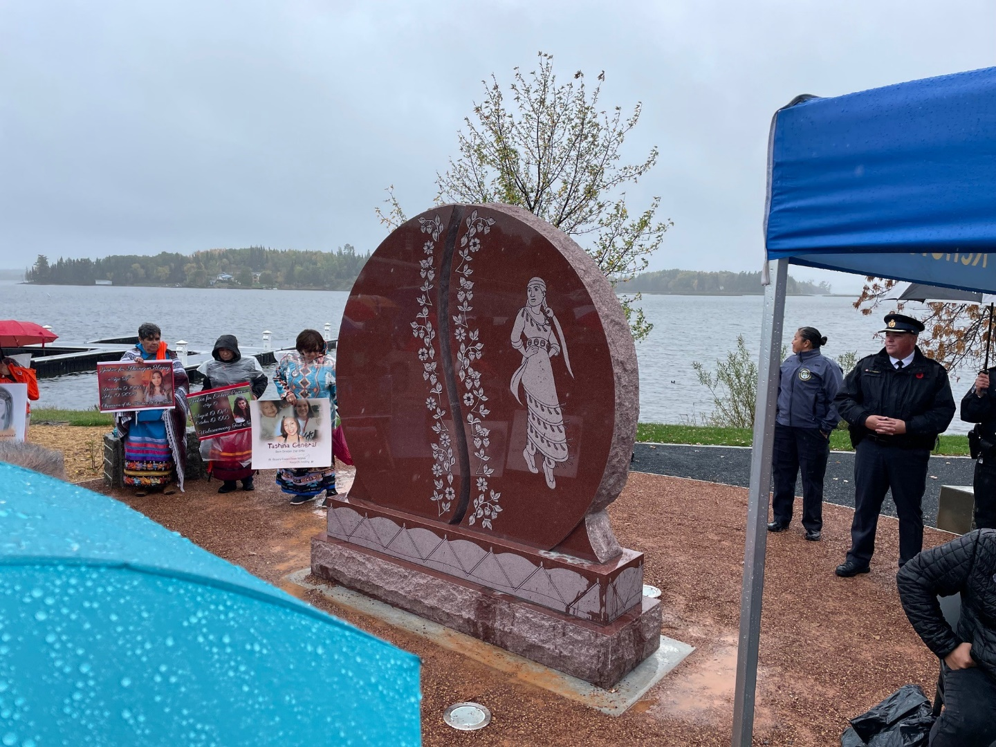
Priority: MMIWG2S+
Two MMIWG2S+ Monument Unveiling Ceremonies took place at Whitefish River First Nation (June 21) and Kenora (October 4)
Monuments were commissioned by Ontario MMIWGT2S+ Loved Ones Commemorative Committee
COO WI and First Nations Women’s Council assisted in sharing information with and supporting families
First Nations donations to the Who Is She Fundraising Campaign were used to reimburse travel costs for First Nations MMIWG families to attend two monument unveilings
Notes:
To add more slides, right click on slide, click ‘Duplicate Slide’

Slide 19
Priority: MMIWG2S+
The sector also participates on the Indigenous Women’s Advisory Council (IWAC) which advises the Ontario government on ending violence against Indigenous women. The main focus of IWAC is the implementation of Pathways to Safety, the provincial government’s response to the National Inquiry into MMIWG2S+
The sector participates in National Gatherings on MMIWG2S+ and Roundtables of Federal/Provincial/Territorial Ministers and Indigenous representatives on MMIWG2S+
The first National Roundtable in January 2023 focused on urban Indigenous issues. A second Roundtable was expected to occur in Fall 2023 (awaiting news on a set date)
Notes:
To add more slides, right click on slide, click ‘Duplicate Slide’

Slide 20
Priority: Victim Services Research
The Risk Assessment and Danger Assessment Tools (RADAT) project is underway, led primarily by the sector’s Research Coordinator
GOAL: To enhance existing risk assessment and danger assessment tools by refining them to meet the specific needs of First Nations communities and individuals
Next phase: Facilitate in-depth group discussions with a select group of victim services workers who participated in the training mainstream risk and danger assessment tools
This work is guided by input from the project working group, trainers, and the First Nations Women's Council. The sector is bringing on a consulting group to assist with the focus groups and tool development
Notes:
To add more slides, right click on slide, click ‘Duplicate Slide’

Slide 21
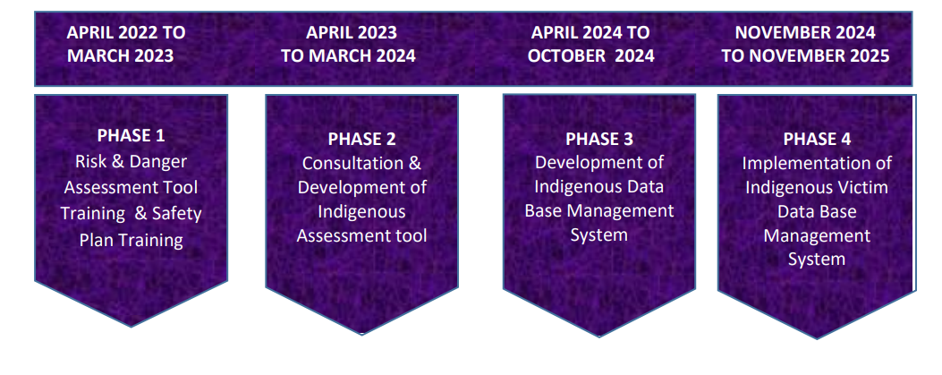
Victim Services Research – Timeline
Notes:
To add more slides, right click on slide, click ‘Duplicate Slide’

Slide 22
Priority: Women’s Leadership
The sector has coordinated monthly meetings of the COO First Nations Women’s Council
Terms of Reference for the COO First Nations Women’s Council were updated to reflect the broader mandate of not only ending violence against First Nations women and girls but also advancing community safety, well-being and empowerment; the inclusion of men and boys in MMIWG2S+ work; and a focus on gender diversity in First Nations leadership
Further to Resolution 41/18, the sector and the COO Women’s Council conducted a First Nations Women’s Leadership Summit in March 2023, providing an opportunity for First Nations women leaders to share their successes and challenges, and to network. Over 100 First Nations women attended (elected and unelected leaders)
Notes:
To add more slides, right click on slide, click ‘Duplicate Slide’

Slide 23
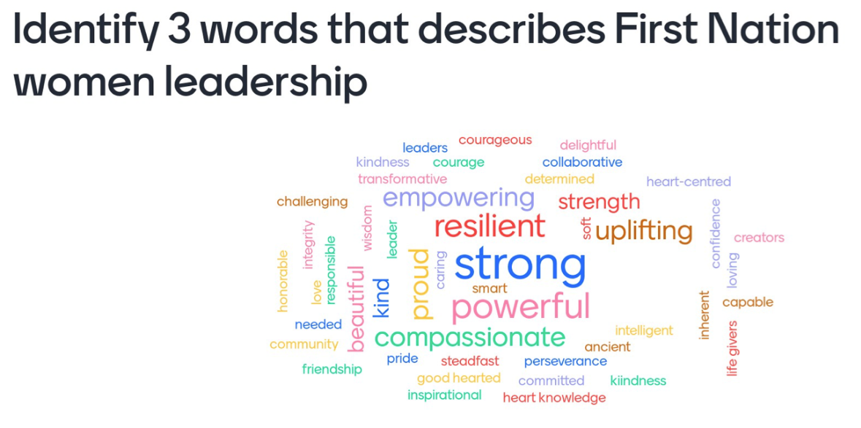
First Nations Women’s Leadership Summit
Priorities areas highlighted included,
  Traditional values
  Pre-colonial governance
  Grooming future leaders
  Support and recognition of women leaders
  Self-care
The final report is available at the sector booth
Notes:
To add more slides, right click on slide, click ‘Duplicate Slide’

Slide 24
Dialogue with Provincial Ministries
The input from Ontario First Nations families and front-line workers in 2021 and 2022 on MMIWG2+ and gender based violence was used to formulate priorities for discussion with the Government of Ontario
In October 2023, the Women’s Initiatives Sector had the opportunity to present these priorities to Ontario Attorney General and Solicitor General, at the First Nations Leadership Advocacy Q2 meeting
A follow-up discussion will occur at the next Leadership Advocacy Strategy meeting in January 2024

Slide 25
Priorities Outlined to Provincial Ministers
Ministry of the Attorney General
Enhanced Victim Support and Advocacy
Free Legal Services and Training of Justice Personnel
Engagement on Protection Orders
Navigators/Advocates for First Nations Offenders
Ministry of the Solicitor General
Implementation of a Missing First Nations Persons Alert
Community Safety/Anti-Crime Plans
Addressing Chronic Domestic Violence – Police Guidelines, Special Units, Community Supports
Addressing Human Trafficking – Training and Coordination
Social Navigators – Victims of Violence
Coordination of Data

Slide 26
Moving Forward –
The Year Ahead
Notes:
Add Introductory Title.

Slide 27
Moving Forward…
First Nations MMIWG2S+: The sector will continue monitoring the Federal/Provincial discussions regarding the MMIWG2S+ National Action Plan and will advocate for First Nations-specific, sustainable community funding. The sector will delve into the provincial government’s Pathways to Safety Year 2 Update in order to revise and refine priorities related to services and supports for MMIWG2S+ survivors, families, and communities.
Victim Services Research (RADAT): The sector will continue its work in Phase Two of the RADAT project. Phase Two focuses on learning from a select group of the 300 front-line victim services workers on their perspectives for refining the mainstream risk assessment and danger assessment tools, such that indicators which respond to the needs and experiences of First Nations communities and individuals are developed.
Human Trafficking: The sector will work with the Ontario First Nations Young Peoples Council in co-hosting a First Nations Gathering on Human Trafficking and developing a toolkit to promote awareness and prevention of human trafficking of First Nations youth.

Slide 28
Moving Forward…
Women’s Well-Being: The sector is beginning to plan its next conference, Restoring Economic Abundance and Community Health (REACH), scheduled for March 5-7 2024. It will bring together those interested in supporting Ontario First Nations women’s economic reconciliation and restoring economic abundance.
Dialogue with Provincial Ministries: The sector will continue analyzing the Pathways to Safety Year 2 Update and be guided by the First Nations Women’s Council and First Nations communities in highlighting service gaps and refining priority areas for eliminating MMIWG2S+ and gender-based violence. The sector will continue gathering and coordinating information on what is (and is not) being implemented in communities as a result of the Pathways to Safety funding. The sector and the First Nations Women’s Council will work towards identifying 2-3 priorities to focus on further.
Gender Diversity: The sector will provide information and learning sessions to promote 2S/gender diversity awareness.

Slide 29
Women’s Initiatives Sector
For further information, please contact:
Nancy Johnson at
Nancy.Johnson@coo.org
Notes:
Insert Sector and Director contact information.

