Slide 1
Chiefs of Ontario
Fall Chiefs Assembly
November 21-23, 2023 Toronto, Ontario
For more information, please visit: www.ChiefsMeeting.com
Notes:
Title. Do not alter.

Slide 2
First Nation Businesses Supply Chain
&
Procurement Project
Economic Development Sector
Notes:
Add Introductory Title.

Slide 3
Project Birth
Economic Growth & Prosperity Table
COO Ec. Dev Sector: In cooperation with the Chiefs Committee on Economic Development, COO works to advance economic development priorities of First Nations Leadership in Ontario through policy analysis, research and support First Nations and regional organizations in accessing funding necessary to address economic development priorities.
Prosperity Table: A platform for First Nations economic growth; support for partnerships with industry, capital sources, businesses, and municipalities; a foundation for enhanced cooperation between First Nations and the Ontario Government led by COO.
Notes:
Role of COO:
Coordinating body for First Nations in Ontario.
Establishes the Prosperity Table to foster understanding and cooperation between First Nations and the Government of Ontario (“Province”).
Purpose of the Prosperity Table:
Promote economic growth in First Nations communities.
Support economic partnerships with industry, capital pools, private sector businesses, and municipalities.
Outcome:
From the Prosperity Table's initiatives, a proposal emerged.
Part of this proposal: The Supply Chain and Procurement Project for First Nation Businesses.

Slide 4
A Cornerstone to First Nations Supply Chain and Procurement Enhancement
Economic Growth & Prosperity Table
The Proposal: In pursuit of fulfilling its duties the Table submitted a budget proposal to the Government of Ontario that outlined initiatives to create lasting prosperity for First Nations in the province. The initiatives included the crucial area of Supply Chain and Procurement. (Jan 2022)
Funding and Launch: The Proposal was successful and led to the announcement of $25 million in Indigenous Economic Development funding in October 2022 by Indigenous Affairs Ontario Minister Greg Rickford; with $800,000 Secured specifically for this project.
Notes:
The need for the project:
The evermore complex web of supply chain in goods and services
The realization of supply chain gaps through the pandemic
Lack of a comprehensive view and tool of First Nation businesses network and supply chain map across Ontario
Inability to locate experts and expertise in different fields and industry amongst First Nation Businesses
Lack of visibility and transparency and cross referencing tools in procurement
Lack of a First Nation Controlled Portal with wide, diligent acceptance of listings while remaining accurate

Slide 5
Supply Chain and Procurement
Economic Growth & Prosperity Table
What is First Nation Business Supply Chain and Procurement as it relates to the current project?
As the economic pillars of their Nations and beyond, First Nation businesses serve as an integral part of the overall supply chain in the province and as the corner stone to the border supply chain map. Collecting and organizing the First Nation Business capabilities is our key task.
Government procurement in Canada is a $200+ billion* dollar marketplace and the 5% procurement mandate announced in 2021 should only be the beginning of taking a higher and higher market share. In order to do so, we need the right tools.
* PAC website - https://ontario.tpsgc-pwgsc.gc.ca/
Notes:
Government procurement refers to all goods, services and construction services purchased by the government. It can range from office supplies to materials and services used in large infrastructure projects.
Through collaboration between Public Services and Procurement Canada (PSPC), Indigenous Services Canada (ISC) and the Treasury Board of Canada Secretariat (TBS), the Government of Canada is implementing a mandatory requirement for federal departments and agencies to ensure a minimum of 5 % of the total value of contracts are held by Indigenous businesses.

Slide 6
The Benefits and Ripples
Economic Growth & Prosperity Table
The projects’ objective is to culminate in the development of a First Nation Businesses Supply Chain Map and Portal. This will empower First Nation supply chain management while enabling better visibility for First Nation businesses to connect and drive one another while allowing for better discovery of the products and services offered by procurement agents (whether governmental or private).
First Nation businesses are at the core of this project. Their prosperity will undoubtedly result in the prosperity of the people they serve and the communities they exist in. In turn, these communities will fuel entire First Nation prosperity and development.
Notes:
A collective portal with added visibility will allow for procurement at community level and above and individual business
Communities will benefit from realizing gaps in industries
Entrepreneurs will also benefit by finding opportunities
With Aligning of the project with National Efforsts in the same front the project will benefit First Nations across the National and meanwhile better integrate province in the national procurement map

Slide 7
Introducing IFSD
Project
IFSD: The Institute of Fiscal Studies and Democracy (IFSD) is a Canadian think-tank that was awarded this contract given their expertise and experience in working with First Nations on similar projects (Aug 2023).
IFSD Experts
A track record of excellence in public finance, economic analysis, and public policy problem-solving.
Advanced graduate degrees in economics, political science, finance, or some combination thereof.
In compliance with OCAP® Principles, they have built trusted and collaborative relationships during past projects.
Trained in the revised OCAP ® Principles course.
Notes:
With out any further delay It is with pleasure that I introduce Jason Jacques , who, along with the rest of the consultant team, has been working tirelessly with the COO on this project. Jason is a Senior Fellow with IFSD at the University of Ottawa. Jason served as the Director General at the Canadian Parliamentary Budget Office. He has also held various positions within the Government of Canada Treasury Board Secretariat and the Bank of Canada.

Slide 8
Supply Chain Mapping and Procurement for First Nations Businesses in Ontario
In Collaboration with Chiefs of Ontario
November 2023
Toronto, Ontario

Slide 9
Opportunity
New Indigenous business and federal procurement mandate
5% minimum federal Indigenous procurement target
Current policy for Ontario to support Indigenous procurement
Aboriginal Procurement Program encourages ministries to purchase from Indigenous-owned businesses
Opportunities to strengthen economic linkages among Ontario FNs
Portal provides another touchpoint with public and private sectors

Slide 10
Project Overview – Mandate and Approach
Project focused on supply chain mapping and procurement
IFSD’s role is to support the COO by providing:
Technical expertise
Conducting research
Facilitating engagement
IFSD’s approach comprises three parts
Schema definition
Data collection support
Portal development
Project timelines
August 2023 to September 2024
Notes:
Approach
– defining the elements needed to map supply chain and procurement
- supporting COO to collect relevant data from First Nations businesses
- creating an online portal to help facilitate procurement from First Nations businesses
October 2023 – Identification of Collaborators
November 2023 – Data Model Development
March 2024 – Data Acquisition
June 2024 – Portal Development
August 2024 – Research Report
September 2024 – Project Completion // Transfer of Portal and Data

Slide 11
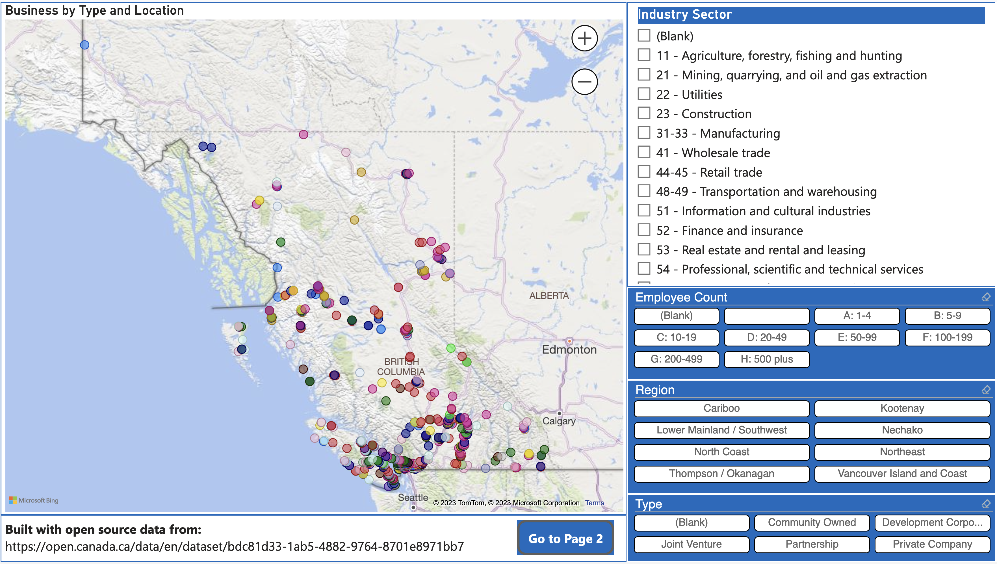
Project Overview – The Art of the Possible
Demonstration Portal
Possibility of targeting specific industries, regions, or business types
Designed to facilitate business opportunities for First Nations in Ontario

Slide 12
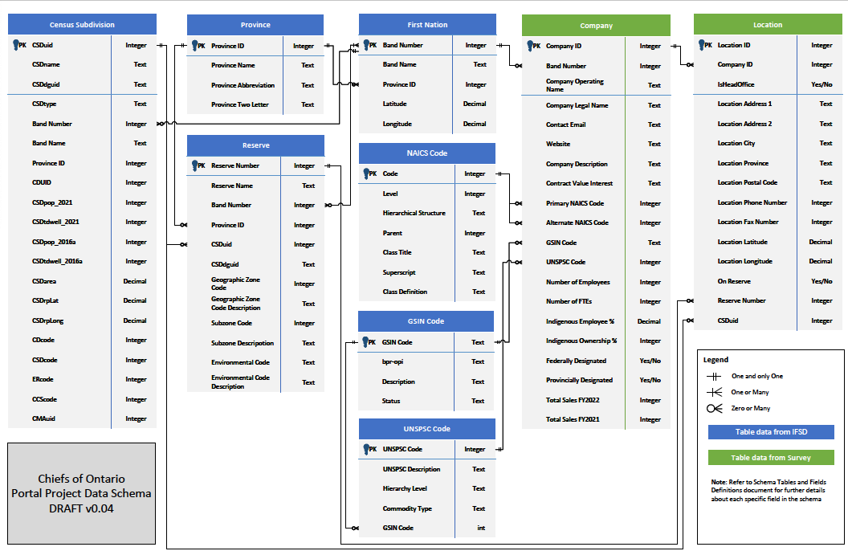
How the data fit together
Notes:
27 pieces of data requested from participating businesses.
In the green columns.
Most of it is pretty straightforward – address, website etc.

Slide 13
How You Can Help
Success of the project is highly dependent on data acquisition
We need your help
Share this project with local businesses, associations, and leadership
Questions or comments?
Reach out to us at info@ifsd.ca

Slide 14
For further information, please contact:
Arvind Sharma, COO EcDev Director
Arvind.Sharma@coo.org
Sam.Abtahi@coo.org
Notes:
Insert Sector and Director contact information.

