Slide 1


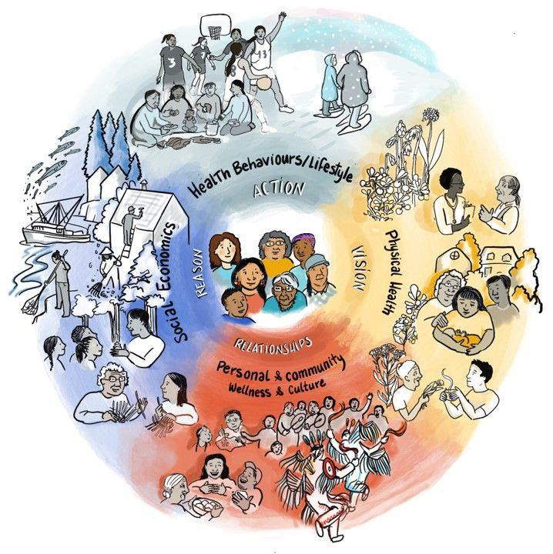




POWERING UP Data & Research
RHS IV
Presented by:
R. Sutherland
Senior Lead, Research and Data Management 416-986-9856 Roseanne.Sutherland@coo.org
Association of Iroquois and Allied Indians • Grand Council Treaty #3 • Independent First Nations • Nishnawbe Aski Nation • Anishinabek Nation • Independent and Non-Affiliated First Nations

Slide 2
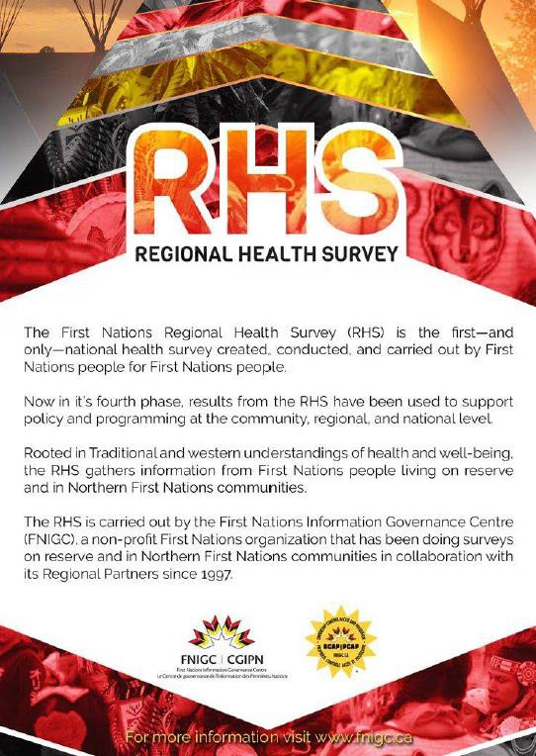
Summary of Presentation
FNIGC
Mandate from Leadership
What is RHS?
4. Lessons Learned
5. Details & Process in Community

Slide 3

First Nation Information Governance Centre
FNIGC is a non-profit organization
Received the national political mandate from the Assembly of First Nations (AFN) Chiefs’ Committee on Health (CCOH)to implement RHS
Provides data that can be used for capacity building while respecting First Nations Principles of OCAP

Slide 4
Chiefs of Ontario
COO is a political forum and secretariat for collective decision-making, action, and advocacy for the 133 First Nations communities located in Ontario. http://www.chiefs-of- ontario.org/
All-Ontario Chiefs Resolution 14/10 passed in June 2014 mandating Chiefs of Ontario (COO) to be keepers of RHS data for Ontario Region
Works with participating First Nation communities in Ontario to implement the survey and collect data
Provides a linkage between FNIGC and participating First Nation communities
Prepares a final report (e.g., The People’s Report)

Slide 5

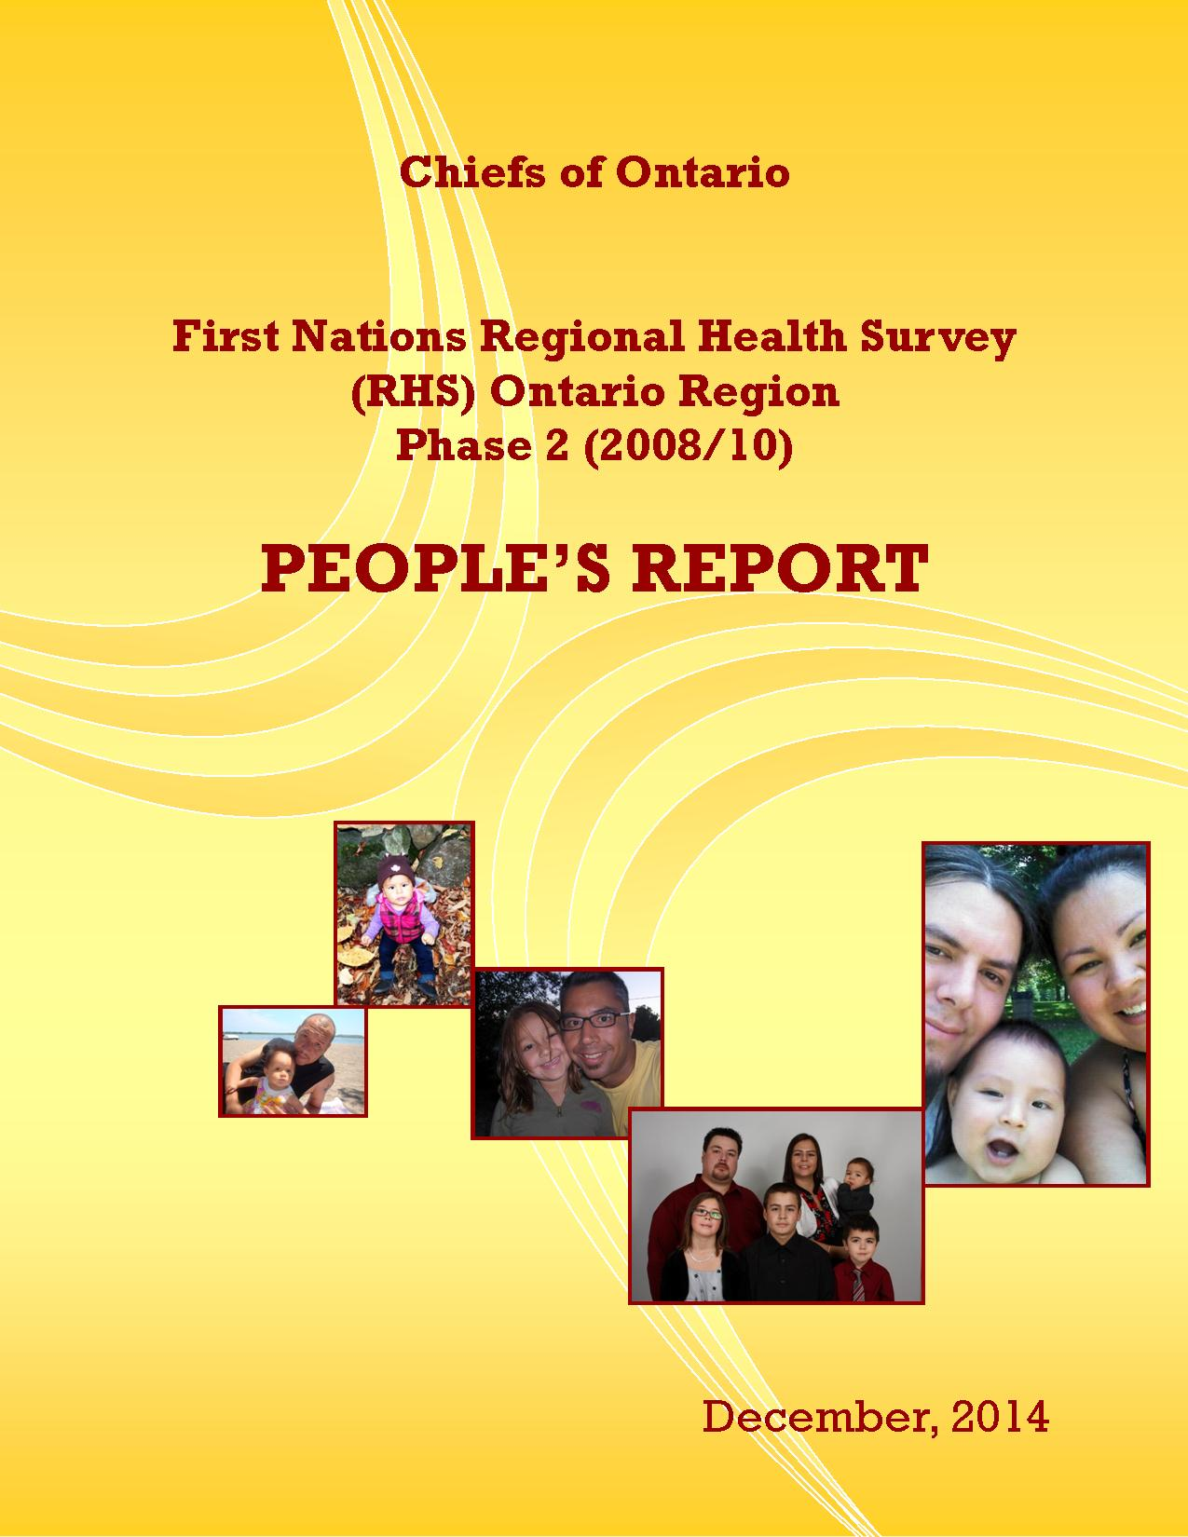
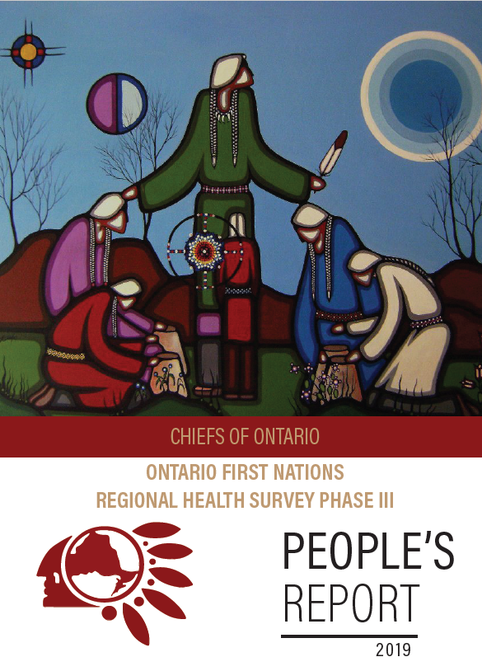
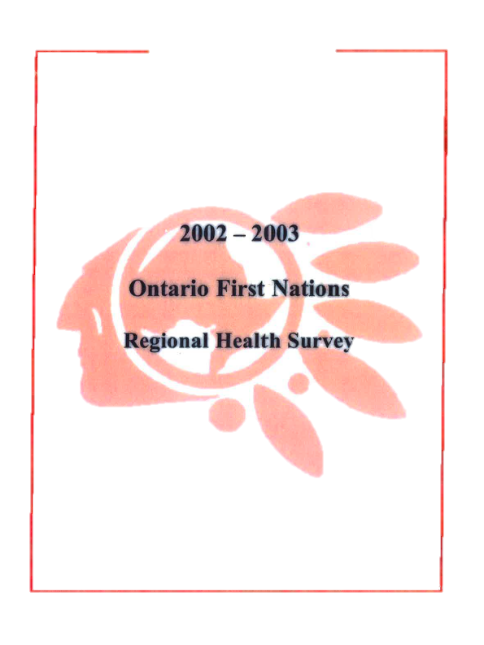
What is the RHS?

Slide 6
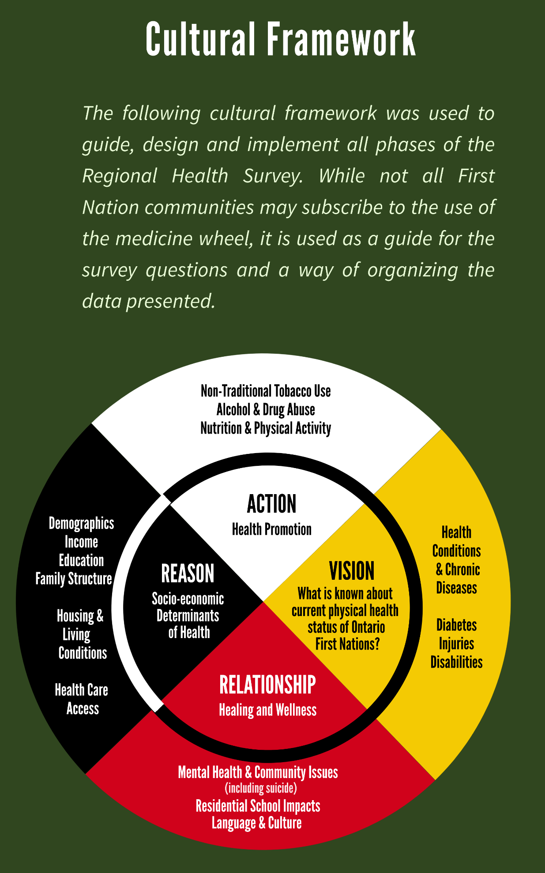
Regional Health Survey (RHS)
The First Nations Regional Health (RHS) survey was conducted on a national level by the FNIGC with ten (10) provinces and territories participating in the survey. Chiefs of Ontario has been involved with the onset of the pilot RHS survey since 1997. Since the pilot, surveys have been conducted in 2002/03, RHS II in 2008/10 and Phase III in 2015/17.
Overseen by FNIGC in collaboration with regional partners such as Chiefs Of Ontario which makes it the only First Nations governed national health survey in Canada
Collects high quality data on the health and well being of on- reserve and northern First Nations

Slide 7
The RHS data collection tools consist of the Adult survey, the Youth survey, and the Child survey. Below are the topics covered for each set of survey instruments:
Child Survey
Topic Areas (0-11 years)
Youth Survey
Topic Areas (12-17 years)
Adult Survey
Topic Areas (18+ years)
Demographics
General Health
Jordan’s Principle
Breastfeeding
Physical Activity
COVID-19
Childcare Arrangements
Household Composition
Health Conditions
Food and Nutrition
Smoking
Injury
Income
Language and Culture
Healthcare Access
Oral Health
Food Security
Personal Wellness
Education
Demographics
General Health
Oral Health
Physical Activity
Cannabis
Community Wellness and Traditional Culture
Education
Household Composition
Mental Health
Smoking
Sexual Health
COVID-19
Residential and Indian Day Schools
Language
Healthcare Access
Food Security
Alcohol and Substance Use
Personal Wellness
Injury
Demographics
Language
Mental Health
Disability
Oral Health
Physical Activity
Cannabis
Personal Wellness
Injury
Employment and Income
Household Composition
General Health
Disability
Healthcare Access
Food and Nutrition
Smoking
Sexual Health
Community Wellness and Traditional Culture
Education
Mobility
Housing – Living Arrangements
Health Conditions
Home Healthcare
Preventative Healthcare Access
Food Security
Alcohol and Substance Use
Gambling
COVID-19
Residential and Indian Day Schools

Slide 8
RHS Data
A powerful tool in the mission to improve First Nation health and wellbeing
RHS data has influenced First Nation initiatives in the following areas:
Aboriginal Head start Program
Children’s Oral Health Initiative
Communicable Disease Control
Food Security and Nutrition
Healthy Living and Child Development
Mental health and Addictions
Public Safety Canada - First Nations Policing Program
Canada Mortgage and Housing Corporation
Canadian Institutes of Health Research
RHS data has been vital to the funding of dozens of programs and initiatives in First Nations communities, from elder care and vaccine programs, to housing and oral health initiatives.

Slide 9

RHS Data
A powerful tool in the mission to improve First Nation health and wellbeing
Community Snapshot
  In Ontario, did you know that there is a steady increase in diabetes rates among First Nations adults?
RHS I
RHS II
RHS III
The highest
rate of diabetes are found in those 60 years and older.
19%
22%
23%
45%

Slide 10
4. Lessons Learned
In 2016, COO organized a Lessons Learned meeting with some Field workers who told us about their experiences and challenges with survey work. Some of the suggestions were:
Improve recruitment strategies i.e. Put rate of pay per survey
Communications: plain language materials for training, COO website use, maintain current community lists, & toolkits sent early on.
Better participation incentives and promotional materials
Risk management: COVID protocols, safe spaces, use of data
Turnover of survey staff means retraining has to occur—perhaps even exit interviews. Consider hiring already trained surveyors from past survey iterations. Have community leads participate in training.

Slide 11
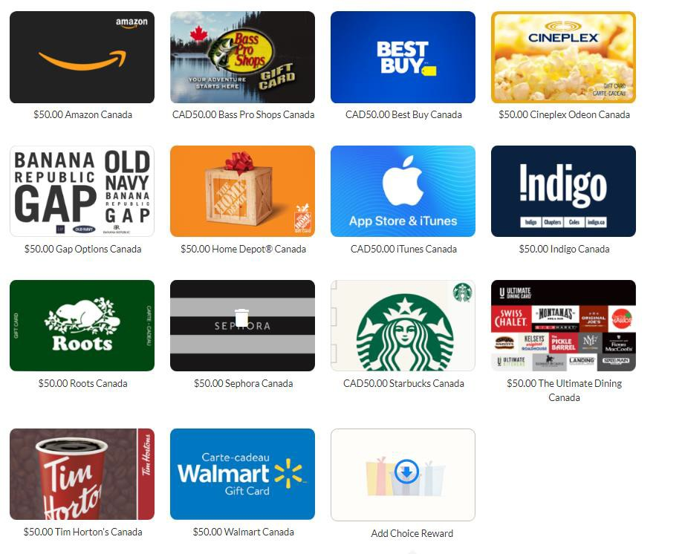
5. Details
There are 4 categories for males and females: 0-11, 12-17, 18-64 and 65 and up for IN community members
Band membership clerk is also involved to set up the sampling frame with support from COO
If a Community Champion is needed- as decided by a First Nation, then they are trained as well.
Knowledge Gatherer Training occurs plus remuneration per completed survey (can provide template for job posting)
Participants $50 gift card electronically
All mailed materials are at COO cost
Online link or by tablet that must be uploaded to FNIGC
Servers
All 47 selected communities have been contacted.

Slide 12
RHS process in community
Complete Band Council Resolution
Letter of Agreement (LOA) reviewed & signed
Discuss the LOA i.e. ways to pay Knowledge Gatherers
Identify Community Champion
Hire Knowledge Gatherers-community
Train Knowledge Gatherers-COO
Review ways to do sampling
Collect surveys & upload to FNIGC
Report -COO

Slide 13
Chiefs of Ontario Contact Information:
Research and Data Management Sector / RHS Team
Roseanne Sutherland Senior Lead, Research and Data Management | Cell: (416) 986 9856 Email: Roseanne.Sutherland@coo.org
Cindy Owl Surveys Lead | Cell: (416) 577 3256 Email: Cindy.Owl@coo.org
Courtney Cada RHS Coordinator | Cell: (416) 254 0709 Email: Courtney.Cada@coo.org

