Slide 1
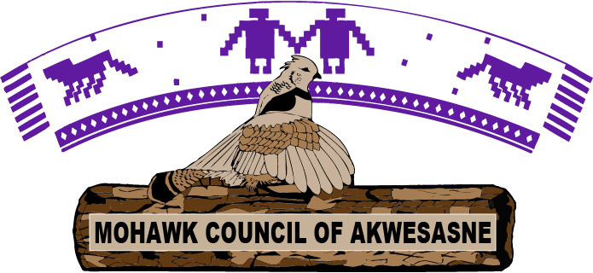
Building Stronger Relationships Social & Economic Development
Presented by:
Joseph Morin-Lauzon, Director | Troy Thompson, Business Services Officer
Chiefs of Ontario
November 2023

Slide 2
Journey to partnership
Negative impacts of Covid-19 due to isolation & lack of social connections, as needed with Indigenous cultures:
Ceremonies, Celebrations, Gatherings, Grieving; etc.
First Nation Child and Family Services/Lease disruptive Measures Funding (Primary prevention as the focal point)
Physical activities declined
Education was not a priority
Increase of drug use
Violence in the home
Unemployment
Lack of reporting of child welfare concerns- increased calls around financial, emotional, mental health support

Slide 3
Economic development
Entrepreneurial support: start-ups, expansions, capacity development, funding assistance
Akwesasne Comprehensive Community Plan
Social Partnership: Youth Entrepreneurship Training
Compliance: Tobacco and Cannabis licensing
Thompson Island Cultural Camp
A'nowara'ko:wa Arena
Master Plan

Slide 4
A'nowara'ko:wa arena
Constructed in 1994
Primary usage: Lacrosse & Hockey
18 acres of property
40,000 sq feet indoor facility
3,000 indoor | 11,000 outdoor capacity

Slide 5
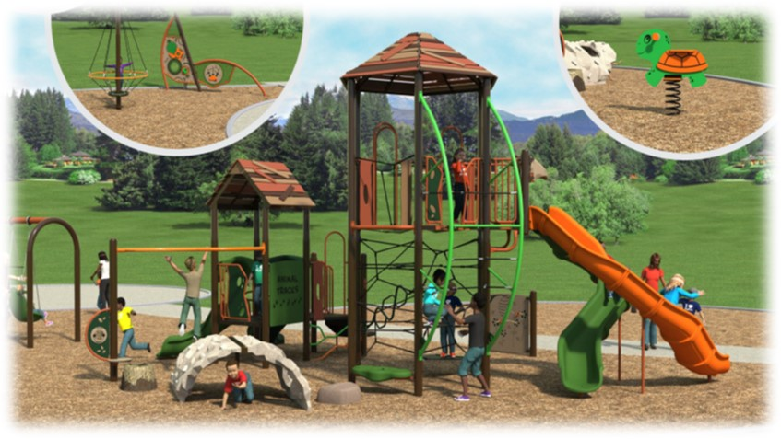
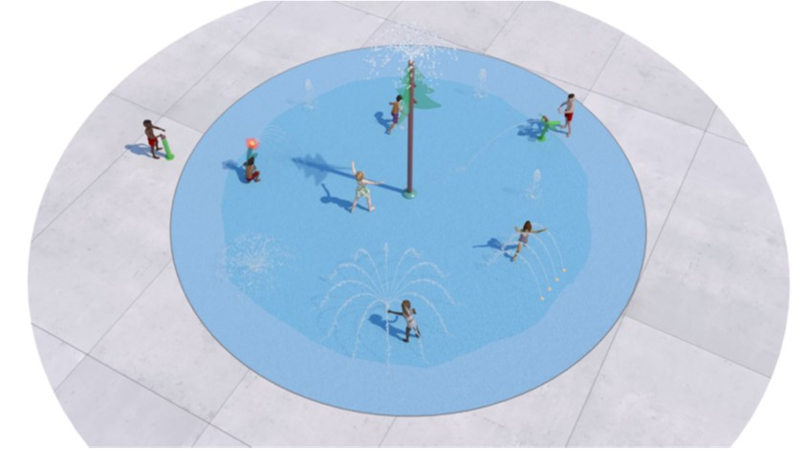
Integrated splash pad & playground
Under construction – Completion in March 2024

Slide 6
Splashpad & Playground
Aging equipment; 20+ years old
Reuniting community is our #1 priority:
Promoting healthy activities
Promoting family togetherness
Universally accessible to meet the needs of our community
Meets the requirements of Prevention Services (mostly Primary) through the Terms and Conditions of First Nation Child and Family Services

Slide 7
Additional Capital improvements
Paved walking path
3200 linear feet
Outdoor stationary workout equipment
currently under construction
Pull Up Machines
Rowing Machines
Chest Press Machines

Slide 8
First Nation Child and Family Services Prevention
“Prevention services including at the primary, secondary or tertiary levels, are evidence-informed and culturally-appropriate, address identified risk factors, and build protective factors within families and communities. Prevention is a continuum of care that is based on the needs of the child and interventions can be included at all stages of prevention. Stages of prevention are not mutually exclusive”.
Activities could include those that enhance protective factors at a community-level, and help to create the network that supports family retention and healing, cultural engagement, connection, and a sense of belonging

Slide 9
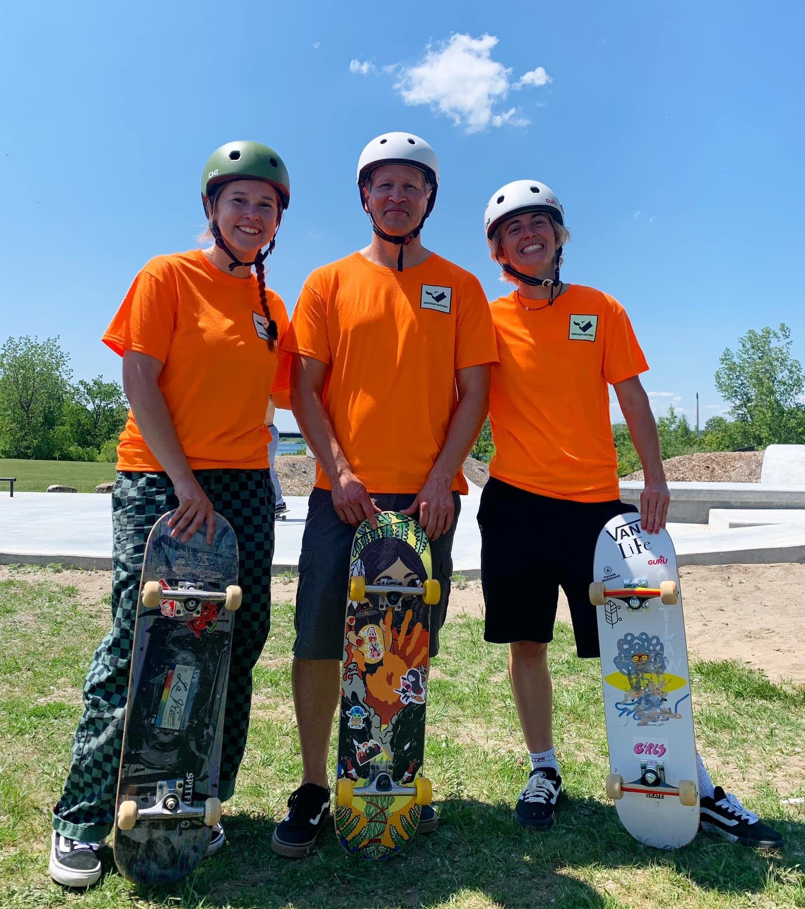
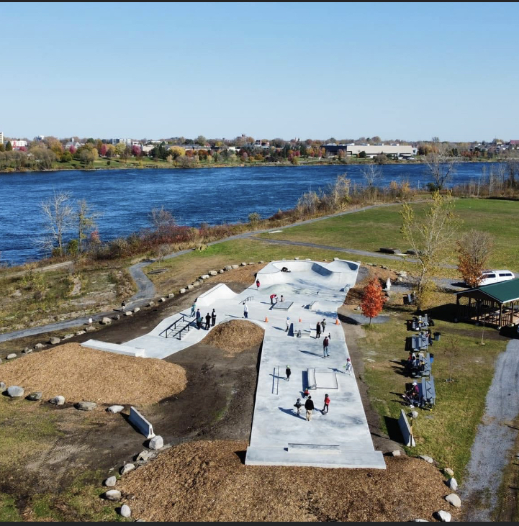
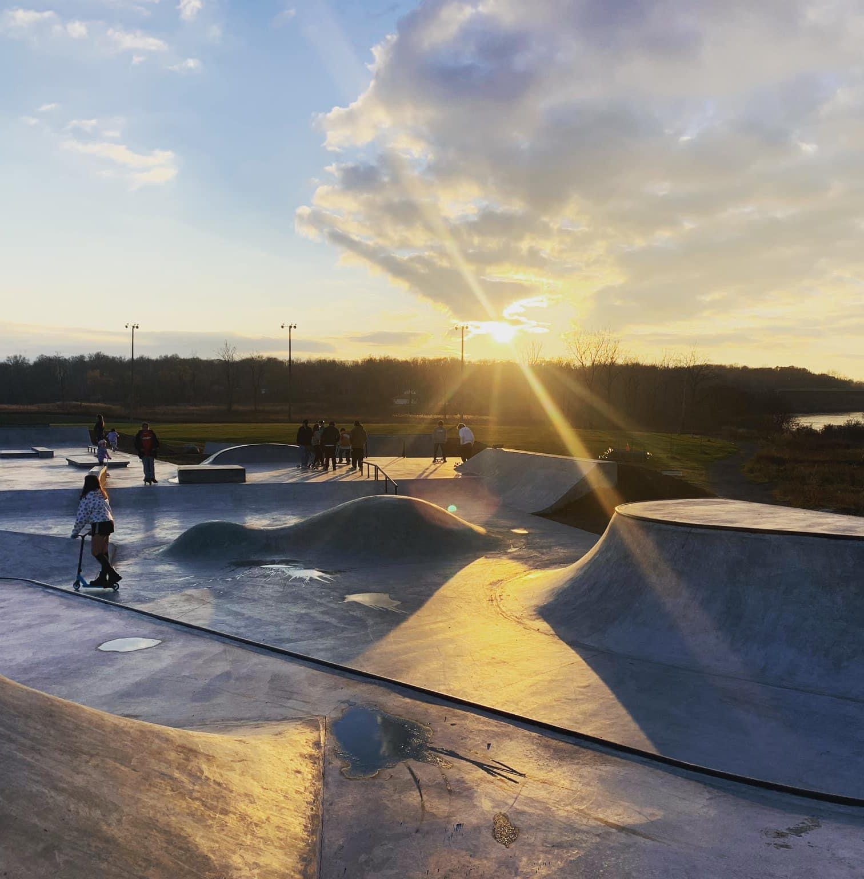
Akwesasne skatepark

Slide 10
Skateboard Project 2023

Slide 11
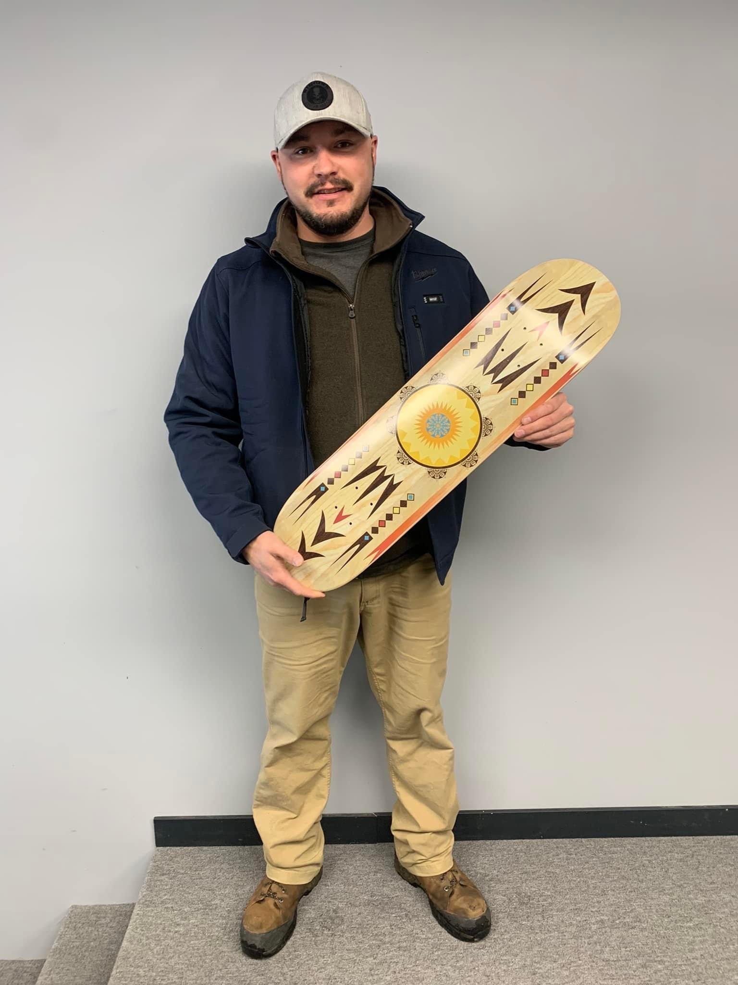
Akwesasne Artists
Joseph King, Owner of KB Entertainment
Ian Clute, Owner of Two House Design

Slide 12
How Our Projects are coming to Fruition?
Economic Development wrote applications for grants to the Canadian Tire Foundation, received funding from private donors paying for roughly half of the project.
Department of Community and Social Services provided funding for the other half through FNCFS/Least disruptive measures.
DCSS when writing the application rationalized the expense base on the site being a primary prevention site in the community for activities targeting children and family by all Mohawk Council of Akwesasne Departments which serve children and families.

Slide 13
Upcoming Capital Projects:
Expansion of our Arena:
Met with ISC: we were told no one has ever done this before! Our response was, “great we will be the first ones!”- This is not a no, this means no one has ever asked!
Addition of a second recreation pad, multimedia arts space and a working location for the delivery of services for children and families in the arena. (child and family, Jordans principle, children's mental health, youth hub, etc).
The plan is to apply for capital grants in other streams and then apply for capital through FNCFS to combine and make this dream a reality!

Slide 14
Upcoming Capital Projects Continued:
New Child and Family Services Facility:
Will be constructed to be able to house all services for children and families including mental health, income assistance, teen clinic, youth hub, food security, etc.
This facility will have office space, community kitchen, space for vendors to set up booths, meeting space, etc.
Currently are meeting with ISC about the capital application.
Designs are being completed by an architect to begin costing it out.

Slide 15
2024 collaborative activities/initiatives
Activities
Capital Projects
Paintball
Laser tag
Cornhole Tournaments
Various Clubs; skating, walking, etc.
Snowshoeing
Outdoor concession
Changing Stalls
Small pavilions for family use/rental

Slide 16
Words of advise
Engage your youth – find out what they want
Our needs have changed from 2019 to 2023
Develop social interactions to promote better communication
Send out letters requesting support from Corporate Canada
Truth & Reconciliation Calls to Actions
Remove your silo’s – Teamwork is essential in succeeding
Ask for help – We are all here to see our communities thrive and prosper!

Slide 17
Words of Advice Cont’d:
ISC is going to tell you that you project must serve Children and families involved with Child and Family Services 90% of the time. Do not accept this answer! Know the Terms and Conditions of FNCFS, know what your community needs!
Partnership and Collaboration within your organization and communities. You cannot do it alone. You need to let community partners assist you.
Spend lots of time on your rationale for the funding. Community level prevention is all of your community.

Slide 18
Niawen/Thank you
Joseph Morin-Lauzon
Troy Thompson

