Slide 1


Moose Cree First Nation
Band Representative/
Prevention Program:
Our successes in obtaining capital assets through the CHRT Order 41 funding

Slide 2
Presentation by:
Jennifer Carey-Cool
MCFN Director of Child & Family Services
First Nation Representative Team
Co-panelists:
Jordon Chilton
Operations Development Manager
Ernest Beck
Chief Negotiator

Slide 3
Our Department
Moose Cree First Nation’s Child & Family Services Department was created in April of 2022.
We started off as a small band representative program back in 2019, where within our first year of operation we had 4 staff, but as our band representatives kept finding and helping our children and families, we grew.
We are now a team of 23 staff and growing.
We also have various contractors/consultants for our capacity building/law development

Slide 4
Our Team
Moose Cree First Nation Chief & Council
MCFN Child Welfare Committee
MCFN Band Representative Child & Family Services (We will be renamed soon)
Director
Staff
Legal
Quality Assurance
Band Representatives
Prevention Team
Administration
Finance
Capacity Building/ Law Development Team
Chief Negotiator
Community Engagement Lead/Law Development Consultant
Finance Development Consultant (for coordination agreements)
Community Engagement Researcher (for children in care)
Legal Counsel - Olthuis Kleer Townshend (OKT) LLP
Capital Project
Management Team
C. Noochtai Technical Services (CNTS)

Slide 5
Our Vision
We see ourselves helping all MCFN children and families, wherever they may be located
We want our children and families to be healthy, happy and prosperous
We want the best for our children and families

Slide 6
How are we working towards our vision?
We are asserting our jurisdiction over our children and families by developing a law that will govern our children and family’s wellbeing, through the Federal Act, commonly referred to as Bill C-92. Our law will completely change the ways that our people have been dealt with in the provincial child welfare system
We are developing the infrastructure, systems, and procedures that will prepare Moose Cree First Nation to implement and enforce our law
We have gathered and are still gathering community feedback about the provincial child welfare system and how it affected us as a people. We are using this research to develop our law, programs, and services that will help our people
We are growing our team as we get closer to finishing our law, and to help prepare for the work that will need to be done to ensure that we have the infrastructure in place to implement and enforce our law.
Moose Cree First Nation has now created our own database, legal department, administration department. We now have an operations manager on board who will be working with the accurate amount of Capital that we will need for our 1668 members that we have collected in our database.

Slide 7
Our Successes

Slide 8
Program Administration Building/
Transition Home
This building will house our Band Representative team as well as some other staff of the child & family services department
We will also use the common areas of the building to put on some prevention programming
This property came with a smoke tent that we will utilize for gathering to teach preparation of traditional food

Slide 10
Prevention Building
This building houses our prevention staff and will also be used for programming
Our plans are to renovate the building with funds that we have obtained in our submission

Slide 12
Ongoing and Future Capital Projects
Transition Modular homes for family reunification.
Transition homes for post majority care support services.
Land for transition homes.
A submission for a Large Office Building and numerous infrastructure is currently in the works.

Slide 13
Transition Homes for family reunification
There is a housing shortage in our community, this causes issues with parents that have children in-care through all CAS agencies, some of our families are able to care for their children. However, these families cannot obtain a house to care for their children. With the purchase of transition homes, we will be able to reunite families, and give them the support where needed to ensure a successful reunification with support and life skills programs attached.
We have a current application in for 4 transition homes in the Moose Factory & Moosonee area as well as some property to situate these homes on. We have a Project Manager who is working with our department to obtain funds through CHRT Order 41.

Slide 14
Transition Home for Post Majority Care
Moose Cree First Nation is in the process of submissions for Post Majority Care Homes with our Project Management Team and Legal Team
Pictured in the next slide is one of our dream homes for our Post Majority Care Program, we plan on bringing our youth within our transition programming, our submissions are in the works
We currently have many applications in the works due to the number of children and youth that we have found within Canada

Slide 15
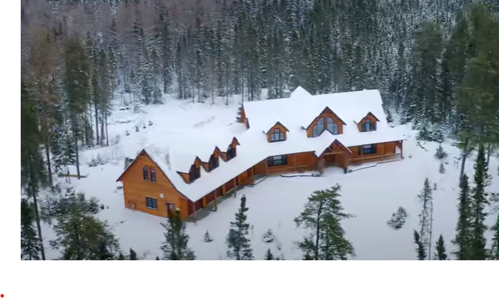
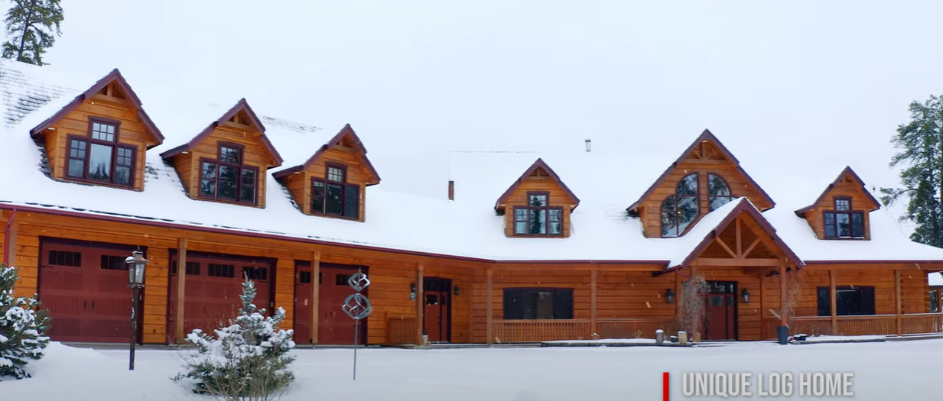

Slide 16
What is Moose Cree First Nations role in our capital applications process?
Needs assessment
Programs & services creation
Identify assets needed
Narrative writing for capital applications
Discussions with Chief and Council
Obtaining a Real Estate Lawyer/Firm
Working closely with our Project Management Team CNTS, and our legal team OKT

Slide 17
What is the scope of work of our Project Manager (CNTS)?
Technical services provider
Site services
Financial analysis
Technical assessments
Collection & compilation of necessary documents

Slide 18
Our Suggestions
Hire a project manager. Professional services fees are an eligible expense through the CHRT order 41 funding
Hire a project manager with a technical services background
Use legal counsel to ensure that funding requirements are clearly understood
Be prepared to explain why you need capital assets, ensure that you have someone who can explain clearly why the capital assets are needed and what your plan is going to be once you obtain your capital assets.
If you are buying houses, ensure they are up to building code, if not then ensure that your application includes the plans and funds needed to bring them up to code
Ensure that your team works close with their legal and capital management team
Ensure that you have a real estate lawyer and agent available when purchasing capital assets

