Slide 1
Annual Chiefs Assembly
Chiefs of Ontario presents
Moving Forward: Strengthening
Relationships for Future Generations
June 13-15, 2023
For more information, please visit: www.ChiefsMeeting.com
Notes:
Title. Do not alter.

Slide 2
WOMEN’S INITIATIVES
Notes:
Add Introductory Title.

Slide 3
WOMEN’S INITIATIVES
Safety, wellbeing and empowerment of First Nations women, girls, 2S/gender diverse and communities
A dedicated Women’s Initiatives Sector was established within Chiefs of Ontario (COO) in 2021 to promote the safety, well-being and empowerment of First Nations women, girls, Two-Spirit and gender-diverse people and communities and to bring a gender-based lens to the issues that impact First Nations communities across Ontario.
The sector provides technical support and coordination to the First Nations Women’s Council, a COO Charter Council with representatives from Nishnawbe Aski Nation, Grand Council Treaty #3, Anishinabek Nation, Association of Iroquois and Allied Indians, Independent First Nations, Six Nations of the Grand River and Mohawk Council of Akwesasne.
Notes:
To add more slides, right click on slide, click ‘Duplicate Slide’

Slide 4
Accomplishments
Notes:
Add Introductory Title.

Slide 5
Accomplishments: Women’s Leadership
In 2022-23, the sector coordinated 12 meetings of the COO First Nations Women’s Council, including a joint meeting with women Chiefs and Ontario Regional Chief Hare in November 2022. A First Nations Women’s Leadership Summit was held in March 2023.
Terms of Reference for the COO First Nations Women’s Council were updated to reflect the broader mandate of not only ending violence against First Nations women and girls but also advancing community safety, well-being and empowerment of First Nations women, girls, Two-Spirit and gender diverse people (2SLGBTQQIA+) and gender diversity in First Nations leadership.
The sector also provided technical support to the Ontario First Nations representative on the Assembly of First Nations Women’s Council, Deputy Grand Chief Anna Betty Achneepineskum, from Nishnawbe Aski Nation.
Notes:
To add more slides, right click on slide, click ‘Duplicate Slide’

Slide 6
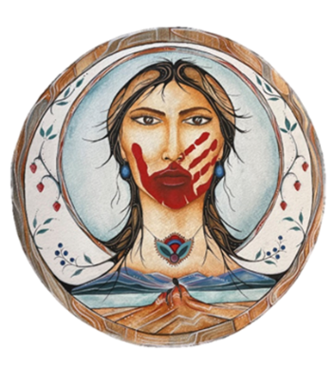
Accomplishments: Gender Violence Action Plan
An Ontario First Nations Gender-Based Violence Action Plan was developed based on the input of Ontario First Nations MMIWG2S families, survivors and front-line workers. The action plan was approved by Leadership Council in April 2022 and initial research was conducted to assist communities in preventing violence against First Nations women, girls, Two Spirit/gender diverse and vulnerable groups.
A COO Women’s Initiatives webpage was developed to highlight the work of the sector and to share information related to MMIWG and gender-based violence. A Safe Space campaign was launched to promote community messaging around ending gender-based violence.
Human trafficking was identified as an immediate priority during the 2022 MMIWG2S Family Gathering. The sector hosted two Lunch and Learn sessions on human trafficking and developed a first draft of a First Nations human trafficking toolkit.
Notes:
To add more slides, right click on slide, click ‘Duplicate Slide’

Slide 7
Accomplishments: Victim Services Research
A research project on Risk Assessment and Danger Assessment Tools (RADAT) was undertaken with the hiring of a Research Coordinator and a Communications Coordinator.
A literature review was completed on First Nations partner violence. Data from the literature review were utilized to create a fact sheet on First Nations gender-based violence.
Training was provided to almost 300 front-line victim services workers on current tools for assessing risk and danger and safety planning with First Nations victims of violence.
This multi-phase project will generate tools and information to support First Nations victim services across Ontario.
Notes:
To add more slides, right click on slide, click ‘Duplicate Slide’

Slide 8
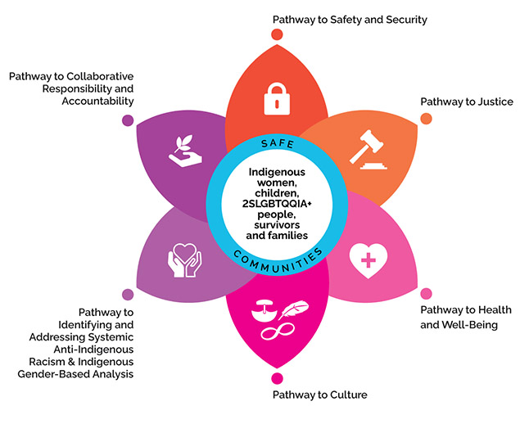
Accomplishments: MMIWG2S
The sector participated on the Indigenous Women’s Advisory Council (IWAC), which advises the Ontario government on ending violence against Indigenous women. In 2022-23, the IWAC focused on implementation of Pathways to Safety, Ontario’s response to the National Inquiry into Missing and Murdered Indigenous Women and Girls.
The sector participated in the National Gathering on MMIWG2S hosted by the Assembly of First Nations and met with Ontario First Nations MMIWG2S families to update them on recent work.
The sector also attended a Roundtable consisting of federal, provincial and territorial ministers and Indigenous representatives on MMIWG2S that focused on urban Indigenous issues. All levels of government have begun discussions on funding for implementation of the MMIWG2S National Action Plan.

Slide 9
Highlights and Updates
Notes:
Add Introductory Title.

Slide 10
Highlights: Women’s Leadership Summit
Further to Resolution 41/18, the sector and the COO Women’s Council conducted a First Nations Women’s Leadership Summit in March 2023 to provide an opportunity for First Nations women leaders to share their challenges and successes and to network. Over 100 First Nations women attended.
Highlights and Updates
Notes:
Add Header. Example: if you are providing an update on a specific file, place file name here.
To add more slides, right click on slide 2, click ‘Duplicate Slide’

Slide 11
Highlights: Women’s Leadership Summit
Outcomes:
Feedback on the role of First Nations women leaders, the governing structures they navigate, their challenges and needs
Summary report and video of proceedings
Compilation video (2 parts): Roles and Responsibilities, First Nations Women Leaders; Challenges and Moving Forward
Priorities: Traditional values; pre-colonial governance; grooming future leaders; support and recognition of women leaders; self-care
Highlights and Updates
Notes:
Add Header. Example: if you are providing an update on a specific file, place file name here.
To add more slides, right click on slide 2, click ‘Duplicate Slide’

Slide 12
Highlights: Victim Services Research
The intent of the Risk Assessment and Danger Assessment Tools (RADAT) research is to:
Support Ontario First Nations victim services through training in current risk and danger assessment tools to inform culturally relevant indicators of risk, and
Develop software templates that can be adapted by First Nations to generate data related to First Nation victim services and enhance data management
A literature review was conducted on First Nations intimate partner violence, and data from this review were utilized to produce a fact sheet profiling First Nations gender-based violence
A total of almost 300 front line individuals working with First Nations victims of violence participated in online training on tools for assessing risk and danger and safety planning. The project will ultimately create First Nations-specific assessment tools and templates that reflect indicators unique to First Nations communities
Notes:
Add Header. Example: if you are providing an update on a specific file, place file name here.
To add more slides, right click on slide 2, click ‘Duplicate Slide’

Slide 13
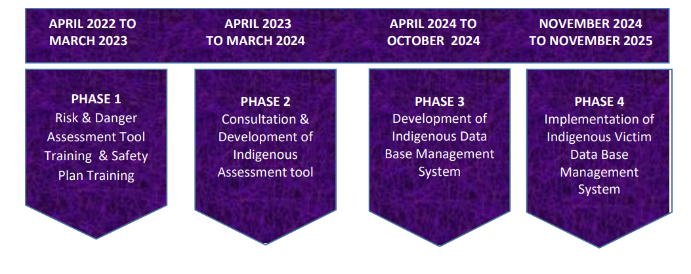
Highlights: Victim Services Research
278 people
trained in Phase 1.

Slide 14
Highlights: Victim Services Research
3 out of 5 First Nations women in Canada (61%) in intimate relationships have experienced intimate partner violence/abuse, compared to less than half (44%) of Canadian women.
First Nations women are almost twice as likely to experience physical/sexual abuse by an intimate partner as non-Indigenous women – 42% compared to 22% respectively reported physical abuse, and 18% compared to 11% respectively reported sexual abuse.
First Nations women and 2SLGBTQQIA+ people are more likely to experience violence when exposed to abuse; physical and emotional neglect; family dysfunction including parental incarceration, intimate partner violence, substance abuse or mental illness in the home; and parental separation.
According to recent StatsCan data, 42% of First Nations women reported being physically or sexually abused by an adult before age 15. Indigenous women who experienced abuse by an adult during childhood are twice as likely to experience violent victimization as Indigenous women who did not experience childhood abuse.

Slide 15
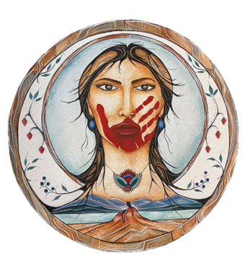
Highlights: Victim Services Research
In Canada, between 2014-2019, nearly 400 women were killed by a current or former intimate partner – 8x the number of male victims. One-quarter of these women were Indigenous.
Between 2015-2020, 17% of all female homicide victims in Canada were First Nations women.
2 out of 3 Indigenous women in Ontario (approximately 67%) experience some form of violence.
The Women’s Initiatives Sector at the Chiefs of Ontario supports the work of Ontario First Nations communities in addressing gender-based violence through information-sharing, promoting awareness and conducting research to identify issues and solutions.

Slide 16
In The Year Ahead – Moving Forward
Notes:
Add Introductory Title.

Slide 17
Moving Forward…
First Nations MMIWG2S: In 2023-24, the sector will continue to monitor federal and provincial discussions regarding the MMIWG2S National Action Plan and will advocate for First Nations-specific and sustainable community funding. A discussion paper will be drafted that highlights Ontario First Nations MMIWG2S priorities and an initial cost estimate for implementing the MMIWG2S National Inquiry Calls for Justice to meet the needs of Ontario First Nations as a starting point for Leadership discussions with Canada and Ontario. The sector will support First Nations families and communities through online information and strategies to support healing.
Human Trafficking: The sector will work with the Ontario First Nations Young Peoples Council to co-host a First Nations Gathering on Human Trafficking and develop a toolkit to promote awareness and prevent human trafficking of First Nations youth.

Slide 18
Moving Forward…
Gender Diversity: The sector will provide information and learning sessions to promote Two-Spirit and gender diversity awareness.
Victim Services Research (RADAT): The sector will utilize survey analysis from training participants and focus groups to create First Nations-specific templates for assessment of risk and danger in support of First Nations victim services.
Women’s Well-Being: Awareness sessions will be hosted on empowering First Nations women and decolonizing power dynamics. A First Nations women’s financial well-being forum will be organized to support First Nations women interested in starting their own businesses or collective enterprises and exploring career opportunities and innovative approaches to financial well-being.

Slide 19
For further information, please contact:
Nancy Johnson, Director of Women’s Initiatives
Nancy.Johnson@coo.org
Notes:
Insert Sector and Director contact information.

