Slide 1
Annual Chiefs Assembly
Chiefs of Ontario presents
Moving Forward: Strengthening
Relationships for Future Generations
June 13-15, 2023
For more information, please visit: www.ChiefsMeeting.com
Notes:
Title. Do not alter.

Slide 2
Education Sector
Dialogue Session
Post-Secondary Engagement
Final Report
Notes:
Add Introductory Title.

Slide 3
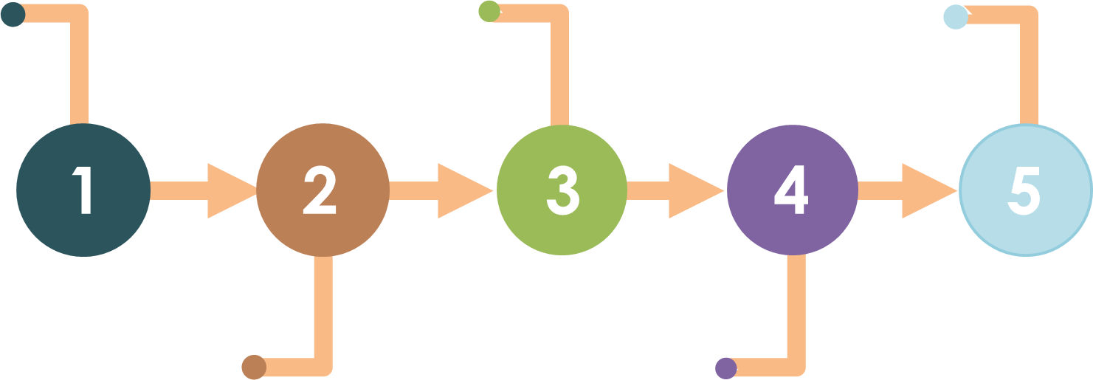
How it Started
The CTCLL agreed the engagement would be conducted by PTO, Independent and unaffiliated First Nations and COO would support the activities
AFN recommended the federal government provide funding for a 3-year engagement
In 2017, Indigenous Services Canada announced plans to review Indigenous post-secondary programs
Assembly of First Nations completed review and made recommendation that First Nations develop regional models
In 2019, the federal government committed $7.5M nationally to conduct engagement
Notes:
To add more slides, right click on slide, click ‘Duplicate Slide’

Slide 4
Post-Secondary Engagement Committee
Notes:
Add Introductory Title.

Slide 5
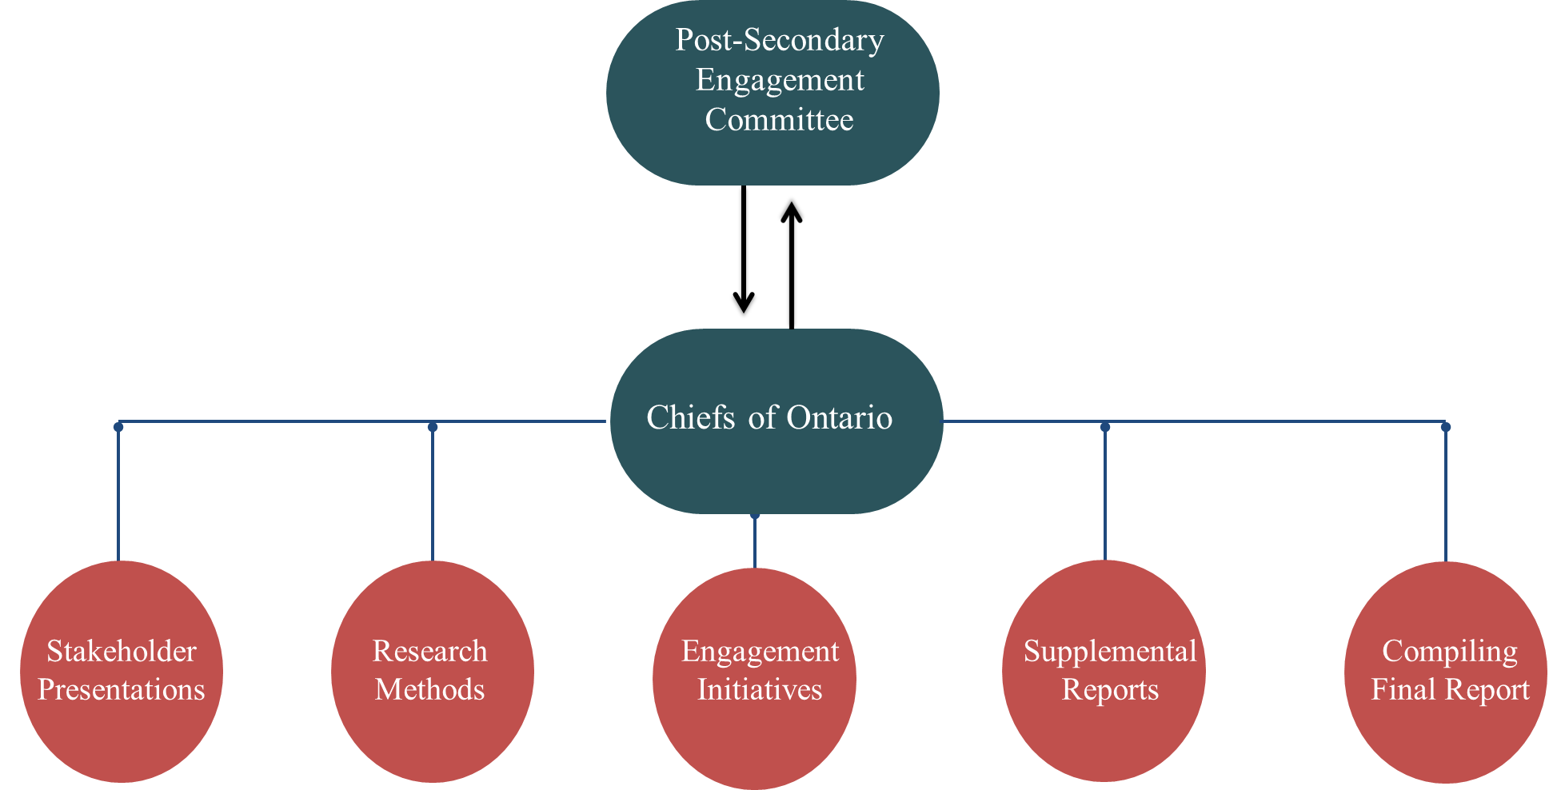
Role of COO
Notes:
To add more slides, right click on slide, click ‘Duplicate Slide’

Slide 6
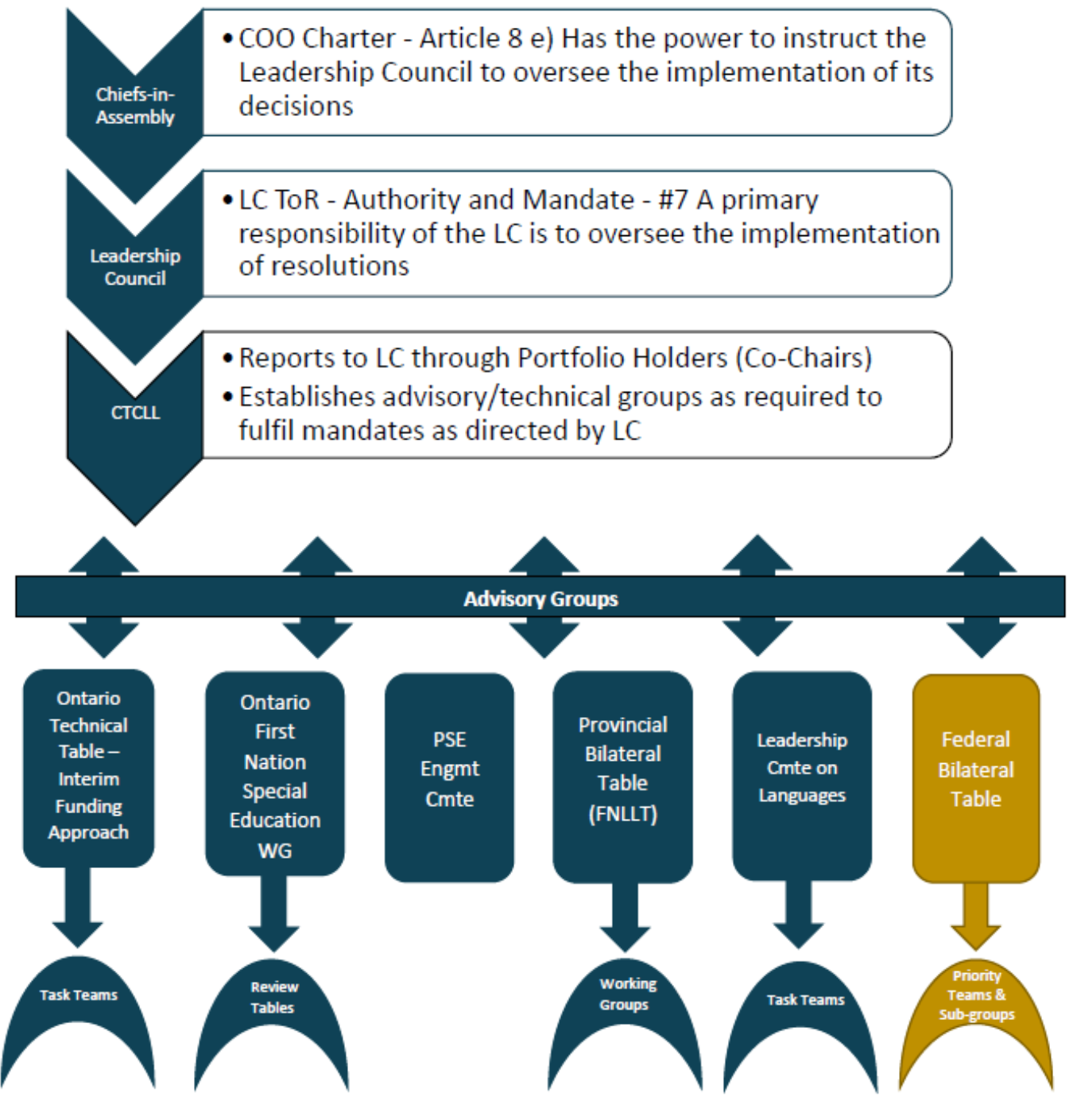
COO Lines
of Authority

Slide 7
Stakeholder Map
Current and former students
Administration
Provincial Territorial Organizations
Indigenous
Institutes
Post-Secondary Engagement
Education Counsellors
Children in Care
Post-Secondary Institutions
Community Members
Parents and Guardians
Notes:
Add Header. Example: if you are providing an update on a specific file, place file name here.
To add more slides, right click on slide 2, click ‘Duplicate Slide’

Slide 8
Methods and Engagement Initiatives
Policy Analysis
Focus Groups
Interviews
Surveys
Document Analysis
Information Sessions
Notes:
Add Header. Example: if you are providing an update on a specific file, place file name here.
To add more slides, right click on slide 2, click ‘Duplicate Slide’

Slide 9
Supplemental Reports
Socio-
Economic Analysis
PSSSP and Federal Policy Analysis
Children in
Care
Data
Sovereignty
ISS Research Report
Notes:
Add Header. Example: if you are providing an update on a specific file, place file name here.
To add more slides, right click on slide 2, click ‘Duplicate Slide’

Slide 10
PSE Engagement Report
41 Broad Regional Recommendations
Executive Summaries from FN engagements
Supplemental Reports
PSE Committee Meeting presentation summaries

Slide 11
Recommendations

Slide 12
Post-Secondary Costs Funding
Fair and equitable funding to First Nation learners that is based on student post-secondary need
Child Care
Travel
Living expenses
Technology
Connectivity
Food
Increases to keep up with inflation

Slide 13
Transitional Programming
First Nations post-secondary support systems must focus on supporting transitions:
From secondary to post-secondary;
From post-secondary into the workforce and future careers;
For non-traditional paths to post-secondary, including transition programs for mature students, students with families; and
For students continuing with education and lifelong learning, such as professional degrees, graduate degrees.

Slide 14
Administration
First Nations post-secondary support systems must be developed from the First Nation up through Nation-based principles and expertise at the discretion of each First Nation
First Nations must have authority, control and funding to determine and implement their own post-secondary support system
The government’s role must be limited to financial administrator only

Slide 15
Relationships
First Nation post-secondary education requires funding to support relationship building and information sharing
Learners
Other Communities
Institutions

Slide 16
Indigenous Institutes
Indigenous Institutes require sufficient and predictable core funding for stability and growth
Federal and Provincial funding

Slide 17
Federal/Provincial Government
Canada Student Loan Program to move to a loan only program for First Nation learners
Must implement debt forgiveness for past First Nation students
Increase connectivity for FN communities to access PSE remotely
Provide increased funding for First Nation PSE and for Indigenous Support Services and Indigenous Student Associations

Slide 18
staff
Increase First Nation instructors and staff
programs
Provide First Nation courses and programs
options
Provide remote learning options
tuition
Post-Secondary Institutions
Offer free tuition for First Nation learners

Slide 19
Next Steps
The PSE Committee developed a work plan to implement broad regional recommendations
Resolution to approve PSE Engagement Report and work plan to be presented at Annual Chiefs Assembly
If approved, COO will solicit funding to begin implementation
PSE committee to continue to guide the work

Slide 20
Nya:wen
For further information, please contact:
Johanna.Mousseau-Krahn@coo.org
Angel.Maracle@coo.org
Julia.Candlish@coo.org
Notes:
Insert Sector and Director contact information.

