Slide 1
DAta Literacy
Jennifer Walker and Sarah Curley Smith
October 26, 2023
Powering Up Data Sovereignty Conference

Slide 2
Data literacy
The ability to
draw meaningful information from data
understand and communicate data in proper context

Slide 3
Importance of Data Literacy to First Nations Data Sovereignty
First Nations Data governance =
First Nations governance of data +
First Nations using First Nations data for governance

Slide 4
Making the data “sing” - requires many voices
Using data to tell a compelling story – to engage, explain and have impact
Entering quality, meaningful data
Preparing and analyzing the data – asking the right questions
Interpreting within our realities and contexts
Building meaningful data visualizations to support a story
Building a narrative to help in decision-making

Slide 5
Building Data Literacy Skills: The importance creativity, context, culture
Sarah Curley Smith

Slide 6
Current state of Data Literacy for First Nations Governance
FNIGC’s First Nations Data Governance Strategy highlights data literacy as lacking in many communities, especially communities that are already facing crises and limited resources
The emerging regional centre in Ontario is being called on to create plans to address data literacy barriers, building up technical knowledge and skills to enable the holding, using of data band the management by building up the capacity
The Strategy highlights the importance of sustained leadership at national, regional and local levels to addressing data literacy issues

Slide 7
Where do we start with building data literacy to support data governance?
Understanding and integrating the language of data in our everyday work
Data scientists – need to understand data within context and be able to tell compelling and understandable stories
Program / policy analysts – need to build in, understand, and rely on data cycles for evaluation and planning
Leadership – need skills to critically assess data and become comfortable with the language of data
Service providers, educators, data collectors and others who contribute the data that will be used. Need to understand importance of data quality and see the value in data cycles to improve services

Slide 8
“You can’t manage what you can’t measure”
But…
“Not everything that can be counted counts…and not everything that counts can be counted”
Notes:
But when it comes to making decisions based on data, the commonly used axiom is…
Historically, Indigenous peoples managed societies and used data to measure things.
e.g., farming, hunting, community planning, etc
Ensuring that communities have access to the information about them is important in supporting decolonization and healing.

Slide 9
Building collective data skills and literacy will move us away from using data to shine a light on “problems”…
to First Nations using data to find and guide a path forward
Example of Thunderbird Partnership Foundation
- Measuring hope, belonging, meaning and purpose
- training

Slide 10
Building Data Literacy Skills – possible paths forward
Data literacy workshops for community members and leadership
Micro-credentials and formal degree programs to train First Nations data scientists
Explicitly integrate First Nations contextual understanding and worldviews
Sector / topic specific training programs, online resources
Importance of mentors and role models

Slide 11
Fostering collaboration and relationships for data literacy
Partnerships with researchers and institutions for training
E.g., ICES Health Data Training Program
Sector-specific collaborations to make meaningful training and mentorship opportunities
Secondments and other opportunities for learning
Creation of a data literacy competency framework

Slide 12
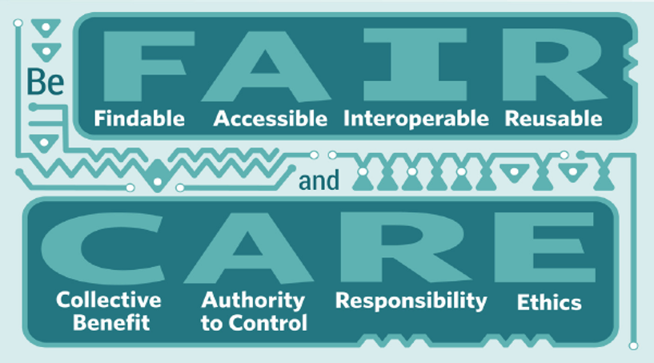
Global Indigenous Data Alliance.(2019). CARE principles for Indigenous data governance. GIDA https://www. gida-global. org/care.
Carroll, S. R., Garba, I., Figueroa-Rodríguez, O. L., Holbrook, J., Lovett, R., Materechera, S., Parsons, M., Raseroka, D.R., Rowe, R., Sara, R., Walker, J.D., Anderson, J., & Hudson, M.(2020). The CARE Principles for Indigenous Data Governance. Data Science Journal, 19(1).
Notes:
This includes the right to create value from Indigenous data in ways that are grounded in Indigenous worldviews and realise opportunities within the knowledge economy.
The CARE Principles for Indigenous Data Governance are people and purpose-oriented, reflecting the crucial role of data in advancing Indigenous innovation and self-determination. These principles complement the existing FAIR principles encouraging open and other data movements to consider both people and purpose in their advocacy and pursuits.

Slide 13
Monitoring and Evaluation
Important to monitor and evaluate data literacy initiatives
What would success look like? What impact would we want data literacy to have?
What would it mean for First Nations to be effectively using our data for governance?
What would build our collective confidence in using the language of data?
Importance of building in feedback and continuous improvement

Slide 14
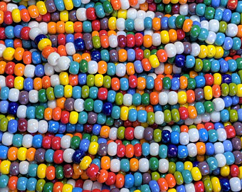
First Nations Data Literacy
Finding patterns,
listening for and telling the stories,
learning for the future

Slide 15
Let’s do this ☺
Jennifer Walker
jenniferlwalker@mcmaster.ca

