Slide 1
First Nation Health Data Landscape Scan

Slide 2
Landscape Scan
The aim of the landscape scan was to discover what First Nation health information is being gathered, where it is stored, and how it is being managed
The information gathered was then assessed in terms of the overall trends, barriers to OCAP®, and opportunities to advance OCAP®
The data was gathered through a literature review and a series of over 40 interviews, utilizing a “snowball” sampling technique

Slide 3
Data Sovereignty
Control
Access
Ownership
Possession

Slide 4
Data Sovereignty
The OCAP® principles should be understood in terms of rights holders—a key concept for First Nation data sovereignty
Rights holders refers to First Nations governments, and by extension First Nations’ citizens
Thus, for a local project involving one or a few communities, the rights holders would be the band council of those communities, while for a province-wide project, the Chiefs in Assembly would be the rights holder
The importance of rights holders has been made clear in the FNIGC First Nations data governance strategy, which has been endorsed by the Chiefs in Assembly

Slide 5
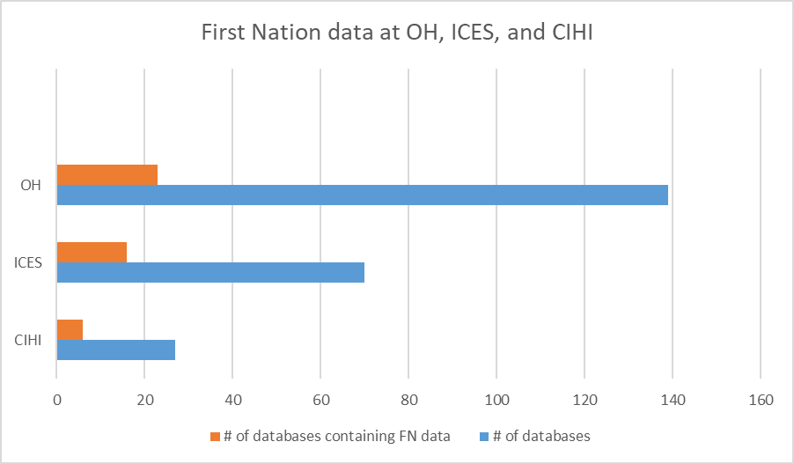
Trends Discovered
Notes:
OH has the most first nations data, out of x databases, y contain FN data

Slide 6
Trends Discovered
The overall trend is towards more First Nation data being collected, often as part of a move towards increased collection of race and ethnicity data
This has resulted in new organizations collecting First Nation health data for the first time, sometimes with little to no awareness of OCAP®
The requirements to appropriately collect First Nations data are very different from other forms of race and ethnicity data since First Nations are nations, and thus have sovereignty over their data

Slide 7
Comprehensive Data Governance
Comprehensive Data Governance
Rights holder control over access and use
Community data protected in addition to individual data
Capacity building for First Nations
First Nations have access to the data
Rights holder permission for collection

Slide 8
Comprehensive Governance Systems
The most comprehensive data governance arrangement was First Nations-led and found at ICES
ICES
Only shares First Nations data with permission from data governance committee and/or Grand council treaty 3 and/or Kenora chiefs’ advisory
Builds capacity in First Nations communities by bringing on community members as ICES agents
Linkages to IRS make important data available to First Nations
Permission from rights holders

Slide 9
Intermediate Governance Systems
Indigenous Services Canada (ISC) holds a great deal of First Nations
ISC
Freedom of information laws make data available without permission
Don’t always provide First Nations access to their data

Slide 10
Problematic Governance Systems
Statistics Canada is aware of OCAP®, but fails to follow it in crucial ways
Statistics Canada
Collects First Nations data against the wishes of rights holders
Performs data linkages between census and health data
Legislative mandate to collect and share information

Slide 11
Barriers to OCAP®
Low quality/non-distinction based data
Knowing what data is collected
Data collected without rights holders permission
Data shared without rights holders permission
Legal barriers to First Nation access to data

Slide 12
Opportunities to Advance OCAP®
Ending the collection of low quality data
Expand on landscape scan and keep up to date
Educate on the role of rights holders
Advocate for legislative change

