Slide 1
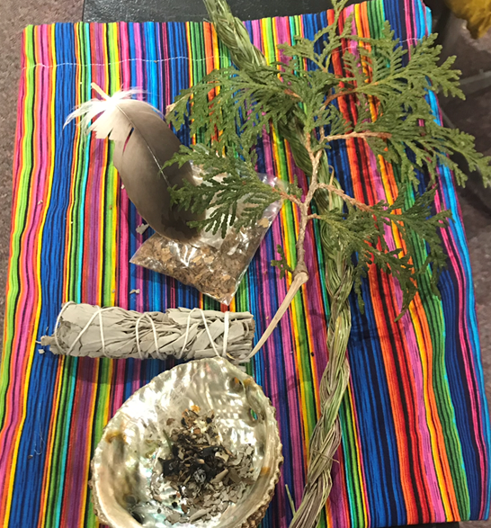
First Nations Health Data at ICES
October 25, 2023
COO: Powering Up Data Sovereignty Conference
Graham Mecredy, Staff Scientist
Indigenous Portfolio

Slide 2
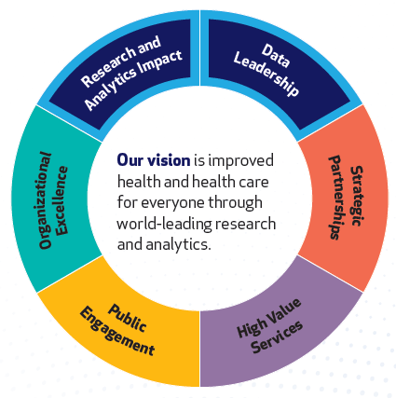
About ICES
Community = people
ICES is a not-for-profit research institute made up of a community of research, data and clinical experts that use data to answer important questions.
We love data!

Slide 3
ICES Core Data Repository: De-sensitized and Linkable
People & Geography
Health Service
Visits
Health Service Provider/
Facilities
Disease Registries
Intersectoral Data*
People in Ontario eligible for health care since 1985
Demographics
Deaths
Census
Immigration & Refugee*
First Nation*
Métis*
Physician claims
~In patient hospital discharge abstracts
~Emergency & ambulatory care
Prescription drug claims (≥ age 65)
Home care claims
Rehab Claims
Long-term care claims
Diabetes
Hypertension
COPD
Asthma
IBD
Cancer
Stroke
Cardiac
POGO
BORN
HIV
Environmental
Transportation
Social Assistance
Education (EDI)
Disability Support
Physicians
Hospitals
Home care
Complex care
Long-term care homes
Unique algorithm based on Ontario health card number
* Special
governance
Linked
data set

Slide 4
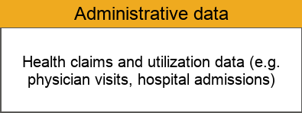
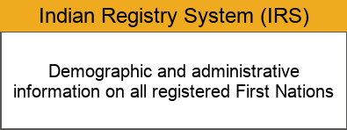
Connecting these databases allows us to learn about the health of registered First Nations people
* Image Reference: Cancer Care Ontario, Aboriginal Cancer Control Unit: How we measure cancer in First Nations, Inuit and Métis populations, 2017.

Slide 5
Connecting these databases allows us to learn about the health of registered First Nations people
Same person
Unique algorithm based on Ontario health card number
* Image Reference: Cancer Care Ontario, Aboriginal Cancer Control Unit: How we measure cancer in First Nations, Inuit and Métis populations, 2017.
Notes:
Add note to this slide

Slide 6
Connecting these databases allows us to learn about the health of registered First Nations people
Same person
Same person
* Image Reference: Cancer Care Ontario, Aboriginal Cancer Control Unit: How we measure cancer in First Nations, Inuit and Métis populations, 2017.
Notes:
Add note to this slide

Slide 7
ICES Indigenous Portfolio
We will support Indigenous-driven use of ICES data.
We will aim to be a trusted partner for Indigenous organizations, scholars and Communities in their use of data to promote wellbeing, healing and effective policy.
We will listen to and learn from Indigenous teachings and principles so that we can strive to apply them to our relationships and collaborative projects.

Slide 8
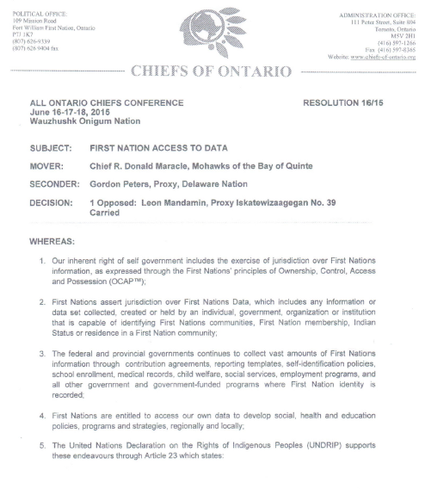
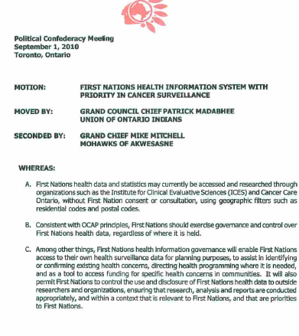
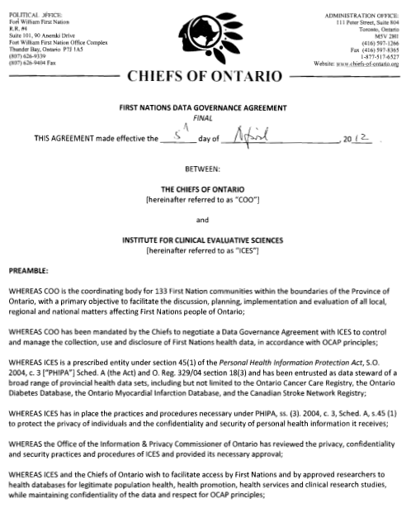
Relationships built on respect and trust

Slide 9
ICES – Chiefs of Ontario (COO) Data Governance Agreement (DGA)
ICES and the Chiefs of Ontario (COO) entered into a Data Governance Agreement (DGA) in April, 2012
DGA facilitates research, while overseeing use of First Nations data at ICES in a manner that protects the interests of First Nations communities
ICES acts as a data steward for First Nations data
First Nations approval is required from First Nations peoples or communities (via Chiefs of Ontario and the First Nations Data Governance Agreement)
DGA is there to protect the data, and minimize potential harm

Slide 10
Types of First Nations Data at ICES
Self-identifiers
Geographic identifiers
Geographic codes to identify people living in First Nations communities
Registries
First Nations self-identifiers in data holdings at ICES
Indian Register System (IRS)
Indigenous-specific datasets
Surveys
Data from Indigenous healthcare providers

Slide 11
Data limitations
Data source | Limitations
General administrative data | missing Federally funded service data (e.g. NIHB) and nursing stations differential access to services, cultural barriers, institutional racism
Self-identifiers | accuracy unclear generic ‘Indigenous’ terminology
Geographic codes | addresses may not be updated shared postal codes used to identify communities
Registries | registration not mandatory part of colonial system cut of IRS only updated to 2014

Slide 12
How to access data at ICES
Multiple pathways
Already working with a researcher?
Already have funding?
Applied Health Research Question (AHRQ) program

Slide 13
Applied Health Research Question (AHRQ)
Ontario Mistry of Health (MOH) funding program to produce research evidence that informs planning, policy and program development that will benefit the Ontario health system
Knowledge users include health system policy makers or providers (e.g. government ministries, hospitals, provincial health associations/agencies)
Dedicated resources for First Nations stakeholders:
Individual communities
Groups of communities
Organizations
Leadership organizations
Documents and results for First Nations projects are NOT shared with MOH
No cost to First Nations

Slide 14
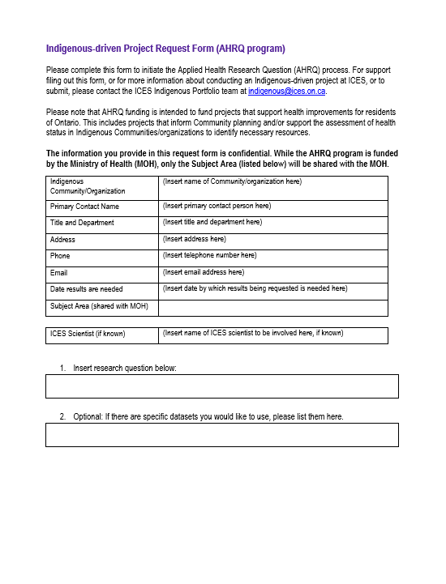
AHRQ Documentation
Knowledge User AHRQ Request Form
ICES will work with you to fill out this form
Requires signature from a representative from your community
Covers:
what/why evidence is needed
how it will be used

Slide 15
AHRQ Pathway
AHRQ Pathway
AHRQ request form
Community leadership support (e.g., BCR)
Review by COO
Analysis conducted at ICES
Research results provided back to First Nation(s)

Slide 16
Thank you / Miigwetch
Questions? Contact:
indigenous@ices.on.ca

