Slide 1
First Nations Data Governance Strategy – Implementation in Ontario
October 24, 2023
Mariette Sutherland, Executive Project Lead
Ontario Data Champion Team
Notes:
Add Introductory Title. Example: if you are providing an update on a specific file, place file name here.

Slide 2
Chiefs of Ontario
Chiefs of Ontario supports all First Nations in Ontario as they assert their sovereignty, jurisdiction, and their chosen expression of nationhood.
Keeping in mind the wisdom of our Elders, and the future for our youth, we continue to create the path forward in building our Nations as strong, healthy Peoples respectful of ourselves, each other, and all of creation.
Notes:
To add more slides, right click on slide 2, click ‘Duplicate Slide’

Slide 3
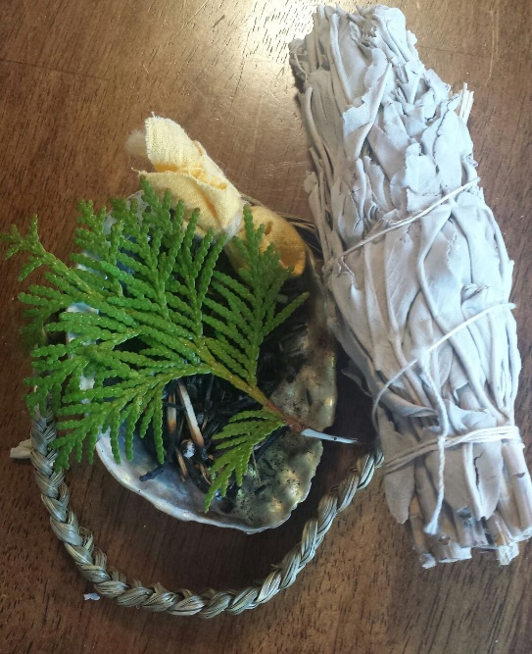
Presentation Goals
Describe Ontario’s approach to the Strategy and process to date
Describe key milestones
Share challenges, key strengths
Describe next steps in key work streams
Highlight how you can participate
Notes:
To add more slides, right click on slide 2, click ‘Duplicate Slide’

Slide 4
Decades of advocacy leading to….
COO Resolution 06/15 asserting jurisdiction over First Nations data
AFN Resolution 57/2016 seeking sustainable investment for regional information governance infrastructure
COO Resolution 17/18 First Nations data for wellness and healing and advocacy for funding
COO Resolution 21/27 the development of an Ontario FNIGC
Notes:
To add more slides, right click on slide 2, click ‘Duplicate Slide’

Slide 5
Resolution 21/27
Establish an interim Data Champion Advisory Committee and develop a terms of reference
Endorses the First Nations Data Governance Strategy, as customized to Ontario priorities and needs
Support for existing forms of data governance until community consultations can take place
Report back yearly to the Chiefs in Assembly (done quarterly)
This work would not prejudice or negatively impact any First Nations initiatives in research and data
Notes:
To add more slides, right click on slide 2, click ‘Duplicate Slide’

Slide 6
Data Champion Advisory Committee
Elder Vera Pawis Tabobondung
Grand Chief Abram Benedict – Leadership Council
Dr. Jennifer Walker
Dr. Darrel Manitowabi
Dr. Emily Faries
Mr. Larry Sault
Chief Shelly Moore-Frappier
Dr. Chris Mushquash
Mr. Gary Allen
Dr. Michael Schull
Notes:
To add more slides, right click on slide 2, click ‘Duplicate Slide’

Slide 7
Our progress and plans
Notes:
Add Introductory Title. Example: if you are providing an update on a specific file, place file name here.

Slide 8
Work to be accomplished 2023-2025
Build a data champion team
Define regional priority capacity needs
Define regional data governance model
Secure phase 2 funding
Ensure trust and support from leadership
Notes:
To add more slides, right click on slide 2, click ‘Duplicate Slide’

Slide 9
Progress to date:
Appointment of the First Nations Data Champion Advisory Committee
Eight meetings of the Committee since November 2021
Regular updates to Chiefs in Assembly
Staffing the Data Champion Team underway
Data Landscape Scan
Development of Draft Communications, Outreach and Engagement Workplan
Notes:
To add more slides, right click on slide 2, click ‘Duplicate Slide’

Slide 10
Challenges
Human resources
Engaging with133 First Nations and First Nation organizations
Varying stages of readiness and capacity in this sphere.
Diverse expectations, perspectives and interests.
Awareness and understanding of data sovereignty and data literacy
Ensuring a platform for informed dialogue moving forward.
Chiefs of Ontario
Provincial Territorial Organizations
(5)
Tribal Councils (18)
Other key FN service orgs
(39)
Non FN partners
First Nations (133)
Regional Data Champion Team
Notes:
To add more slides, right click on slide 2, click ‘Duplicate Slide’

Slide 11
Strengths to build on
Growing capacity and interest
OCAP® celebrates 25 years
Many examples of data partnerships and initiatives
Regional Health Survey has paved a solid path
COO Research and Data Management providing guidance through its Strategic Plan
Sound First Nations research principles and projects
Cultural strengths and sovereignty of our diverse First Nations
Notes:
To add more slides, right click on slide 2, click ‘Duplicate Slide’

Slide 12
Plans moving forward
Building Awareness
Ongoing communications
Partner engagement
Collaborative planning of outreach
Building data literacy
Information gathering
Exploring governance models
Notes:
To add more slides, right click on slide 2, click ‘Duplicate Slide’

Slide 13
Participation in shaping Ontario’s RIGC
- learn more about the Strategy
- share with your colleagues
- invite our team to present at your meeting
- partner with us in community outreach
- participate in and help promote webinars & information gathering activities
- give feedback and share insights
- join our team! (we’re hiring)
Notes:
To add more slides, right click on slide 2, click ‘Duplicate Slide’

Slide 14
Chiefs of Ontario Secretariat Support:
Mariette Sutherland, Executive Project Lead
Priscilla Nakochee, Executive Assistant
Carmen R. Jones, Director of Research and Data Management
Notes:
To add more slides, right click on slide 2, click ‘Duplicate Slide’

Slide 15
First Nations Data Governance Strategy and Ontario’s Data Champion Team
For enquiries and further information, please contact:
Priscilla Nakochee
Priscilla.Nakochee@coo.org
Notes:
Insert Sector and Director contact information.

