Slide 1
Chiefs of Ontario
Fall Chiefs Assembly
November 21-23, 2023 Toronto, Ontario
For more information, please visit: www.ChiefsMeeting.com
Notes:
Title. Do not alter.

Slide 2
COO Education Sector:
Restructure of First Nations Lifelong Learning Table
Notes:
Add Introductory Title.

Slide 3
Resolution 45/16
Approve 3-Year Strategic Plan
Approve FNLLT Terms of Reference
Require EDU to fund process
Request expansion - PSE
FNLLT – Current Mandate
Notes:
To add more slides, right click on slide, click ‘Duplicate Slide’

Slide 4
https://app.box.com/folder/153461212817
FNLLT is a sub-committee of the Chiefs and Technical Committee on Language and Learning (CTCLL)

Slide 5
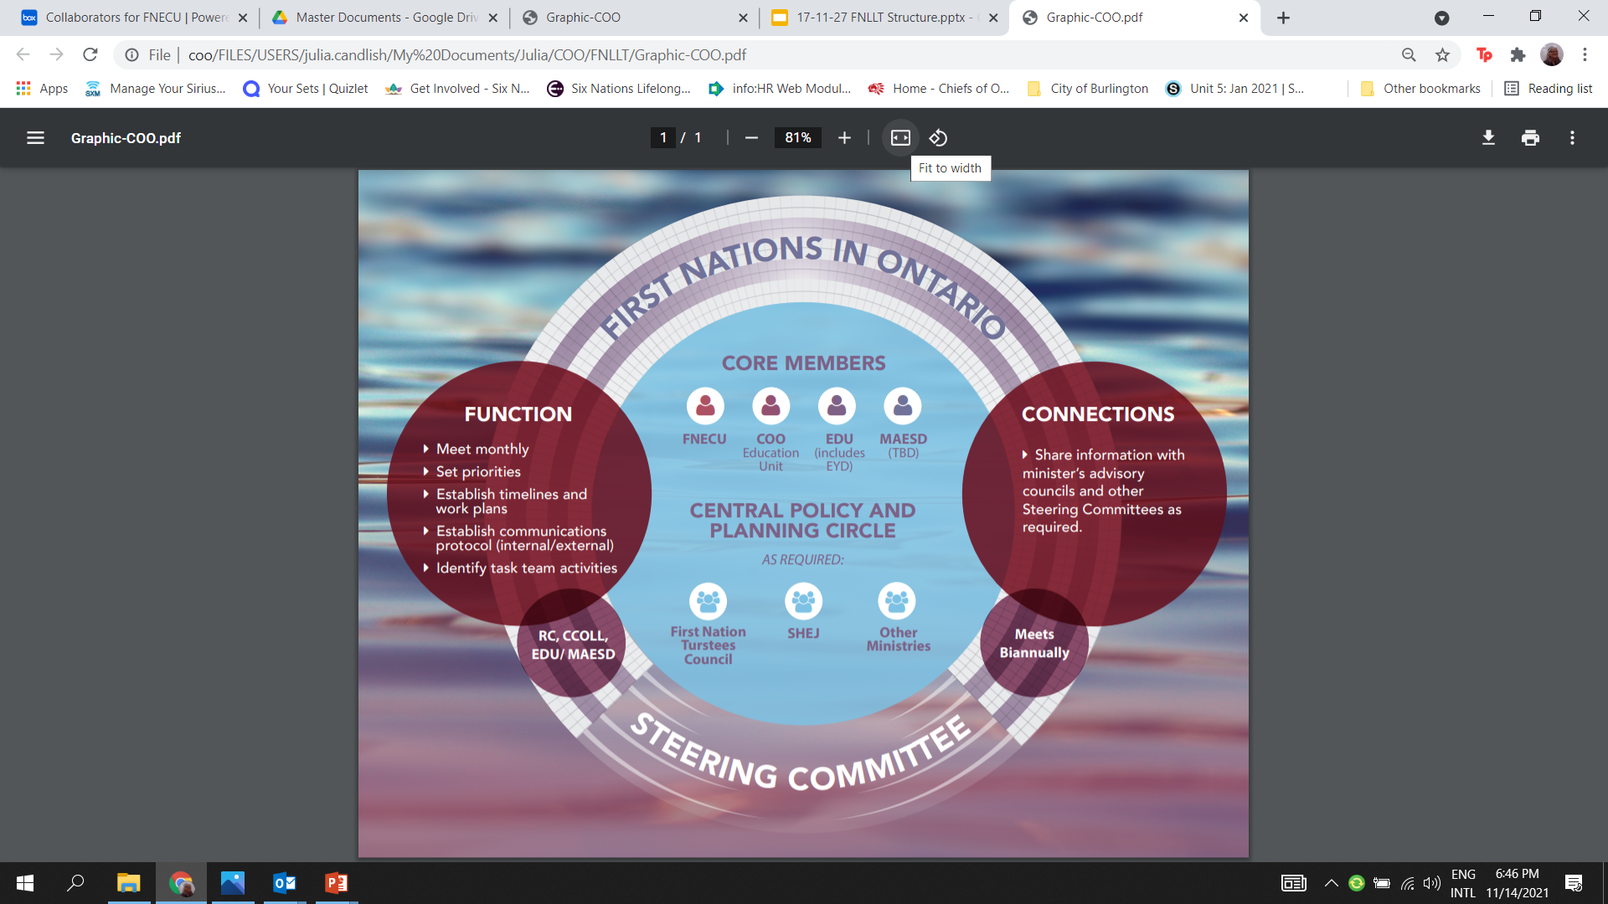
FNLLT Structure
2017-18

Slide 6
FNLLT 2019 and Beyond
Probable barriers to communication and engagement
Sunset of the FNMI Framework 2017
Change in provincial government June 2018
Change in First Nation Leadership July 2018
COO staffing changes - Education
COVID pandemic 2020
Lack of First Nation policy framework and strategic plan

Slide 7
June 2023 Leadership Advocacy Strategy
Full commitment to establish a table with bi-monthly meetings with ADMs
COO / EDU to determine what the First Nations Lifelong Learning Table Planning Circle will look like and how it will work
Notes:
To add more slides, right click on slide, click ‘Duplicate Slide’

Slide 8
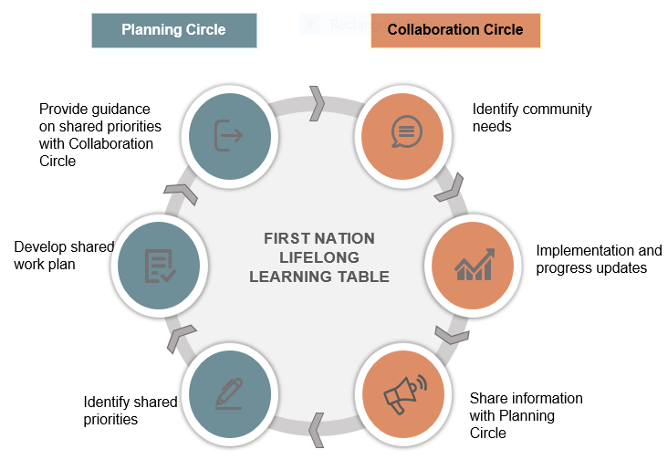
New Structure FNLLT

Slide 9
Revise FNLLT Terms of Reference for approval
Utilize recent analyses as priority areas of focus
Determine EDU support to address First Nation priorities
FNLLT Next Steps

Slide 10
Student Outcomes in Provincially Funded Schools
Attendance at school 90%
- Ontario-wide 67%
- First Nations – 40%
Grade 9 credit accumulation
- Ontario-wide 87% on track
- First Nations 40% on track
Suspensions and Equitable Access to a Positive Disciplinary Climate
Suspensions in Elementary Schools
- Ontario-wide 2%
- First Nations 9.4%
Suspensions in Secondary Schools
- Ontario-wide 5.5%
- First Nations 12.3%
Graduation
- Ontario-wide 89%
- First Nations 60%
Recent
Analysis

Slide 11
Suggested Mandate
Retire Resolution 45/16 Provincial Bilateral Process on Education and replace it with this resolution.
Agree to replace former FNLLT components with the Planning Circle and the Collaboration Circle.
Require the FNLLT to be fully funded by the Ministry of Education.
Require the CTCLL to provide an agreed upon revised Terms of Reference for the FNLLT to the Leadership Council for approval prior to the 2024 COO Annual Chiefs Assembly.
Agree to address outcomes of recent analysis be used as key evidence and basis for work being undertaken by the FNLLT.
Direct the CTCLL to pursue a similar bilateral process with the Ministry of Colleges and Universities to focus on post-secondary education for First Nation learners.

Slide 12
Education Sector
For further information, please contact:
Director of Education, Julia Candlish at julia.candlish@coo.org
Notes:
Insert Sector and Director contact information.

