Slide 1
Annual Chiefs Assembly
Chiefs of Ontario presents
Moving Forward: Strengthening
Relationships for Future Generations
June 13-15, 2023
For more information, please visit: www.ChiefsMeeting.com
Notes:
Title. Do not alter.

Slide 2
Chiefs of Ontario
Justice Sector
Notes:
Add Introductory Title.

Slide 3
Chiefs of Ontario Justice Sector
The Justice Sector at Chiefs of Ontario is dedicated to supporting and advocating for First Nations justice systems and self-governance in Ontario. The Justice Sector’s responsibilities are to coordinate the technical and political positions of First Nations Leadership on justice issues affecting First Nations in the Ontario region.
Leading justice priorities throughout 2022-2023 included addressing the lack of enforcement of First Nations laws, ensuring community safety, implementing a strategy to advance First Nations rights in the Ontario region, completing and distributing valuable law-making and preventing-harassment resources, supporting improved consultations and engagement, raising awareness of heritage and burial issues, and providing access to legal information on the implementation of the UNDRIP Act.
Notes:
To add more slides, right click on slide, click ‘Duplicate Slide’

Slide 4
Accomplishments
Notes:
Add Introductory Title.

Slide 5
Accomplishments
Completed and disseminated the First Nations Law Making Bundle
Established a Heritage and Burials Portfolio
Hosted a Special Chiefs Assembly on Rights Assertions
Successfully advocated for a Private Prosecution Pilot for First Nations laws
Launched a website for the Preventing Sexual Harassment in the Workplace Project
Hosted several successful webinars on United Nations on the Rights of Indigenous Peoples Act
Distributed materials to the Ontario Government to improve consultation and engagement practices and polices
Notes:
To add more slides, right click on slide, click ‘Duplicate Slide’

Slide 6
Highlights and Updates
Notes:
Add Introductory Title.

Slide 7
Priority Area: Policing
Provincial Policing
Enforcement of First Nations laws: Continued advocacy to the Ministry of the Solicitor General to ensure the enforcement of First Nations by-laws are included as a mandatory policing functions within the regulations for the CSPA, 2019
Coordination support: Ongoing coordination support for First Nations policed under various policing models, including the OFNPA Chiefs and Delegates Working Group
Monitor and support individual policing issues across the region
Federal Policing
AFN is mandated to co-develop federal policing legislation with Canada to recognize First Nations policing as an essential service
COO has distributed capacity funding to interested PTOs, the Independent First Nations, and unaffiliated First Nations to support region-led input into legislative process
Resolution 21/38 mandates advocacy on priorities and interests of First Nations in the Ontario region
Notes:
Add Header. Example: if you are providing an update on a specific file, place file name here.
To add more slides, right click on slide 2, click ‘Duplicate Slide’

Slide 8
Priority Area: Tripartite Collaborative Table on Enforcement and Prosecution of First Nation Laws
Resolution 21/37 mandates advocacy for Interim Measures to the ongoing gaps and obstacles to the consistent and reliable enforcement and prosecution of First Nations laws, while longer-term solutions are developed
Interim Measure 1 achieved in December 2022: Canada and Ontario co-funded a Private Prosecution Pilot for First Nations to hire prosecutors to prosecute infractions of their laws through fiscals 2022-23 and 2023-24
Interim Measure 2 outstanding: Advocacy continues for Crown(s) prosecutors to be made available by Canada and Ontario, on request by a First Nation
Development of recommendations for Table to support will be presented to Chiefs-in-Assembly for review, input, and guidance
Notes:
Add Header. Example: if you are providing an update on a specific file, place file name here.
To add more slides, right click on slide 2, click ‘Duplicate Slide’

Slide 9
The UNDRIP Act
Canada is currently completing the engagement process on the United Nations Declaration on the Rights of Indigenous Peoples Act and its Action Plan (to be released on June 21, 2023)
COO does not have a current resolution or mandate on the Act and its related processes
However, the Justice Sector has continued to support First Nations by hosting Dialogue Sessions with (a) access to legal counsel and Department of Justice Canada officials; (b) space for information sharing, discussion, and strategizing; and (c) circulation of materials to support First Nations in making their own decisions about how to participate in this process and the implementation of this Act
Notes:
An important priority to highlight is our work with the United Nations Declaration on the Rights of Indigenous Peoples Act, as known as the UNDRIP Act.
The UNDRIP Act became law on June 21, 2021. From that date, a timeline of 2 years was given to produce an Action Plan that would guide the implementation of the Act. Engagement has been carried out over the last two years on what measures should be included in the Action Plan. This led to the release of the Draft Action Plan and a What We Learned report in March 2023. Since then, further validation processes have taken place to finalize the Action Plan, which is set to be released on June 21, 2023.
Since the Act became law in 2021, the Justice Sector has kept a close eye on the topic and has done its best to support First Nations with legal access and information on the Act through seven dialogue sessions. These sessions varied in their composition and included targeted discussions for Leadership, technicians, youth, and consultation and governance workers.

Slide 10
Priority Area: Duty to Consult
Leadership have repeatedly raised concerns about substandard consultation and engagement practices led by the federal and provincial governments
In response, the Justice Sector has, as mandated by Resolution 21/39:
Circulated its developed resources (Minimum Standards and Principles, and Engagement Checklist) to the Premier’s office and Ontario Ministries
Hosted a Dialogue Session with First Nations and Ontario Ministries to set out First Nations requirements for improvements
Monitored consultation and engagement issues experienced by First Nations and provided assistance, as requested
Notes:
Add Header. Example: if you are providing an update on a specific file, place file name here.
To add more slides, right click on slide 2, click ‘Duplicate Slide’

Slide 11
Priority Area: Rights Assertions
Five (5) new COO Resolutions on this file since November 2021
Resolution 22/25A passed at the June 2022 ACA mandated COO to establish a Technical Committee tasked with developing a draft Advocacy Strategy
Draft Advocacy Strategy was presented to Chiefs-in-Assembly at September 2022 SCA on Rights Assertions and accepted by the Chiefs by a confidential resolution
The Advocacy Strategy includes Communications, Research, Political and Legal components
The Technical Committee on Rights Assertions continues to oversee the ongoing implementation of the Advocacy Strategy
Notes:
Add Header. Example: if you are providing an update on a specific file, place file name here.
To add more slides, right click on slide 2, click ‘Duplicate Slide’

Slide 12
Justice Sector Projects
Preventing Sexual Harassment in the Workplace
First Nations Law Making Project
Anti-Racism Project
Notes:
Add Introductory Title.

Slide 13
Preventing Sexual Harassment in the Workplace
The Justice Sector is continuing its work to provide legal education and raise awareness on sexual harassment in the workplace, and more broadly, harassment in the workplace, including issues such as discrimination, lateral violence, and poisoned work environments
Over the past year, the Project launched a Toolkit and Website to provide information on preventing and addressing harassment in the workplace and educate employees and employers on their rights, protections, and obligations when it comes to a safe and healthy workplace
Notes:
Add Header. Example: if you are providing an update on a specific file, place file name here.
To add more slides, right click on slide 2, click ‘Duplicate Slide’

Slide 14
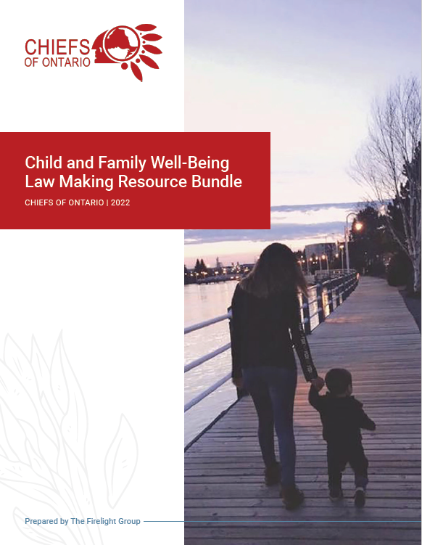
First Nations Law Making Project
The Justice Sector remains committed to enhancing First Nations capacity in developing their own laws through creating culturally relevant tools, guides, and resources
Recently, the Child and Family Well-Being Law Making Resource Bundle was completed in response to Bill C-92, to support and enhance First Nations’ capacity in exercising their jurisdiction over child welfare
Notes:
Add Header. Example: if you are providing an update on a specific file, place file name here.
To add more slides, right click on slide 2, click ‘Duplicate Slide’

Slide 15
Anti-Racism Project
Resolution 21/36 directed the COO Secretariat to seek funding in order to develop awareness campaigns. Funding was secured for 2022-2023 and 2023-2024.
A public education and awareness campaign that explores systemic racism through policy choices was developed based on input from Dialogue Sessions hosted with First Nations Youth, Elders, and Women in November 2021 and January 2022, with guidance from the Chiefs and Technicians Committee on Justice
Notes:
Add Header. Example: if you are providing an update on a specific file, place file name here.
To add more slides, right click on slide 2, click ‘Duplicate Slide’

Slide 16
Committee Work
Chiefs and Technicians Committee on Justice
Kee:Way Heritage and Burials
Notes:
Add Introductory Title.

Slide 17
Chiefs and Technicians Committee on Justice
The creation of the Committee is rooted in Resolution 12/09: Chiefs Committee on Justice
The Chiefs and Technicians Committee on Justice supports First Nations in their work to advance justice and jurisdiction by providing technical and political advice to the Regional Chief, Chiefs of Ontario Leadership Council, Chiefs-in-Assembly, and Justice Sector on all matters related to First Nations justice
The Justice Committee met in-person for the first time in April 2023 to priority map and identify future initiatives for the Committee
Priority areas include the revitalization of First Nations traditional legal systems, First Nations law making, and policing and community safety
Notes:
Add Header. Example: if you are providing an update on a specific file, place file name here.
To add more slides, right click on slide 2, click ‘Duplicate Slide’

Slide 18
Kee:Way: Heritage & Burials Committee
This year, Kee:Way retained legal advice to develop recommendations for policy and legislative reform in the area of heritage and burials, e.g., protection of sacred and burial sites
Resolution 22/36S passed at the November 2022 FCA directing the COO Secretariat to create a separate Portfolio for Heritage and Burials and directing Kee:Way to advocate for policy and legislative reform, i.e., implementation of recommendations
The Heritage and Burials Portfolio was established in February 2023 with Anishinabek Nation Grand Council Chief Reg Niganobe as Portfolio Holder
Prioritization of relationship building with the Ministry of Citizenship and Multiculturalism and the Association of Municipalities of Ontario to advance priorities and recommendations
Notes:
Add Header. Example: if you are providing an update on a specific file, place file name here.
To add more slides, right click on slide 2, click ‘Duplicate Slide’

Slide 19
In The Year Ahead – Moving Forward
Notes:
Add Introductory Title.

Slide 20
Moving Forward…
Continue to support and provide updates to First Nations on the implementation of the UNDRIP Act
Continue advocating with Canada and Ontario for consultation and engagement practices that reflect the standards and expectations of First Nations
Continue momentum on immediate and long-term solutions to ensure that First Nations laws are consistently and reliability enforced and prosecuted
Ongoing collective coordination and support on their various community safety and policing needs
Support the return of Ancestors and artifacts and lobbying for legislative and policy reform in the heritage and burials space
Support First Nations as they assert their inherent and treaty rights over their ancestral and treaty territories
Host information sessions and workshops, and provide accessible resources in the area of law-making and preventing harassment in the workplace

Slide 21
For further information, please contact:
Jackie Lombardi
Director of Justice
jackie.lombardi@coo.org
Notes:
Insert Sector and Director contact information.

