Slide 1




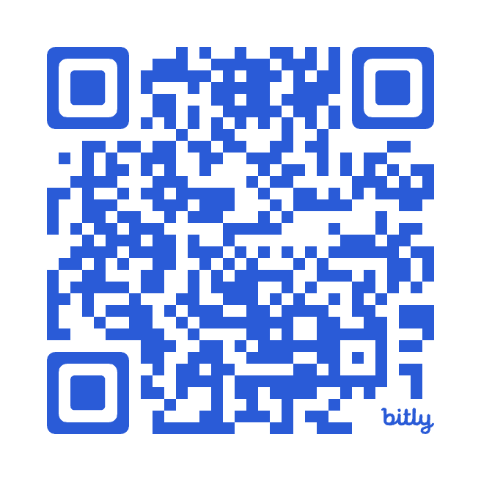
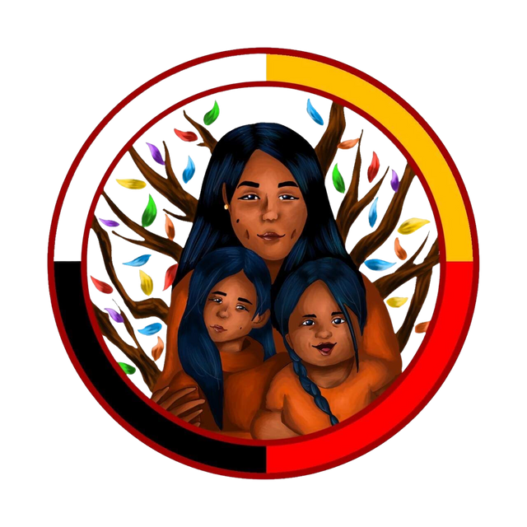

Indigenous Child & Family
20
24
Well-Being Conference
January 23-25, 2024 | Anishinaabe Algonquin Territory | Shaw Centre Ottawa
Early Bird tickets on sale until November 13!
Scan Me

