Slide 1
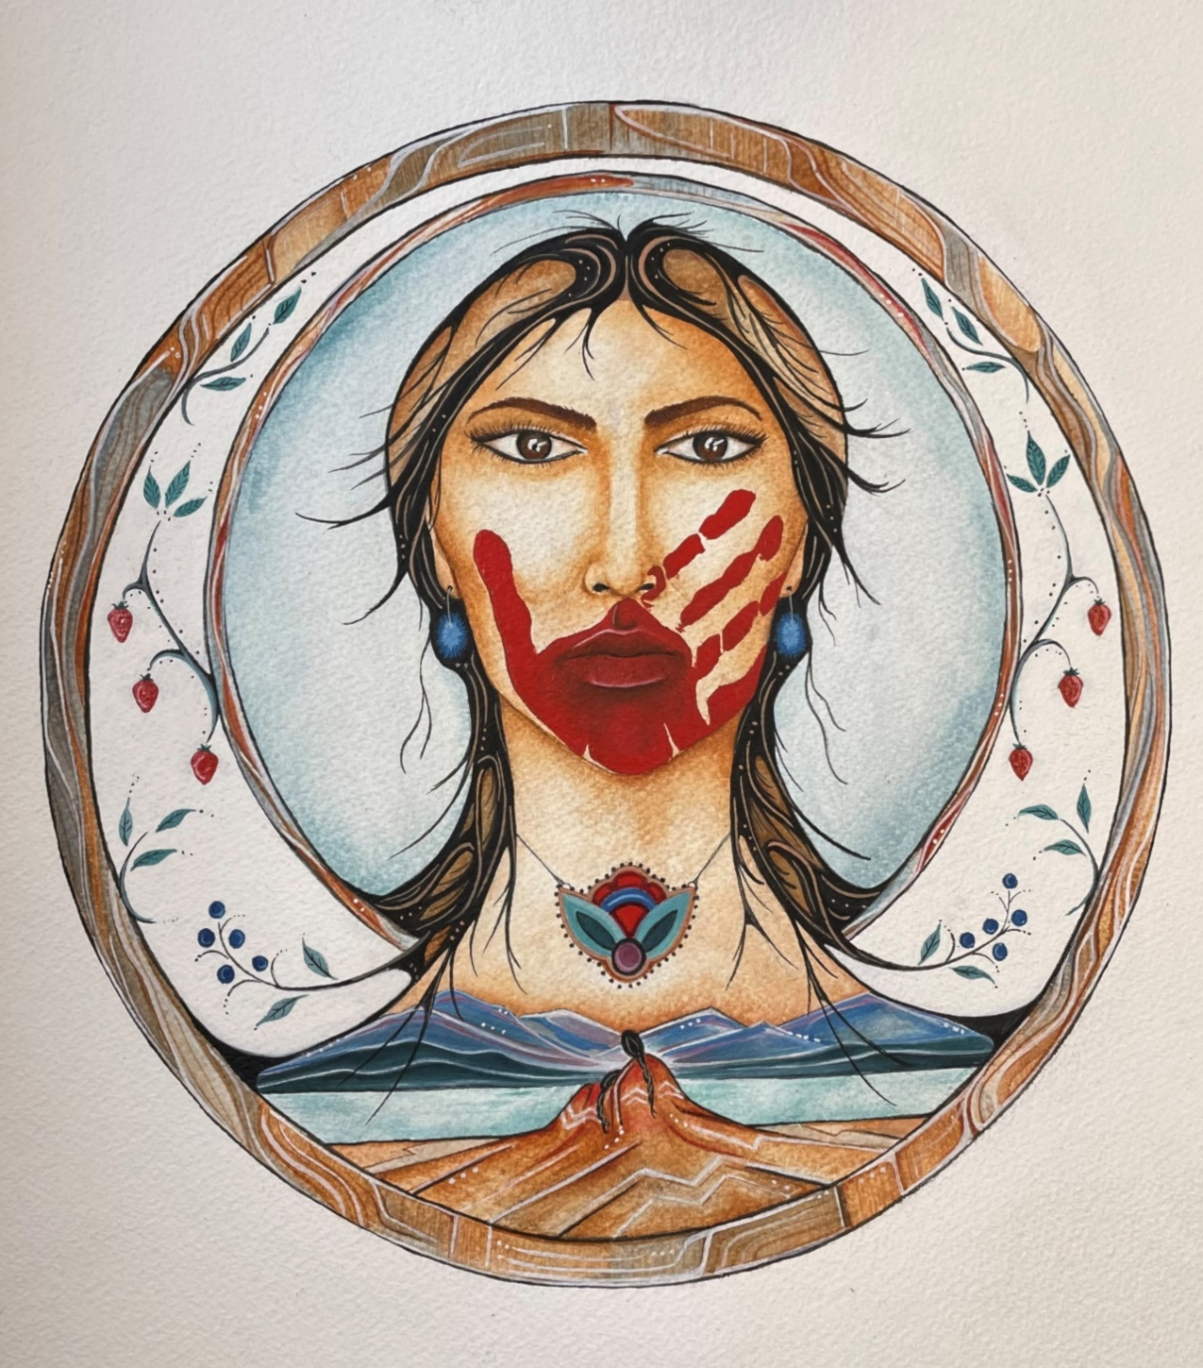
Gender-Based Violence Research: Risk and Danger Assessment Tools
Nancy Johnson, M.Ed.
Director of Women’s Initiatives
and
Rebekah Ederer, MSW, RSW
Women’s Initiatives Research Coordinator
Chiefs of Ontario
Powering Up Data Sovereignty Conference
October 26, 2023

Slide 2
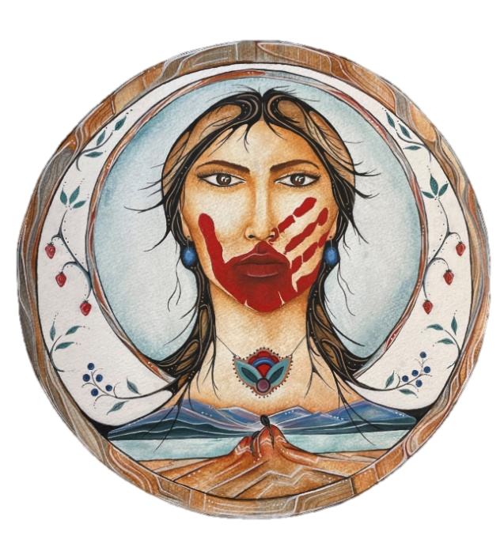
We honour the memory of
all of our missing and murdered.
ARTIST’S STATEMENT: The piece entitled “Etinǫhkwa”(a Cayuga word meaning “We all love her”), is a thoughtful representation of MMIWG and their families. The woman stands in strength and love while her family and loved ones remember her. The elements, which are represented in the water, the earth, and the wind in her hair, are symbolic of the universal energy that flows through all of us. She is encircled by berries, as the women traditionally hold the responsibility of gathering and berry picking. This piece is emblematic of the symbiotic relationship we have with all of creation and a reminder that our loved ones who have been taken from us will never be gone, as they live all around us and within us. Commissioned for the Ontario First Nations MMIWG2S Family Gathering, 2022.
ARTIST: Charlene Hemlock, Cayuga, Wolf Clan, Six Nations of the Grand River.

Slide 3
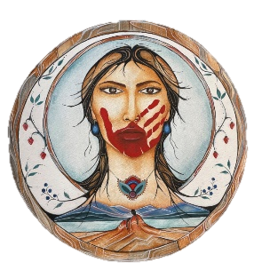

We commemorate
all of our missing and murdered

Slide 4
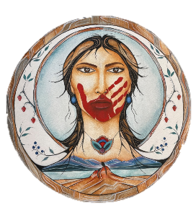

Gender-Based Violence Research: Risk and Danger Assessment Tools
PURPOSE OF PRESENTATION:
To outline work being done through the Chiefs of Ontario Women’s Initiatives sector to support Ontario First Nations in ending gender-based violence
To highlight a Women’s Initiatives research project on victim services that supports assessment of risk and danger and safety planning

Slide 5
Gender-Based Violence Research: Risk and Danger Assessment Tools
PRESENTATION WILL COVER:
Ontario First Nations and Gender-Based Violence – Chiefs’ Resolutions; role of First Nations Women’s Council
Gender-Based Violence Research – MMIWG Calls for Justice and National Action Plan; Ontario First Nations recommendations; links between gender-based violence and MMIWG
RADAT – Project outline; process; findings to date; how the work supports Ontario First Nations in ending gender-based violence

Slide 6

Part 1: Background
Ontario First Nations and Gender-Based Violence

Slide 7
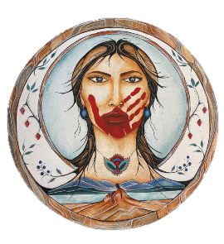
Gender-Based Violence Research: Risk and Danger Assessment Tools
Chiefs of Ontario secretariat (COO) supports all First Nations in Ontario as they assert their sovereignty, jurisdiction, and their chosen expression of nationhood
COO supports the political leadership in discussing and deciding on regional, provincial and national priorities affecting First Nation people in Ontario and providing a unified voice on these issues through Resolutions
A Leadership Council is mandated by the Chiefs-in-Assembly to work with Ontario Regional Chief to set, coordinate, and implement First Nations leaders’ priorities
Leadership Council: Anishinabek Nation (AN), Association of Iroquois and Allied Indians (AIAI), Nishnawbe Aski Nation (NAN), Grand Council Treaty #3 (GCT3), Independent First Nations, Six Nations of the Grand River, Mohawks of Akwesasne, and Mushkegowuk Council

Slide 8
Gender-Based Violence Research: Risk and Danger Assessment Tools
Chiefs Resolutions:
10-31 - Support for Sisters in Spirit. Called on Canada to support community facilities such as women's shelters and services for victims of violence and family members. Called for a public inquiry into MMIWG
13-04 - Chiefs’ Declaration to support ending violence and abuse in communities and continued strategizing on ending violence and abuse
14-19 - First Nations Women’s Council to conduct research and compile data on issues related to MMIWG for First Nations leadership
39-18 – Support for family gatherings and that MMIWG work include men and boys
29-19 – Called on Canada and Ontario to provide an Ontario-based implementation plan for the MMIWG National Inquiry Calls for Justice, to support the First Nations Women’s Council and an Indigenous-led research entity and data steward, and to support a healing fund for MMIWG families

Slide 9

Gender-Based Violence Research: Risk and Danger Assessment Tools
First Nations Women’s Council
The Chiefs of Ontario First Nations Women’s Council (FNWC) is an advisory council to the Ontario First Nations Chiefs in Assembly on ending violence against women and girls and promoting community well-being
FNWC was established by Leadership Council in 2011 as a caucus to provide a First Nations voice to Ontario’s strategy to end violence against Indigenous women
Members: Nishnawbe Aski Nation, Anishinabek Nation, Grand Council Treaty #3, Association of Iroquois and Allied Indians, Independent First Nations, Mohawk Council of Akwesasne, Six Nations of the Grand River
Image: Maxine Noel. Walking Together: Ontario’s Long-Term Strategy to End Violence Against Indigenous Women. Year Two report, 2018

Slide 10
Gender-Based Violence Research: Risk and Danger Assessment Tools
First Nations Women’s Council
Elder/Knowledge Keeper: Donna Debassige
DGC Anna Betty Achneepineskum, Nishnawbe Aski Nation
Loretta Sheshequin, Nishnawbe Aski Nation
Rebecca Timms, Anishinabek Nation
Debbie Lipscombe, Grand Council Treaty #3
Sydney Lockwood, Association of Iroquois & Allied Indians
Lyndia Jones, Independent First Nations
Chief JoAnn Swamp, Mohawk Council of Akwesasne
Chief Sarah Diabo, Mohawk Council of Akwesasne
Sandra Montour, Six Nations of the Grand River

Slide 11
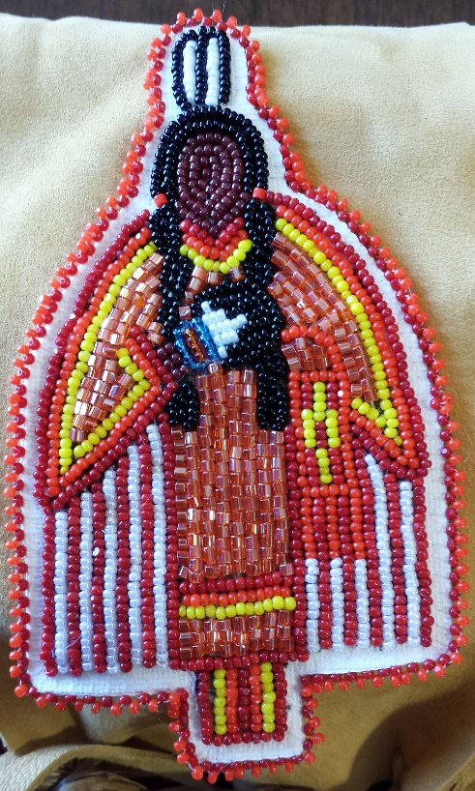
Gender-Based Violence Research: Risk and Danger Assessment Tools
First Nations Women’s Council
First Nations Women’s Council (FNWC) provides reports, updates and recommendations to the Chiefs-in-Assembly
Terms of Reference (updated in 2022) highlight the Council’s role in applying a gender lens in the work of COO and identifying strategies to promote the safety and well-being of First Nations women, girls, and Two-Spirit and gender diverse people – 2SLGBTQQIA+ (2S+)
FNWC supported Ontario First Nations families and survivors through two family gatherings during the MMIWG National Inquiry process
FNWC assisted Assembly of First Nations to coordinate regional engagement sessions with Ontario First Nations families and survivors to inform the 2021 National Action Plan on MMIWG2S+

Slide 12
Gender-Based Violence Research: Risk and Danger Assessment Tools
COO Women’s Initiatives
Women’s Initiatives Sector of COO (established in 2021) provides support and coordination to FNWC and promotes the safety, well-being and empowerment of Ontario First Nations women, girls and Two Spirit/gender diverse people
COO Women’s Initiatives supported FNWC in coordinating Ontario First Nations input into MMIWG National Action Plan
Women’s Initiatives and FNWC convened a third MMIWG Family Gathering in 2022 and utilized input from First Nations families and front line workers to develop an Ontario First Nations Gender-Based Violence Action Plan and work on initial priorities
Safety, wellbeing and empowerment of First Nations women, girls, 2S/gender diverse and communities
Focus of the COO Women’s Initiatives sector –
https://chiefs-of-ontario.org/priorities/womens-initiatives/

Slide 13
Part 2: MMIWG and
Gender-Based Violence Research

Slide 14
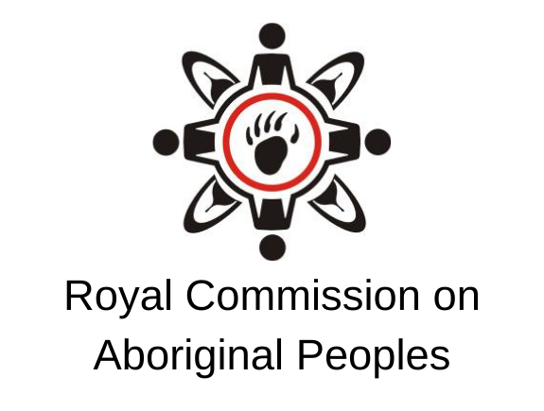
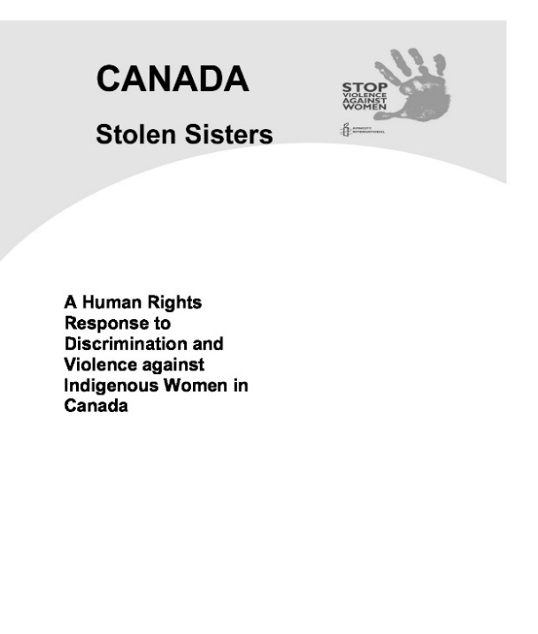
Gender-Based Violence Research: Risk and Danger Assessment Tools
National Inquiry into MMIWG: Background Research
RCAP, the Aboriginal Justice Inquiry of Manitoba, Amnesty International’s 2004 Stolen Sisters report and the Native Women’s Association of Canada (NWAC) “Sisters in Spirit” research all focused on violence against Indigenous women and MMIWG
NWAC developed a database of 582 cases of MMIWG*
RCMP review confirmed 1,181 police-recorded incidents of Indigenous female homicides and unresolved missing Indigenous females between 1980 and 2012 - 16% of all female homicides in Canada - despite making up only 4% of the female population
Anecdotal information identified closer to 4,000 MMIWG
* https://www.nwac.ca/assets-knowledge-centre/Fact_Sheet_Missing_and_Murdered_Aboriginal_Women_and_Girls.pdf

Slide 15
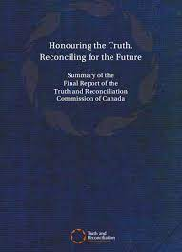
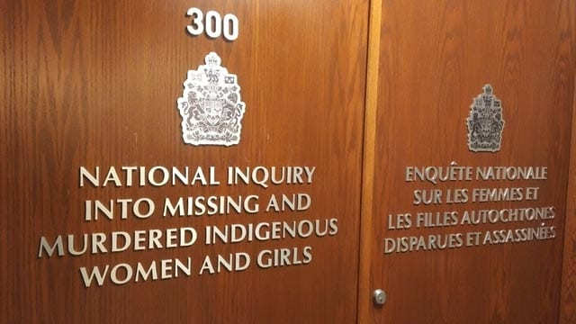
Gender-Based Violence Research: Risk and Danger Assessment Tools
National Inquiry into MMIWG: Background Research
TRC Final report noted that most of the 150,000 children who attended Indian residential schools experienced humiliation, fear, grief, were punished for crying or speaking their language; many experienced physical or sexual abuse
TRC Calls to Action 39 and 40: National plan to collect and publish data on criminal victimization of Aboriginal people including family violence and homicide data, and adequately funded, accessible Aboriginal victim programs and services
Call to Action 41 called for a public inquiry into the causes of, and remedies for the disproportionate victimization of Aboriginal women and girls including MMIWG and links to the intergenerational legacy of residential schools

Slide 16
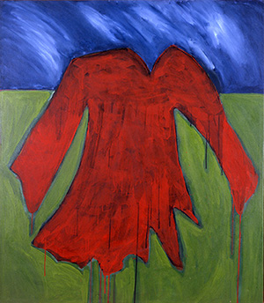
Gender-Based Violence Research: Risk and Danger Assessment Tools
National Inquiry into MMIWG: Mandate
Look into and report on the systemic causes of all forms of violence against Indigenous women and girls and 2SLGBTQQIA+ people
Examine underlying social, economic, cultural, institutional, and historical causes that contribute to the ongoing violence
Look into and report on existing institutional policies and practices to address violence, including those that are effective in reducing violence and increasing safety
Look at all forms of violence including Indigenous women who went missing or were murdered and those who died under suspicious circumstances
Consider interconnected issues such as sexual assault, child abuse, domestic violence, bullying, harassment, suicide, self-harm

Slide 17
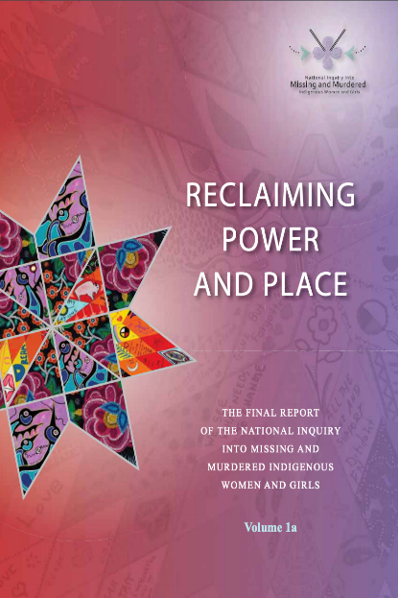
Gender-Based Violence Research: Risk and Danger Assessment Tools
National Inquiry into MMIWG: Highlights
Final report, Reclaiming Power and Place identified 231 Calls for Justice (CFJ) based on human rights laws and Indigenous rights
The 231 CFJ focus on prevention measures to address the root causes of violence: colonial violence and intergenerational trauma; socio-economic marginalization; institutional lack of will (status quo); and ignoring the agency and expertise of Indigenous women, girls and 2S+
CFJ must be implemented in a trauma-informed approach. Impact of the root causes of violence: unresolved grief, trauma, abuse, neglect; poverty, homelessness, food insecurity, unemployment; and greater vulnerability to violence, without adequate supports (counselling, treatment) or Indigenous-led solutions to ending the violence

Slide 18
Gender-Based Violence Research: Risk and Danger Assessment Tools
National Inquiry into MMIWG: Summary of the 231 Calls for Justice
For all Governments:
Human and Indigenous Rights – eliminate socio-economic marginalization; Indigenous representatives in governments; close service gaps; long term funding
Recognize/protect Indigenous culture, language, health & wellness
Social and economic infrastructure, safety and security, housing, transportation
Justice – legal reform including Indigenous perspectives on partner violence; equitable policing in First Nations; holistic support to Indigenous victims, missing persons legislation; prompt, effective protection orders; enhanced restorative justice; Indigenous community-based sentencing options; measures to reduce over-representation of Indigenous women and girls in the criminal justice system

Slide 19
Gender-Based Violence Research: Risk and Danger Assessment Tools
National Inquiry into MMIWG: Summary of the 231 Calls for Justice
Industries, Institutions, Services, Partnerships:
Decolonizing approach in media, academic institutions, stereotypes
Indigenous-led health services; training in human trafficking
Policing: culturally appropriate services free of bias; respectful working relationships; more Indigenous representation; enhance investigations
Decolonized education and child welfare systems and extraction industry
For all Canadians:
Promote safety, non-tolerance of violence; learn Indigenous history
Distinctions-Based Calls:
Specific to Inuit; Métis; and 2SLGBTQQIA+*
* Two Spirit, Lesbian, Gay, Bisexual, Transgender, Queer, Questioning, Intersex, and Asexual Plus

Slide 20
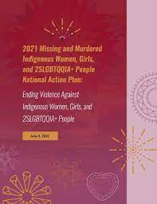
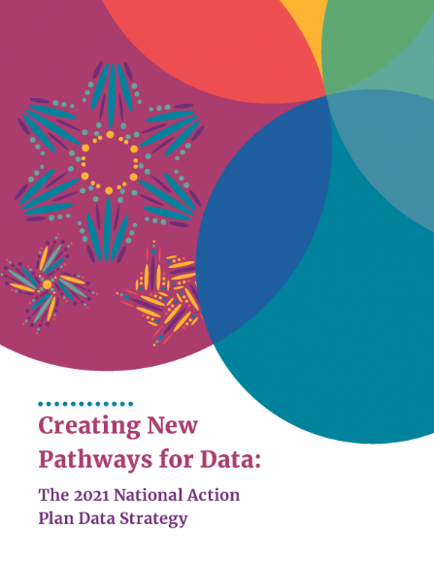
Gender-Based Violence Research: Risk and Danger Assessment Tools
National Inquiry into MMIWG: National Action Plan
Following the final report in 2019, a multi-jurisdictional core working group developed a National Action Plan to implement the 231 Calls for Justice; it was released in 2021
National Action Plan (NAP) has several components including federal, provincial and territorial plans, Inuit- and First Nations-specific plans
NAP includes a Data Strategy based on Indigenous data sovereignty
Data Strategy identified safety for Indigenous women, girls and 2SLGBTQQIA+ people as a central indicator, i.e. not just the absence of violence but the presence of factors that actively create a safe environment for Indigenous women, girls, 2SLGBTQQIA+ people and survivors – indicators of well-being

Slide 21
Gender-Based Violence Research: Risk and Danger Assessment Tools
Gender-Based Violence and MMIWG National Action Plans
Gender-based violence is experienced by many individuals but disproportionately affects women, Indigenous women, girls and 2SLGBTQQIA+; and women living in Northern, rural, and remote communities
GBV takes many forms, e.g. physical violence; sexual assault; exploitation; domestic homicide; intimate partner violence; or attempts to humiliate, intimidate, coerce, deprive or harm
Federal government created a gender-based violence strategy in 2017 and began working with provincial/territorial governments to advance a GBV National Action Plan, distinct from but in alignment with the MMIWG National Action Plan. Negotiation of bilateral funding agreements began in 2022-23

Slide 23
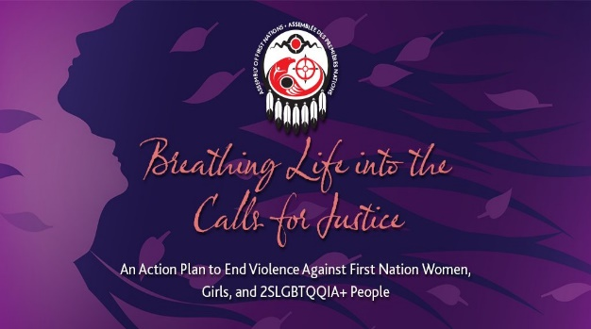
Gender-Based Violence Research: Risk and Danger Assessment Tools
MMIWG National Action Plan: Ontario First Nations
In 2021 the Assembly of First Nations coordinated engagement with First Nations across regions to inform the National Action Plan
Purpose: to seek input from First Nations families and survivors of MMIWG to inform the National Action Plan
In Ontario, FNWC assisted AFN to coordinate 21 sessions with First Nations families and survivors. The roll-up report, Decolonizing Systems and Planting Seeds* was appended to the AFN framework document, Breathing Life into the Calls for Justice – see Recommendations below
* https://drive.google.com/file/d/1g9B1WAfFLWJfrLCl2-vk2GVrjS3vZ_VH/view?usp=sharing

Slide 24
Gender-Based Violence Research: Risk and Danger Assessment Tools
MMIWG National Action Plan: Ontario First Nations Recommendations
Land-based and culturally informed community services and school curriculum
Safe, inclusive, supportive community programs/services
Harm reduction approaches and cultural safety training
24/7 crisis support line
Affordable, safe transportation
Support in navigating health care and legal systems
Safety in media, industry, child welfare, housing and community infrastructure

Slide 25
Gender-Based Violence Research: Risk and Danger Assessment Tools
Ontario First Nations MMIWG2S+ Family Gathering
Further to Resolution 39-18 COO and FNWC conducted a virtual Family Gathering in 2022 to support MMIWG2S+ families and survivors and to develop an Ontario First Nations Gender-Based Violence Action Plan
Presentations on a range of topics related to gender-based violence and MMIWG2S+ (grief, men’s healing, human trafficking, gender diversity)
Participants identified several priorities for further action – see below
Feedback from participants (family members and front line workers) was used to draft an Ontario First Nations Gender-Based Violence Action Plan that was approved by Leadership Council in April 2022

Slide 26
Gender-Based Violence Research: Risk and Danger Assessment Tools
Ontario First Nations MMIWG2S+ Family Gathering: Priorities
Human trafficking awareness and prevention
2SLGBTQQIA+ gender diversity awareness
Enhanced victim advocacy and support services
Trauma-informed services
Culture-based programming & land-based programs
Men’s healing programs
Youth life skills programs, cultural programs, access to Elders/teachings
Enhanced cultural safety training for police, health care, justice systems
Enhanced family healing supports & access to police and coroners during and post-investigations
Grief and loss programming

Slide 27
Part 3: RADAT
Risk Assessment & Danger Assessment Tools Research Project

Slide 28
Gender-Based Violence Research: Risk and Danger Assessment Tools
Risk Assessment and Danger Assessment Tools: Project Rationale
The need to support victim services in First Nations communities was identified as an initial priority within COO Women’s Initiatives as called for by Ontario First Nations families and survivors as well as in the TRC and MMIWG final reports
FNWC noted variations in service availability: not all First Nations received victim support funding or were even aware of victim support services; in some communities funding was minimal and was being utilized to support holistic healing
Experience showed that First Nations victim services in Ontario were generally not accessing available mainstream tools to assess the level of risk and danger to First Nations victims of partner violence
Assessment tools were unlikely to reflect conditions within First Nations

Slide 29
Gender-Based Violence Research: Risk and Danger Assessment Tools
Risk Assessment and Danger Assessment Tools: Project Outline
The purpose of the RADAT research initiative is to support First Nations victim services by enhancing tools for assessing risk and danger, safety planning, and for tracking work with victims of partner violence
This is being done in four phases:

Slide 30

Gender-Based Violence Research: Risk and Danger Assessment Tools
Risk Assessment and Danger Assessment Tools: Project Outline
RADAT Project focus: To identify unique risk indicators of intimate partner violence against First Nations women and use these indicators to create a First Nations toolkit on risk and danger assessment and safety planning
Ultimate Project Goal: to design a First Nations victim database management system for community use based on First Nations assessment tools
Phase 1 (Aug 2022-April 2023): literature review, practitioner training on risk, danger, and safety, and completion of post-training surveys
Phase 2 (May 2023-March 2024): Survey analysis; focus groups and working group feedback to create First Nations-specific risk assessment/danger assessment/ safety planning tools
Phases 3 - 4 (April 2024-Nov 2025): Creating the database templates and pilot testing in communities

Slide 31
Gender-Based Violence Research: Risk and Danger Assessment Tools
Risk Assessment and Danger Assessment Tools: Working Group
• Alana Morrison, D. Sgt. #1220 – Survivor Assistance Program
• Jocelynn Rancourt – Survivor Service Worker, Survivor Assistance Program (alternate)
• Anna-Lee Straatman – Project Manager Knowledge Hub, Family Violence Family Law, Centre for Research & Education on Violence against Women and Children, Western University
• Katreena Scott – Academic Director, Family Violence Family Law, Centre for Research & Education on Violence against Women and Children, Western University (alternate)
• Sandra Montour – Executive Director, Ganohkwasra Family Assault Support Services
• Lyndia Jones – Health Director, Independent First Nations (alternate)
• Marilyn Pajunen – Branch Manager, Ontario Native Women’s Association
• Abi Ajibolade – Executive Director, The Redwood
• Lucy Deluca – Office Coordinator, The Redwood (alternate)
• Jeanine George – Executive Director, Aboriginal Shelters of Ontario
• Dr. Lana Ray – Lakehead University
Training - mainstream assessment and safety planning tools – 274 participants (First Nations shelter workers, crisis workers, victim services workers, police)
Surveys - feedback on mainstream tools, missing indicators – 94% response rate
Survey analysis - quantitative and qualitative; summary report
Focus groups – enrich findings, address any gaps in data
Draft risk, danger, and safety planning toolkit package
Database management – victim database management system designed based on program needs, to assist front line workers in recording victim intakes, updating activity and producing reports. And pilot testing this database management system for community use

Slide 32
Gender-Based Violence Research: Risk and Danger Assessment Tools
Risk Assessment and Danger Assessment Tools: Literature Review
Three out of five First Nations women in Canada (61%) in intimate relationships have experienced intimate partner violence, compared to just over two out of five Canadian women (44%).
First Nations women are almost twice as likely to experience physical and sexual abuse by an intimate partner as non-Indigenous women – 42% compared to 22% respectively reported physical abuse, and 18% compared to 11% respectively reported sexual abuse.
Two out of five First Nations women in Canada (42%) reported being physically or sexually abused by an adult before age 15. When abused by an adult in childhood, Indigenous women are twice as likely to experience violent victimization in adulthood.
From 2015-2020, 17% of all female homicide victims in Canada were First Nations women.
https://chiefs-of-ontario.org/priorities/womens-initiatives/

Slide 33
Gender-Based Violence Research: Risk and Danger Assessment Tools
Risk Assessment and Danger Assessment Tools: Literature Review
Two out of three Indigenous women in Ontario (approximately 67%) experience some form of violence.
According to a 2015 OPP report on missing and murdered Indigenous people, over half of murdered Indigenous females in Ontario were under age 30 (over 35% of murdered Indigenous females from 1964 to 2014 were age 11 to 20 and another 22% were age 21 to 30).
The OPP report found that almost all murdered Indigenous females knew their killer (in 46 solved homicides of Indigenous females only one offender was unknown to victim).
Almost two out of five murdered Indigenous women and girls (about 37%) were killed by a domestic partner and for another one in five (19.5%) it was a family member, based on 46 solved cases.
According to another data source a total of 97 Indigenous persons from Ontario were reported missing in 2022 (most were later reported to be alive and safe).

Slide 34
Gender-Based Violence Research: Risk and Danger Assessment Tools
Risk Assessment and Danger Assessment Tools: Training Sessions
Three topics: Ontario Domestic Assault Risk Assessment (ODARA), Jacqueline Campbell's Danger Assessment tool (DA) and The Redwood’s Safety Assessment and Risk Management tool (SARM)
ODARA - actuarial tool that assesses an offender’s risk of recidivism. Created by OPP Behavioural Sciences and Analysis, used by police services throughout Ontario
DA - developed by Jacqueline Campbell who consulted with women’s shelters, law enforcement, other VAW clinical professionals. DA tool helps determine level of danger of an abused woman by her partner
SARM - developed by Beth Jordan, Adobe Consulting Services in collaboration with Deborah Sinclair, MSW, RSW and The Redwood staff, based on their work with front-line workers, researchers, criminal/legal service providers, health professionals and women and children affected by violence
Participants: 274 from Ontario First Nations: victim services, shelter workers, police

Slide 35
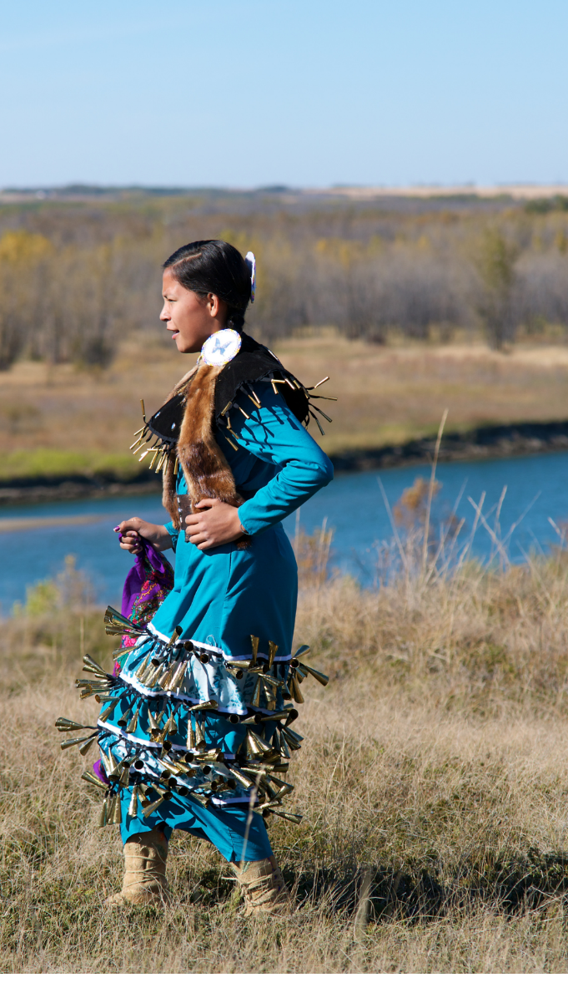
Gender-Based Violence Research: Risk and Danger Assessment Tools
Risk Assessment and Danger Assessment Tools: Surveys and Focus Groups
94% response rate to the post-training surveys
Survey Monkey for quantitative and NVivo for qualitative analysis
Survey analysis is providing feedback on the mainstream assessment tools regarding indicators of risk and danger reflective of First Nations communities and any gaps
Additional input will be gathered from focus groups by early 2024 to refine the indicators and draft a First Nations toolkit for assessing risk and danger that will inform safety planning
Next Steps
Phase 3 and 4 in development - creating and implementing the database system in communities through a pilot project

Slide 36
Gender-Based Violence Research: Risk and Danger Assessment Tools
Risk Assessment and Danger Assessment Tools: Lessons Learned - Data
First Nations domestic violence may go unreported due to lack of trust in police; need for accurate data is critical
Need external governments to work with Ontario First Nations to identify data sources (e.g. MMIWG2S+; domestic assaults) and ensure First Nations data sovereignty principles in establishing systems to track the issue so that progress can be measured
As implementation of National Action Plan on MMIWG continues First Nations will advocate for systems to standardize and coordinate the data they are gathering based on OCAP principles
In the meantime we will continue to work on developing tools to assist First Nations communities in this work
Miigwech, Nia:wen

