Slide 1
Aanish Naa Gegii: the Children’s Health and Well-being Measure (ACHWM)
Diane Jacko, Health Services Director, Naamdwechige-Gamig, Wiikwemkoong Health Centre
Sydney Chabot-Hamden, Community Outreach and Communications Coordinator, ACHWM
October 26, 2023

Slide 2
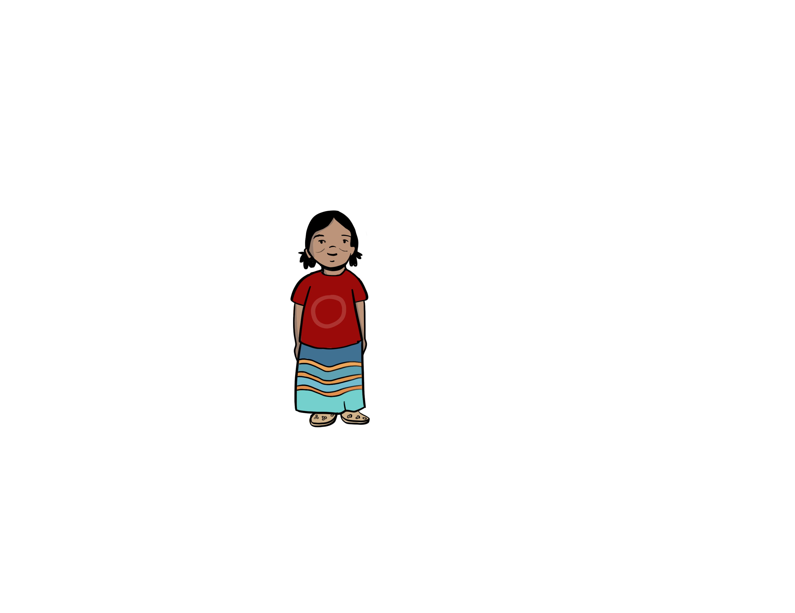
ACHWM
Aaniish Naa Gegii : the Children’s Health and Well-being Measure
A self-reported, tablet-based wellness assessment tool
With and for First Nation, Inuit and Métis children and youth (8 to 18 years of age)
Generates information for each community
Locally controlled; Numerous usages for data
Rooted in medicine wheel teachings
Spiritual, Emotional, Physical, Mental
Notes:
Diane

Slide 3
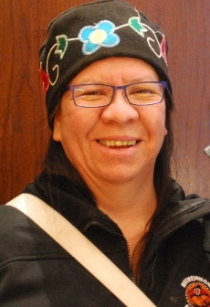
Origin of the ACHWM
2009
2010 - 2011
Present
A partnership developed between Indigenous health leaders and academic researchers to incorporate traditional wisdom and ensure scientific credibility
Intent was to ensure the relevance for Indigenous children across Canada
Indigenous Ways of Knowing
Western Science
Mary Jo Wabano
Nancy L. Young
Notes:
The trailblazers in this work were Mary Jo Wabano, who was the Health Services Director at the Wiikwemikong Health Centre back in 2010 and Dr. Young, a measurement scientist, who was at Laurentian University at the time.
Mary Jo has now moved on and works at Indigenous Services Canada and Dr. Young has moved to CHEO RI as a Senior Scientist.

Slide 4
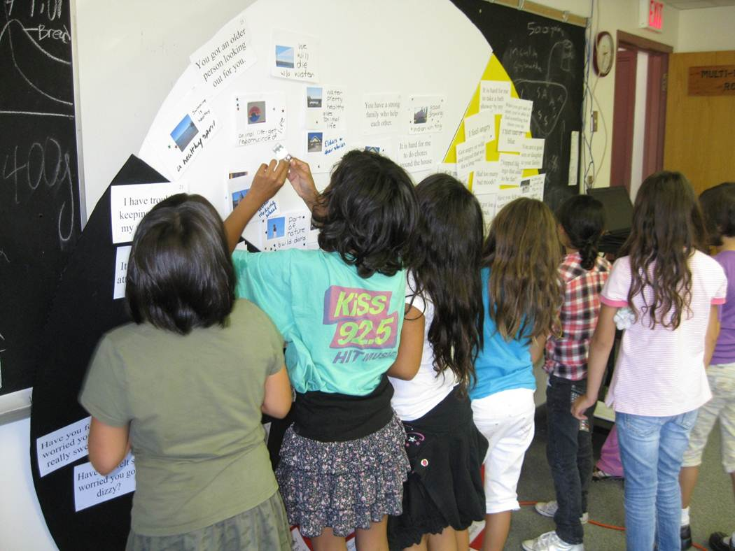
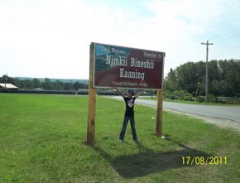
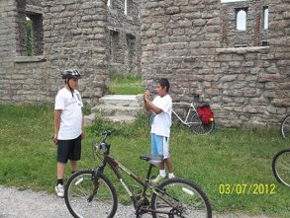
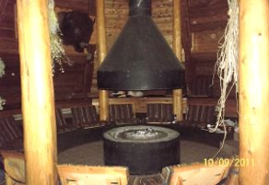
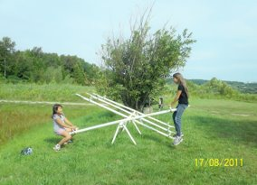
Photovoice Activities
2009
2010 -
2011
Present
Notes:
38 children in Wiikwemkoong
Selected the best photos
Gave a name to each photo to describe the wellness concept
Assigned the photos/concepts to quadrants
58 questions related to health and wellness were developed
with 4 more added later by other communities
Guided by an Advisory Committee
2 open ended questions, and 2 more questions added by Inuuqatigiit, Ottawa Inuit Children’s Centre
The advisory committee consisted of an elder, parents, teachers, and local health workers
--------------------------------------------------------------------------
Young NL, Wabano MJ, Burke TA, Ritchie SD, Mishibinijima D, Corbiere R. A Process for Creating the Aboriginal Children’s Health and Well-Being Measure (ACHWM). Canadian Journal of Public Health. 2013 Feb 25;104(2):e136-e141. URL: http://journal.cpha.ca/index.php/cjph/article/viewFile/3636/2776

Slide 5
Assessed the Fit in Other Communities
2009
2014 -
2015
Present
Weechi-it-te-win Family Services June 2014
Métis Community in Sudbury July 2014
M’Chigeeng First Nation August 2014
Whitefish River First Nation October 2014
Ottawa Inuit Children’s Centre January 2015
(Now: Inuuqatigiit Centre for Inuit Children, Youth and Families)
Notes:
Diane
We do have a few ongoing adaptation projects happening as well as hope to have done.
Little Kids ACHWM for children between 4-7 (just passed REB)
Older Youth 19-29
Iqaluit Project
Madawaska-Maliseet First Nation in New Brunswick
“Assessed the fit with other organizations. Weechi-it-te-win FS, one of the least research friendly communities, but it succeeded because we let the children lead the process” - Nancy

Slide 6
Extensive Community Engagement
2009
Present
Repeated and continuous feedback from a variety of sources
Responsive to communities
Timely changes to ensure relevance
Help us stay grounded in culture
Children and Youth
Health and Education Leaders
Chief and Council
Notes:
Diane

Slide 7
Knowledge to Action
Notes:
Sydney

Slide 8
Co-created a custom app
2009
2014 -
Present
To enable children to self-report, efficiently
Enhances engagement in the process
Non-judgemental
No delays in entering data
Generated reports immediately
Stores de-identified data on a REDCap server
Controlled by agreements
Notes:
Sydney
In 2014 was the co-creation of the ACHWM app. The app was created so children have the ability to self-report in a non-judgemental and engaging way. While some children may have concerns about sharing information to workers, we found that many children were comfortable sharing information with the tablet. The tablet also facilitates the data gathering process for local staff as there are no delays in data entry and reports are generated from the data immediately after the child finishes the survey.
Depending on the agreement type the community chooses, the information collected from the child will be later uploaded to the redcap server for safe storage. We will talk more about agreement types later in the presentation

Slide 9
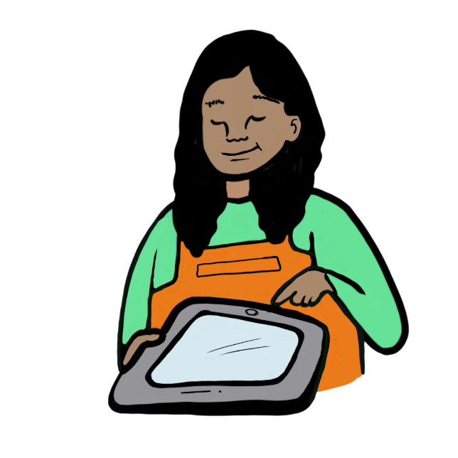
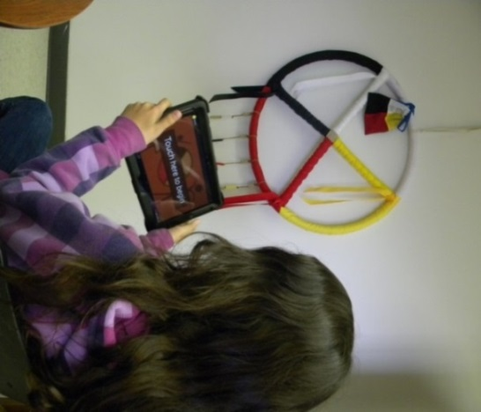
ACHWM App continued …
Completed by children independently using a tablet in 10 to 15 minutes
No data entry
Produces scores that are:
shared with each child on a balance chart
shared with a local health worker in a brief report
shared with the community in an automated report based on pooled data
Connects children at “potential risk” to a local safety net
*Reminder: the ACHWM is not a diagnostic tool
The ACHWM is a wellness tool
Notes:
Sydney
The survey is completed by children in about 10-15 minutes.
The measure produces data that is then wrapped in different packages, one for the children and youth, one for the local health worker and one for community leaders and health and education administrators (again, depending on agreement type)
The goal of the ACHWM measure is to connect children and youth to a circle of care and empowerment. This triage process is not only to connect children and youth who may be struggling and need supports, we also want to encourage communities to connect children who are doing well. For example, if a child receives a score indicating they have great spiritual health, they could be connected to other culturally rooted groups within the community to help develop that skill and help them find a sense of belonging within their community.
We also say the app connects children at “potential” risk. We have a wide safety net, the reason being is that we would rather identify children who may not need additional support, than to miss children who do.
Just a reminder, the ACHWM is NOT a diagnostic tool. It is a wellness tool

Slide 10
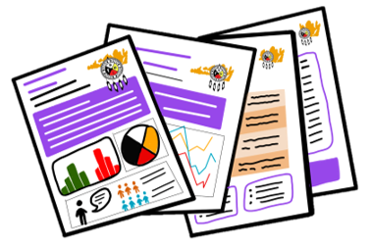
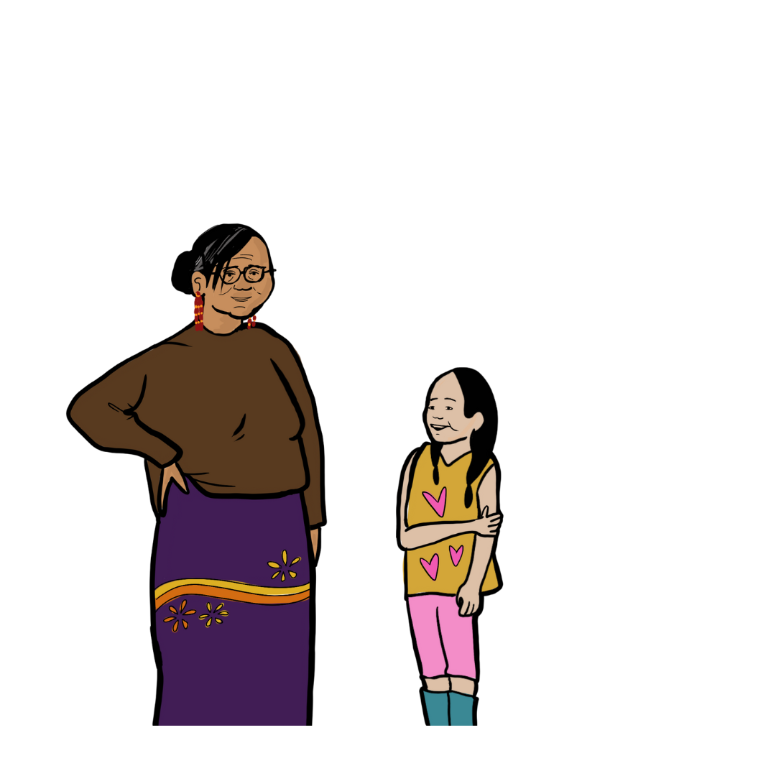
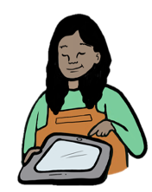
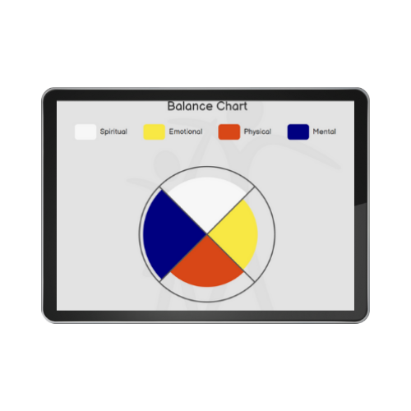
Layers of Data
Health and Education Administrators
ACHWM
Local Supports
Children and Youth

Slide 11
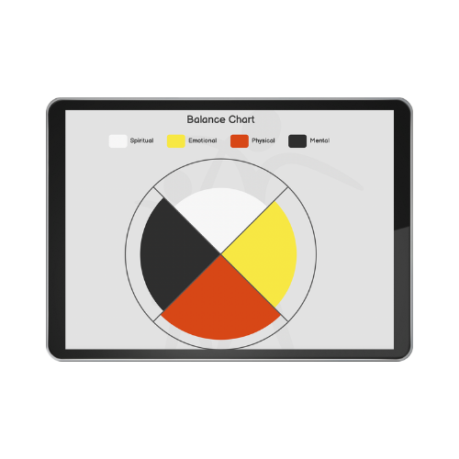
Balance Chart
Children and Youth: Strengths-Based Conversations
The Balance Chart provides children/youth a real-time visualization of their strengths and opportunities by highlighting four areas of health:
Spiritual,
Emotional,
Physical, and
Mental (intellectual)
Notes:
Sydney
After the child fills out their questionnaire in the app, they get a visual representation of what their scores look like. We call this the balance chart. Rooted in medicine wheel teachings, the balance chart shows children and youth where their strengths are and where they could use some support to continue developing. Go through colours
The Balance Chart offers real-time results in a visual form which highlights our four areas of focus in Indigenous children's wellness; spiritual, emotional, physical, and mental (intellectual) health. This is a visual way to show children and youth survey scores in a non-judgemental way
This tool is valuable when the local health worker has conversations with the child in regards to their strengths and opportunities. By focusing on what the child does have, not what they lack, the chart creates opportunities for children to build confidence and use their strengths

Slide 12
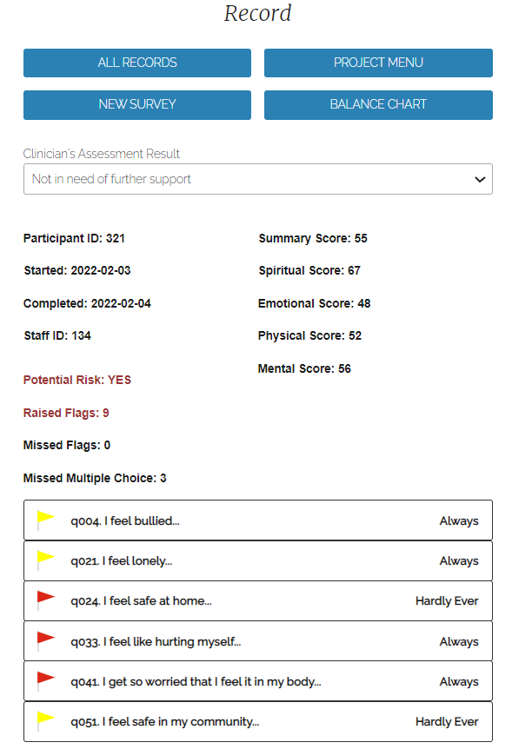
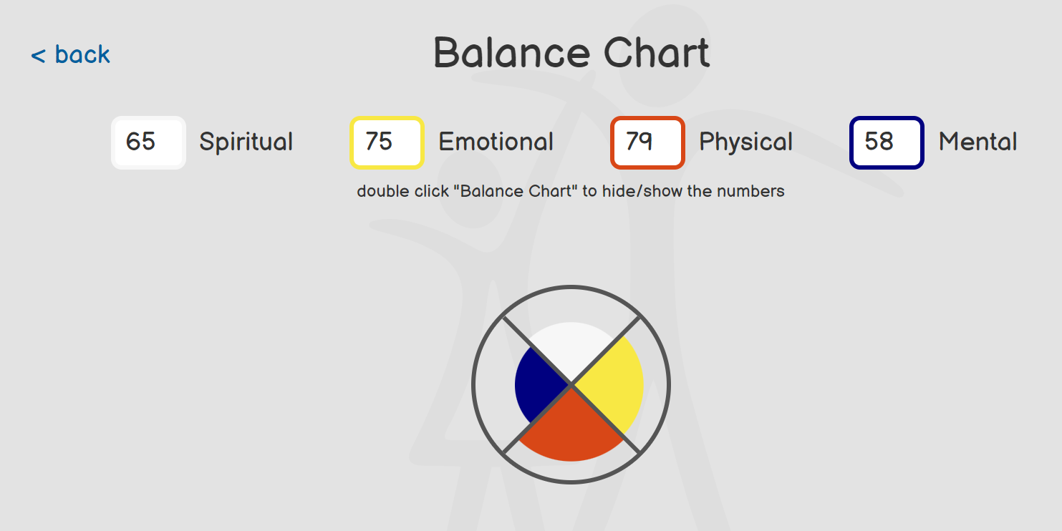
Local Health Workers: Individual Participant Summary
Notes:
Sydney
Also see the balance chart when reviewing it with the child. In their own time, if the balance chart title is double clicked, the legend that shows how the colours correspond to each quadrant turn into number scores. This is hidden for the child so they don’t focus on the number, but instead see only the visual. The local worker also sees this brief assessment that is generated after the questionnaire is complete. This assessment shows where there could be potential risk. There are questions that the youth wanted to include that were deemed necessary by staff at the Nadmadwin clinic to flag to ensure the child was connected to support if necessary. There are some responses that when chosen raise a red flag, and others that raise a yellow flag. If the child has one red flag or two yellow it warrants a follow up convo with a health worker

Slide 13
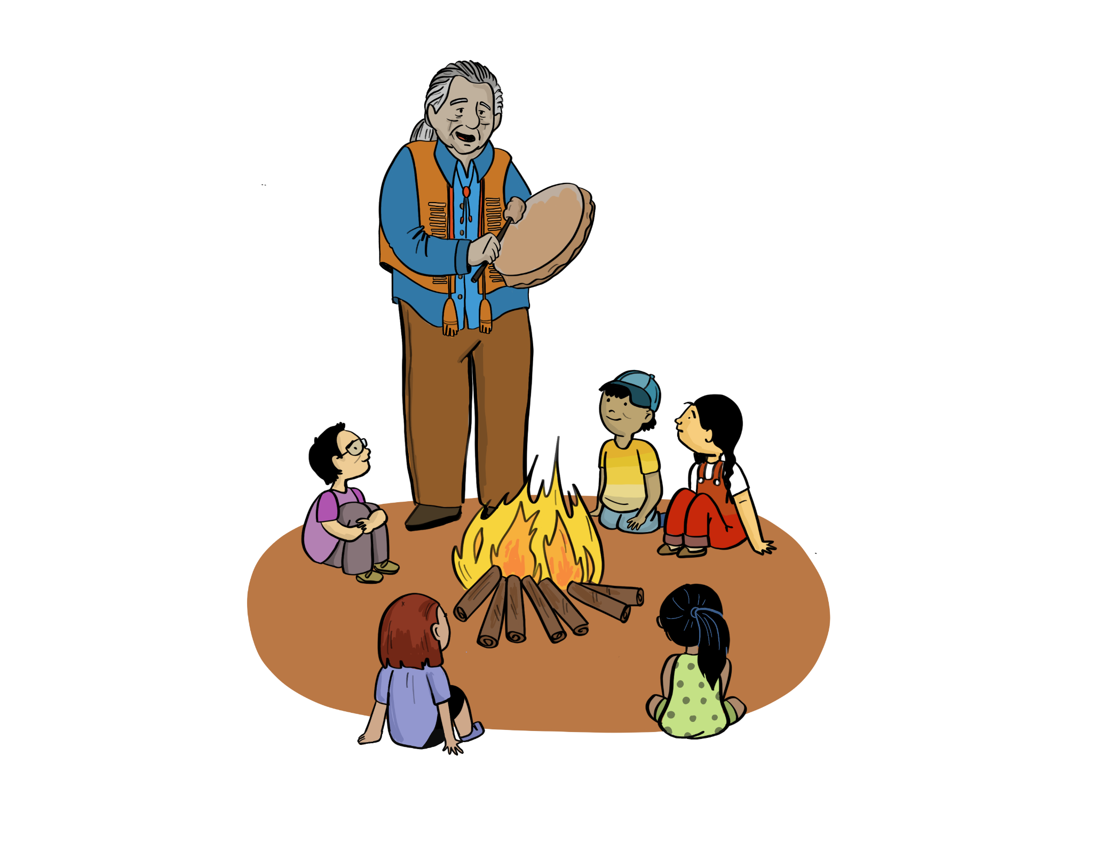
Local Health Workers are Essential
Chose someone with the skills and preparedness to support children and youth at all levels of need
Prepared to have brief conversations with the children/youth
Trusted within the community
Knowledge of community resources
Able to connect to natural helpers
Crisis support skills
Examples: Elder, counsellor, social worker, nurse
Notes:
Sydney
Choosing a LHW is not based on academics. The LHW needs to be someone that the local leadership believes has the skills and preparedness to support children/youth at all levels of need, ranging from early support to crisis.
Some essential qualities of the LHW include:
Connections to natural helpers
Knowledge of resources/supports available in the community
Crisis intervention skills
Preparedness for brief conversations with the children/youth
Trusted within the community: someone who the children/youth will feel comfortable opening to
Some examples of LHWs include: Elders, counsellors, social workers, guidance counsellors, nurses, etc.

Slide 14
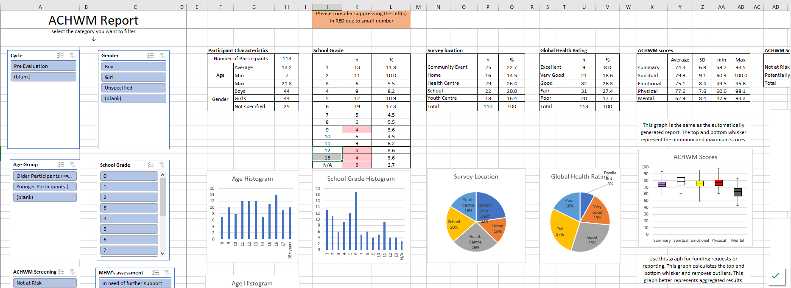
Community Leaders/Administrators: Aggregated Reports
Aggregated Report
Analytic Spreadsheet
Database
Notes:
Sydney
Depending on agreements
Analytic spreadsheets and aggregated reports and a database that combine many childrens data. We wanted to provide multiple formats of data so communities can look at data in a way that is beneficial and impactful to them and their needs
Helps to make decisions about services and needs within the community

Slide 15
Data Sovereignty and Management
Notes:
Sydney

Slide 16
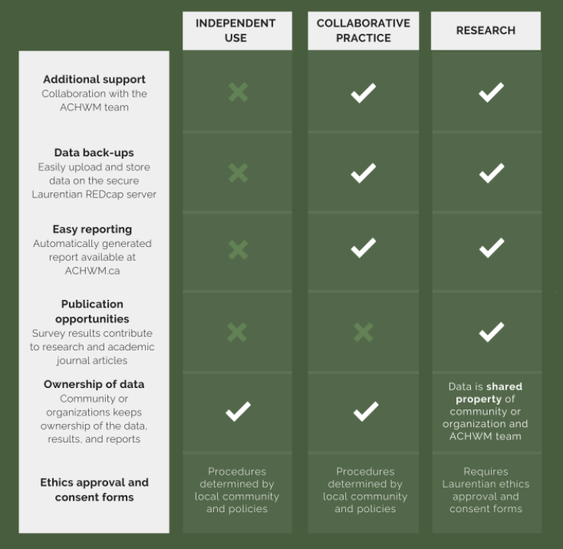
Agreement Types
Give communities choice
They decide how they want to control the data/survey results
Communities can choose how they want to use the App.
Notes:
Sydney
Agreement types Ensure clear understanding of responsibilities
Community is responsible for
Children’s well-being
Providing local health resources
Ownership of data
ACHWM team is responsible for
Stewardship of the data
Providing resources via the website

Slide 17
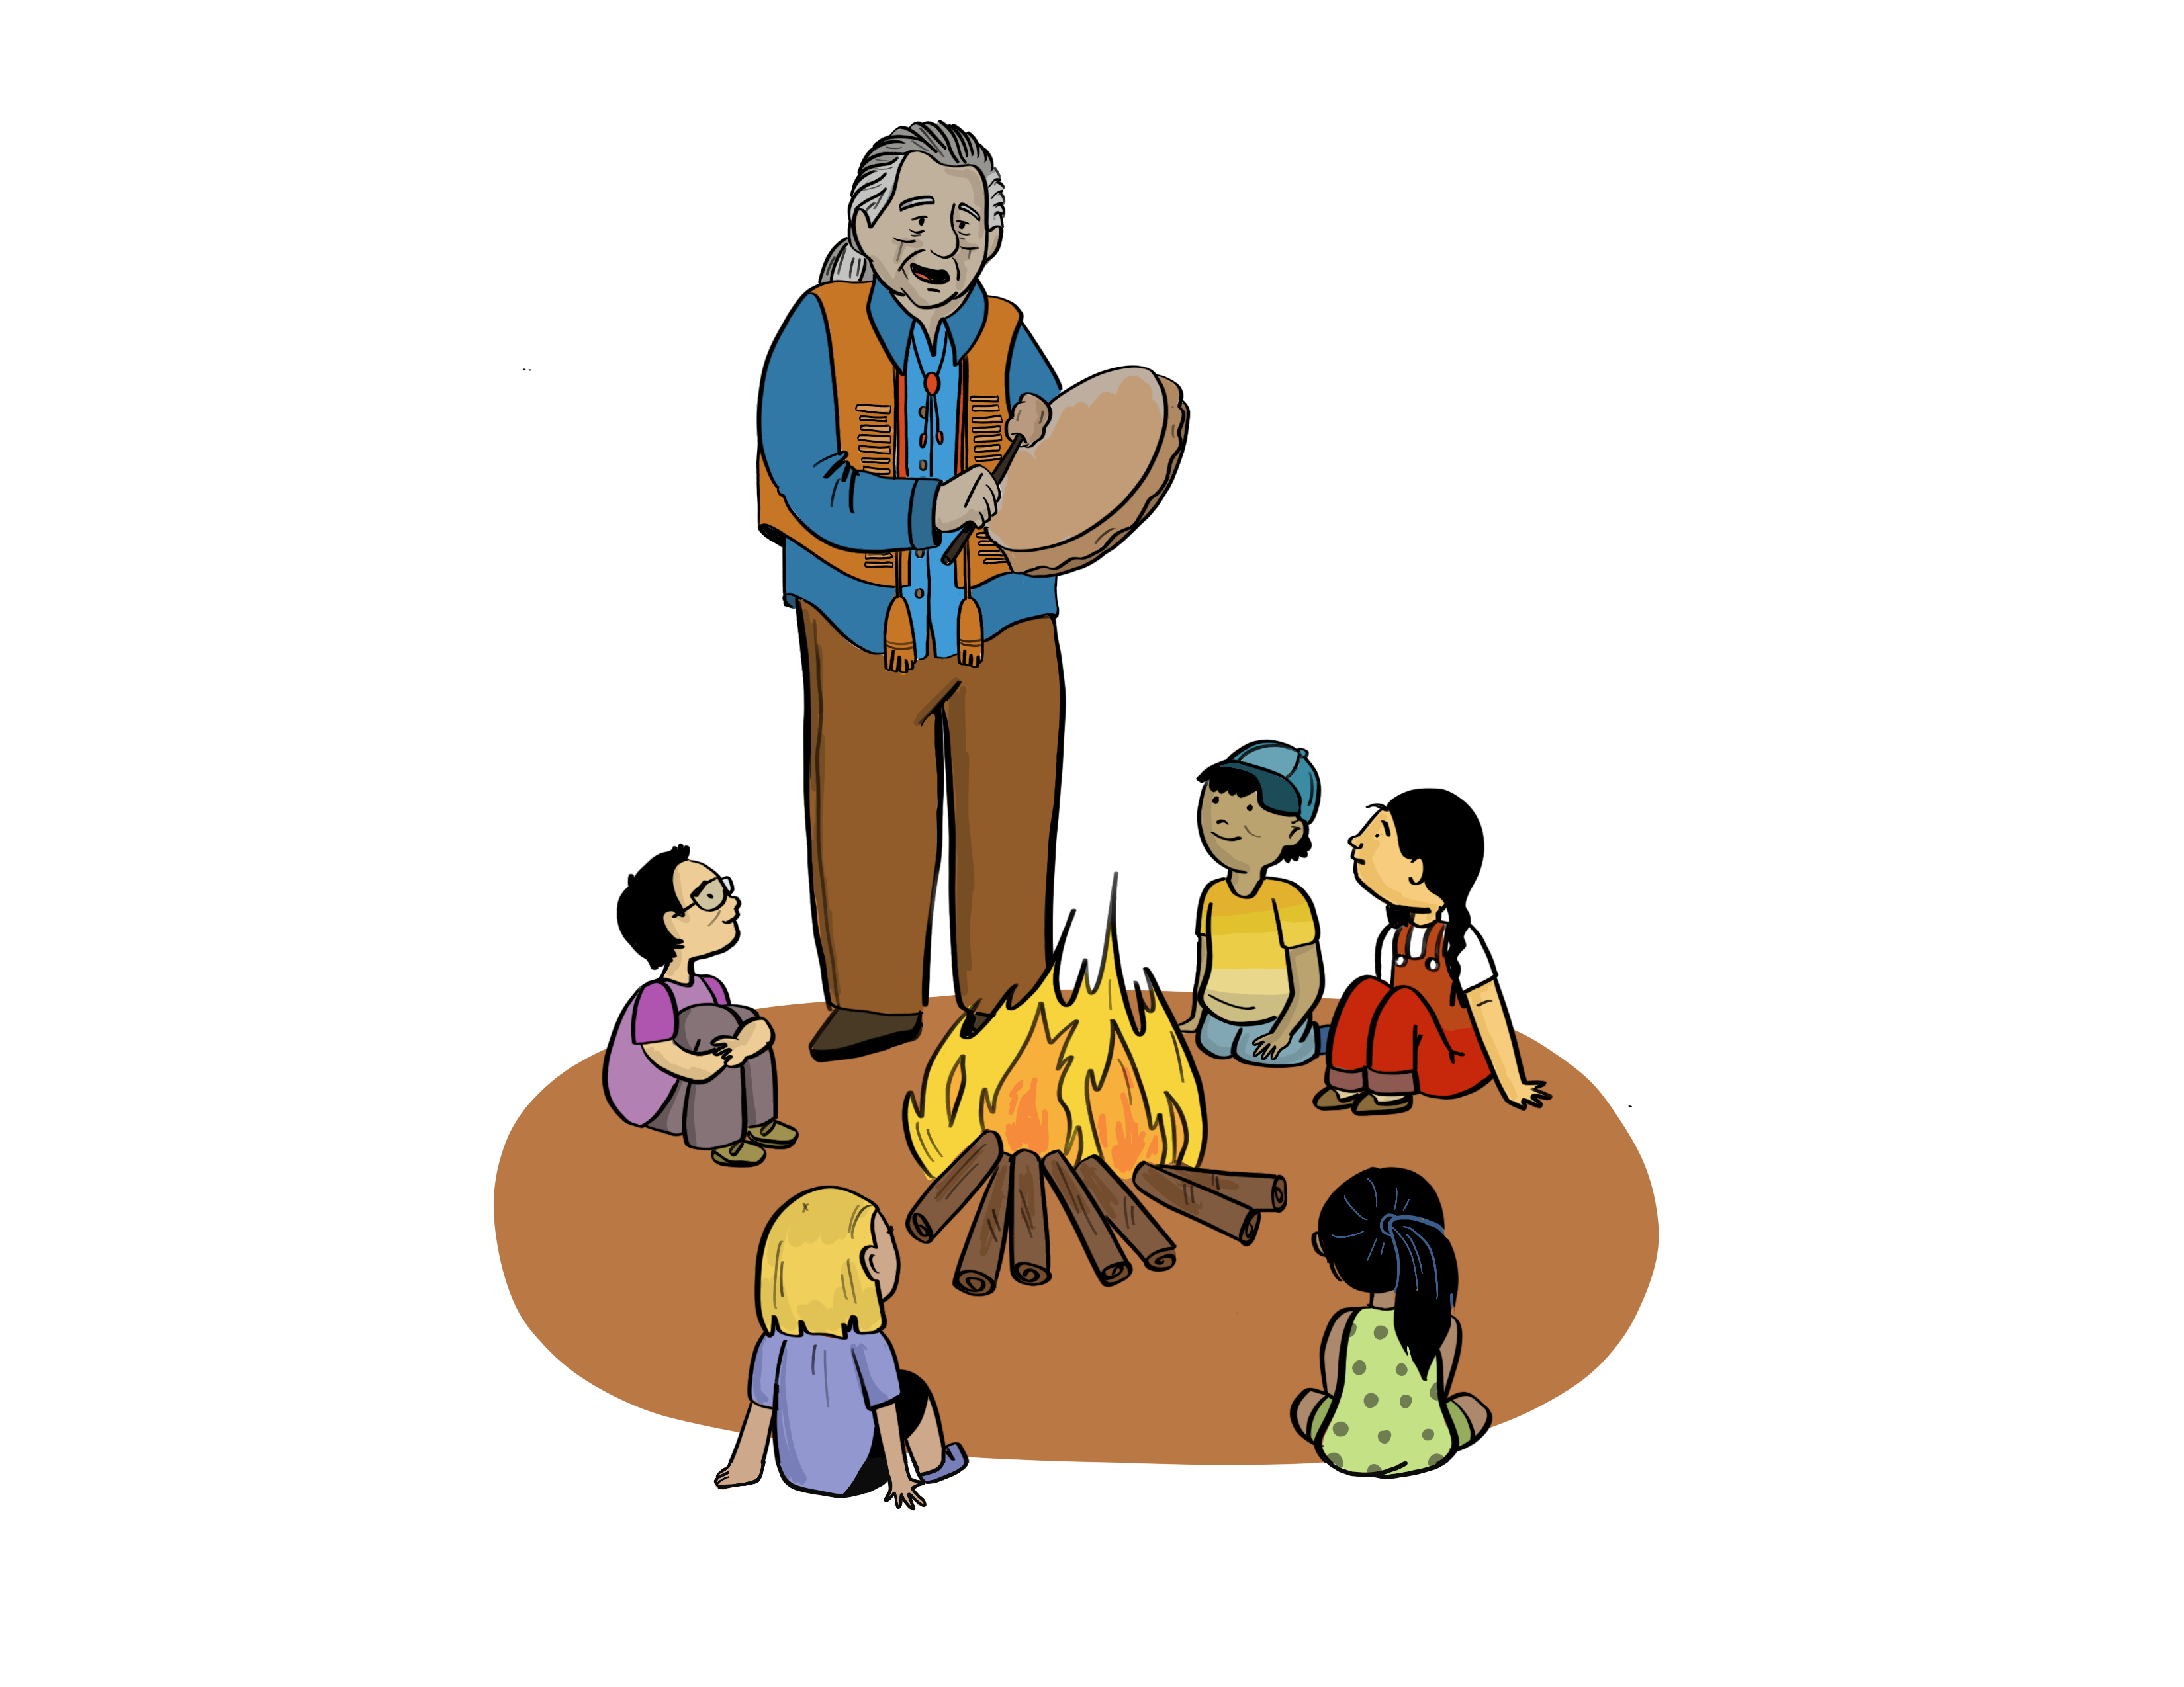
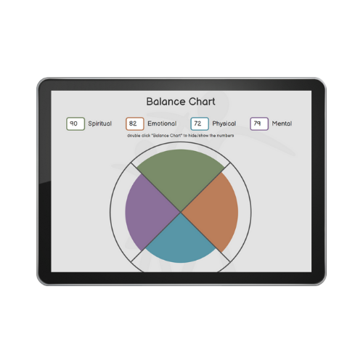
Flow of data
Aggregated data report is created
Final report informs local programming
Upload/save data over Wi-Fi
ACHWM
Implementation
Child completes survey
Results are displayed
Brief Assessment
Notes:
Sydney
1, 2, 3 are all on the app; 4 is the data transition to redcap through the web server; 5 data pulled from redcap to the webserver to generate the report.
4. 4 and 5 are external.The app submits data to the web server, which sends the data over to redcap and does not store it locally. For data aggregation in reports, data is pulled from the redcap server temporarily to generate the report for the community. The community can access their own data through the member portal and either download it or view it in report form. Data is de-identified from the beginning of the process. Data is uploaded de-identified. Community can attach information to a child but no one else. We collect the gender, year and month of birth, and age

Slide 18
ACHWM and the OCAP Principles
Ownership
Setting up projects
Separating data by community
Control
Adding or removing team members
Removing data from the REDCap server
Access
Reporting controlled by passwords (online)
Possession
Storing and backing up on an academic server
Downloading via password protection
Notes:
Sydney
What I just covered was a brief summary of the ACHWM and what we stand for. Data sovereignty has always been a key part of the ACHWM, we strive to meet ocap standards by incorporating these aspects into all our process, including on the ACHWM app and web portal
These are some ways in which we apply the ocap principles to the ACHWM. Setting up projects that meet their needs, take all decisions for everything around their data, access is controlled around online password system
Possession – ask Diane what she thinks. In my opinion, part of data sovereignty to transparency. One of the drawbacks (synonym)? where we are looking to improve is communities housing their data within their own servers. There are a variety of reasons why this is a challenge on our team at the moment, but What we have created is an interim solution by housing the data in a central location. We are constantly looking to improve and I believe that a conference like this where there are so many brilliant minds in the room…
Point about Carol “data is one way of telling our story”.
We are looking into data being stored in each community.
Right now our system is set up to respond to the REDCap server; We could also work with multiple REDCap servers because it is standardized and our system knows how to communicate with it.
Challenges: REDCap needs an admin in each location. In the future we want communities to set up their own storage system, but it would have to be redcap to be compatible.

Slide 19
Community Experience and Impact
Notes:
Diane – whole section

Slide 20
Experience from the perspective of Wiikwemkoong Unceded Territory
The initiator for the ACHWM, full partners in the co-creation
Shaped the research funding proposals
Contributed to the research
Shared the results
Notes:
**Clarify with Nancy about point: shaped the research funding proposals (community experiences shaping the approach to evolving the measure and app); informed the methods (background, what do we want shared)
-Also the point about sharing more broadly, in research or proposals? Clarify
The initiator for the ACHWM
Full partners in the co-creation
Shaped the research funding proposals
Ensured the questions were relevant to our band members
Contributed to the research
Informed the methods – using bikes for kids to get around the communities, bringing in staff to chaperone the activity, bringing in elders for teachings; doing the intro in the medicine lodge; integrating culture in the right ways, consistent with the community
Shared the results
Community first - taking the results to chief and council, community members,
Then shared more broadly – sharing it in other communities, Mary Jo or Diane would be there for those sharing trips

Slide 21
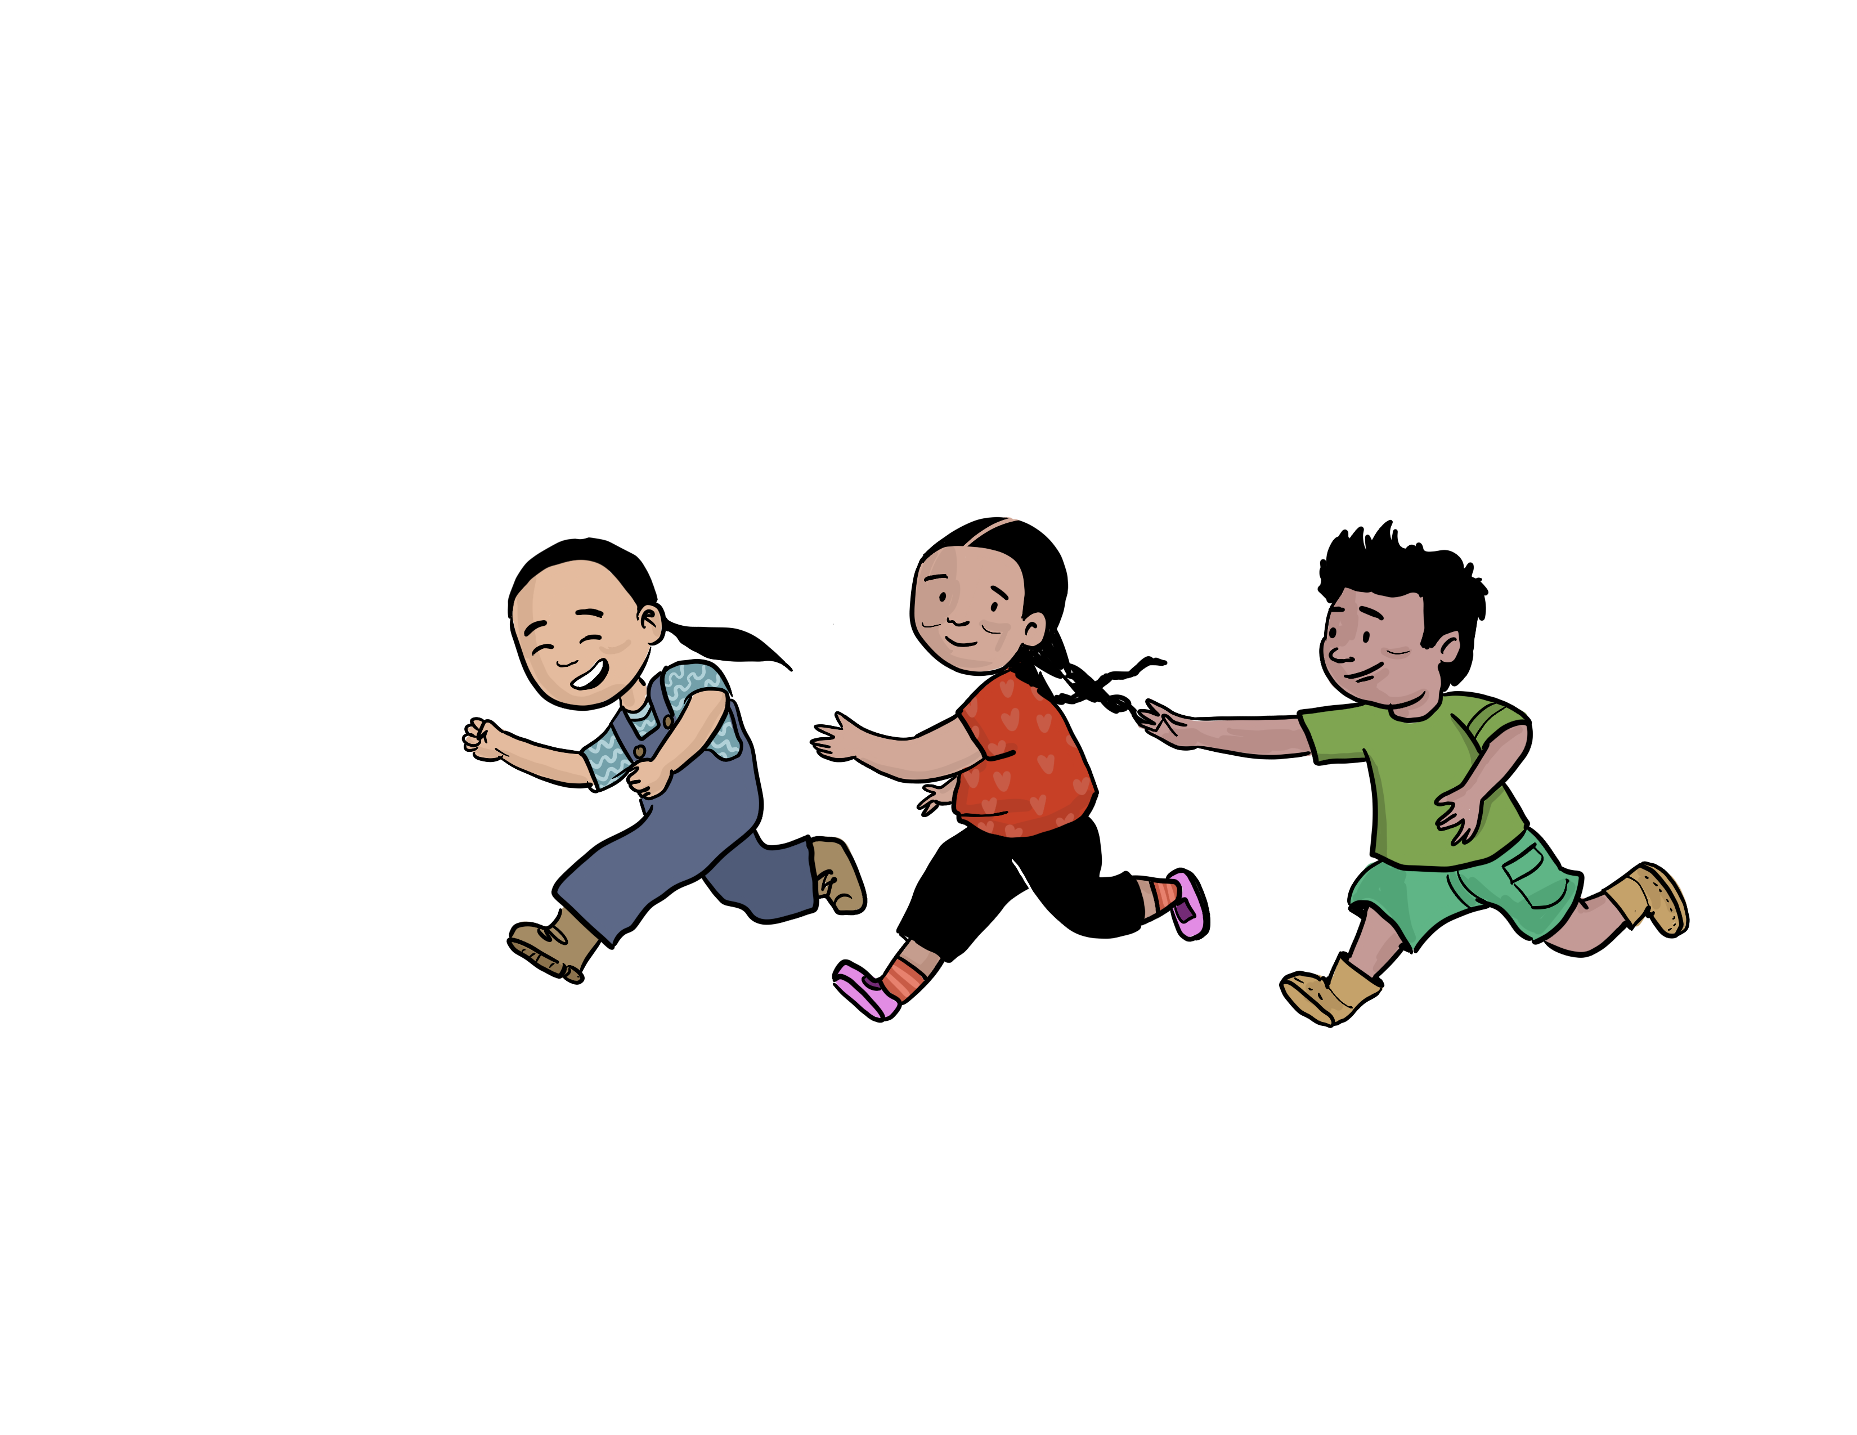
Research on our terms
Research for to promote wellness
Integrating Indigenous perspective
Research that answered our questions
Is the OALE program effective in promoting wellness?
How do scores change over time with local treatment?
How do we support younger children and adults over 18?
Notes:
Clarify: paddling upstream – Mary Jo phrase. Paddling upstream towards wellness. It is easy to go with the flow to where the river takes you, but it takes effort and intention to paddle upstream against the current.
Research for to promote wellness
Paddling upstream
Integrating Indigenous perspective
Research that answered our questions
Is the OALE program effective in promoting wellness?
Is community-based screening effective?
How do scores change over time with local treatment?
How do we support younger children and adults over 18?

Slide 22
How we have Used the Measure
Variety of settings:
Mental health, school health, youth centre, community events
Different purposes:
Needs assessment
Program evaluation
Conversation starter for individual counselling

Slide 23
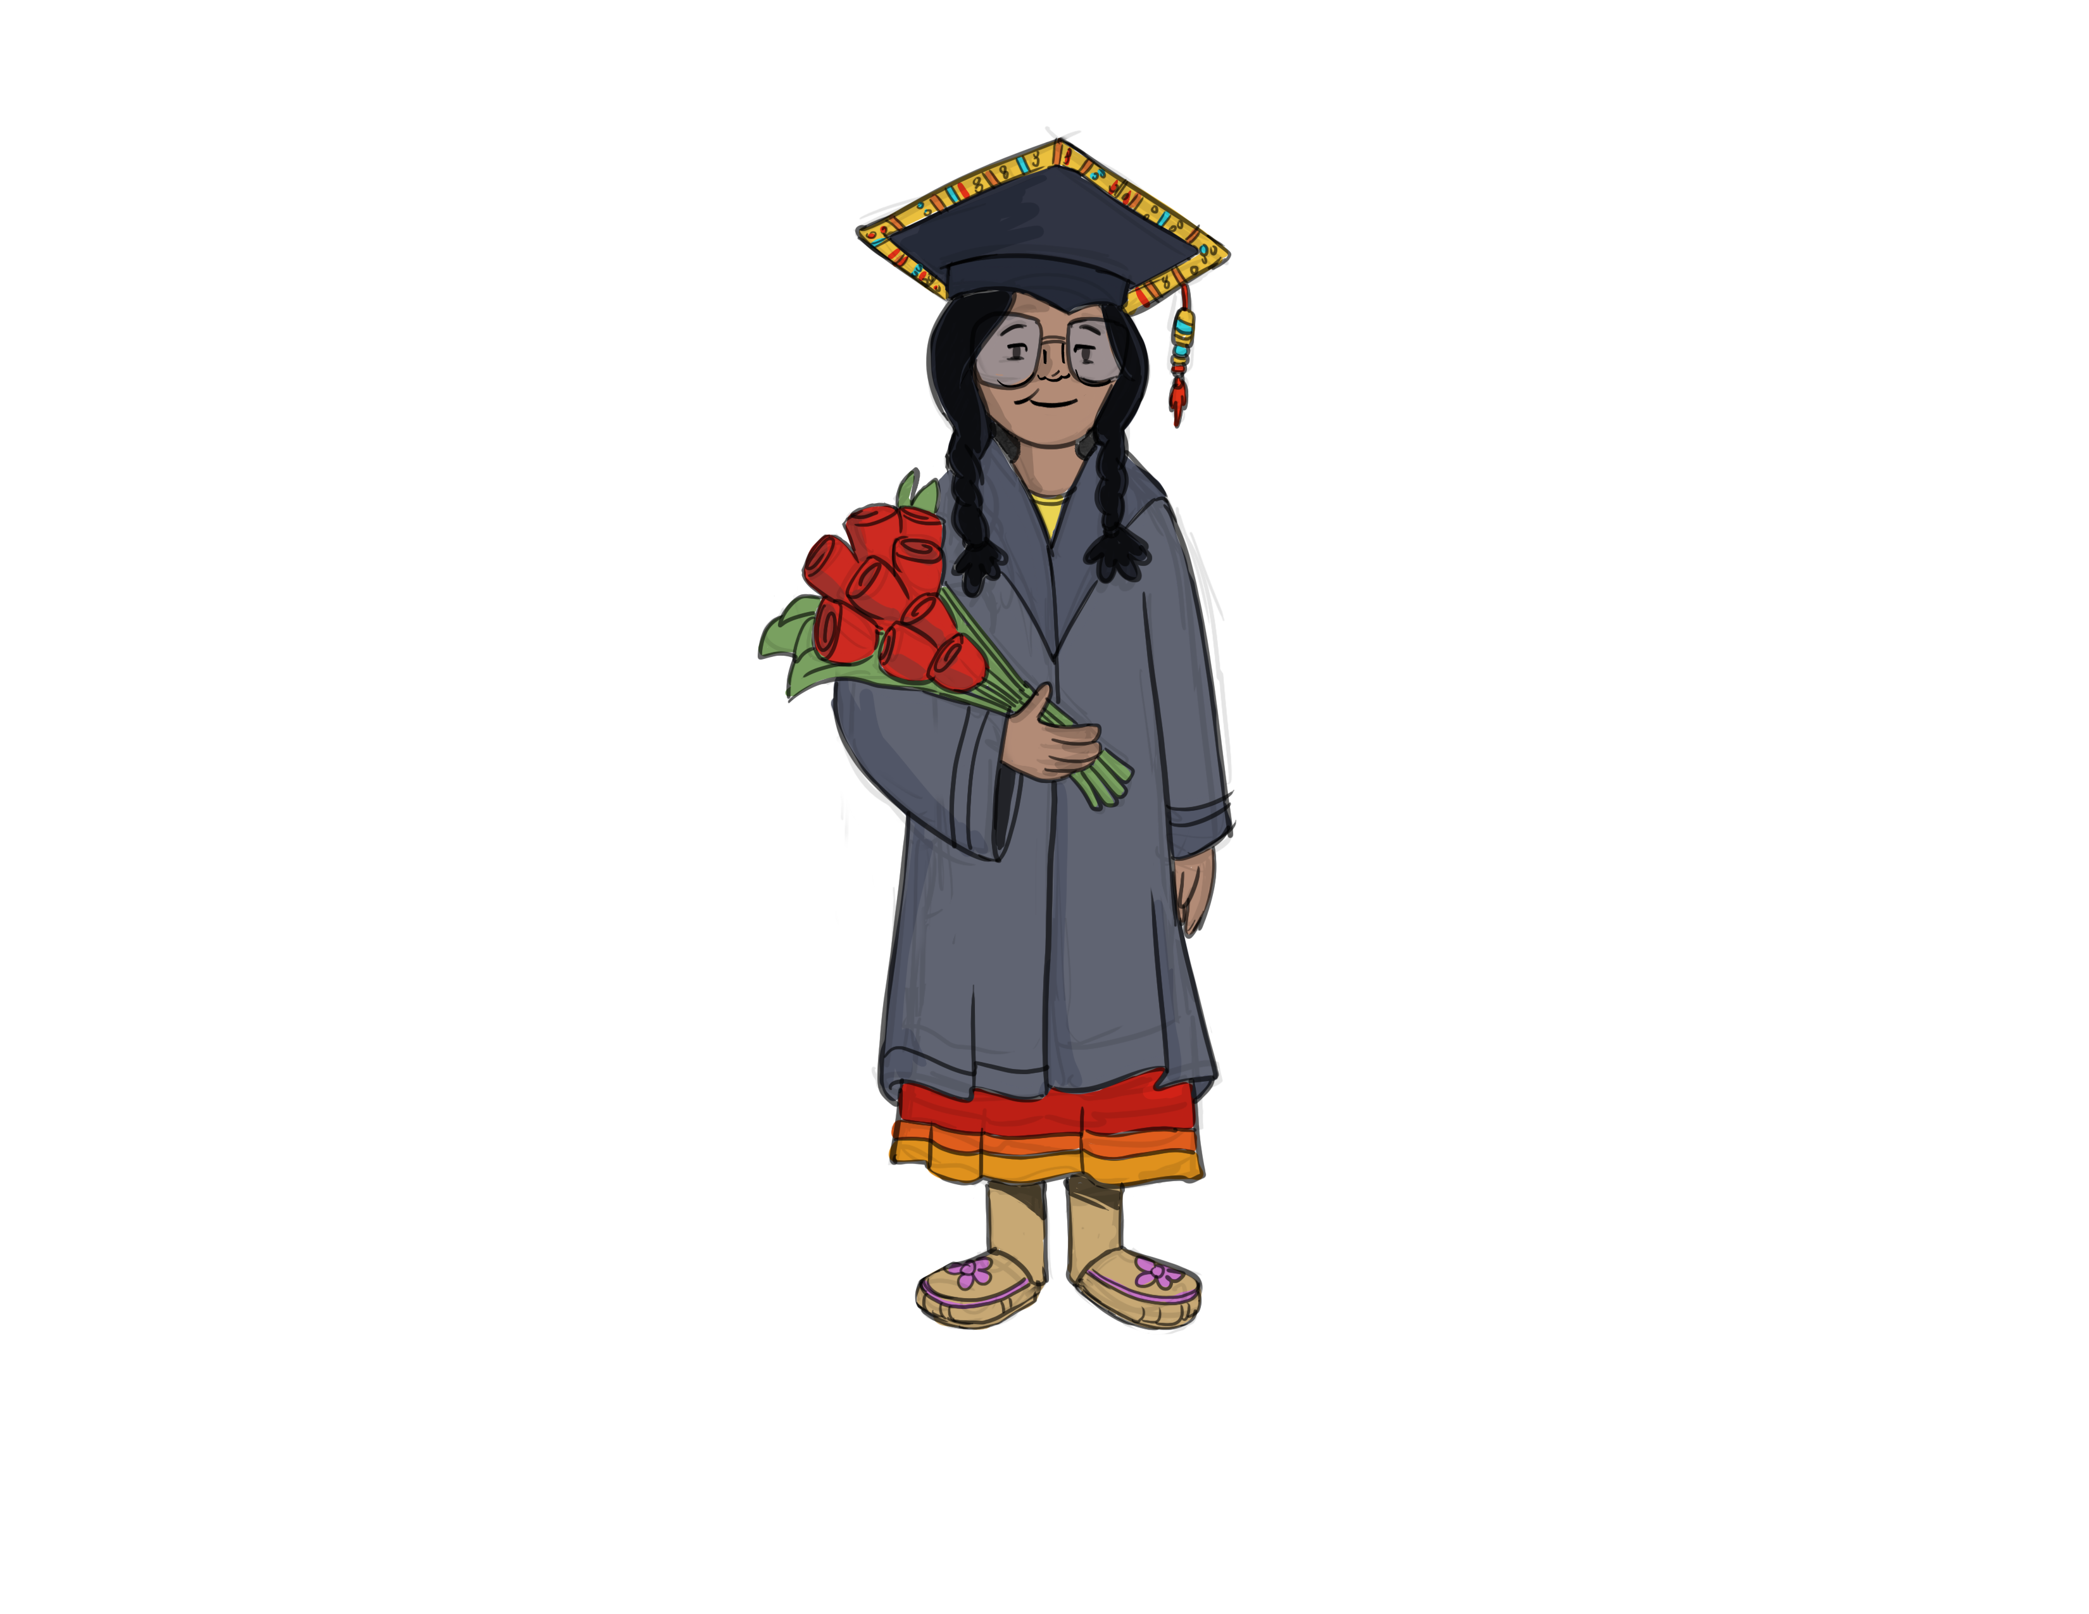
Reflecting on how data has supported our community
Informed health planning
Informing community planning
Proved the effectiveness of local mental health services
Notes:
Informed health planning
Reinstated anti-bullying lessons in specific grades
Informing community planning
Supported a proposal for a local shelter
Proved the effectiveness of local mental health services
Showed that local mental health workers improved the emotional wellness of 75% of their clients over one year
Mental health workers were most effective with those who were identified through community screening programs

Slide 24
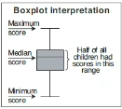
Changes in emotional scores over 1 year
Base-line
Follow-up
Base-line
Follow-up
Base-line
Follow-up
0
0
1
Outliers have been suppressed to protect the identity of children
0
8
EMOTIONAL SCORES
0
6
0
4
0
2
n=71
n=18
n=17
Healthy Peers
Newly Identified
Typical Treatment
GROUPS
Notes:
Recruited two groups of children, community-based sample and clinical sample. Community sample was broken into healthy peers (don’t need mental health support - green) or newly identified (need mental health support and have not received any support - yellow). Pink group was getting mental health services from Nadmadwin mental health. All participants completed the ACHWM at baseline and then about a year later.
Box: middle line is the median. The box itself is 50% of the participants. The Ts are the whiskers, 25% in each one (top and bottom), Outliers were removed to keep data confidential.
Green: Over a year, the healthy kids didn’t change. Went down slightly but that is as expected with aging.
Yellow: Moved up about 8% or so.
Pink: improved, but not as much as yellow
Means: local treatments at Nadmadwin are effective. The app is able to pick kids out who need support and refer them to services earlier than they may have otherwise been.
graph box emotional0 emotional1 if Include_Q2==1, over(Group) yscale(range(0 100)) yline(74.1, lwidth(thin) lcolor(purple))
Horizontal line shows the mean of 74.1 from Mary Jo’s profiles paper
Note: Group B with no follow-up have a mean emotional score of 67.9, C with no follow-up have 67.9, and Group A was 78.1

Slide 25
Reporting back to communities:
Result are always shared with children and youth participants
Shared locally within the community
Shared external to the community
Conferences
By the ACHWM Outreach Team
Notes:
Can we get a picture of what the summary looked like?
How far has the measure reached – where have some of these conferences happened? – has been presented to those in NZ and Australia. The OALE was presented in Ireland. ACHWM screening paper was presented in Dublin in 2018
Research team takes results back to Chief & Council
Share at a Research Conference in the community
Result are always shared with children and youth participants
One-page summary in every mailbox in the community
Shared locally within the community
Shared external to the community
Conferences
By the ACHWM Outreach Team
Online, virtual visits, on-site support when invited

Slide 26
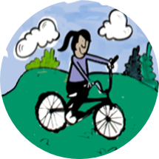
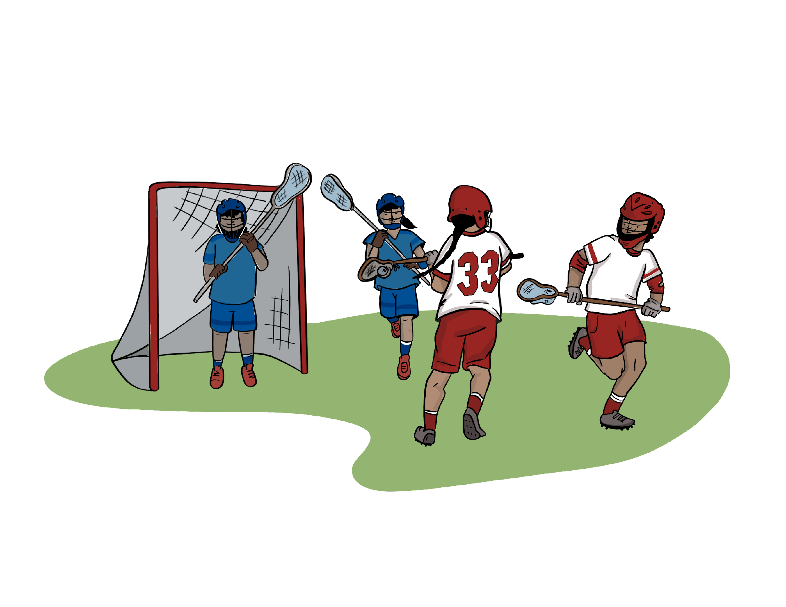
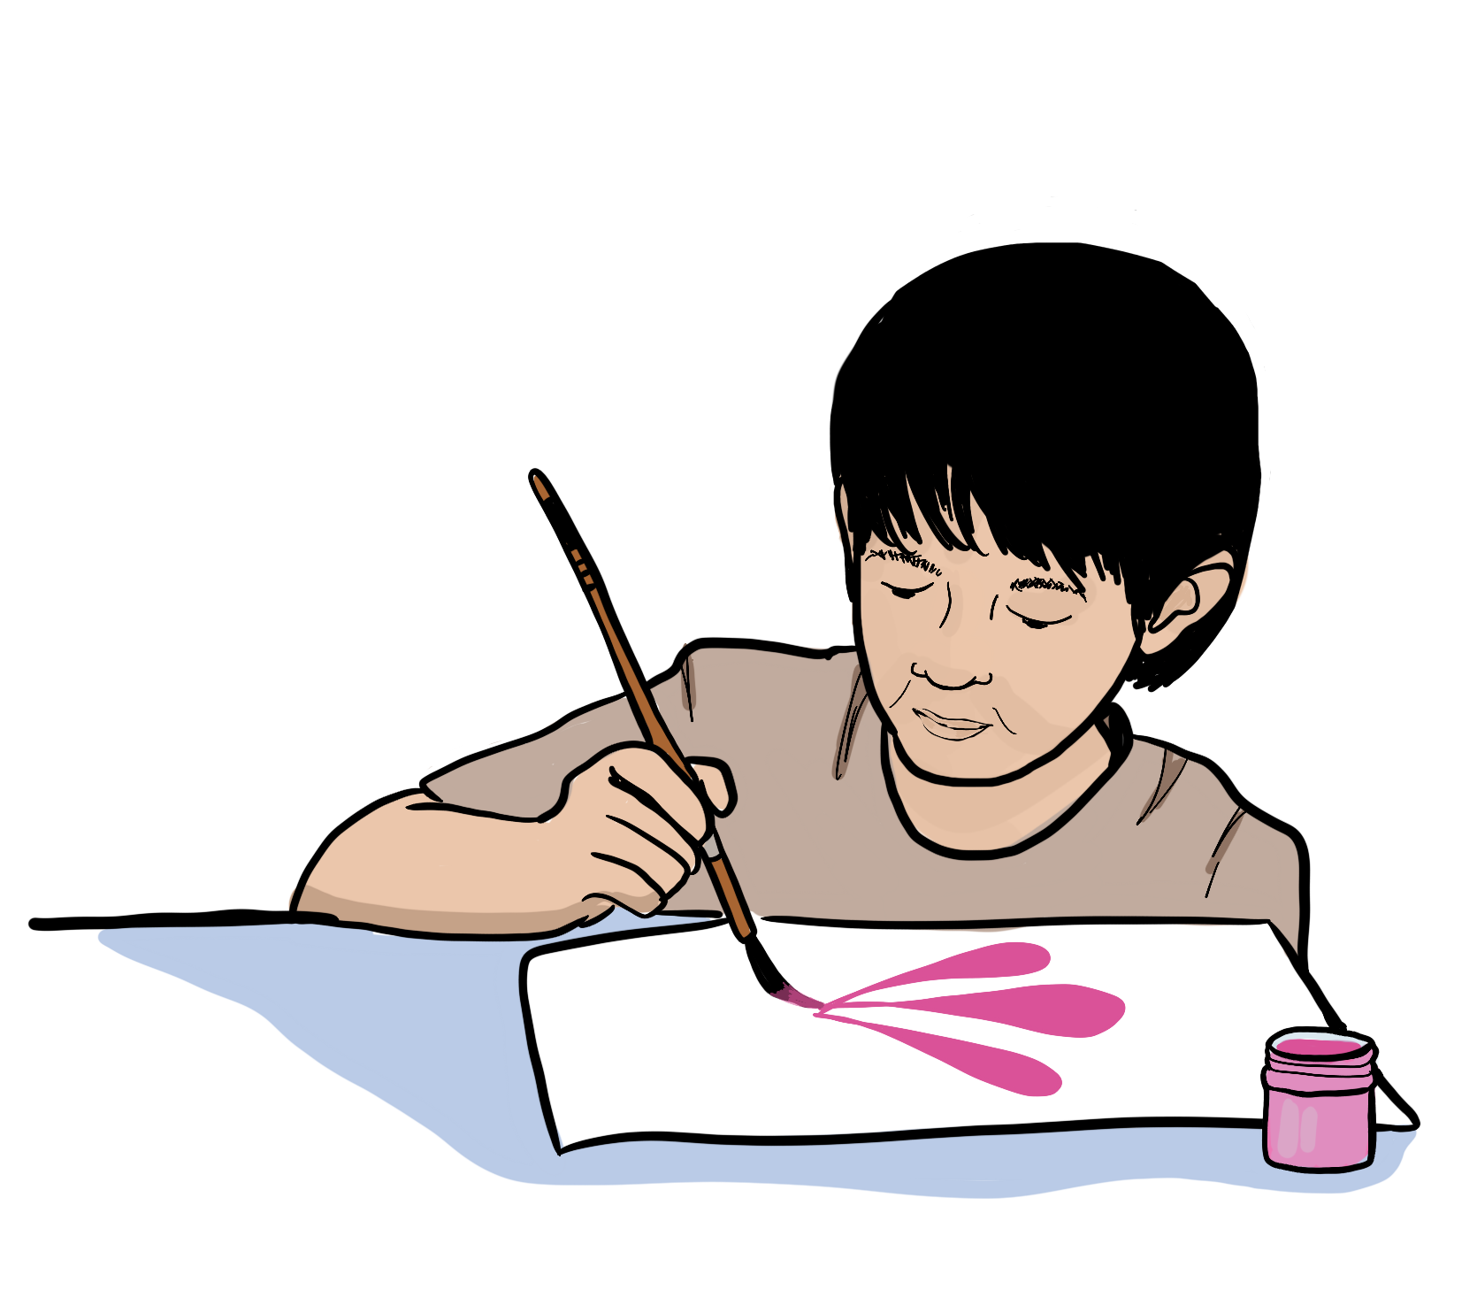
Empowering communities
Consider ways your community could use data to create change

Slide 27
Chi Miigwetch
To the many children and youth who shared their vision of health with us through this project;
The Elders, for their devotion to this project;
To the Health and Social Well-being Committee and Chief & Council for their ongoing support;
To the communities who have helped us along our journey
To the members of the Advisory Committee for their wisdom and guidance
Notes:
Both – Sydney and Diane

Slide 28
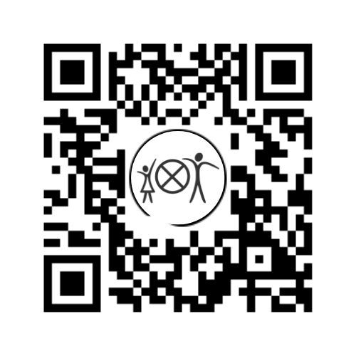
Stay in touch!
ACHWM@cheo.on.ca
@ACHWM
@ACHWM_official
@ACHWM_official
Notes:
Thanks for listening! Here is how you can get in contact with our team. ☺

