Slide 2
First Nations COVID-19 Scenario Model
Presented by Cal Stewart and Dr. Sharmistha Mishra

Slide 3
Summary of Todays Presentation
Background information about the model.
Reviewing how to input information into the model.
Reviewing how to use the scenario model to help your community.
Question period.

Slide 4
Background: What is the model?
Who Developed the model? The model was developed by the Chiefs of Ontario and a team of academic partners.
Why was the model created? The model was created to help First Nations communities to see the possible impact of actions they may take in their community to reduce the spread of COVID-19.
How does it work? The model will ask you to input information about COVID-19 in your community and current efforts to protect against it. The model will then show you the future potential impact of actions you may decide to take in your community.

Slide 5
The model is set up using a typical mathematical framework
Not infected
Exposed
Infected and may pass on infection
Recovered from infection
Mild
Severe
Fully vaccinated
(vaccinated)
Not infected
(vaccinated)
Exposed
(vaccinated)
Infected and may pass on infection
Recovered from infection
(vaccinated
Mild
Severe

Slide 6
What is different about this model from typical COVID-19 models?
Community
Community
Nearest Public Health Unit A
Community
Community
Nearest Public Health Unit B
…
Nearest Public Health Unit C
Community

Slide 7
Connections between communities
Connections between communities
Visual example only
Larger circles could reflect larger FN communities. Lines show the connections between FN communities.

Slide 8
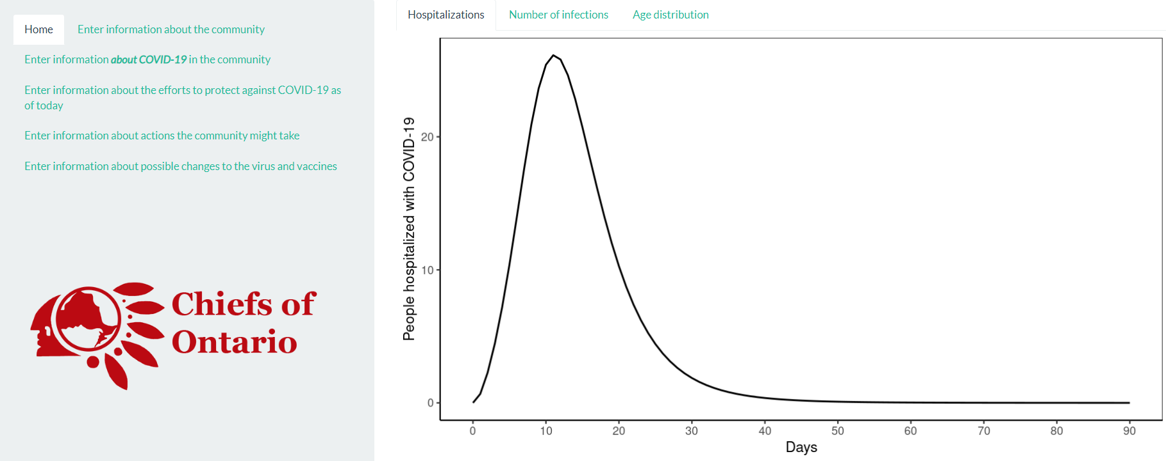
Using the Model: How to input information

Slide 9
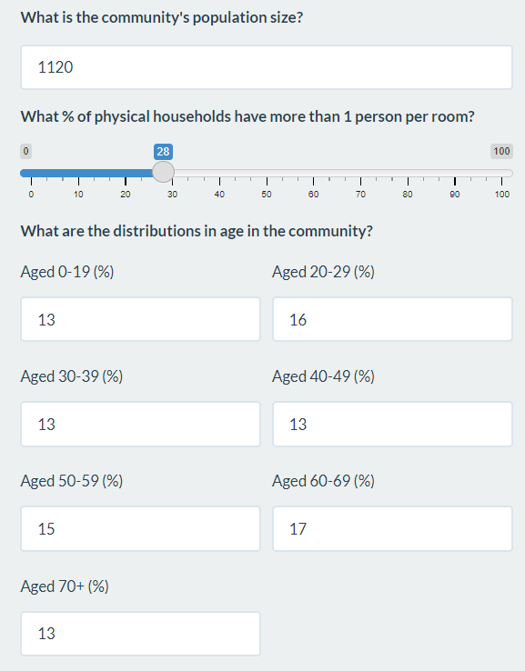
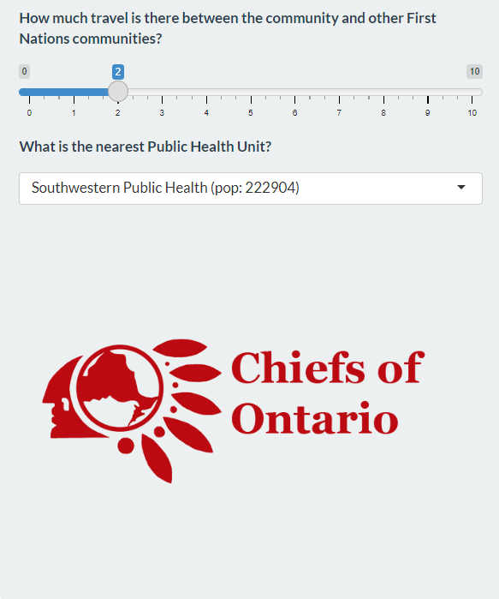
Section 1: Information about your community

Slide 10
Section 1: Information about your community

Slide 11
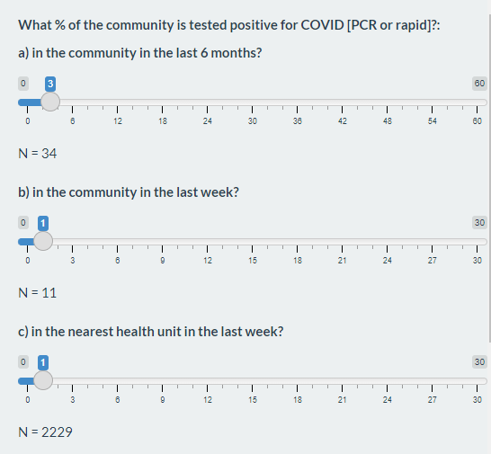
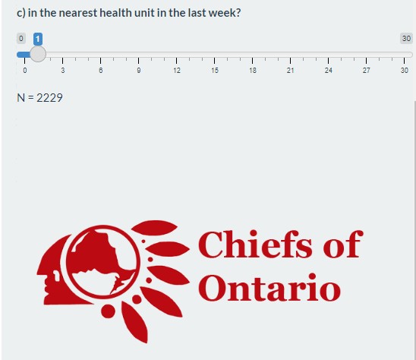
Section 2: Information about COVID-19 in your community

Slide 12
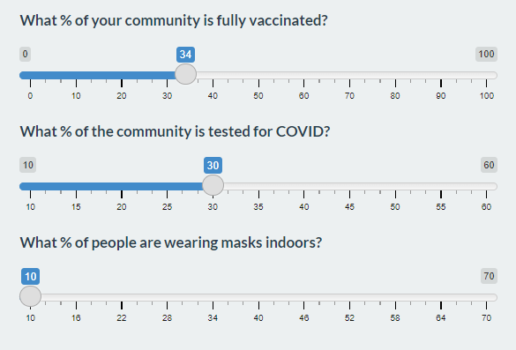
Section 3: Efforts to control COVID-19 as of today

Slide 13
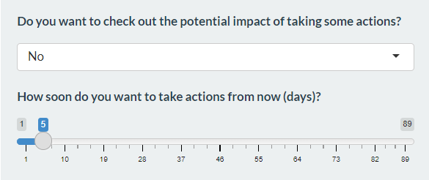
Section 4: Future actions your community may take
This section the model is designed to help your community see how certain actions may reduce the spread of Covid-19. By seeing how taking certain actions may impact hospitalizations and the number of infections, your community will be in a better position to assess which future actions to take
The model will ask if you would like to see the impact of actions your community may take. By selecting “yes”, it will create a new baseline. This can be moved by answering how soon you would like to take action.

Slide 14
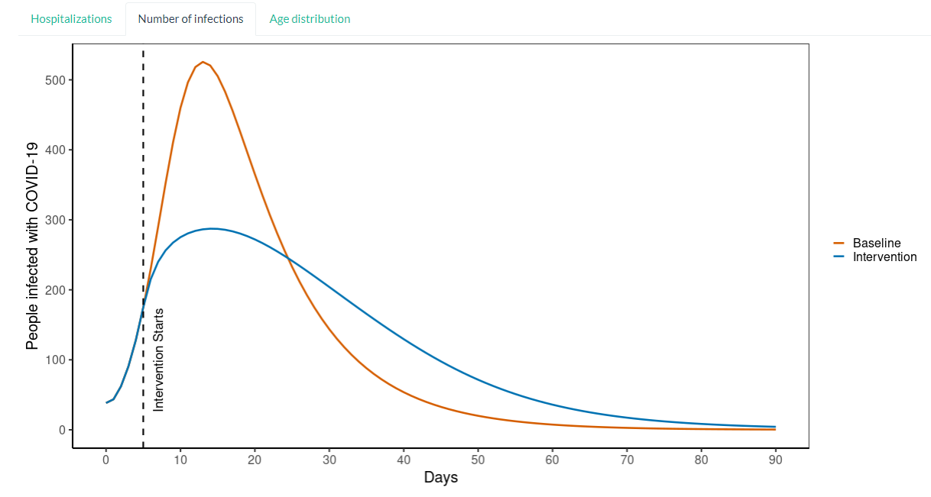
Section 4: Future actions your community may take

Slide 15
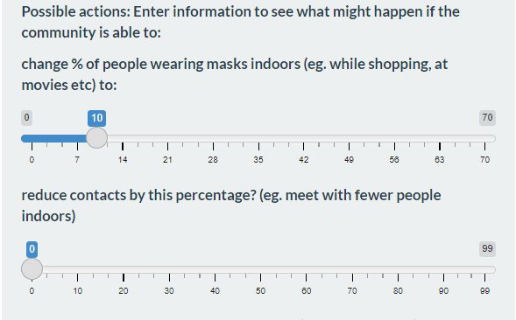
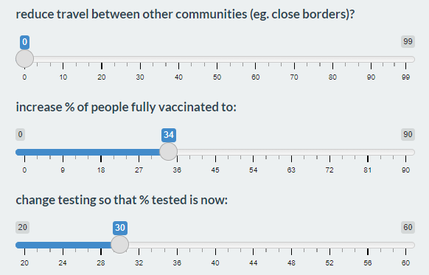
Section 4: Future actions your community may take
The model provides you with future actions your community may take. You control the degree to which each action is taken by moving the individual dials for each action. The graph will then change to reflect the impact of each action after baseline.

Slide 16
How will the model benefit your community?
An additional tool to help plan for the future: The model will help you and your community decide what actions are best for your community by showing you the potential impact of actions you may take.
An opportunity to reduce the health burden of COVID-19: It is no surprise that COVID-19 impacts both community and individual health. Choosing the right combination of actions in your community can substantially reduce the risk of COVID-19 and help protect community members and the local healthcare system.
A way to encourage positive action: It can be hard convincing community members on the benefits of certain, more difficult actions, such as closing community borders. By showing the possible impact of taking action, the model may encourage positive action towards reducing the burden of COVID-19 on your community.

Slide 17
Questions about the model?
We’re happy to answer all of your questions right now. You can also contact Cal Stewart at cal.stewart@coo.org for questions.

