Slide 1
Understanding Opioid Use among First Nations People in Ontario
Sacha Bragg, Chiefs of Ontario
Tara Gomes, ODPRN
October 25, 2023

Slide 3
CIHR Grant: Supporting a Program of Research
Pathways of Healthcare Use
Patterns and Trends in
Opioid Prescribing
and Related Harm
Treatment
Outcomes
Initial Priority Project
Notes:
The first objective was funded as an interim priority project and will be completed at the end of 2021

Slide 4
Opioid Use, Related Harms, and Access to Treatment among First Nations in Ontario
Objective
Examine trends and patterns in opioid prescribing and opioid-related poisoning among First Nations people
Timeline
Trends: Fiscal year 2013-2019
Demographics: Calendar year 2019
Indicators
Opioid prescribing
Opioid use for pain
High dose opioid prescribing
Combined prescribing of opioids for pain and benzodiazepines
Opioid agonist therapy (OAT) to treat opioid use disorder
Opioid-related poisoning
Emergency department visits
Hospital admissions
Deaths
Comparison between First Nations and non-First Nations people

Slide 5
Opioid Use, Related Harms, and Access to Treatment among First Nations in Ontario
Between 2013 and 2019:
Prescription opioid use for pain decreased
Higher among First Nations people compared to non-First Nations people in 2019
Opioid agonist therapy (OAT) use increased
Particularly, buprenorphine/naloxone (Suboxone®) rose considerably, becoming the most common type of OAT used among First Nations people living within First Nations communities in 2019.
Between 2009 and 2019:
Hospital visits for opioid-related poisoning have increased
Deaths due to opioid-related poisoning have rapidly increased among First Nations people
Higher among First Nations people compared to non-First Nations people in 2019

Slide 6
Impacts of the COVID-19 Pandemic on Opioid-Related Poisoning among First Nations in Ontario
Objective
Describe the impact of COVID-19 on hospital visits and deaths due to opioid-related poisoning among First Nations and non-First Nations people
Timeline
March 17, 2020 – March 16, 2021
Indicators
Hospital visits for opioid-related poisoning
People who died of an opioid-related poisoning
Comparison between First Nations and non-First Nations people

Slide 7
Impacts of the COVID-19 Pandemic on Opioid-Related Poisoning among First Nations in Ontario

Slide 8
Impacts of the COVID-19 Pandemic on Opioid-Related Poisoning among First Nations in Ontario

Slide 9
Impacts of the COVID-19 Pandemic on Opioid-Related Poisoning among First Nations in Ontario

Slide 10
Our Research Approach
Build trust, respect, and commitment between the research team and First Nations communities.
COO Steering Committee advised on all steps along the process, provides
guidance, and identifies priorities
All researchers are OCAP©
Certified (FNIGC)
A research agreement has formalized the partnership between COO and the
ODPRN
The COO Data Governance Committee ensures the grant meets requirements for OCAP compliance
Ongoing communication with the Steering Committee through at least biannual teleconferences and annual in-person meetings (virtual during COVID-19)

Slide 11
Circle of Lived Experience Advisory Committee

Slide 12
Knowledge Translation
Implement a knowledge translation framework for broad dissemination and uptake of research in First Nations communities and to relevant policy-makers and clinicians.
A research coordinator leads knowledge translation initiatives, including planned sharing findings with a panel of individuals with lived experience and community members to ensure research is contextualized
Utilize opportunities to present research findings to communities through workshops and presentations using variety
of media
Following approval from the Steering Committee, HCU and DGC, findings will be released publicly and shared with First Nation Leadership, policy-makers and other knowledge users

Slide 13
Thank you!
Questions?
Bernadette@coo.org
Tara.Gomes@unityhealth.to

Slide 14
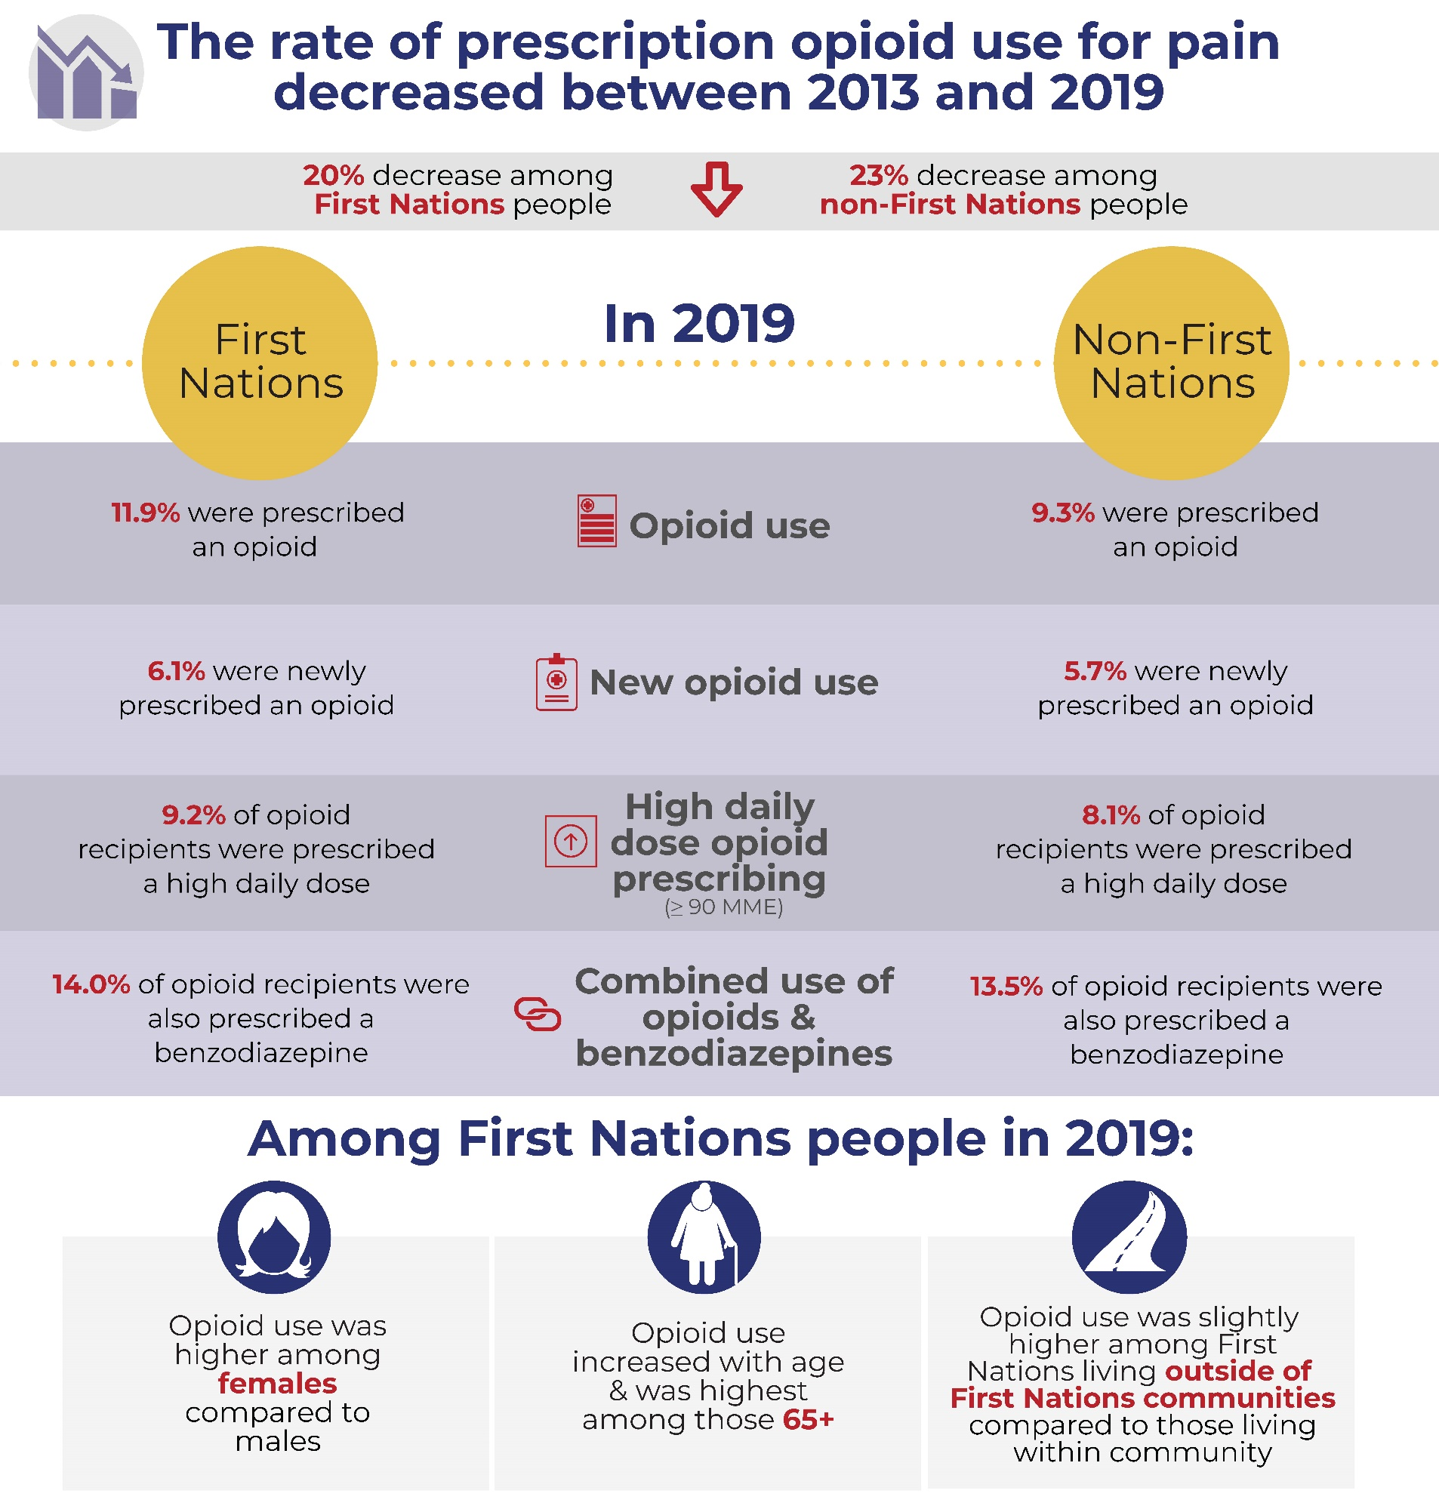
Opioid Use, Related Harms, and Access to Treatment among First Nations in Ontario

Slide 15
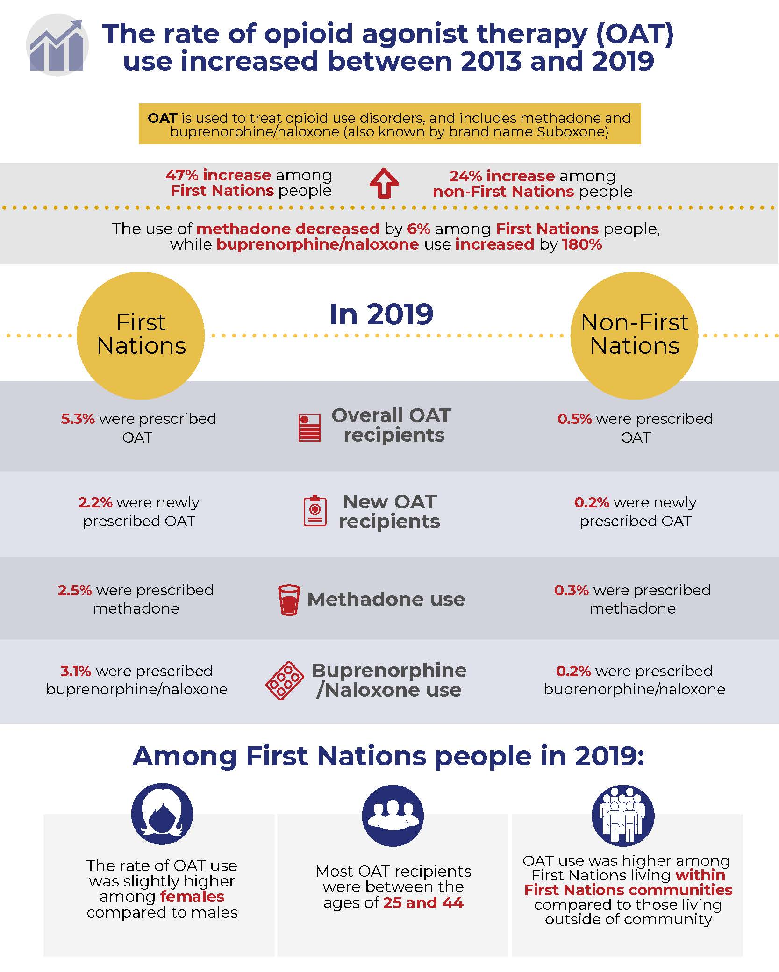
Opioid Use, Related Harms, and Access to Treatment among First Nations in Ontario

Slide 16
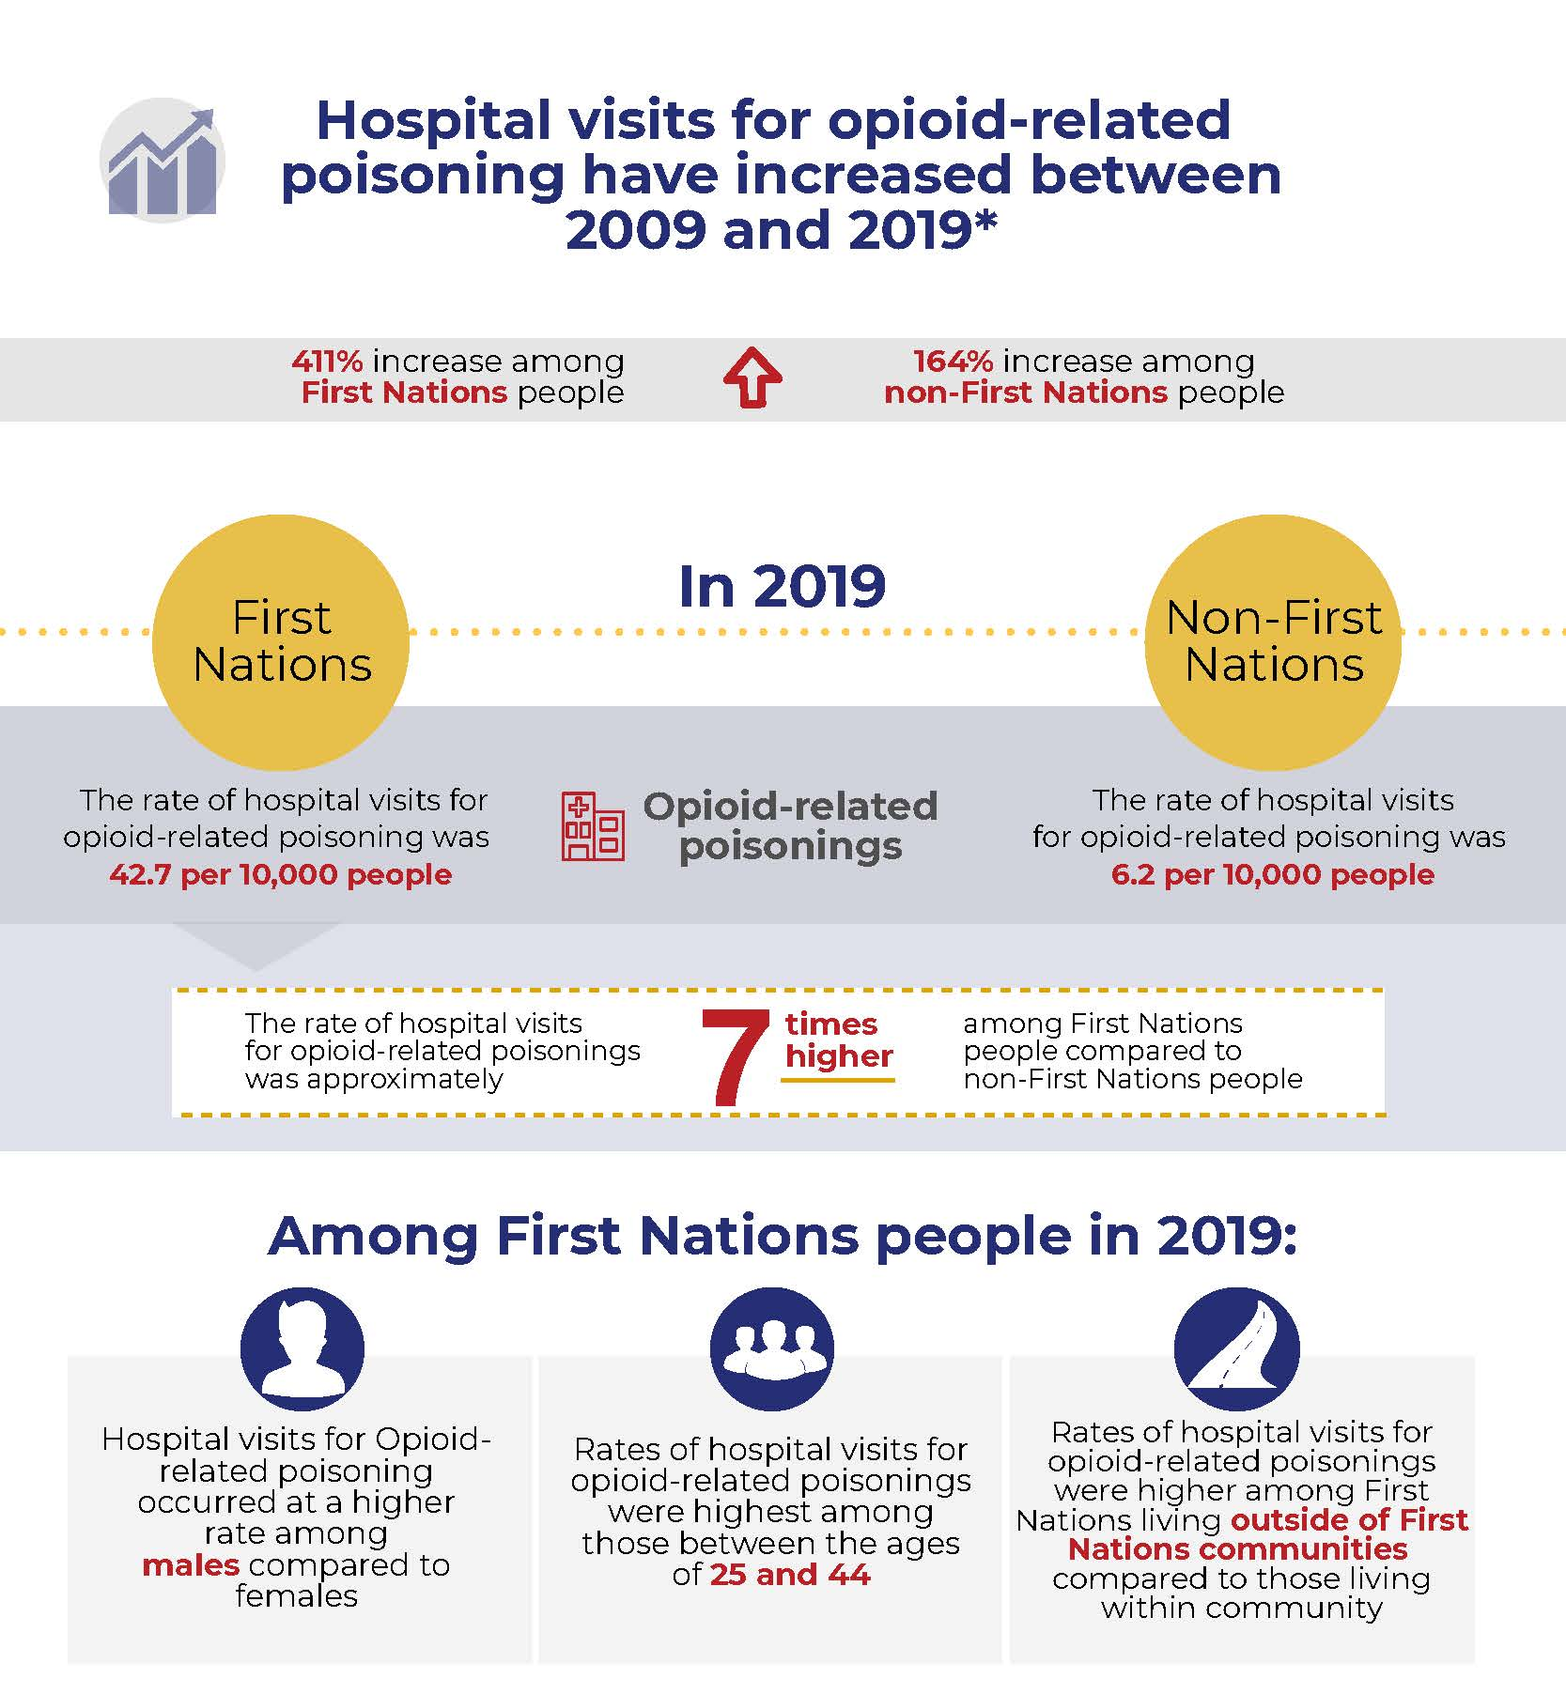
Opioid Use, Related Harms, and Access to Treatment among First Nations in Ontario

Slide 17
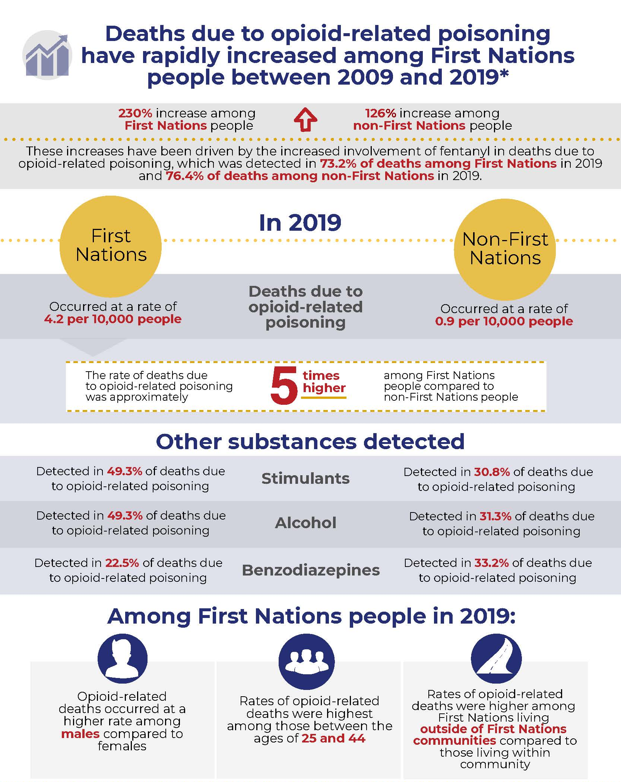
Opioid Use, Related Harms, and Access to Treatment among First Nations in Ontario

Slide 18
ODPRN Dissemination Plan
Option 1: Press release
Press release jointly prepared by COO and ODPRN
Embargo copy of reports sent to media outlets
1-2 days prior to release date
Key contact(s) for media will be pre-determined and media interview requests will be triaged as appropriate
Option 2: Online dissemination
Posting on COO and ODPRN websites
Dissemination on social media
*Note: may still garner media attention so need to be prepared to have people who can speak to the context of these findings in media

Slide 19
CIHR Grant: Objectives
Pathways of Healthcare Use
Patterns and Trends in
Opioid Prescribing
and Related Harm
Treatment
Outcomes
Notes:
The CIHR research grant was developed in response to Resolution 20/18, and is guided by the priorities of the existing COO Opioid Surveillance Steering Committee.
Title: Understanding Opioid Use and Harms among First Nations People in Ontario: Integrating Administrative Databases with Guidance from Communities
Goal: Provide real-world evidence on opioid use and related health outcomes to First Nations communities across Ontario that can inform programs and services to address the negative consequences of opioids.
Methodology: Administrative health databases (Indian Registry System, Narcotics Monitoring System, and Coroner’s Mortality databases at ICES)
Project Outline:
Trends and characteristics of opioid use and related-harms (To conduct ongoing monitoring of trends of prescription opioid use, treatment for opioid use disorder, and opioid-related harms),
Pathways of health care use (To understand clinical indications for prescription opioid use as well as factors and circumstances associated with fatal opioid overdoses )
Treatment outcomes (To compare retention in treatment and health outcomes among First Nations people with an opioid use disorder starting opioid agonist therapy)

