Slide 1
Cultural Indicators for Research Projects
Carol Hopkins, O.C., MSW, RSW, LL.D. (hons)
CEO Thunderbird Partnership Foundation
October 2023

Slide 2
Gaps between evidence and decision-making occur at all levels of health care, including inclusion of First Nations, health care professionals and policy-makers.
Knowledge translation involves using high-quality knowledge, Indigenous Knowledge, Data, Evidence, Practice Based Evidence in processes of decision-making.
The knowledge-to-action framework provides a model for the promotion of the application of research, wise practices, with culture relevance and the process of knowledge translation.

Slide 3
Cultural Indicators are Strengths Based Indicators
Culture is strength

Slide 4
What is Strength Based Data & What Difference Does it Make
For First Nations, a strengths-based approach is consistent with community values and principles.
Strengths-based approaches support future generations with research findings that are focused on strengths in order to ground wellness in First Nations worldview, identity, language, relationship with land and ancestors.
Strength based approaches to outcome measures and indicators do not alter statistical rigor.
A decolonizing approach with strengths-based methodologies, to counter the dominant deficit discourse that pervades research, policy, and media relating to Indigenous health and wellbeing.
More likely to support positive change than standard pathogenic models.

Slide 5
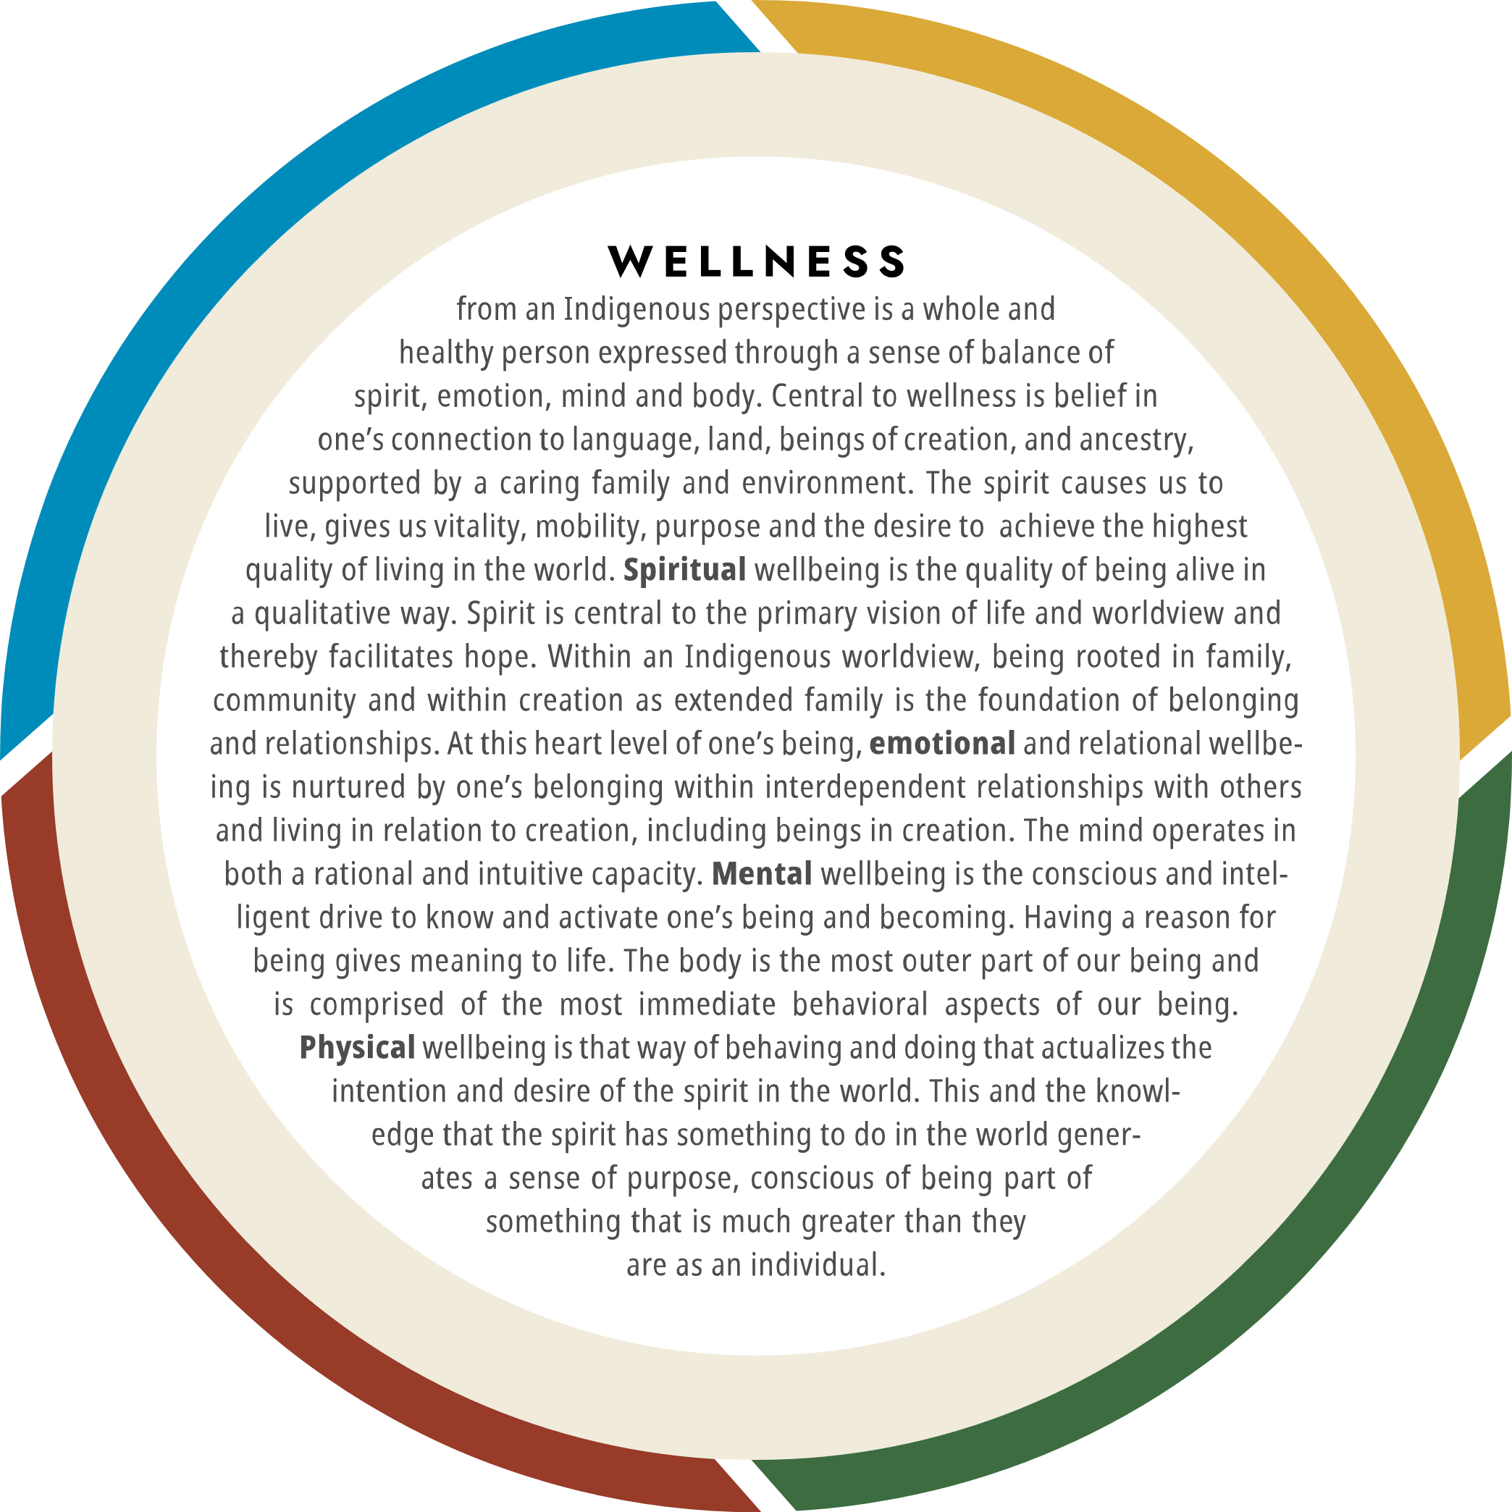
Indigenous Wellness
Spirit
Emotion
Mental
Physical

Slide 6
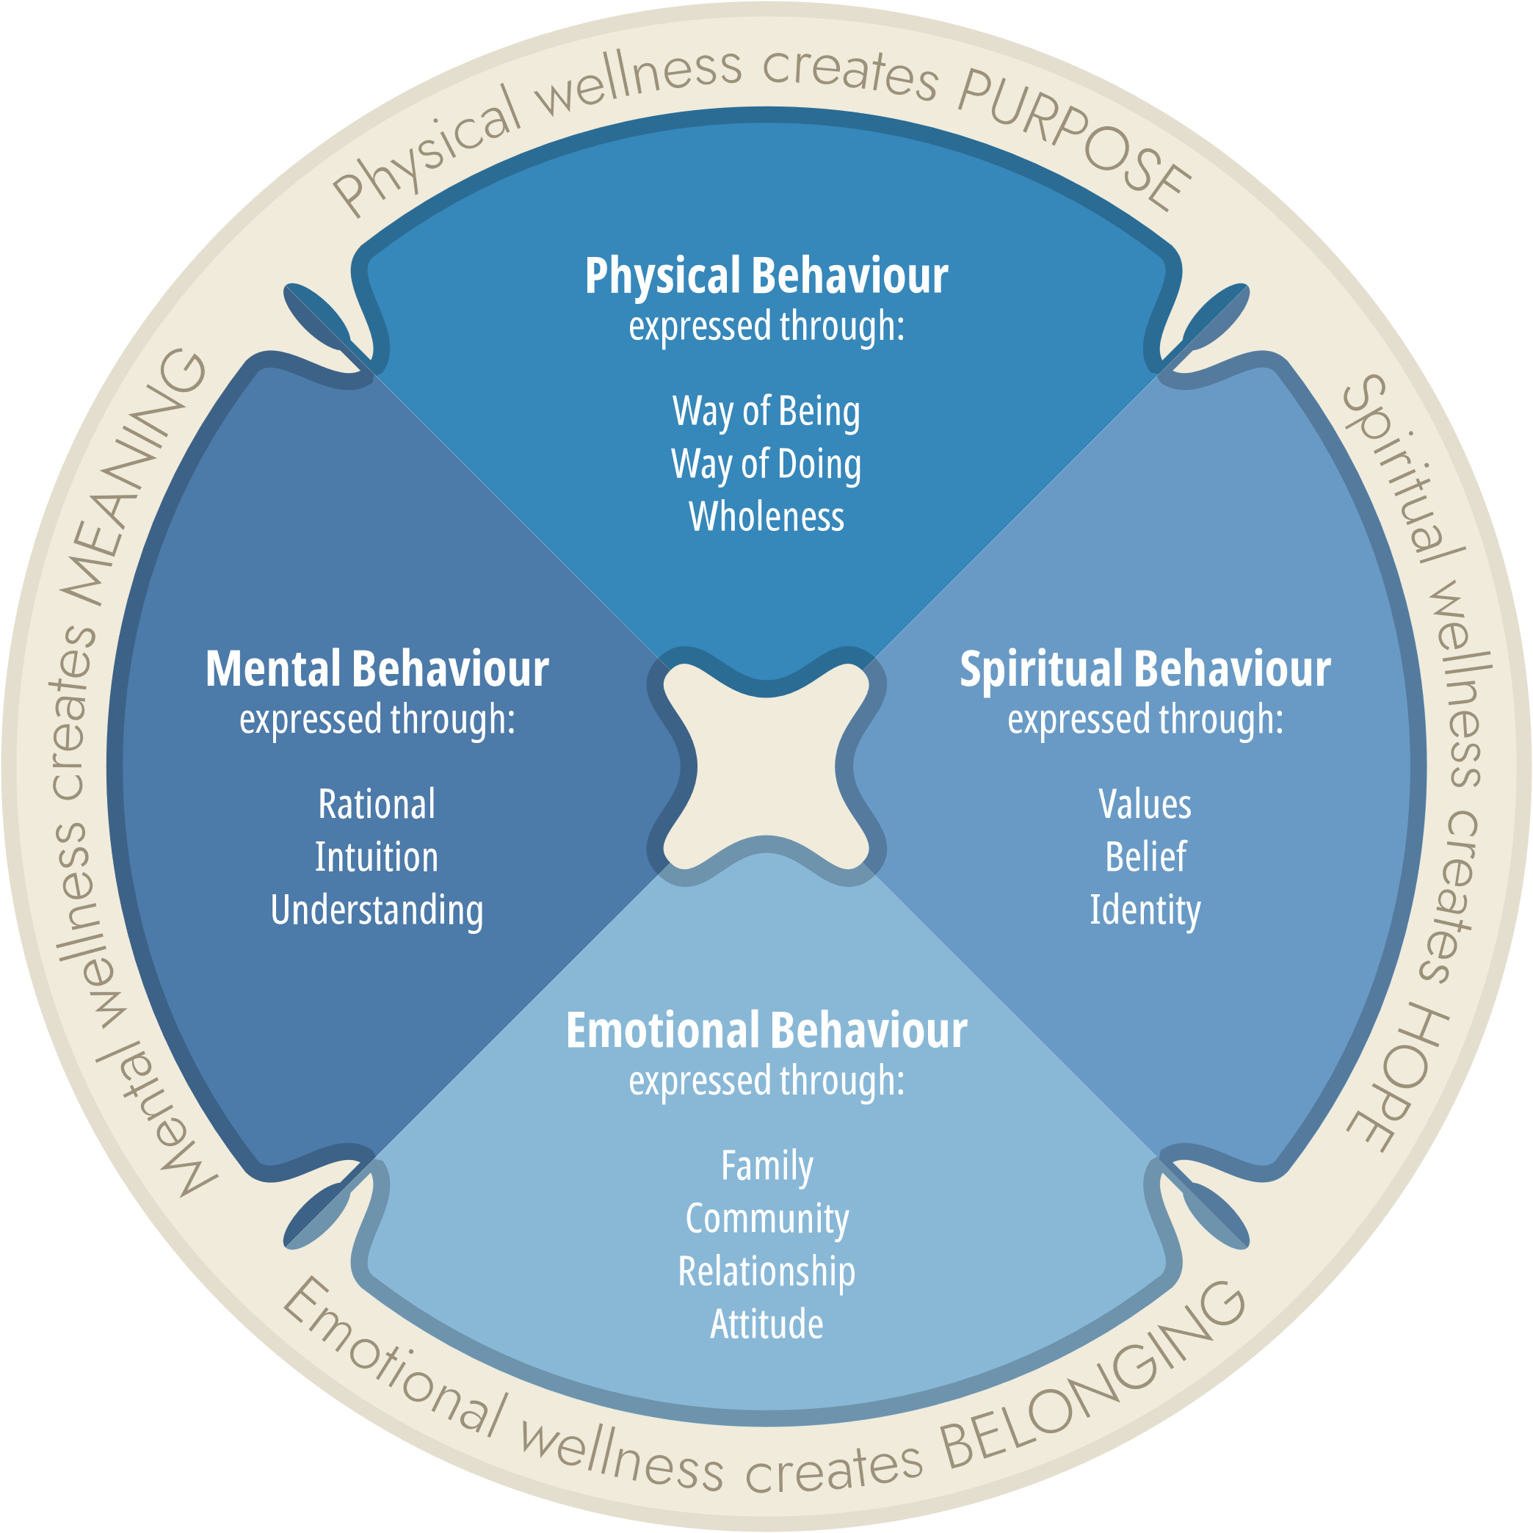
Strengths Based Data Depends on…
World View
Language
Definition of Indicators
What are we really measuring?
Why are we so focused on measuring deficits?

Slide 7
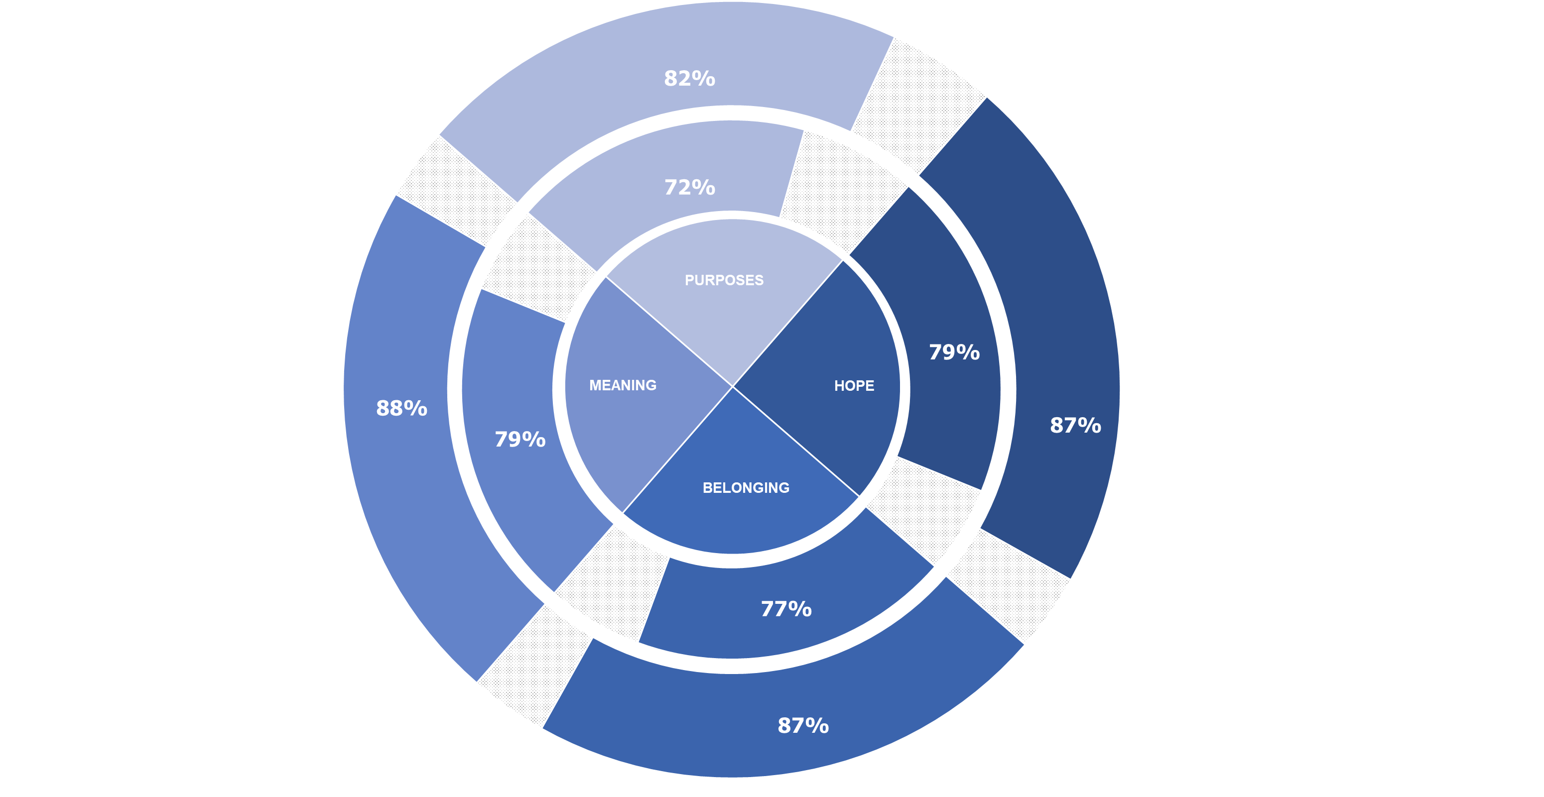
NWATM – Outpatient Virtual
Outpatient Virtual services includes virtual treatment provided on a non-residential basis, usually in regularly scheduled sessions (ie. 1-2 hours per week).
client wellness increased from 8 – 10% due to culture interventions used during outpatient virtual services at NNADP and NYSAP treatment centres across Canada.
Entry Point
Exit Point
Figure 1: A Comparison of Balance in wellness across time
*Data provided as an average over Episodes of Care 1 and 2

Slide 8
Land-Based Practices: Balance in Wellness across Time
Self-Entry
Self-Exit
15% increase in Belonging
11% increase in Meaning
15% increase in Purpose
13% increase in Belonging
15% increase in Meaning
19% increase in Purpose
13% increase in Belonging
16% increase in Purpose
2017 - 2018
2018 - 2019
2019 - 2020
 | Group 1 | Group 2 | Group 3
Self-Entry | 2.1 | 2.0 | 1.9
Self-Exit | 2.4 | 2.4 | 2.3
 | Group 1 | Group 2 | Group 3
Self-Entry | 2.2 | 2.1 | 2.0
Self-Exit | 2.43 | 2.41 | 2.24
 | Group 1 | Group 2 | Group 3
Self-Entry | 2.2 | 2.1 | 2.0
Self-Exit | 2.6 | 2.5 | 2.4
Group 1: daily or several times a week: such as prayer, smudge
Group 2: weekly or monthly, such as Sweatlodge
Group 3: seasonal, may require specific ceremonial practice, such as Fasting

Slide 9
Belonging and Purpose balance each other
Belonging:
Family
Community
Relationships
Attitude
Purpose:
Way of Being
Way of Doing
Wholeness

Slide 10
Quality of Life: Measuring What Matters
Public opinion polling commissioned by the Federal Department of Finance in August 2020 revealed that 82% of Canadians agree that beyond GDP measures are important in their own daily lives,
And, when government makes decisions, a majority of Canadians further agree that it is very important that government consider factors like:
  health,
  Safety,
  Environment
These factors are universal domains.
Universal domains have different outcomes
For First Nations, how can data be used to:
  support reconciliation,
  advance collective rights…as defined by treaty, UNDRIP, Rights of Indigenous Child, Languages Act, Canada Health Act – universal access,
  increase or clarify self-determination,
  and close socio-economic gaps through increased equity.
What worldview defines these concepts: reconciliation, rights, self-determination, socio-economy

Slide 11
Example of Strength-Based Questions
Survival Questions
  How have you managed to survive this far given all the challenges you have had to contend with?
Support questions
  Who are the people on whom you can depend?
Exemption questions
  When things were going well in life, what was different?
Possibility questions
  What are your gifts and abilities?
Esteem questions
  When people say good things about you, what are they likely to say?
Perspective questions
  What are your ideas about your current situation?
Change questions
  What has worked in the past to bring a better life for you?

Slide 12
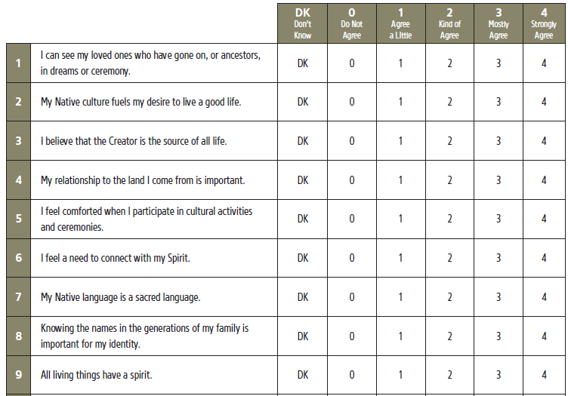
Native Wellness Assessment
Sample of the questions
Based on indigenous knowledge
Strengths based
Measures Hope, Belonging, Meaning and Purpose

Slide 13
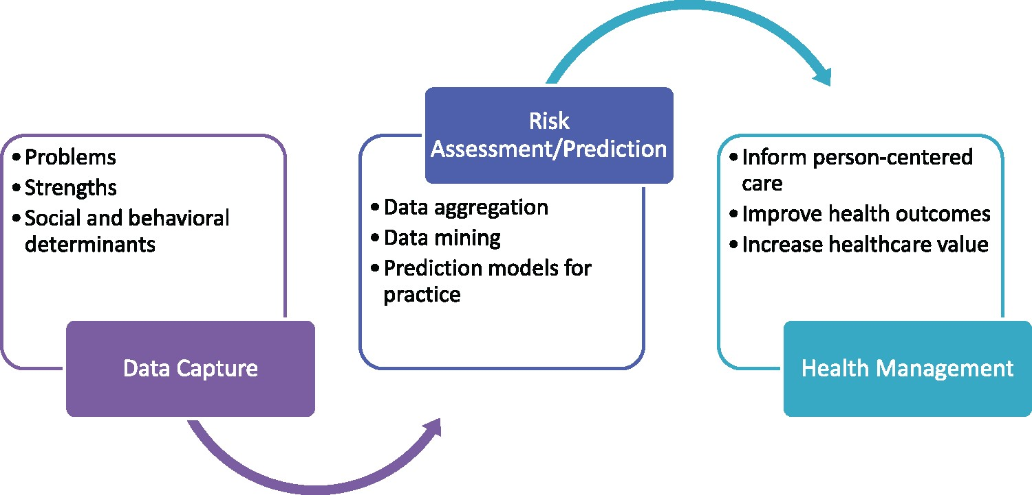

Strengths-based data capture model.
Indigenous Health Management
Or to inform family & community-centered care, outcomes and Healthcare values
Notes:
Figure 1. Strengths-based data capture model.
Unless provided in the caption above, the following copyright applies to the content of this slide: © The Author(s) 2018. Published by Oxford University Press on behalf of the American Medical Informatics Association.This is an Open Access article distributed under the terms of the Creative Commons Attribution Non-Commercial License (http://creativecommons.org/licenses/by-nc/4.0/), which permits non-commercial re-use, distribution, and reproduction in any medium, provided the original work is properly cited. For commercial re-use, please contact journals.permissions@oup.com

Slide 14
*
National Addictions Management Information System
April 2021 to March 2022 Data, N=1133

Slide 15
Strengths Based Data Model
Using an Indigenous Knowledge lens
  generates whole-person information and knowledge to improve health outcomes
  Whole – person information accounts for determinants of health
  Knowledge to Improve Health Outcomes accounts for Indigenous Knowledge, Spirit Centered Knowledge, Outcome measure of strength grounded in language & culture
  Whole – person data is considered within context, for example, determinants of health, social factors of community

Slide 16




Risk Factors: Determinants of Health
Food security:
People who reported that they are “fairly often” unable to buy food for their household are 3 times more likely to use methamphetamine compared to those who never have had issues accessing food. (p=0.001, 95%CI 2.56-6.54).
43% never or almost never have enough money to buy food. 48% said that they lose their appetite with methamphetamine use
Housing:
People who have been experiencing homelessness during COVID-19 are 2 times more likely to use methamphetamine (p=0.001, 95%CI 1.69- 3.28).
3. First Nations Opioid and Methamphetamine Survey, 2021
First Nations Opioid and Methamphetamine Survey, 2021

Slide 17
Risk & Protective Factors
Building capacity within communities also requires sustainable funding and partnerships, lack of these resources are the main reasons for the lack of harm reduction services and programs in communities.
For those who have a history of trauma their odds of using opioids in a harmful way is 2.9 times greater than those who do not have a history of trauma (p=0.010, 95%CI 1.289-6.574).
The odds of using opioids in a harmful way is 2.8 times greater for those who experienced grief or loss when they first ever used an opioid compared to those who did not experience grief or loss (p<0.008, 95%CI 1.314-6.200).
The odds of not using opioids in a harmful is 2.9 times greater for those who have positive role models or mentors in their life compared to those who do not have positive role models or mentors in their life (p=0.004, 95%CI 1.407-5.869).
A trend was identified and indicated that the odds of not using opioids in a harmful way is 2.3 times greater for those who believe that their cultural identity matters than those who do not.

Slide 18
Key Questions for Considering Strengths Based Data
What value is there for demonstrating the significance of language, world view, culture, despite the challenges/problems or as an answer to the challenges/problems
What expectations do have for using the data
What comparability do you want to have with other groups

Slide 19
References
Katherine A. Thurber, Joanne Thandrayen, Emily Banks, Kate Doery, Mikala Sedgwick, Raymond Lovett (2020). Strengths-based approaches for quantitative data analysis: A case study using the australian Longitudinal Study of Indigenous Children. SSM - Population Health, Volume 12,100637. ISSN 2352-8273. https://doi.org/10.1016/j.ssmph.2020.100637. (https://www.sciencedirect.com/science/article/pii/S2352827320302743)
Erika Stoerkel (2022). What is a Strength-Based Approach? (Incl. Examples & Tools). https://positivepsychology.com/team/erika-stoerkel/
Thunderbird Partnership Foundation. (2020). Indigenous wellness framework reference guide. National Native Addictions Partnership Foundation. Retrieved from: https://www.thunderbirdpf.org/IWF
Grace Gao, Madeleine J Kerr, Ruth A Lindquist, Chih-Lin Chi, Michelle A Mathiason, Robin R Austin, Karen A Monsen (2018). A strengths-based data capture model: mining data-driven and person-centered health assets. JAMIA Open, Volume 1, Issue 1, July 2018, Pages 11–14, https://doi.org/10.1093/jamiaopen/ooy015 https://doi.org/10.1093/jamiaopen/ooy015
Native Wellness Assessment TM – Copyright c2015, National Native Addictions Partnership Foundation Inc. All rights reserved. 22361 Austin Line, Bothwell, ON, N0P 1C0
Department of Finance Canada (2021). Toward a Quality of Life Strategy for Canada.
Thunderbird Partnership Foundation (2022). First Nations Opioid & Methamphetamine Survey
Thunderbird Partnership Foundation (2022). 2022 Adult Substance Use Data, Addictions Management Information System
Thunderbird Partnership Foundation (2021). Suicide Risk for Adults in Treatment, Addictions Management Information System
Thunderbird Partnership Foundation (2021). Pre Covid and Covid 19 Comparative Data. Addictions Management Information System
Thunderbird Partnership Foundation (2020). Land Based Service Delivery Data. Addictions Information Management System.

