Slide 1
Regional Health Survey
Analysis
Chiefs of Ontario presents
Research and Data Management
Power Up Conference
October 24, 2023
Notes:
Title. Do not alter.

Slide 2
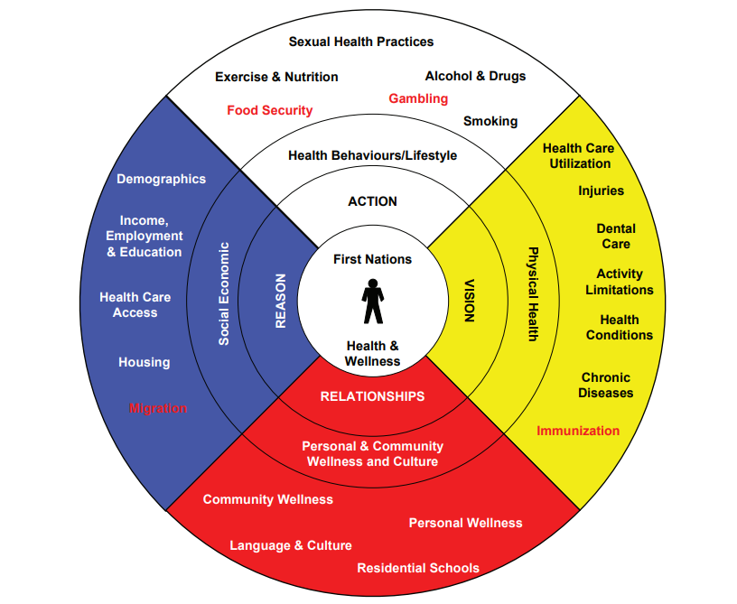
RHS Cultural Framework
Guided by this framework, the meaning of First
Nations health is defined as “the total health of the
total person within the total environment”.
The goal is to assist in achieving a culturally
informed interpretation process that reinforces
and reflects their ways of seeing, relating, knowing
and being.

Slide 3
Regional Health Survey(RHS) analysis using Descriptive Analysis
Methods
Review indicators from each RHS phase to report on trends using the RHS Cultural Framework.
Short list indicators to report on how health of First Nations people has changed from RHS phase 1.
Primarily reporting on First Nations adults, limited reporting on First Nations youth and children.
Observe trends where possible. Compare with indicators how it impacts First Nations health. Otherwise a snapshot was reported, when available
Determine how First Nations health has changed from each RHS phase 3.

Slide 4
About the RHS
Regional Health Survey Phase 1 was known as the First Nations Regional Longitudinal Health Survey
(RHS) Phase 1 2002/03
RHS Phase 2 (2008/10) National Report
Corrections were made in October 2012
Phase 3: Volume One, (Ottawa: 2018).
Published in March 2018
Phase 3: Volume Two, (Ottawa: 2018).
Published in July 2018.
For more information, please fnigc.ca

Slide 5
Action
Health Behaviors/
Lifestyle
Notes:
Add Introductory Title.

Slide 6
Notes:
More First Nations adults had one drink or more a month, for the past 12 months.
Comments: is it socially more acceptable that alcohol consumption is on the rise
Analysis: Would like to see which communities are considered a ‘dry’ reserve or not.
To determine risky behavior, a better indicator is how many individuals have binged alcohol, in the past 12 months

Slide 7
Notes:
The rate of physical inactivity of First Nations Adults are on the rise.

Slide 8
Notes:
Analysis: First Nations Adults who did not smoke has slightly increased from RHS phase 1. Those who have refrained from smoking any cigarettes

Slide 9
Notes:
First reported in phase 2. Food insecurity decreased slightlyfrom RHS phase 2 to RHS phase 3. as defined as a question “In the past 12 months, were you ever hungry but
didn’t eat because there wasn’t enough money for food”
Analysis: RHS phase 2 introduced the question, so we only data reported from phase 2. Food insecurity has decreased slightly

Slide 10
Notes:
Analysis: First Nations adults who always or almost always ate a balanced nutritious meal has increased from RHS phase 1

Slide 11
Notes:
Analysis: RHS Phase 3 does not explicitly report the rates of body mass index. Rather they combined the rates of body mass index by physical activity.
Rates of rhs phase 3 rates were then omitted, as they did not explicitly report on the same variables such as those reported in phase 1 and phase 2.

Slide 12
Vision:
Physical Health
Notes:
Add Introductory Title.

Slide 13
Notes:
Analysis: First Nations adults who lived further away from dense population centres(Urban, rural, remote/special) reported higher report of mould or mildew in their homes

Slide 14
Notes:
Analysis: This chart shows comparison between First Nation Females and Males shows that there is a significant higher percentage of co-morbidity for First Nations Females compared to males. Similarly, First Nations females reported in RHS phase 2 significantly higher compared to First Nations males(not shown here)

Slide 15
Notes:
Co-morbidity increases with age.

Slide 16
Notes:
The grey bar shows a descending order of the top 5 chronic health conditions in RHS phase 3. Allergies was the highest reported health condition in rhs phase 3, followed by Arthritis and so on. The highest reported chronic condition in each RHS iteration was Arthritis in phase 1. All reported chronic health conditions were decreasing over all three phases, except allergies.

Slide 17
Notes:
Although, allergies was the highest reported chronic health condition, diabetes was the highest reported treatment received for chronic health conditions for First Nations adults. The highest reported chronic health condition from RHS phase 3 was the 10th highest for those receiving treatments for their conditions

Slide 18
Notes:
This chart shows that the mean age of diagnosis for a chronic health condition for First Nations adults.

Slide 19
Notes:
Some of the barriers to health care that First Nations Adults reported in RHS phase 3

Slide 20
Notes:
The Regional health survey also reported the difference from 100 for those respondents who considered their water supply not safe to consume year round. For an example, in phase 3, the 100 minus 72.5 is 27.5, who was the proportion of those who considered their water supply not safe to consume year round. Location of respondents did not differ significantly in their responses(not shown here)

Slide 21
Relationship:
Personal & Community
Wellness and Culture

Slide 22
Notes:
A little more than 1/8th of First Nations adults reported having fair or poor mental health.

Slide 23
Notes:
Roughly 1 in 13 First Nations adults contacted a mental health professional about their mental health. Significantly more respondents contacted their family or friends for mental health support.

Slide 24
Notes:
Sense of belonging did not change significantly for those that reported having a health condition. In psychology, the sick role behavior theory, The value of one's self does not change significantly when ill, or they don’t believe that they are not less a part of the community when one does become sick or ill.

Slide 25
Notes:
The self-reported experience of racism does not change with increasing age.

Slide 26
Notes:
Self-reported experience of racism has decreased significantly from RHS phase 1.

Slide 28
Notes:
First reported in phase 2. Interpret with caution. I could not find if this a subset of another question. Such as, if respondents were asked if their community faced challenges, if yes, then what were the challenges. If this is an actual question, then 80% of respondents felt that Alcohol and drug use were a challenge to some degree. RHS phase 1 did not present this question. Data dictionary did not give a satisfactory answer

Slide 29
Reason:
Social Economic

Slide 30
Notes:
More First Nations who had a chronic health condition reported they accessed health care compared to those who did not report any health conditions

Slide 31
Notes:
RHS phase 2 was the only iteration that explicitly reported the quality of health care for First Nations adults. Slightly more than 3/8ths reported that they had less access to quality of health care that Canadians receive.

Slide 32
Notes:
The unemployment rate virtually did not change from RHS phase 1 to phase 3. With a static unemployment rate, how does it impact the community.

Slide 33
Notes:
Crowding index, measured by more than one person per room per house. Increased from RHS phase 1 to phase 3. Appears to be remain unchanged from RHS phase 2 to phase 3

Slide 34
Notes:
Household income gap has increased from RHS phase 1. unchanged from phase 2. although personal income has risen from phase 1(not shown), perhaps it could be more related with inflation or other

Slide 35
Notes:
There was an increasing attainment of education, measured by the completion of a grade 12 diploma or higher.

Slide 36
Summary
Notes:
Add Introductory Title.

Slide 37
RHS Cultural Framework
Action
Physical inactivity, and possibility rates of obesity, is on the rise
Food insecurity and eating nutritious meals have improved
Social consumption of alcohol was on the rise
Vision
First Nation females are significantly more like than First Nation males to have higher rates of co-morbidity
With the exception of allergies, the top 5 highest health conditions have reported a decrease in each condition

Slide 38
RHS Cultural Framework
Relationship
Sense of belonging in the community is strong for First Nations people
Alcohol remains the top reported community challenge
Reason
Unemployment rates did not improve over all RHS phases
Income gap between the lowest bracket appears to be widening
More individuals are finishing high school or higher

Slide 39
For further information, please contact:
Trevor Koostachin, Research Analyst
Trevor.Koostachin@coo.org
Name, Title
email@coo.org
Notes:
Insert Sector and Director contact information.

