Slide 1
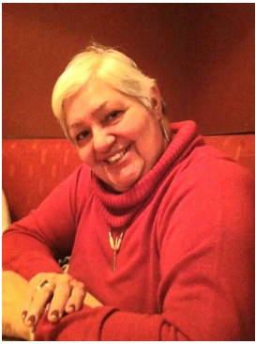
Honouring Cathryn Mandoka Ownership, Control & Access
Later to become known as OCAP

