Slide 1
Annual Chiefs Assembly
Chiefs of Ontario presents
Moving Forward: Strengthening
Relationships for Future Generations
June 13-15, 2023
For more information, please visit: www.ChiefsMeeting.com
Notes:
Title. Do not alter.

Slide 2
Education Sector
Dialogue Session
FEDERAL BILATERAL PROCESS RECOMMENDATIONS
Notes:
Add Introductory Title.

Slide 3
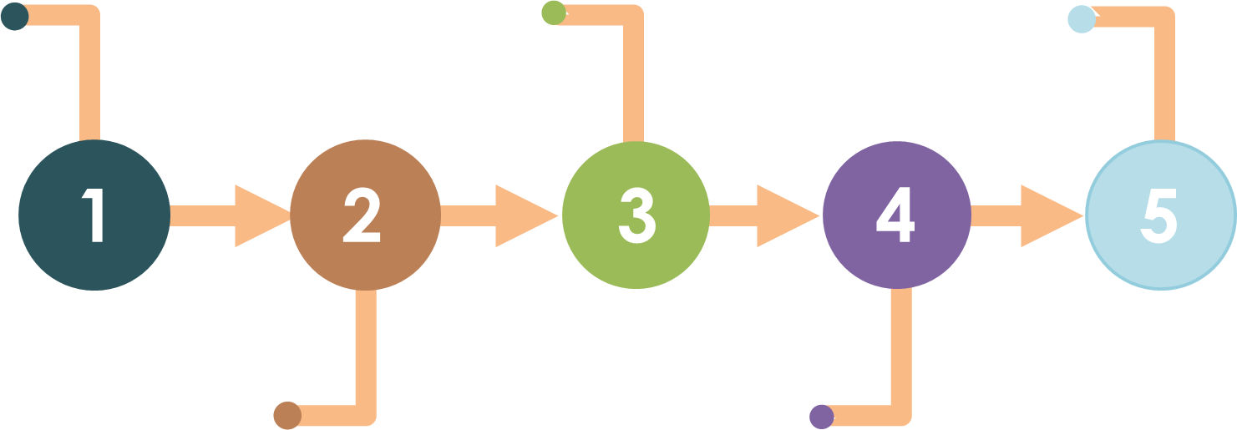
BACKGROUND
Entanglement of political decision-making and discussions with Leadership Council stall development
November 25, 2020 Chiefs of Ontario withdrawal from participation at AFN national committees on education
February 2021 Resolution 21/07 calls for CTCLL to develop recommendations on a bilateral process with ISC
Mar – Sep 2021 the CTCLL establishes a joint committee with ISC and conducts community engagement to develop recommendations
December 15, 2020 ORC letter to the ISC requesting establishment of a bilateral process between Ontario First Nations and ISC
Notes:
(COO) withdrew Ontario’s representatives from the AFN Chiefs Committee on Education and the AFN National Indian Education Council
due to lack of consideration for the funding needs of First Nations in Ontario and a flawed decision-making process that pits Regions against one another.

Slide 4
Recommendations on a Federal Bilateral Process
Stalled due to significant challenges associated with the joint political decision-making processes embedded in the COO-AFN relationship
AFN Relations on Education
FNECU provided recommendations to the Leadership Council to begin discussions with the AFN National Executive in an effort to address these challenges.
Dual Track Activity as Reported in 2022

Slide 5
Funding/Capacity
Access (HQ)
Voice
Complementary
Dual Track Advantages

Slide 6
AFN Relations Track
Notes:
Add Introductory Title.

Slide 7
Decision-making process
Negative impacts for First Nation learners in Ontario
Outdated Terms of Reference
Concerns
Notes:
lack of consideration for the funding needs of First Nations in Ontario and a flawed decision-making process that pits Regions against one another.

Slide 8
No reduction in financial resources for regions
Full revision of Terms of Reference
Transparency and consistency in Committee composition
Reduce conflict of interest
Formalize process for decision-making
Clearly define roles and responsibilities
Recommendations

Slide 9
Meeting with AFN CCOE June 26, 2023
Resolution submitted for AFN AGA
July 11-13, 2023
Next Steps

Slide 10
Bilateral
Recommendations Track
Notes:
Add Introductory Title.

Slide 11
Purpose
Ensure First Nations are able to shape the future of education through a collaborative process of adapting, reforming and developing educational processes, policies and programming
Objectives
Support all First Nations in Ontario in asserting their sovereignty and jurisdiction over education and learning

Slide 12
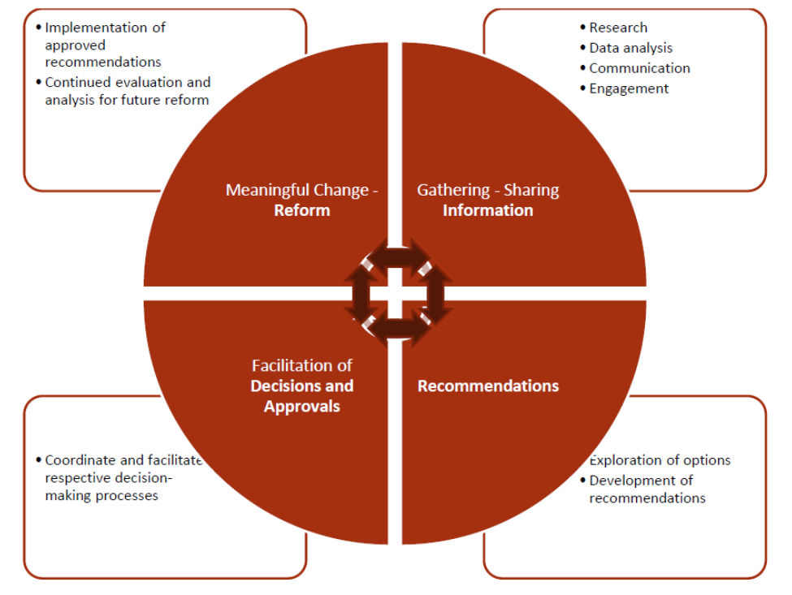
Four Pillars

Slide 13
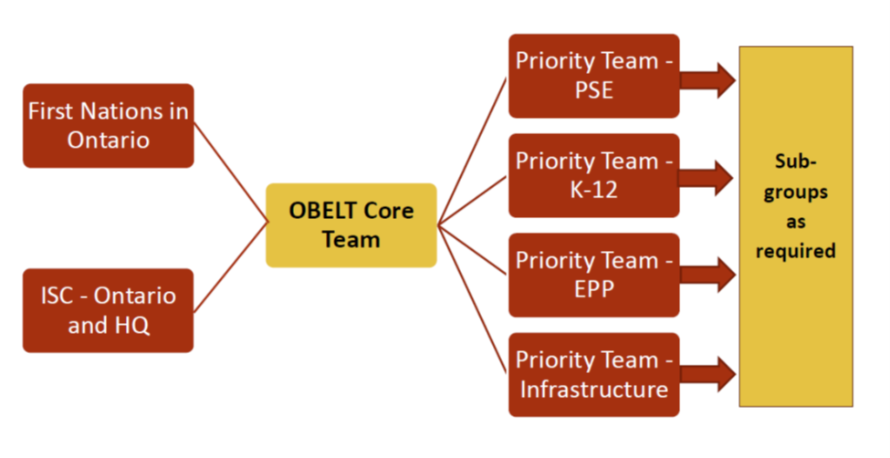
Structure

Slide 14
Post-Secondary
K-12
(OTTIFA)
Education Partnerships Program
Infrastructure
Initial Priority Teams

Slide 15
For further information, please contact:
Julia Candlish, Director of Education
Julia.candlish@coo.org
Michael Staruck, Associate Director of Education
Michael.staruck@coo.org
Notes:
Insert Sector and Director contact information.

