Slide 1
First Nations Data Governance Strategy – Implementation in Ontario
Update to Chiefs in Assembly
From Chief Abram Benedict
Data Champion Advisory Committee
November 21, 2023
Notes:
Add Introductory Title. Example: if you are providing an update on a specific file, place file name here.

Slide 2
Chiefs of Ontario
Chiefs of Ontario supports all First Nations in Ontario as they assert their sovereignty, jurisdiction, and their chosen expression of nationhood.
Keeping in mind the wisdom of our Elders, and the future for our youth, we continue to create the path forward in building our Nations as strong, healthy Peoples respectful of ourselves, each other, and all of creation.
Notes:
To add more slides, right click on slide 2, click ‘Duplicate Slide’

Slide 3
Key elements of COO Resolution 21/27
Establish an interim Data Champion Advisory Committee and develop a terms of reference
Endorses the First Nations Data Governance Strategy, as customized to Ontario priorities and needs
Support for existing forms of data governance until community consultations can take place
Report back yearly to the Chiefs in Assembly (done quarterly)
This work would not prejudice or negatively impact any First Nations initiatives in research and data
Notes:
To add more slides, right click on slide 2, click ‘Duplicate Slide’

Slide 4
Completed: In Progress:
Data Champion Advisory Committee appointed Nov 2021
8 meetings of the Committee since November 2021
Regular updates to Chiefs-in-Assembly
Health Data Landscape Scan
Awareness/Communications to build on momentum of October 24 – 26 “Powering Up Data Sovereignty” Conference
Staffing the Data Champion Team (2 new hires this month)
Participation in FNIGC’s Executive Leaders Table – November 17/23
Notes:
To add more slides, right click on slide 2, click ‘Duplicate Slide’

Slide 5
Research and Data Management Sector – Powering Up Data Sovereignty Conference
October 24-26, 2023 in Toronto - 245 registrants
3 full days of plenary & panel presentations, group discussions
Day One – Gord Peters spoke about Sovereignty in our First Nations
Day Two – Dr. Maggie Walters, University of Tasmania spoke about Data Sovereignty in the global context and as a key driver for self-determination
Day Three – Dr. Jennifer Walker, McMaster University spoke about Data Literacy and ways to achieve this
Valuable learning about the research projects undertaken by COO Research and Data Management on behalf of First Nations as well as key step in raising awareness of Data Sovereignty and data literacy
Notes:
To add more slides, right click on slide 2, click ‘Duplicate Slide’

Slide 6
Plans Moving Forward
Building awareness via a dedicated web presence
Ongoing communications and in-person presentations
Partner engagement, for example; Mamow Ahyamowen, Association of Native Child and Family Services
Collaborative planning of outreach with tribal councils and university research groups
Building data literacy through sector-specific webinars
Information gathering workshops being planned to explore data service needs and governance models
Notes:
To add more slides, right click on slide 2, click ‘Duplicate Slide’

Slide 7
Engagement Goals
Engagement Plans
Chiefs of Ontario
Provincial Territorial Organizations
(5)
Tribal Councils (18)
Other key FN service orgs
(39)
Non FN partners
First Nations (133)
Regional Data Champion Team
First Nations, Tribal Councils, PTOs
First Nations led organizations and initiatives
Federal, provincial, and territorial government
Promote awareness of FNDGS
Collaborate with partners
Gather information
Notes:
To add more slides, right click on slide 2, click ‘Duplicate Slide’

Slide 8
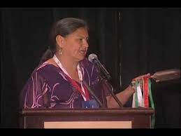
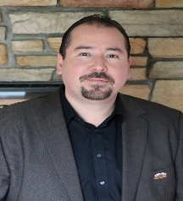
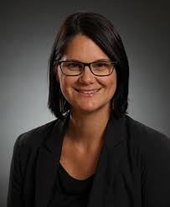
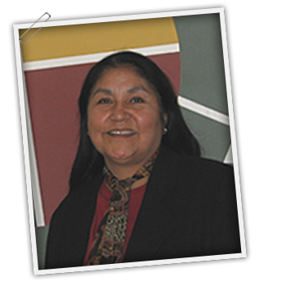
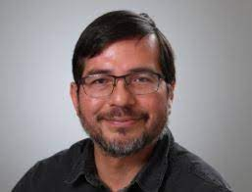
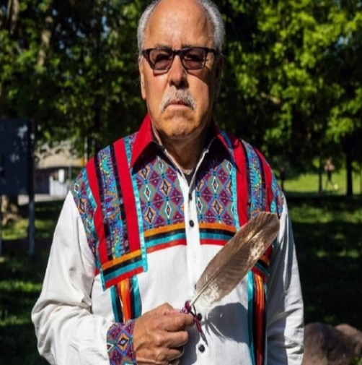
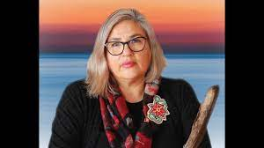
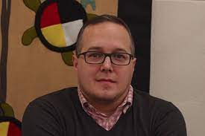
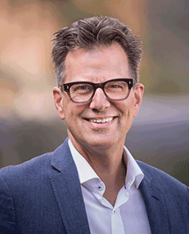
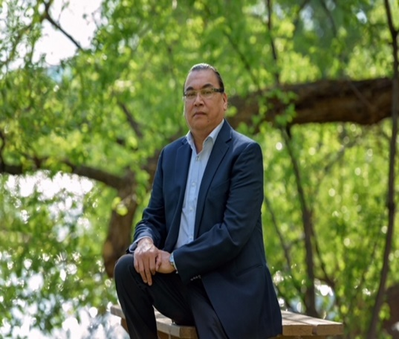
Data Champion Advisory Committee
Notes:
Just a reminder – this is the Data Champion Advisory Committee Members include:
Elder Vera Pawis Tabobondung
Grand Chief Abram Benedict – Leadership Council
Dr. Jennifer Walker
Dr. Darrel Manitowabi
Dr. Emily Faries
Mr. Larry Sault
Chief Shelly Moore-Frappier
Dr. Chris Mushquash
Mr. Gary Allen
Dr. Michael Schull

