Slide 1
First Nations Inuit Health Branch - Ontario Region
Mental Wellness
July 2023

Slide 2
ISC Organizational Chart
Minister of Indigenous Services
The Honourable Patty Hajdu
Deputy Minister
Gina Wilson
Associate Deputy Minister
Valerie Gideon
First Nations Inuit Health Branch
Regional Operations
Senior Assistant Deputy Minister
Candice St-Aubin
Senior Assistant Deputy Minister
Joanne Wilkinson
Assistant Deputy Minister
Jennifer Wheatley
(formerly Keith Conn)
Associate Assistant Deputy Minister
Paula Hadden-Jokiel
Regional Executive
Lisa Westaway
Regional Director General
Michael O’Byrne
Notes:
Organizational Plan- showing minister all the way down to RE and RDG level (FNIHB and RO respectively)
Two branches report to the same Minister under one department.

Slide 3
FNIHB Ontario Senior Management Team
Regional Plans and Partnerships (RPP)
Director, Stephanie O’Brien
-Health Planning & Funding Agreements
-Audit & Accountability
-Management Operational Planning
-Health Transformation & Health Service Integration Funding
-Community Programs
-Indian Residential Schools Cultural Supports (Contribution Agreements)
-Federal Hospital Burial Sites
-Policy Analysis & Development
-Partnership Coordination
Operations
Director, Valerie Flynn
-Health Facilities Development
-Federal Divestiture
-Technical support for emergency repairs and new construction
-Health Facilities Capital
-Facilities Devolution
-Dental Program
Client & Community Response
A/Director, Cheri Roy
-Jordan’s Principle Individual
-Jordan’s Principle Group Requests
-Choose Life
-Health Emergency Management
-Indian Residential Schools Resolution Health Support Program
Primary Health Care
Director, Shari Glen
-Nursing Leadership & Administration
-Home & Community Care
-eHealth
-Professional Practice
-Pharmacy
-Nutrition
-Paramedicine
Health Protection Unit
Preventive Medicine specialist, Dr.Claudia Sarbu and Senior Manager, Georgina Lentz
-Regional Medical Officer
-Environmental Public Health
-Communicable Disease Control & Management
-Epidemiology
-Population Health Science
Non-Insured Health Benefits
A/Senior Manager, Julie Caves
-Medical Supplies & Equipment
-Medical Transportation
-Short Term Mental Health Counselling
-Traditional Healers
Corporate Business Management Unit
Senior Manager, Natasha Mozes
-HR Planning
-Workplace & Personnel Security
-Business Continuity
-Asset Management & Procurement
-Return to Office Coordination

Slide 4
Mental Wellness in Ontario: Framing the Situation
The Indian Act, Residential Schools, the 60s Scoop and ongoing apprehension of children and youth
Programs and services in Indigenous Communities continue to be inadequate in areas- leading to decreased overall health outcomes for the mental health and wellness of Indigenous peoples in Canada.
This ongoing legacy has resulted in a systemic lack of Hope, Meaning, Purpose, and Belonging for individuals; with increased mental health, suicide and substance use crises seen today as Indigenous Peoples try to heal from these collective traumas.
Notes:
Before diving into the mental health and substance use crisis in Ontario and what ISC-FNIHB has been doing to address it, we must frame the situation.
The Indian Act, Residential Schools, the 60s Scoop and ongoing apprehension of children and youth has led to the fracturing of Indigenous Nations, communities and peoples due to loss of knowledge and connection to lands, identities, languages and cultures.
This disconnection, and chronic underfunding of community based programs, has created worse health outcomes, leading to a profound deficit in the protective factors of Hope, Meaning, Purpose and Belonging (which are the Pillars of the First Nations Mental Wellness Continuum Framework) in many individuals.
This ongoing legacy has lead us to the mental health, suicide and substance use crisis that we see today as individuals and communities try to deal with these collective traumas.

Slide 5
Regional Reality: Current Status
Rising use of opioids and other substances
Support First Nations communities in response to the opioid-related daily living, hospitalizations and emergencies of their members
Significant increase in First Nations in Ontario declaring mental health/opioid related States of Emergencies
Notes:
The rising use of opioids and other substances has become a major concern in Ontario, and a particular public health crisis in First Nations communities.
Ontario Region has been consistently challenged to fully support First Nations communities in their response to the opioid-related daily living, hospitalizations and emergencies of their members largely as a result of accessibility, funding and complexities related to coordination of various service providers/partners.
The opioid crisis in Ontario continues to grow; and the COVID-19 pandemic contributed to record-high levels of accidental overdoses.
Since 2010 there has been a significant increase in First Nations in Ontario declaring mental health/opioid related States of Emergencies with 12 declared in the past year

Slide 6
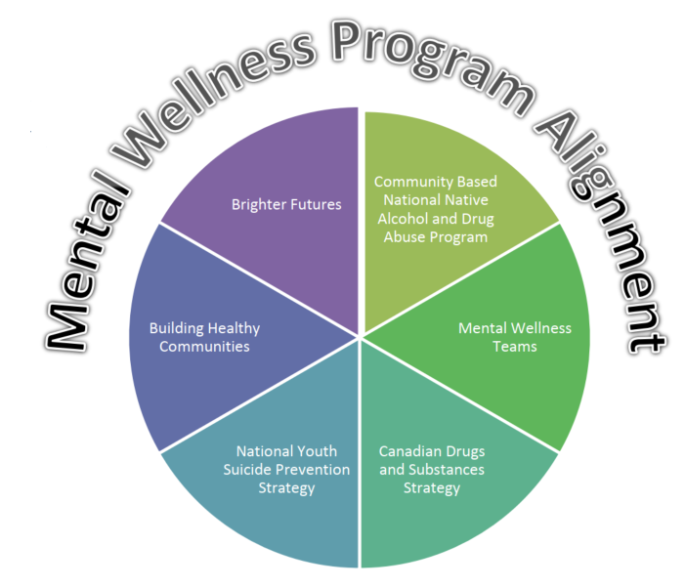
Mental Wellness Program
Mental Wellness Program/Alignment
$126,229,008 in mental wellness funding supporting First Nations communities and organizations.
Notes:
GOAL:
- The goal of the mental wellness program is to address both the greater risks and lower health outcomes which are associated with the mental wellness of First Nations individuals, families and communities.
ALLIGNMENT:
- Mental Wellness Program alignment aims to bring together a number of mental wellness programs such as Brighter Futures, Community Based National Native Alcohol and Drug Abuse Program, Mental Wellness Teams, Canadian Drugs and Substances Strategy, National Youth Suicide Prevention Strategy, and Building Healthy Communities- and align them into one program.
BENEFITS:
This alignment provides communities with more flexibility to develop their programming and use their funding in a way that best meets their mental wellness needs and priorities while streamlining reporting to reduce the burden on recipients.
FUNDING:
- In fiscal year 2022-2023, FNIHB-Ontario supported communities and Indigenous organizations with $126,229,008 in funding.

Slide 7
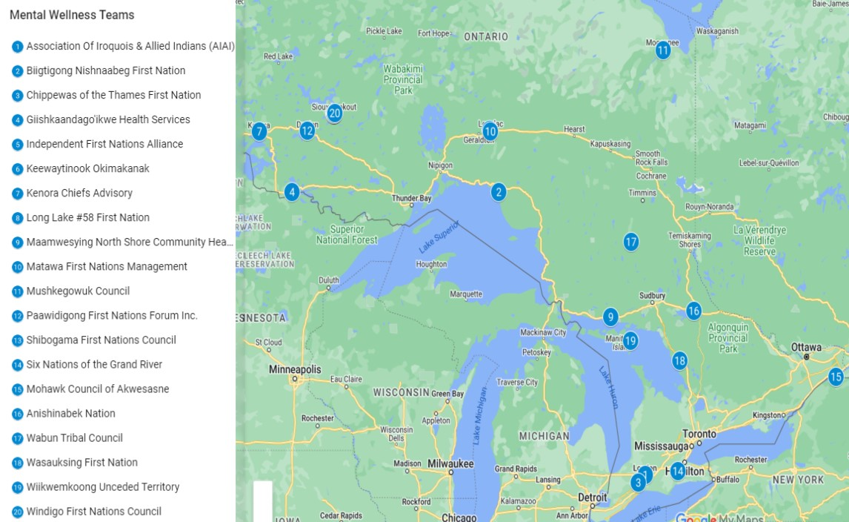
Mental Wellness Teams
Notes:
Mental Wellness Teams
In response to the on-going need for mental health crisis response services in Ontario, FNIHB ON region entered into a jointly funded initiative with the province of Ontario to co-fund 20 Mental Wellness Teams to serve all First Nations communities in the province (2018).
This agreement allows for greater mental health support coverage across all Ontario First Nation communities.
Funding is provided at the Tribal Council Level to support enhancement of existing Mental Wellness Teams (MWT).
Teams serve between 5 to 7 First Nations communities.
MWT’s are community-based, client-centred, multi-disciplinary teams that provide a variety of culturally-safe mental wellness services and supports to First Nations communities using a range of service models that can include crisis response, capacity-building, trauma-informed care, land-based care, prevention, early intervention and screening, after care, and care coordination with provincial health and social services.
The combination of services provided and composition of an individual team reflects community needs and priorities. Team members can include coordinators, Elders, cultural workers, psychologists, social workers and therapists, Resolution Health Support workers, and substance use workers.

Slide 8
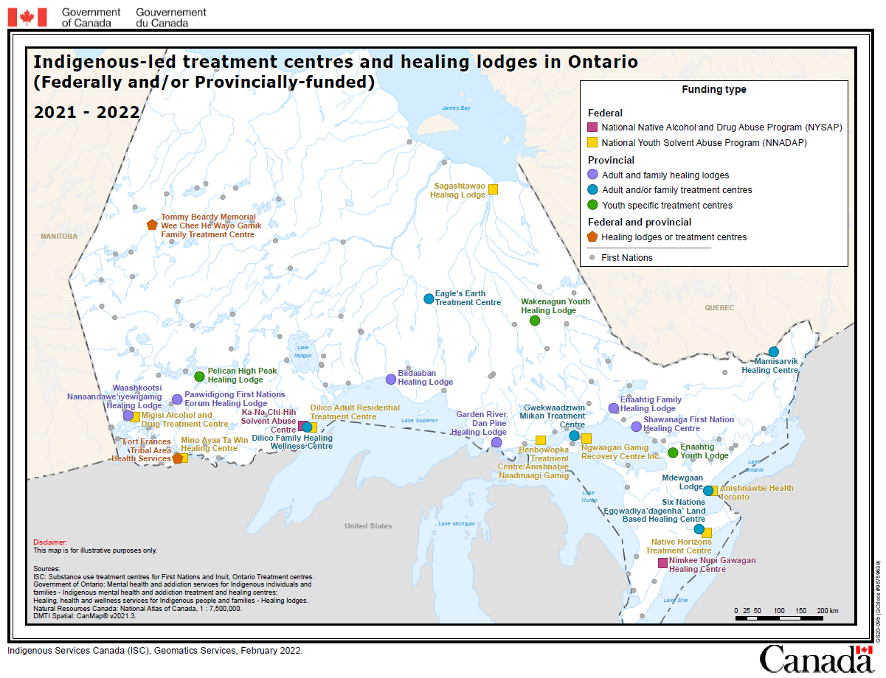
Treatment Centres Funded by FNIHB
Notes:
This map shows the location of Indigenous-led treatment centres and healing lodges in Ontario which are Federally and/or Provincially-funded.
There are 11 FNIHB-funded treatment centres in Ontario-10 of which offer inpatient services with a combined 132 beds and one offers an outpatient facility with space for 228 patients.
There are two funding streams available- the National Native Alcohol and Drug Addiction Program (NNADAP) and the National Youth Solvent Abuse Program (NYSAP)
Both Programs seek to strengthen the links between the residential treatment and the community-based prevention component of NNADAP, and other health services to ensure that client needs are met before, during and after treatment.
Increasing the number of culturally safe Treatment Centres would plan an important role in expanding the reach of community-based responses to crisis and harm reductions strategies.
The program objectives are to:
Provide an evidence-based and strengths approach to pre-treatment, in-patient treatment and post-treatment services to First Nations and Inuit people who are experiencing alcohol and substance abuse problems.
Provide culturally sensitive and treatment with equitable access to First Nations and Inuit peoples;
Make appropriate and regular investments in evidence-based or certified training for treatment staff in direct addiction treatment counselling roles with clients.

Slide 9
Opioid Agonist Treatment (OAT)
Addressing opioid dependency
Holistic Care
Reduce spread of infectious diseases
29 OAT programs in Ontario Region
Concentration in Northwestern Ontario
Notes:
Opioid Agonist Therapy is an effective treatment for people dependent on different types of opioids such as heroin and oxycodone. The therapy involves medications such as Methadone or Suboxone which, when taken properly, prevent the effects of withdrawal and reduce cravings for opioids. OAT is prescribed by a doctor and can be accessed through public service providers, private clinics, and residential or outpatient treatment programs.
The Opioid Agonist Treatment program focuses on a holistic care plan for treatment of opioid use disorder, which is categorized as a chronic medical condition. Clients within the program are working to reduce illicit opioid or other drug usage through various treatment programs. The program highlights the respect and dignity of clients to encourage recovery and long-term success.
OAT has the capacity to greatly reduce the spread of infections diseases within communities. Particularly, it prevents the outspread of blood-borne infections such as hepatitis B virus, hepatitis C virus and HIV, which can be spread by contaminated equipment such as the sharing of syringes.
There are currently 29 OAT programs in the Ontario Region aimed at addressing opioid dependency with many of these programs in the Nishnawbe Aski Nation territory and all in Northwestern Ontario.

Slide 10
Trauma-Informed Health and Cultural Supports/ Expanded Trauma Informed Supports
Provides cultural/emotional support and mental health counselling services to Survivors of Indian Residential Schools and the families of former students
Ensures eligible former IRS students and their family members have access to an appropriate level of mental wellness support services
Notes:
Trauma-Informed Health and Cultural Supports were originally established as part of the 2006 Indian Residential School Settlement Agreement and provides cultural and emotional support, and mental health counselling services to Survivors of Indian Residential Schools and the families of former students.
Expanded trauma informed funding was announced to improve access to mental wellness supports for those impacted by the ongoing investigations and confirmations of unmarked burials at the sites of former Indian Residential Schools.
Expanded Trauma-Informed Health and Cultural Support Funding is intended, as its primary purpose, to increase the number of community-based, Indigenous health and cultural support providers. ie. Cover salary and related costs for more workers to provide emotional and cultural supports to all those needing it in Indigenous communities.
There is a continued need for healing, health and cultural supports from the intergenerational trauma linked to Indian Residential Schools and other issues such as Missing and Murdered Indigenous Women and Girls
Planning is underway to explore how best to continue to address this need, in a way that is more reflective of Indigenous priorities (i.e. First Nations Mental Wellness Continuum Framework and National Inuit Suicide Prevention Strategy), and that does not create service gaps for clients
There are 8 organizations who currently receive IRS funding through contribution agreements: Noojmowin Teg Health Centre, Toronto Council Fire Native Centre, Grad Council Treaty #3, Keewaytinook Okimakanak, WAHA, Maamwesying, Nishnawbe Aski Nation, and Sioux Lookout First Nations Health Authority

Slide 11
Counselling
Non-Insured Health Benefits
Mental Health Counselling Benefits cover access to professional counselling sessions (including, but not limited to, crisis situations), as well as access to traditional healing in support of mental health.
22 Hours per year
Indian Residential School/Indian Day School/ Missing and Murdered Indigenous Women and Girls
Provides access to counselling support and medical transportation to individuals impacted by Indian Residential Schools.
62 Hours per year
Notes:
NIHB
ISC’s Non-Insured Health Benefit Programs provides coverage for professional mental health counselling to complement other mental wellness services.
Every 12 months, an eligible client can receive up to 22 hours of individual or group counselling performed by an eligible provider on a fee-for-service basis
Additional hours in the same 12-month period may be provided on a case-by-case basis.
NIHB also supports access to medically required health services that cannot be obtained on the reserve or in the community of residence through their Medical Transportation Benefit.
Indian Residential School/Missing and Murdered Indigenous Women and Girls Counselling
Provides access to counselling support and medical transportation to individuals impacted by Indian Residential Schools. This also encompasses individuals affected by Missing and Murdered Indigenous Women and Girls and Indian Day Schools.
Every 12 months, an eligible client can receive up to 62 hours of counselling performed by an enrolled provider on a fee-for-service basis (such as individual, family or group counselling). Additional hours in the same 12-month period may be provided on a case-by-case basis.
Funds are committed until 2023-2024.

Slide 12
First Nation Inuit Health Branch
Ontario Region
FNIHB ON Proposal Inbox: propositionsdesanteondgspni-onfnihbhealthproposals@sac-isc.gc.ca
Jordan’s Principle Group Request Inbox: grouprequest-jordansprincipleon-principedejordan-demandedegroupe@sac-isc.gc.ca
Jordan’s Principle Individual Inbox: jordansprinciple-principedejordan@sac-isc.gc.ca
Jordan’s Principle CHRT Capital Proposals: onjpchrt41-onpjtcdp41@sac-isc.gc.ca
Non-Insured Health Benefits Client Information (Toll Free): 1-800-640-0642

Slide 13
First Nation Inuit Health Branch
Ontario Region
Regional Executive: Lisa Westaway, lisa.westaway@sac-isc.gc.ca
Director RPP: Stephanie O’Brien, stephanie.obrien@sac-isc.gc.ca
Director of Operations: Valerie Flynn, valerie.flynn@sac-isc.gc.ca
A/Director of Community & Client Response: Cheri Roy, cheri.roy@sac-isc.gc.ca
Director Primary Care: Shari Glenn, shari.glenn@sac-isc.gc.ca
Health Protection: Georgina Lentz, georgina.lentz@sac-isc.gc.ca
Dr. Claudia Sarbu, claudia.sarbu@sac-isc.gc.ca
A/Senior Manager NIHB: Julie Caves, julie.caves@sac-isc.gc.ca

Slide 14
Questions?

