Slide 1
All Our Voices:
Working with Data to Address the Unique Needs of Northern Ontario First Nations
Maureen Gustafson
Christina Vlahopoulos
Powering Up Data Sovereignty
Tuesday, October 24, 2023
Notes:
Add note to this slide

Slide 2
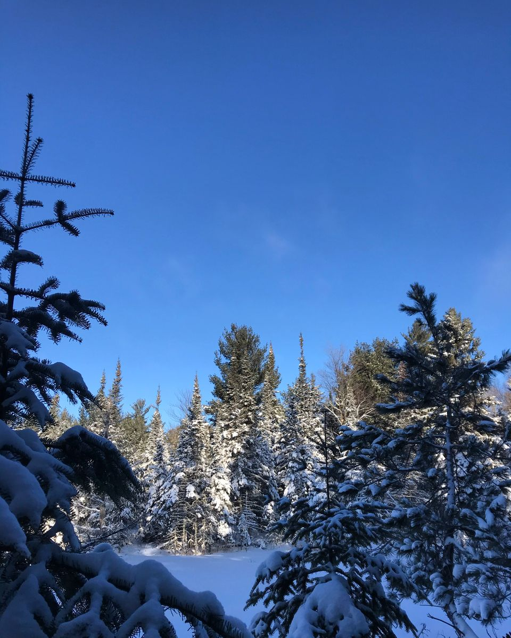
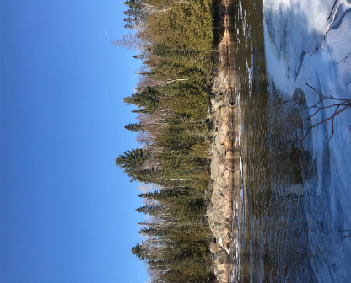
Notes:
notes_title
add_note_to_this_slide

Slide 3
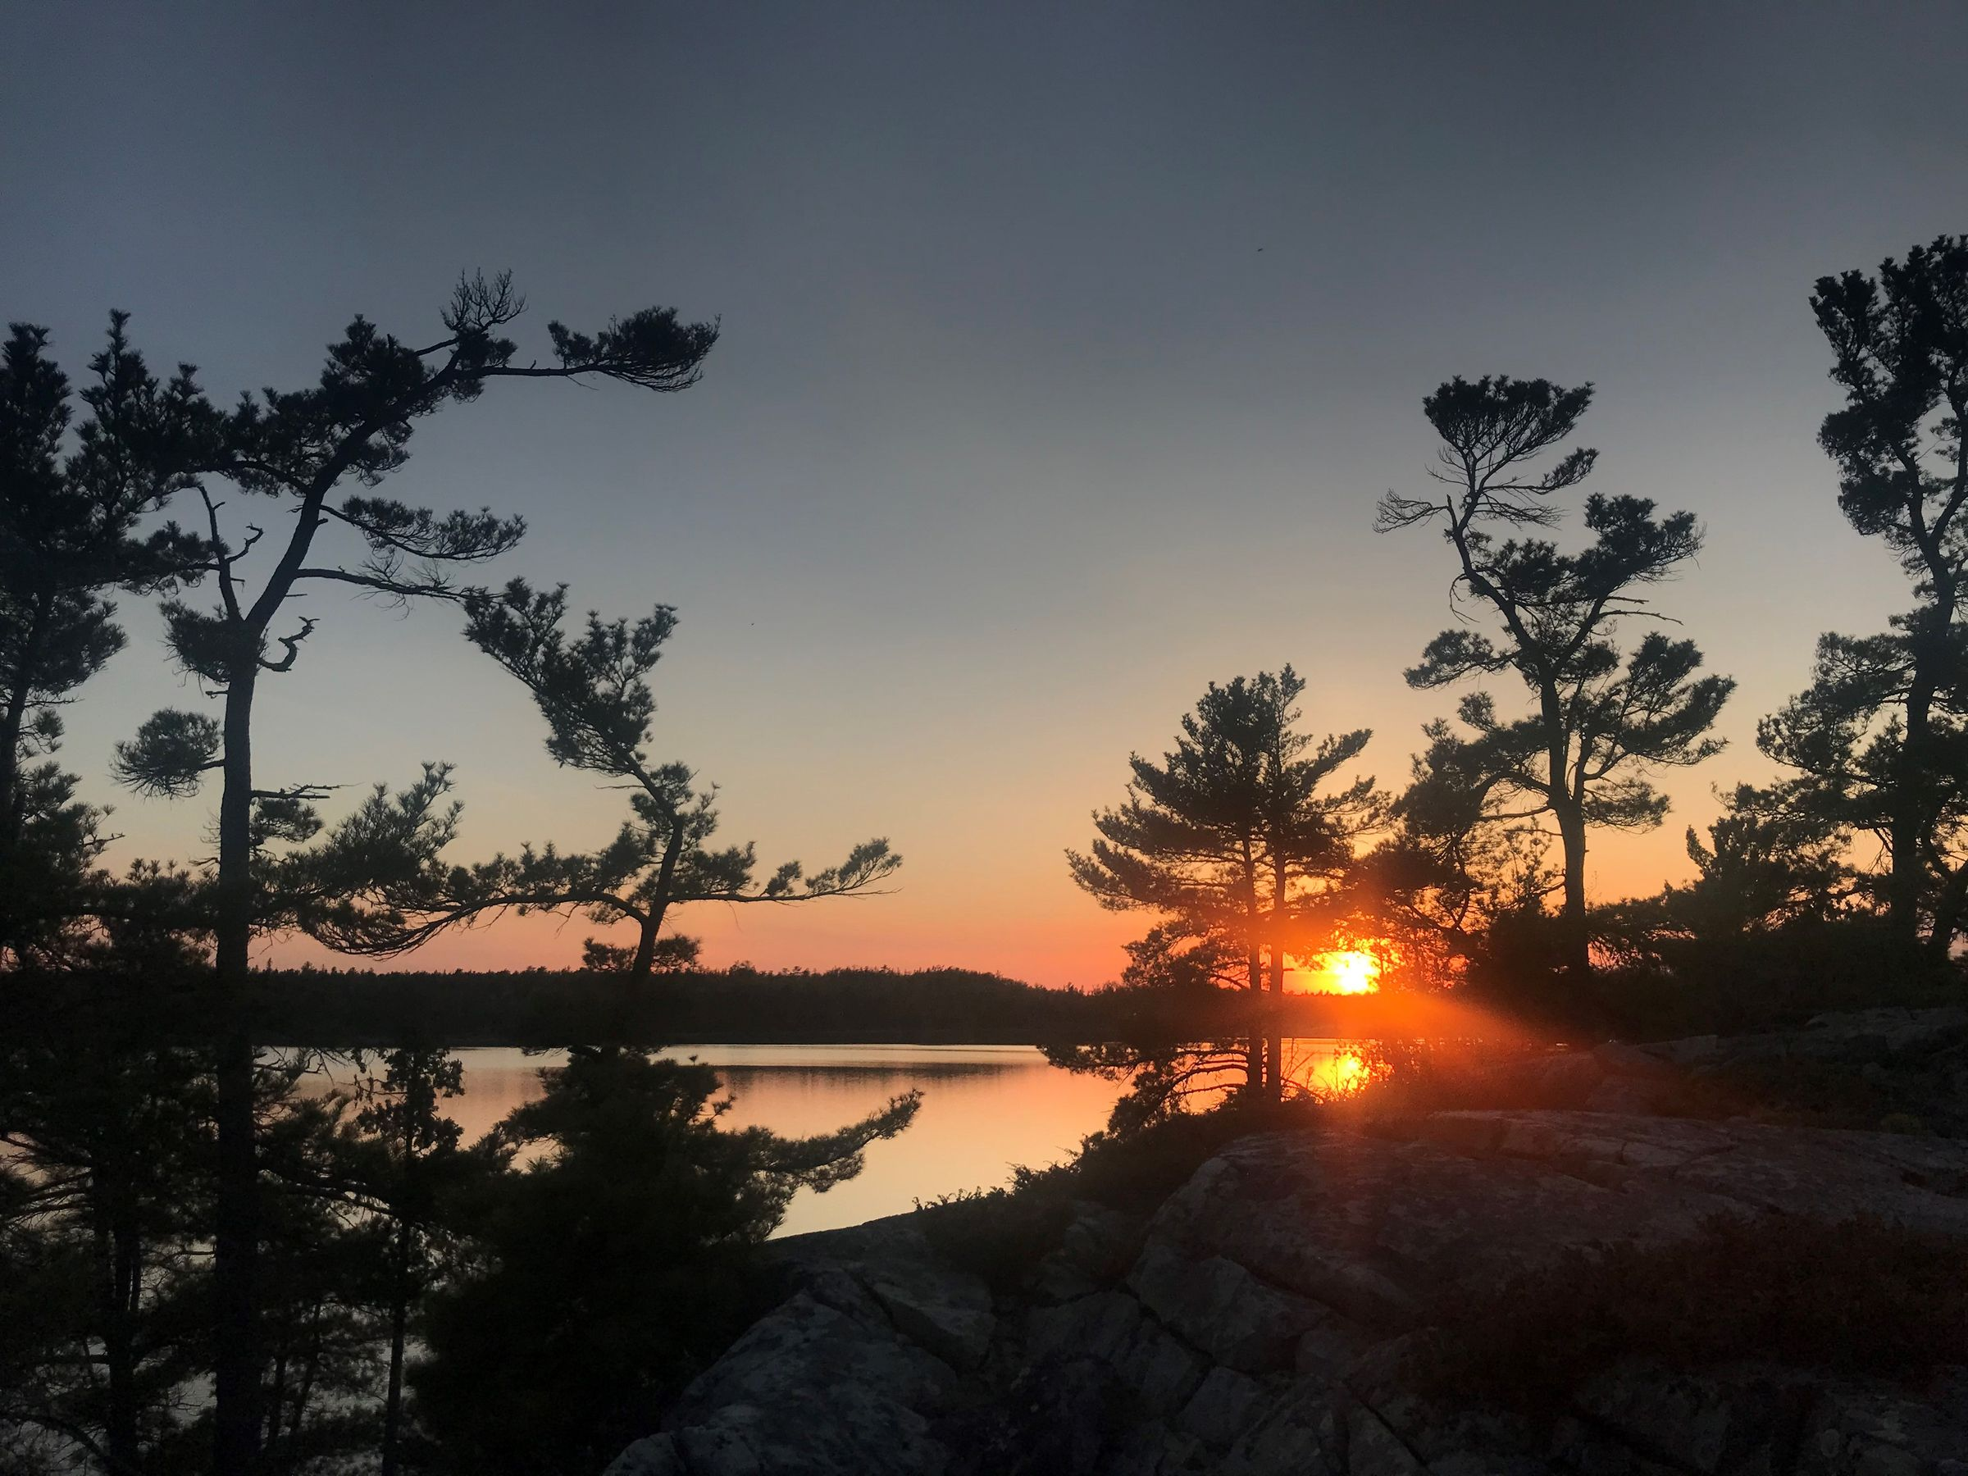
Notes:
notes_title
add_note_to_this_slide

Slide 4
Outline
Introductions
Background
Data & Data Linking
Our Projects
Knowledge Sharing & Impact
Notes:
Add note to this slide

Slide 5
Background
Notes:
notes_title
add_note_to_this_slide

Slide 6
Background
Alliance between First Nations health and social service organizations serving communities across northern Ontario
Formed in 2016
Shared need for high quality, community-specific health data
Notes:
Add note to this slide

Slide 7
Background
Giishkaandago'Ikwe Health Services
Weeneebayko Area Health Authority
Independent First Nations Alliance
Wabun Tribal Council
Sioux Lookout First Nations Health Authority
Keewaytinook Okimakinak
Kenora Chiefs Advisory
Shibogama First Nations Council
Maamawesying North Shore Community Health Services
Mushkegowuk Health Department
Matawa First Nations Management
Notes:
Add note to this slide

Slide 8
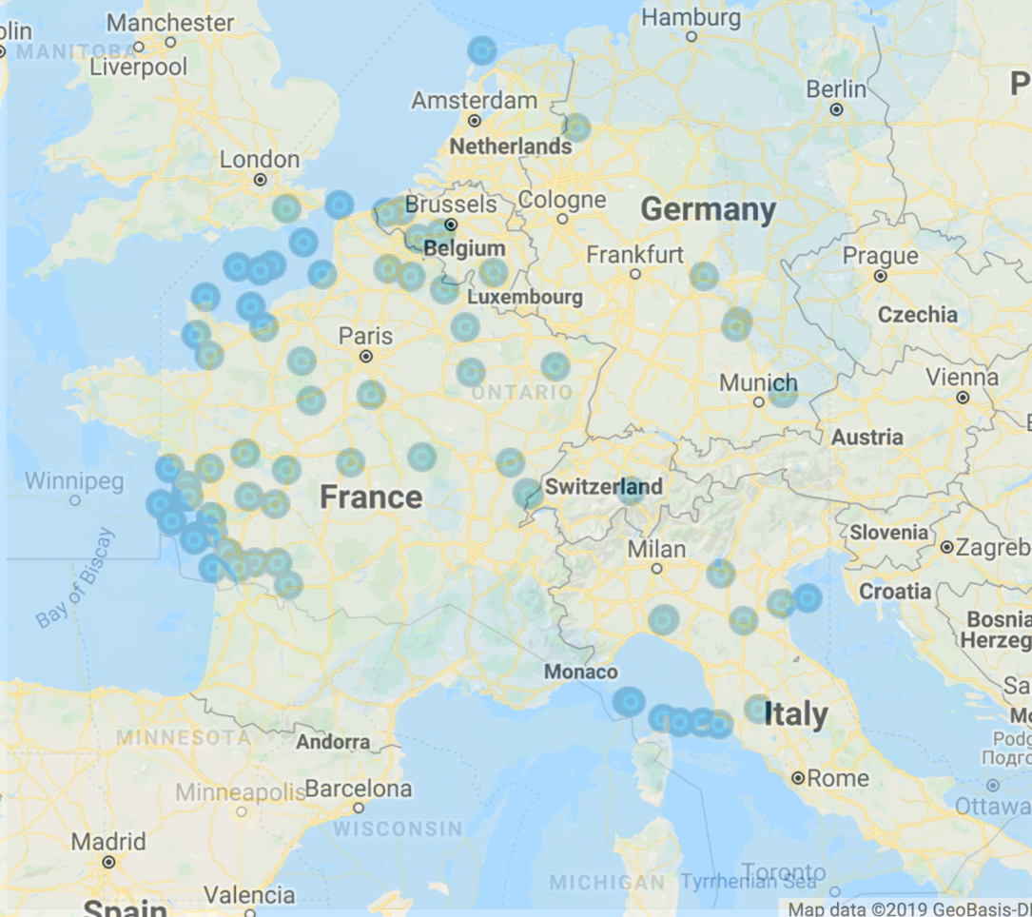
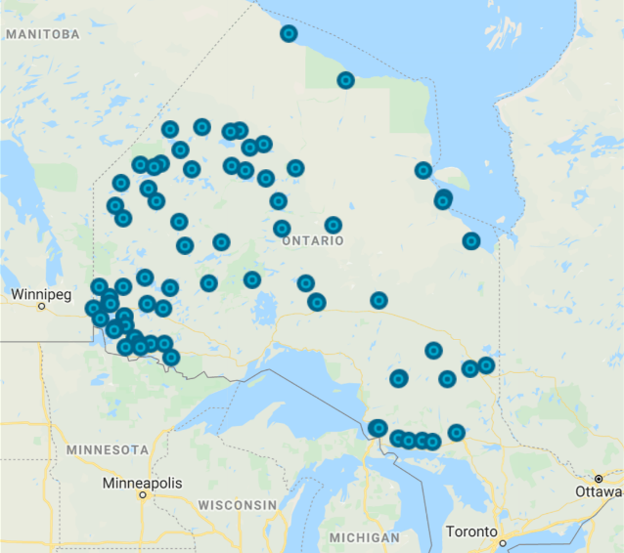
Map of First Nations communities served by Mamow Ahyamowen
Notes:
notes_title
add_note_to_this_slide

Slide 9
Map of Mamow Ahyamowen service area overlaid with map of Western Europe
Notes:
notes_title
add_note_to_this_slide

Slide 10
Background
We work with communities to
find, analyze, and interpret data
in response to questions that they have prioritized
following a culturally-respectful path
Notes:
Add note to this slide

Slide 11
Data & Data Linking
Notes:
notes_title
add_note_to_this_slide

Slide 12
What is data?
pieces of information collected together for reference or analysis
plural of datum: a piece of information
Data
Notes:
Add note to this slide

Slide 13
What is data?
Personal information originally collected for another purpose
Data
Administrative data
Notes:
Add note to this slide

Slide 14
Health Administrative Data in Ontario
"prescribed entity" under the Personal Health Information Protection Act
collects administrative data to monitor and evaluate health system
ICES
Notes:
Add note to this slide

Slide 15
First Nations Data at ICES
Chiefs of Ontario
ICES
Notes:
Add note to this slide

Slide 16
Health Administrative Databases
Health claims and utilization data (e.g. doctors visits, lab results)
Notes:
Add note to this slide

Slide 17
Health Administrative Databases
Indian Registry System
Health claims and utilization data (e.g. doctors visits, lab results)
Demographic and administrative information on all registered First Nations people
Notes:
Add note to this slide

Slide 18
Health Administrative Databases
Indian Registry System
Health claims and utilization data (e.g. doctors visits, lab results)
Demographic and administrative information on all registered First Nations people
By linking these data together, we can learn more about the health of people from the communities we serve
Notes:
Add note to this slide

Slide 19
Our Projects
Notes:
notes_title
add_note_to_this_slide

Slide 20
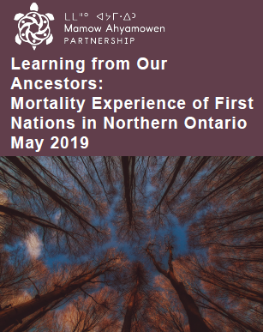
Learning From Our Ancestors
Focused on the health of people who passed away between 1992 and 2014
59 out of 74 communities opted in
Multiple levels of findings:
Alliance
Organization
Communities
Notes:
Add note to this slide

Slide 21
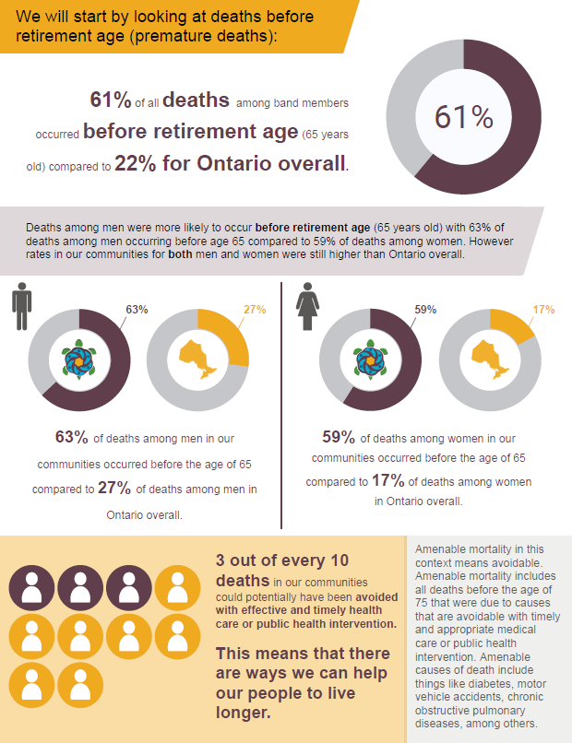
Learning From Our Ancestors
Premature deaths
Common causes of death
Chronic conditions present at death
Diabetes
Heart conditions
Mental Health conditions
Etc.
Notes:
Add note to this slide

Slide 22
What's next?
We are currently working on in-depth analyses on:
Mental Health & Addictions
Chronic Conditions
Injuries
Notes:
Type your notes

Slide 23
Knowledge Sharing & Impact
Notes:
notes_title
add_note_to_this_slide

Slide 24
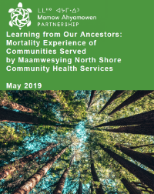
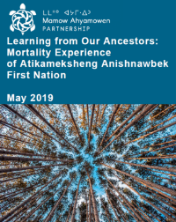
Knowledge Sharing
Knowledge Products
Reports - 4 different types:
Alliance level
Organization level
Community level
Companion reports
Slide decks
One-page infographics
Whiteboard video
Notes:
Note title
Type your notes here. They will be viewable in presenter view.

Slide 25
Knowledge Sharing
Knowledge Products
Engagement Strategies
Reports - 4 different types:
Alliance level
Organization level
Community level
Companion reports
Slide decks
One-page infographics
Whiteboard video
Varied depending on the organization and community. Examples:
Interactive workshops
Press releases
Presentations
Webinars
Social media
Notes:
Note title
Type your notes here. They will be viewable in presenter view.

Slide 26
Why is this important?
When we work with data in a good way, it supports
Evidence-Informed Decision Making
Advocacy
Self Determination
Notes:
Add note to this slide

Slide 27
Why is this important?
For example, organizations have used data to
Apply for funding
Inform planning
Support organization-specific initiatives
Notes:
Add note to this slide

Slide 28
Miigwech / Thank you
mamowahyamowen@gmail.com
www.mamowahyamowen.ca
Notes:
notes_title
add_note_to_this_slide

