Slide 1
Anishinaabek Research Ethics
Lorrilee McGregor, PhD
Whitefish River First Nation
Manitoulin Anishinaabek Research Review Committee
October 24, 2023

Slide 2
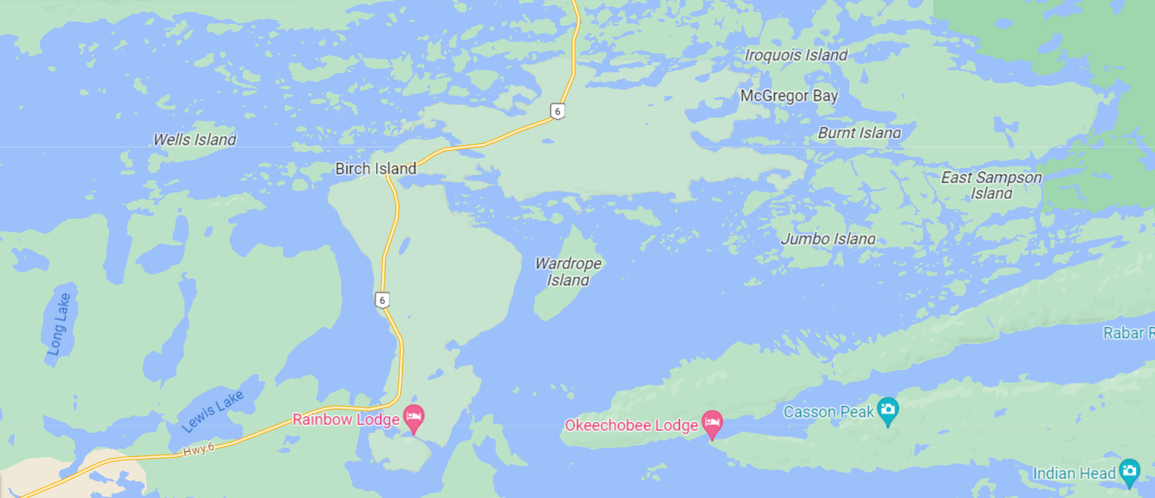
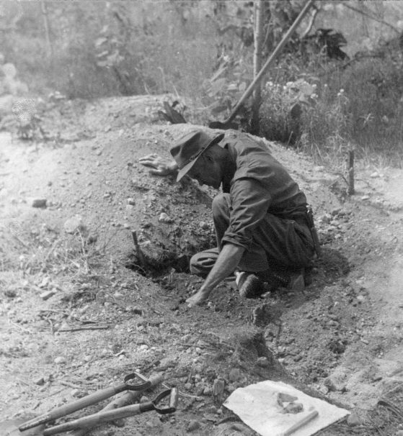
Wagaskinaga Mnising
Notes:
In 1938, the search for evidence of the east-west-south trade route led Emerson Greenman, an anthropologist from the University of Michigan, to conduct an archeological survey at one of my community’s village sites on Wardrope Island. Professor Greenman excavated the graves of my ancestors and shipped their remains and their funerary items to the University of Michigan where Greenman could study them. I983, our community discovered that our ancestors were being held at the University of Michigan we began lobbying the university to repatriate those remains in 1983. The first thing the university did was to deny that these were our ancestors despite the proximity to our current village. I was on band council and part of the negotiations with the university and I recall that when the university began to express some willingness to return our ancestors they tried to make it conditional by extracting dentin from the teeth for DNA testing in exchange for their return – holding our ancestors remains as hostage so that they could do further research. Our community vehemently opposed further desecration of the remains. I share this story because it is just one of many stories of researchers coming to our communities and conducting extractivist, harmful research.

Slide 3
Indigenous research
Time immemorial
Research methods:
observation;
experimentation;
visions and dreams.
Notes:
“The search for knowledge about ourselves and the world around us is a fundamental human endeavour. Research is a natural extension of this desire to understand and to improve the world in which we live.” Research has been defined as “an undertaking intended to extend knowledge through a disciplined inquiry or systematic investigation.”
Indigenous people have been doing research since the beginning of time; this is how we were able to survive in very harsh environments

Slide 4
Indigenous Peoples’ Experiences with Research
Indigenous research (creation ➔ present)
Discovery phase (1400-1800s)
Salvage research (1900-1970s)
Resurgence of Indigenous research (1970s - present)
Notes:
Our experience with research is directly connected to colonization. Through Papal Bulls, the Doctrine of Discovery provided religious authority for Christian empires to invade our lands and colonize them. Indigenous peoples were dispossessed from our lands by forced removal, disease and death. Indigenous people were considered sub-human. Following the creation of Canada, salvage research became the focus because colonial policies intended to eliminate Indigenous people. This is when anthropologists began documenting ‘exotic’ Indian cultures for posterity. The salvage period was characterized by outside experts doing research on the ‘Indian’ problem. A noticeable shift began in 1969. In response to the White Paper with it’s proposed changes to the Indian Act, a resurgence of Indigenous research like land claims research and needs assessments was being conducted for the benefit of First Nations.

Slide 5
RCAP Research Guidelines
Royal Commission on Aboriginal Peoples (1991-1996)
Volume 5, Appendix E: Ethical Guidelines for Research
Principles
Guidelines
Access to Research Results
Community Benefit
Notes:
Some of you will recall the Royal Commission on Aboriginal Peoples which took place following the Oka Crisis of 1990. Numerous research reports were commissioned between1991-1996 and Dr. Marlene Brant-Castellano was instrumental in developing Ethical Guidelines for Research. These guidelines were intended to ensure that all research conducted during the Royal Commission respected Indigenous cultures, languages, knowledge and values.

Slide 6
Chapter 9: Tri-Council Policy Statement (TCPS) Research Involving the First Nations, Inuit and Métis Peoples of Canada
Community engagement
Collaborative research
Local governing authorities
Respect for community customs and practices
Research agreements
Strengthen research capacity
Recognition of Elders and other Knowledge Holders
Notes:
The Tri-Council Policy Statement was first introduced in 1998 with the most recent revision in 2022. The TCPS applies to any research conducted on humans. Although there are criticisms that institutional Research Ethics Boards are more interested in protecting researchers and minimizing legal risks, Chapter 9 of the TCPS does provides some guidance for researchers who wish to conduct research with Indigenous peoples.

Slide 7
Indigenous self-determination in research
Six Nations Research Ethics Committee
Nuu-chah-nulth Tribal Council Research Ethics Committee
Mi’kmaw Ethics Watch
Manitoulin Anishinaabek Research Review Committee (MARRC)
Notes:
All across this land…

Slide 8
MARRC research guidelines
Based on the Seven Grandfather Teachings
Community collaboration & benefit
How will the research benefit 7 generations?

Slide 9
Community engagement
Validity of Anishinaabe ways of knowing and thinking
Naagdowendiwin (caring for each other)
Anishinaabemowin (speaking our language)
Ceremony
Reciprocity
Nbaachwe (visiting) and storytelling
Listening & silences
Culturally safe
Involving youth and Elders
Protecting Anishinaabek knowledge
Notes:
“Stop oppressing First Nations. Stop making money off of our suffering.”

Slide 10
“This is about healing.”
- Leona Nahwegahbow
Notes:
Despite the risks and challenges, research is considered important because it is supposed to help our communities.

Slide 11
In 2005, our ancestors remains were repatriated and reburied.

Slide 12
References
Castellano, M. B. (2004). Ethics of Aboriginal research. International Journal of Indigenous Health, 1(1), 98-114.
Hayward, A., Sjoblom, E., Sinclair, S., & Cidro, J. (2021). A new era of Indigenous research: Community-based indigenous research ethics protocols in Canada. Journal of Empirical Research on Human Research Ethics, 16(4), 403-417.
Panel on Research Ethics. (2022). Tri-Council Policy Statement: Ethical Conduct for Research Involving Humans – TCPS 2.

