Slide 1
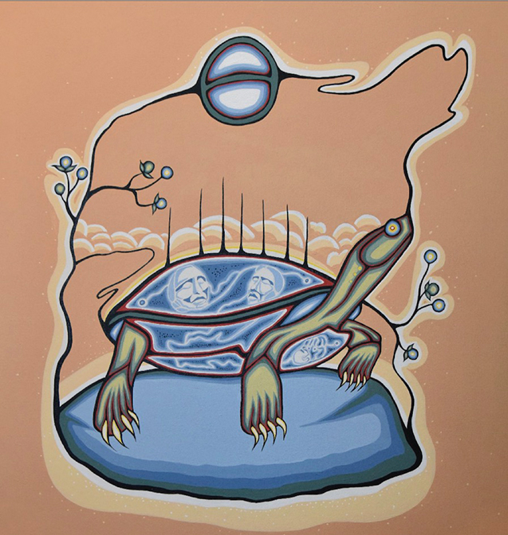
Chiefs of Ontario
Education Agreements
Patrik Lowen
&
Nikina Bear-Lowen
February 9, 2023
Chelsea Hotel - Toronto

Slide 3
Join at slido.com #2005753
ⓘ Start presenting to display the joining instructions on this slide.

Slide 4
Where are you from?
ⓘ Start presenting to display the poll results on this slide.

Slide 5
My Educational Journey
Constance Lake First Nation School daycare & K-4
French Public School Gr 4-6
French Immersion Public School Gr 6-8
English Public School Gr 9-12
University
Notes:
Hi My name is Nikina Bear-Lowen and I am from Constance Lake First Nation . I am here today because my dad forced me……just kidding . No in all seriousness I am here to share my educational journey with you and how it connects to the supports that First Nation students like myself may or may not have access to. As you can see on the screen my own journey has crossed many different schools and school system. I started my formal educational journey on Constance Lake First Nation and then moved into French Public School, French Immersion, English Public High School and I am now currently in my 2nd year at University of Waterloo where I am in the Health and Science Program.

Slide 6
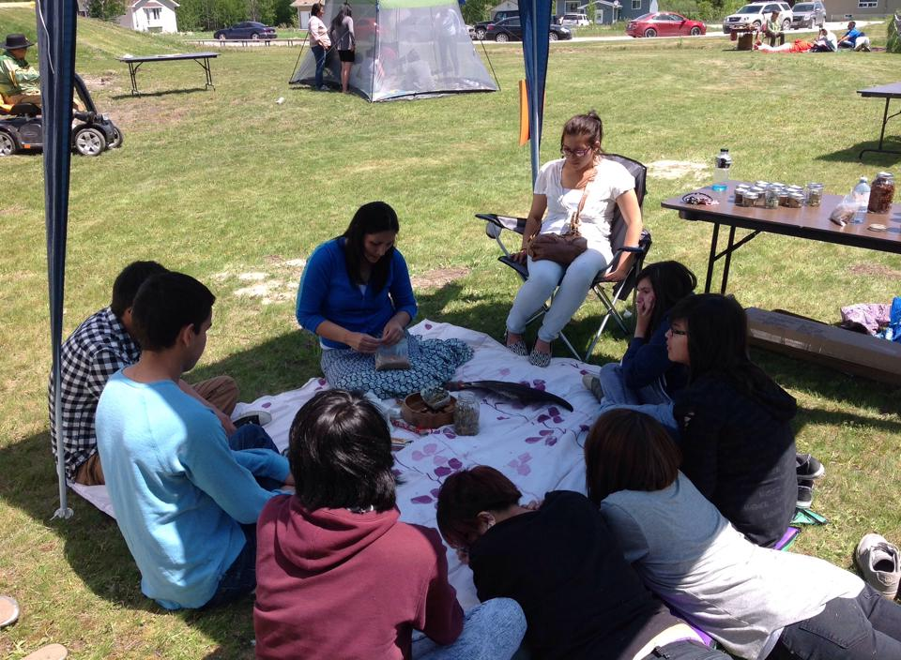
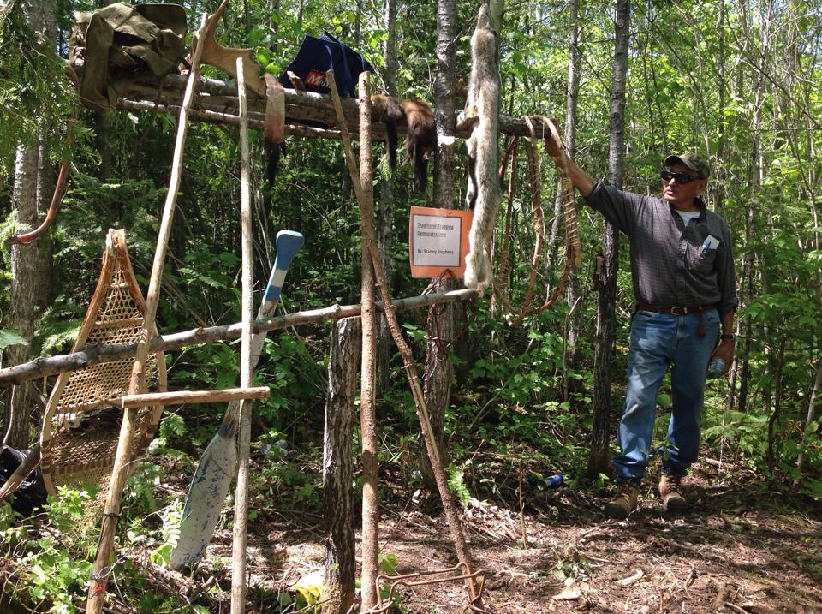
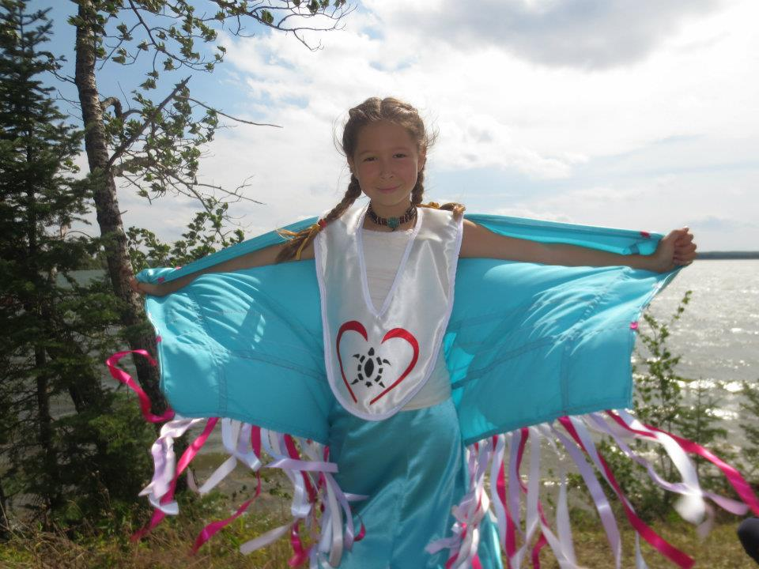
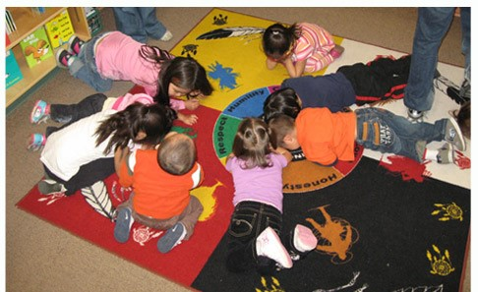
Constance Lake First Nation School
Notes:
Early in my life I lived in Constance Lake First Nation and attended daycare there and later on Junior Kindergarten to grade 4. We had daily Cree language classes , lots of cultural activities and on the land learning opportunities. In grade 4 my parents moved to a small northern French town and I attended French Public school.
I spoke no French what so ever and it was difficult at the beginning to fit in . At the French public school there were very few First Nation students and no First Nation staff. Basically I did not see my people or culture reflected at that school. As with many public schools we did the token activities such as dream catcher making or watch a documentary .

Slide 7
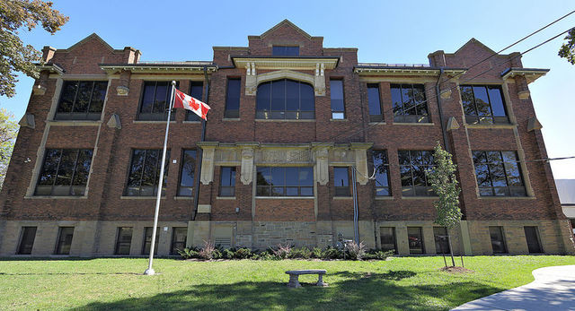
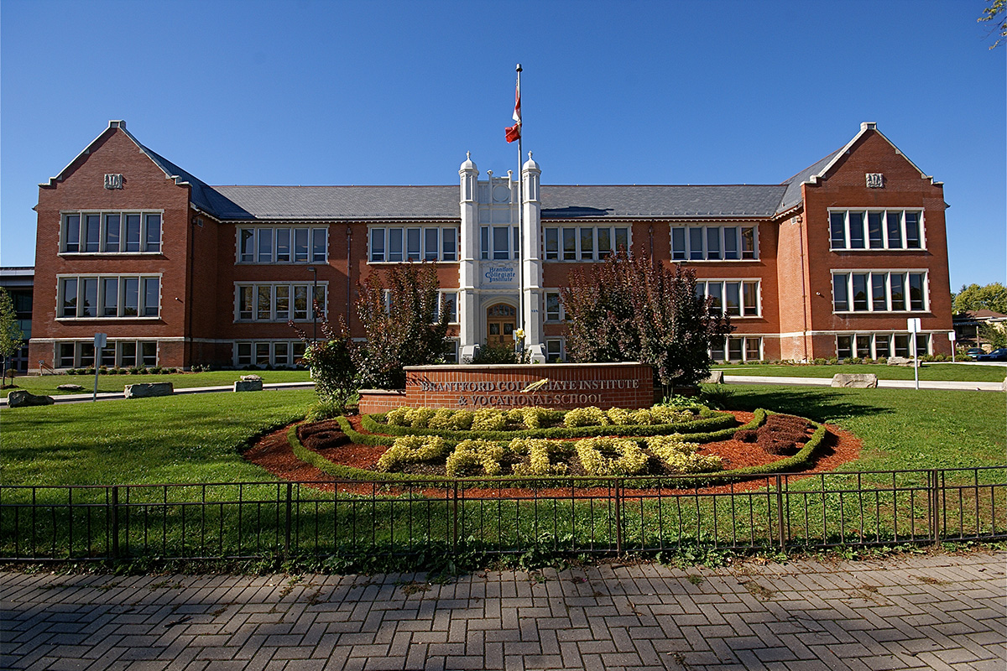
Notes:
My first experience when I moved from the on-reserve I spoke no French what so ever and it was difficult at the beginning to fit in . At the French public school there were very few First Nation students and no First Nation staff. Basically I did not see my people or culture reflected at that school. As with many public schools we did the token activities such as dream catcher making. As you can see the school building themselves are even colonial looking which in itself can be triggering for students and their families. That being said I did manage to navigate the system and I actually graduated a year early .

Slide 8
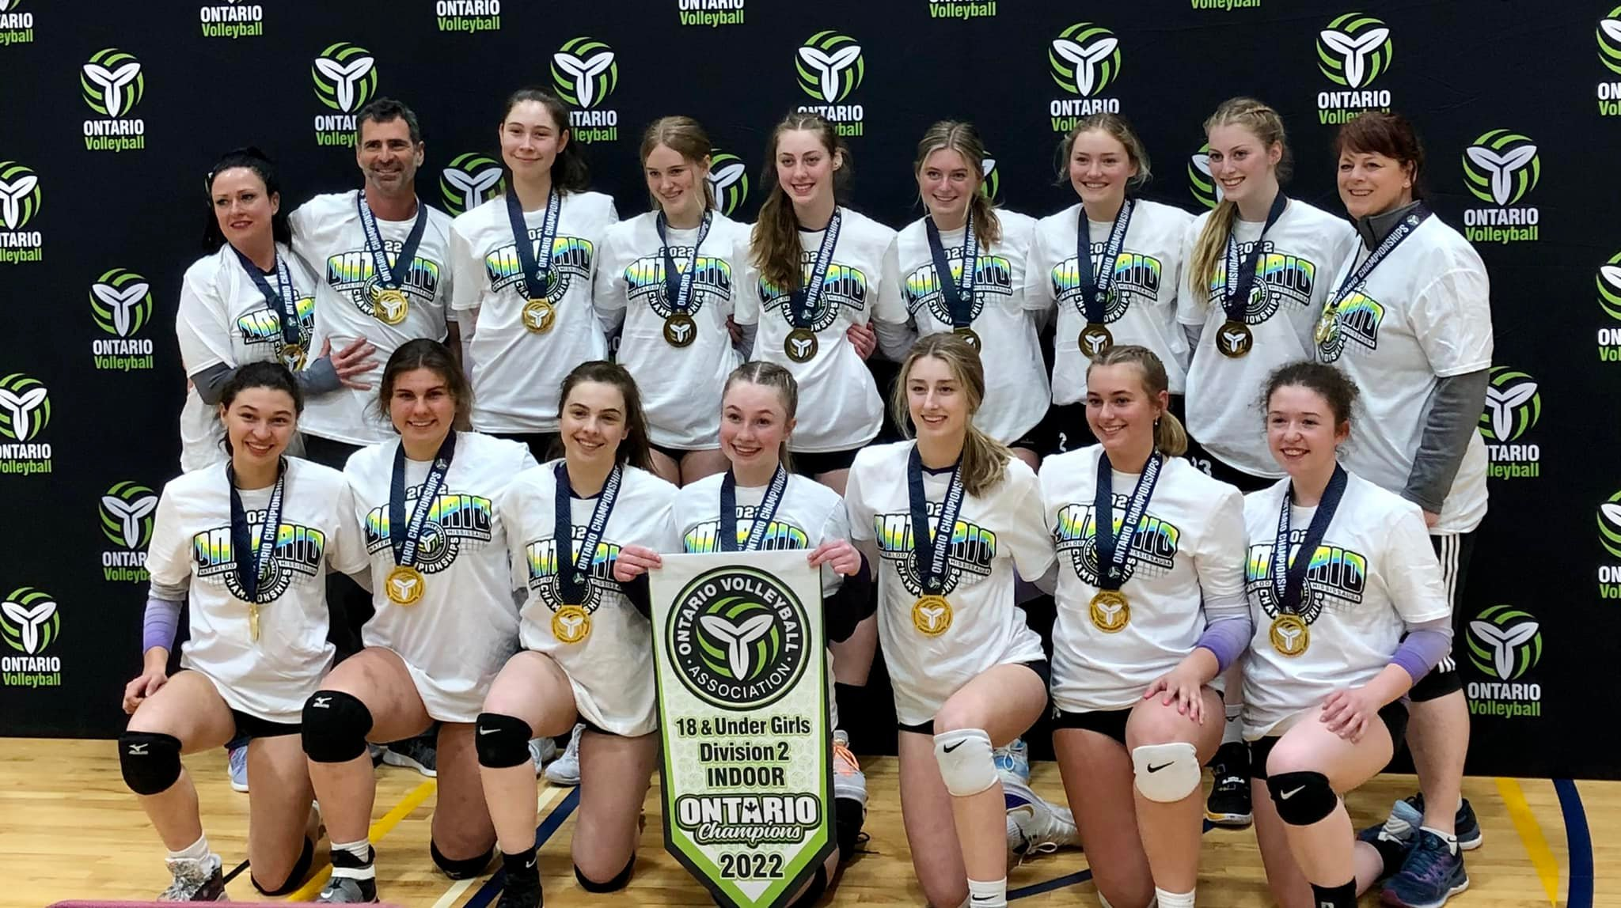
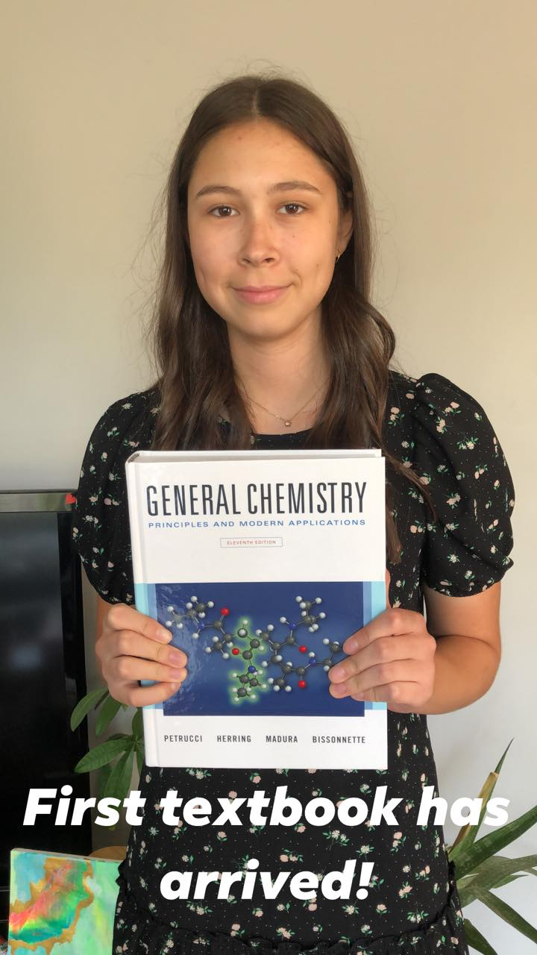
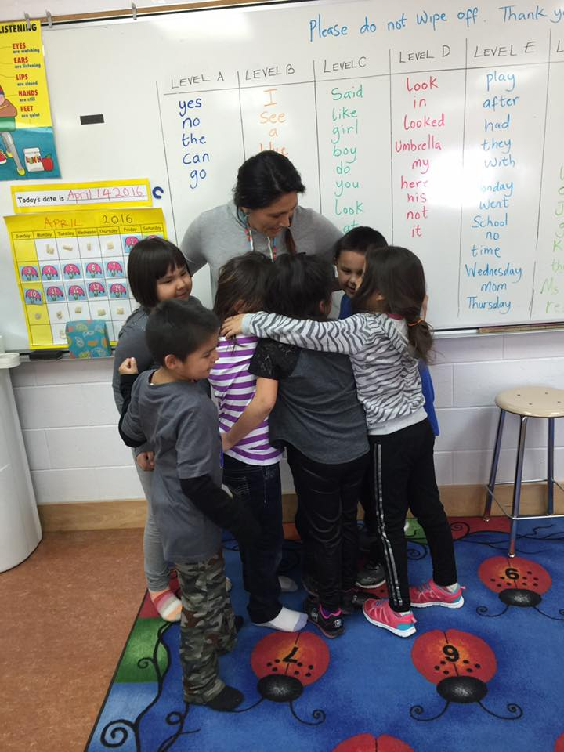
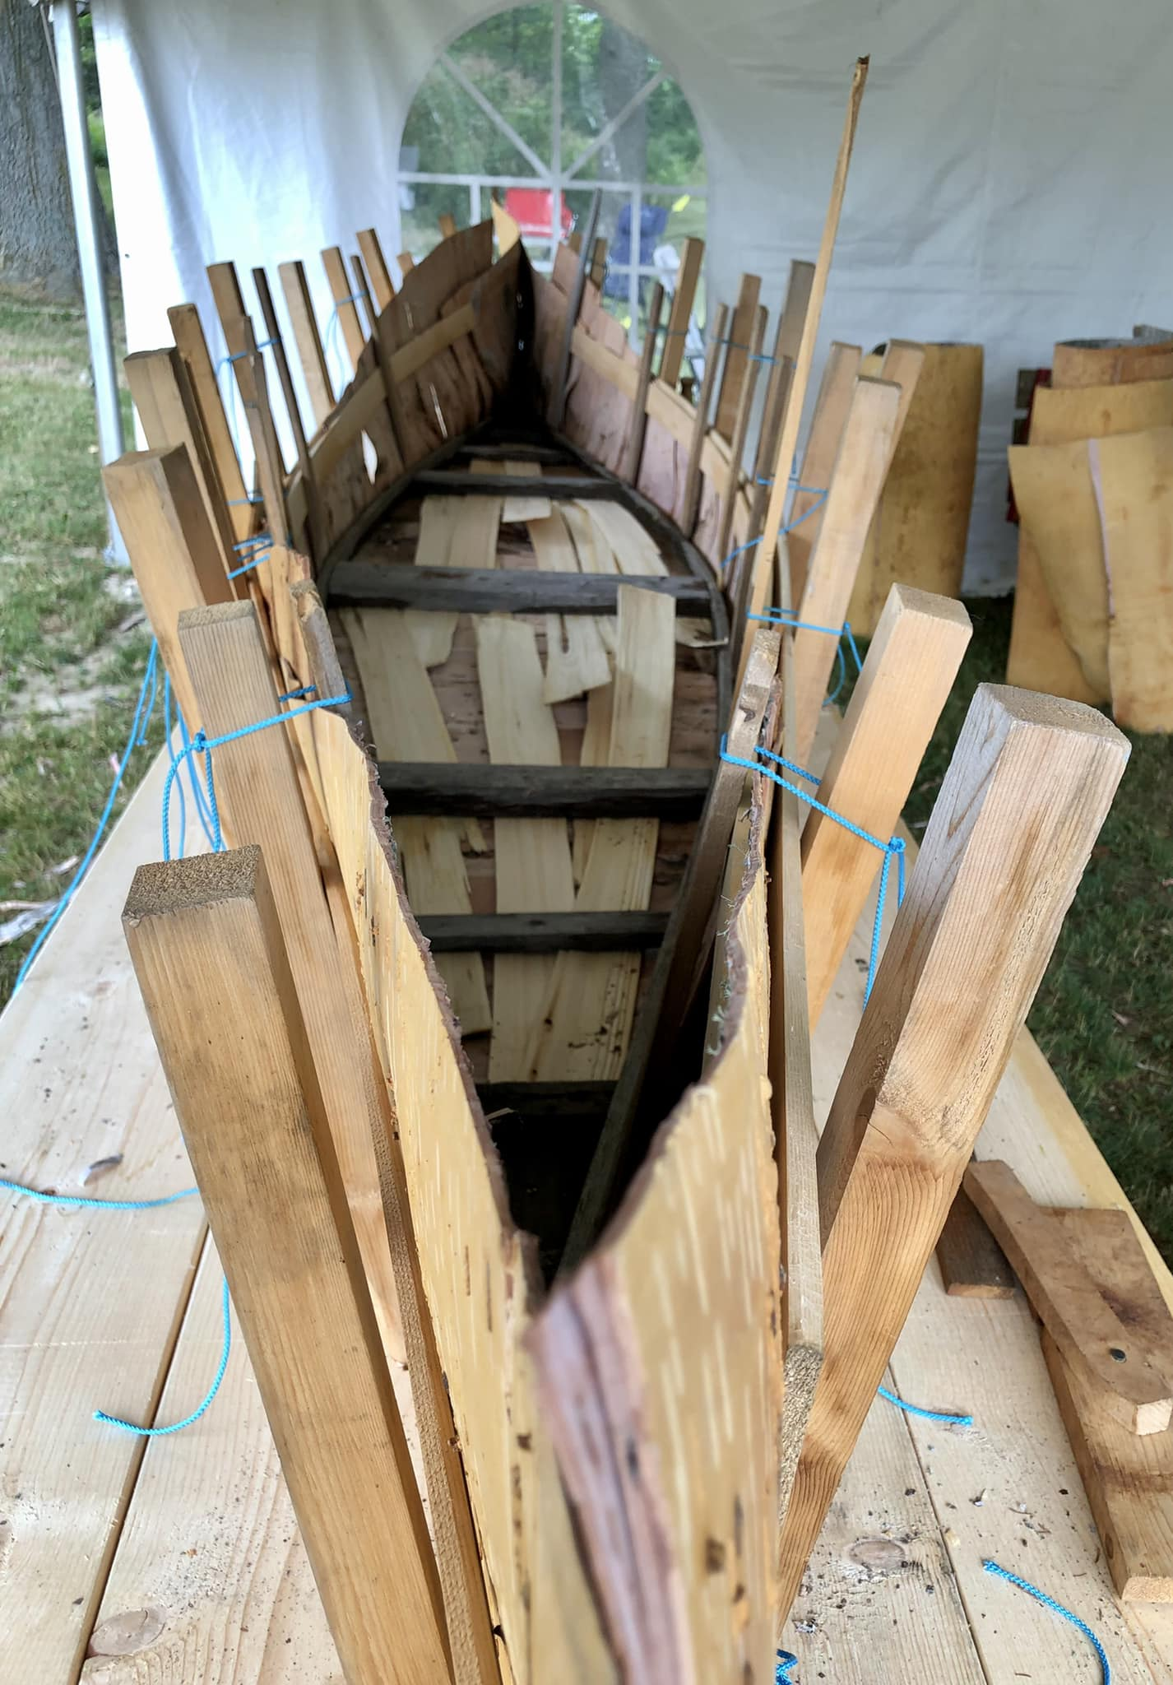
Notes:
So right now I am in my second year at the University of Waterloo, I am studying Health Sciences and I hpe one day to become an optometrist. As my parents have always reminded me of , education is life long and if look at post-secondary studies I do think that there are a lot of work to be done to better support First Nation students when they transition from high school to University or College.
In closing I will say that there is much work to be done to better support First Nation students that attend public schools. This responsibility does not soley rest on us First Nations pe

Slide 9
Does your First Nation currently have an Education Agreement with a school board(s)
ⓘ Start presenting to display the poll results on this slide.

Slide 10
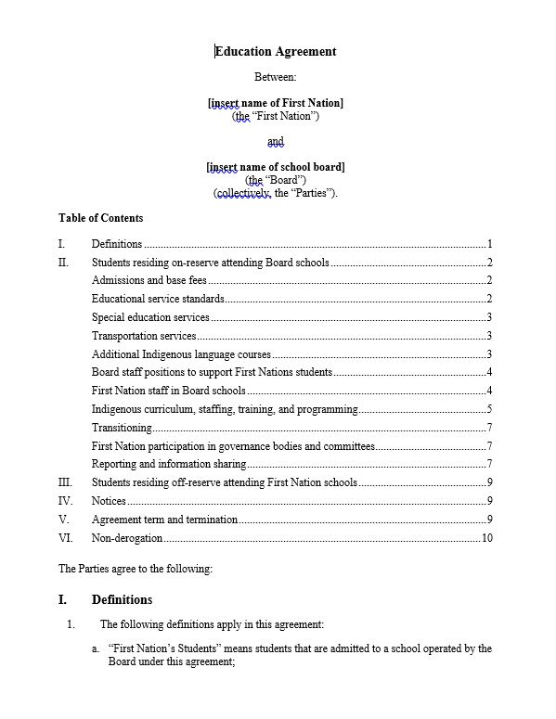
Education Agreements
ESA-Education Service Agreements
RESA-Reverse Education Agreements
TA-Tuition Agreements
REA-Reciprocal Education Approach

Slide 12
What are some of the essential support services that should be included in an Education Agreement?
ⓘ Start presenting to display the poll results on this slide.

Slide 13
Essential Services
Staffing
Programing
Transitioning
Governance Bodies
Data

Slide 14
Essential Services
The Board shall provide the First Nation’s Students:
a. Access to the full range of educational services offered by the Board and ongoing program placement assessment;
b. Access to supports and/or programs as a result of the First Nation, Métis and Inuit (FNMI) Education Policy Framework; and
c. At least the same level and quality of services it provides its resident pupils, including special education services.
The Board shall take the appropriate steps and provide the required services to improve achievement among the First Nation’s Students and to close the gap between the First Nation’s Students and non-Indigenous students in the areas of literacy and numeracy, retention of students in school, graduation rates, and advancement to postsecondary studies.
In accordance with the Education Act and the best interests of the child, the Board shall not expel and not decline to offer a service a student or decline to admit a student on the basis of there being a financial dispute between the Board and the First Nation

Slide 15
Staffing Positions
The Board shall staff at least the following positions focused on supporting First Nations students:
Indigenous Support Worker(s), Indigenous System Navigator(s), Indigenous Graduation Coaches, Indigenous Leads, Elders in Residence, Cultural Coordinators / Facilitators, Education Assistants, Student Cultural and Well-Being Support Workers
The Board shall provide the First Nation a position on the hiring committee for positions intended to support Indigenous students and those relating to Indigenous studies and languages.
The Board shall provide the First Nation with an updated list of the First Nation staff members in support positions whenever staffing changes are made, including email addresses.
The Board shall ensure that any First Nations program funding for staffing positions that support First Nations students are used as set out in the Ministry Guidelines (GSN)

Slide 16
The Board shall develop Indigenous educational programming that supports the spiritual, intellectual, emotional and physical well-being of First Nations students. For example:
Educational Programming on Indigenous Cultures and Histories
a. The Board shall offer Indigenous Studies courses in all secondary schools enrolling the First Nation’s Students.
b. The Board shall develop units and courses of study which infuse Indigenous culture/values across the curriculum, including instruction that is specific to the First Nation’s culture, values, and history.
c. The Board shall develop and deliver a land-based credit-eligible course founded in the First Nation’s and other Indigenous cultures, values, and traditions, or partner with another institution to do so. [Insert details]
d. The Board shall ensure that all secondary schools where the First Nation’s students are enrolled are provided with a dedicated space for First Nations students to participate in cultural, academic and other programming as needed by the First Nations students.

Slide 17
Transitioning
Whenever one or more of the First Nation’s Students will be entering a school of the Board outside of junior kindergarten, the Board will hold transition meetings to collaboratively plan placement, timetabling, and any support that is needed. These meetings will be held jointly with educators from the school the student is leaving (if available) and with parents or guardians (if available).
The Board shall work with the First Nation to co-develop a re-entry program for First Nations students that is based on the regional and territorial culture and beliefs. The reentry program would provide First Nations students that have been suspended or expelled an opportunity to engage in restorative practices upon re-entry to school.

Slide 18
First Nation participation in governance bodies and committees
The Board shall seek input from the First Nation regarding its budgets and plans for spending all funds received from the Ministry of Education for Indigenous education, including all of the funding it receives under the Indigenous Education Grant. For example, the Board shall seek feedback on draft budgets and plans for these funds before those budgets and plans are finalized.
The Board shall co-develop the Indigenous Board Action Plan, “BAP” with the Indigenous Education Council ,“IEC” or Indigenous Education Advisory Committee, “IEAC” or First Nations Advisory Committee, “FNAC” on an annual basis. The IEC, IEAC or FNAC shall be provided with quarterly updates on the ongoing implementation and evaluation of the annual BAP.
The Board shall offer to meet with First Nations to review and discuss the Board Improvement and Equity Plan, ”BIEP” on a bi-annual basis.

Slide 19
Data
The Board shall provide an annual report to the First Nation that will include, among other things:The following aggregate statistics for the First Nation’s Students: i. Credit accumulation by grade ii. EQAO scores iii. Student lateness (total and as a percent) iv. Student absences (total and as a percent) v. Suspension (total and as a percent) vi. Students with an IEP, total and broken down by exceptionality (total and as a percent of the student body) vii. Students waiting for a special education assessment viii. Graduation rates (total and as a percent)
The above statistics in a comparative format for (i) the First Nation’s Students and (ii) on a board-wide average (for the primary purposes of assessing what educational outcome gaps may exist), to be provided both as a 5-year average (to reduce irrelevant data noise) and as a chart over 5 years (to show potential trends); and
A list of all of the Board’s obligations under this agreement with a brief description of whether and how each obligation has been met over the past year.

Slide 20
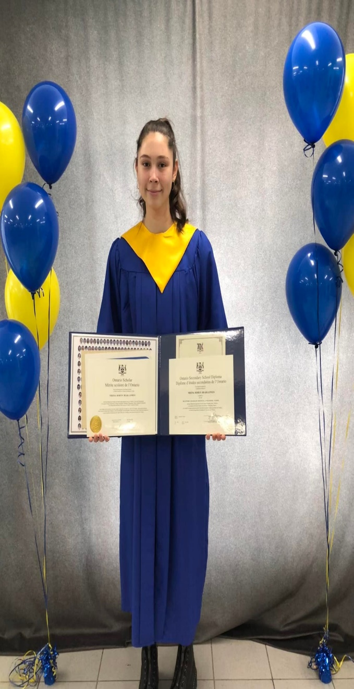
Thank you !
Patrik Lowen
Program Lead
Patrik.lowen@coo.org
519-717-0161
Nikina Bear-Lowen
Youth
Nikinaaabl@gmail.com

