Slide 1
Chiefs of Ontario
Language & Education Forum
Breakout Session: Jordan’s Principle in the Provincial School System
Chelsea Hotel, Toronto
Windsor Room
Thursday, February 9, 2023
11:00 AM EST

Slide 2
Join at slido.com #3806702
ⓘ Start presenting to display the joining instructions on this slide.

Slide 3
What is Jordan’s Principle
COO Jordan’s Principle Survey
Results
Q & A with COO Health
Group Discussion
Slido Live Polling

Slide 4
What is Jordan’s Principle?
In memory of Jordan River Anderson
Legal rule resulting from the Orders of the Canadian Human Rights Tribunal
Not a policy or a program
Child-first principle that aims to eliminate service inequities and delays for First Nations children
A child is eligible if they are under the age of majority and meet one of the following criteria:
Is registered or eligible to be registered under the Indian Act
Has one parent or guardian who is registered or eligible to be registered under the Indian Act
Is recognized by their nation for the purposes of Jordan’s Principle
Is ordinarily a resident on reserve
https://fncaringsociety.com/what-you-can-do/ways-make-difference/jordans-principle
https://www.afn.ca/policy-sectors/social-secretariat/jordans-principle/
https://www.sac-isc.gc.ca/eng/1568396296543/1582657596387#sec2
Notes:
Jordan’s Principle is named in memory of Jordan River Anderson, a First Nations boy from Norway House Cree Nation in Manitoba, who spent his entire life in hospital while caught in a jurisdictional dispute between the governments of Canada and Manitoba, which both refused to pay for the in-home medical care necessary for Jordan to live in his home and community. Jordan died in the hospital at the age of five years old, never having spent a day in a family home.
Jordan’s Principle is a legal rule resulting from the Orders of the Canadian Human Rights Tribunal (CHRT) and is not a policy or program. Jordan’s Principle is a child-first principle that aims to eliminate service inequities and delays for First Nations children. Jordan’s Principle states that any public service ordinarily available to all other children must be made available to First Nations children without delay or denial.
Jordan’s Principle may be accessed for health, social and education needs of a child under the age of majority if they meet one of the following criteria:
is registered or eligible to be registered under the Indian Act
has one parent or guardian who is registered or eligible to be registered under the Indian Act
is recognized by their nation for the purposes of Jordan’s Principle
is ordinarily resident on reserve.
Unfortunately, despite the unanimous support of the House of Commons in 2007 for a broad definition, the federal government went on to implement Jordan’s Principle in a manner so narrow that few, if any, First Nations children qualified.
In a landmark ruling on January 26, 2016, the CHRT ruled that Canada’s definition of Jordan’s Principle was discriminatory and ordered the federal government to take immediate measures to implement the full and proper scope of Jordan’s Principle.
Canada failed to comply with the Tribunal’s ruling and three months later, in April 2016, the CHRT issued its first non-compliance order against Canada. In all, the Tribunal has been forced to issue more than 20 additional orders, many of them non-compliance orders against Canada. The Tribunal orders have led to over 2.04 million products, services, and supports for First Nations children through Jordan's Principle. The Tribunal has also ordered Canada to review previous service requests dating from April 1, 2009, whether made pursuant to Jordan's Principle or otherwise, to determine what supports children/youth would or should have received had Canada applied the proper definition of Jordan's Principle.
Jordan’s Principle funding for educational support is accessed by First Nations communities, First Nations organizations, Tribal Councils, families, service navigators, case managers, schools and school boards. These supports may include, technology, school supplies, transportation, assessments, and staff positions.

Slide 5
COO Jordan’s Principle Survey
To gather insight into the experiences of Ontario First Nations education staff, pertaining to Jordan’s Principle in provincial schools
To develop recommendations that improve implementation of Jordan’s Principle for First Nations learners in provincial schools in Ontario
COO administered a survey of 15 questions for First Nations education directors or education staff
Survey focused on:
Education Agreements between First Nations and school boards
Strengths and weaknesses of Jordan’s Principle use in school boards
Barriers to implementing Jordan’s Principle at school boards
Awareness of Jordan’s Principle at school boards
Use of Jordan’s Principle to fund services normally funded through the GSN
Existence of any policies and procedures
Existence of any communication protocols
Determining who initiates Jordan’s Principle applications
Identifying services accessed through Jordan’s Principle at the school board
Identifying improvements to the implementation of Jordan’s Principle at school boards
The survey was co-developed with the COO Health Sector
Notes:
The purpose of this research is to explore and gather insight into the experiences of Ontario First Nations education staff, as they pertain to Jordan’s Principle in provincial schools. More specifically, the purpose of this research is to develop recommendations that improve the implementation of Jordan’s Principle for First Nations learners attending provincial schools in Ontario. The process of understanding how First Nations education staff, parents, and students view and interact with Jordan’s Principle in provincial schools is best understood by connecting with the people who work with First Nations students and families, and provincial school boards.
To gather this perspective, the Chiefs of Ontario administered a survey for First Nations education directors, or designated education staff by the First Nation, with relevant experience and insight. The survey consisted of 15 questions.
The survey focused on the following:
the existence of Education Agreements between the First Nations and school boards;
perceived strengths and weaknesses of Jordan’s Principle use in school boards;
barriers experienced or observed in the implementation of Jordan’s Principle at school boards;
awareness of Jordan’s Principle at school boards;
use of Jordan’s Principle to fund services normally funded through Grants for Student Needs (GSN);
identifying school board staff positions who most often initiate/manage Jordan’s Principle applications;
confirming the existence of a designated school board contact for Jordan’s Principle;
identifying any policies and/or procedures in place for Jordan’s Principle;
identifying any communication protocols in place between school boards and First Nations for Jordan’s Principle applications;
identifying usual initiator of Jordan’s Principle applications for First Nations students within school boards;
identifying services accessed through Jordan’s Principle at school boards; and
identifying improvements to the implementation of Jordan’s Principle at school boards.
The survey was co-developed with the help of the COO Health Sector.

Slide 6
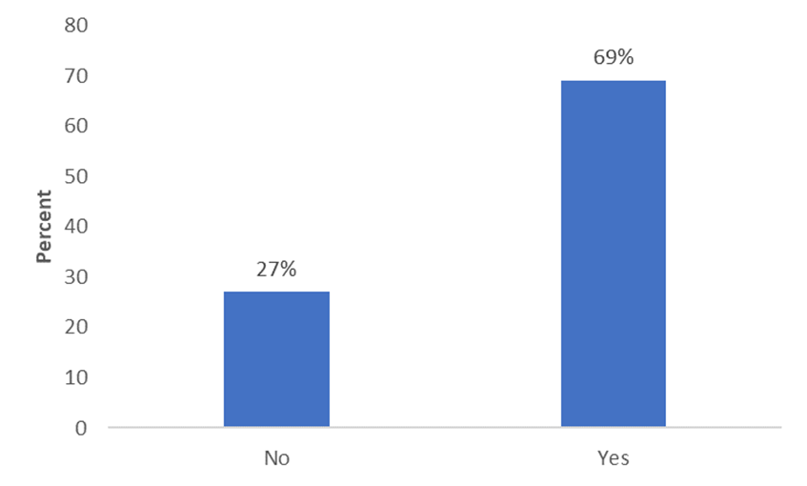
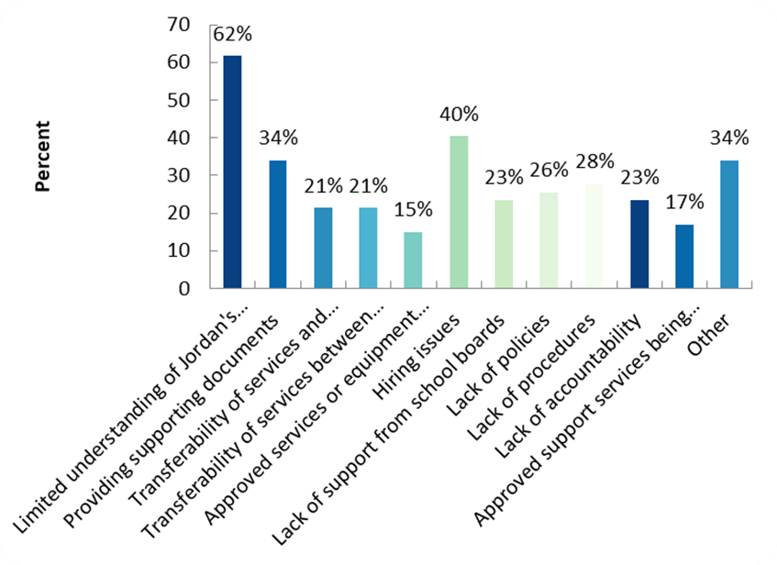
Results
Education Agreements with school boards:
Barriers in implementing Jordan’s Principle:
Notes:
Intro to Results
A link to the First Nations Jordan’s Principle survey was circulated by email on April 19, 2022 to all 133 First Nations in Ontario. Participants were eligible for a $20 Tim Horton’s gift card for the completion of the survey. The total number of respondents was 49, with 3 surveys left incomplete.
Education Agreements with School Boards:
At the time of survey, the majority of respondents (69%) held an Education Agreement with school board(s). Of those who answered yes, respondents held Education Agreements in the following quantities: 1 agreement (10), 2 agreements (12), 3 agreements (1), 4 agreements (1). Respondents also answered “all boards” (1), “several (1),” and “unsure (1)”.
Barriers in implementing Jordan’s Principle:
Limited understanding of Jordan’s Principle at the school board (62%)
Hiring issues (40%)
Other (34%)
Providing supporting documents (34%)
Lack of procedures (28%)
Lack of policies (26%)
Lack of accountability (23%)
Lack of support from school boards (23%)
Transferability of services and between school boards (21%)
Transferability of services between First Nation schools and school boards (21%)
Approved support services being used by other students (17%)
Approved services or equipment used by other students (15%)

Slide 7
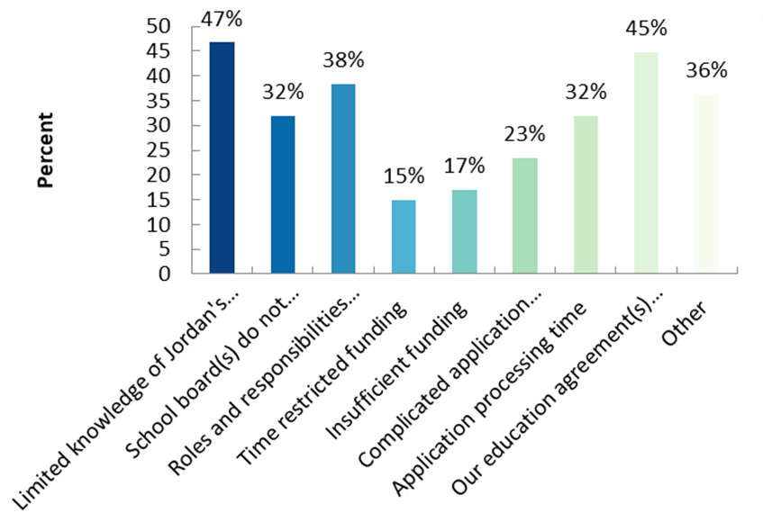
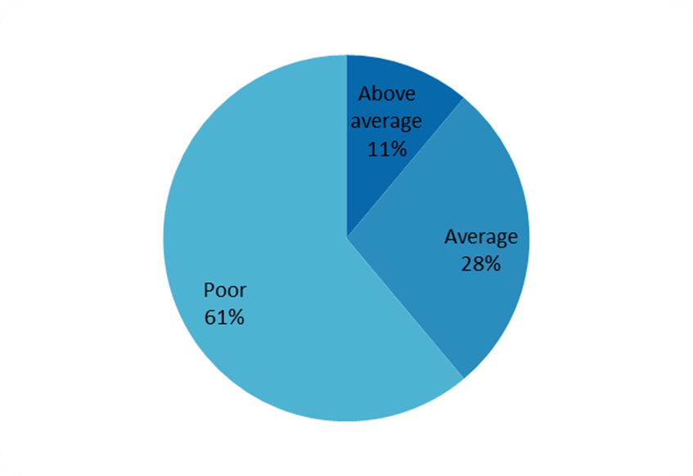
Results
Specific concerns/issues in the implementation of Jordan’s Principle at school boards:
Overall awareness of Jordan’s Principle at school boards:
Notes:
Specific issues/concerns in the implementation of Jordan’s Principle in school boards:
Limited knowledge of Jordan’s Principle (47%)
Our education agreement(s) lack language around Jordan’s Principle (45%)
Roles and responsibilities (who does what/how is it done) (38%)
Other (36%)
Application processing time (32%)
School board(s) do not engage with First Nation (32%)
Complicated application process (23%)
Insufficient funding (17%)
Time restricted funding (15%)
Overall Awareness of Jordan’s Principle at School Boards
61% “poor”
28% “average”
11% “above average”

Slide 8
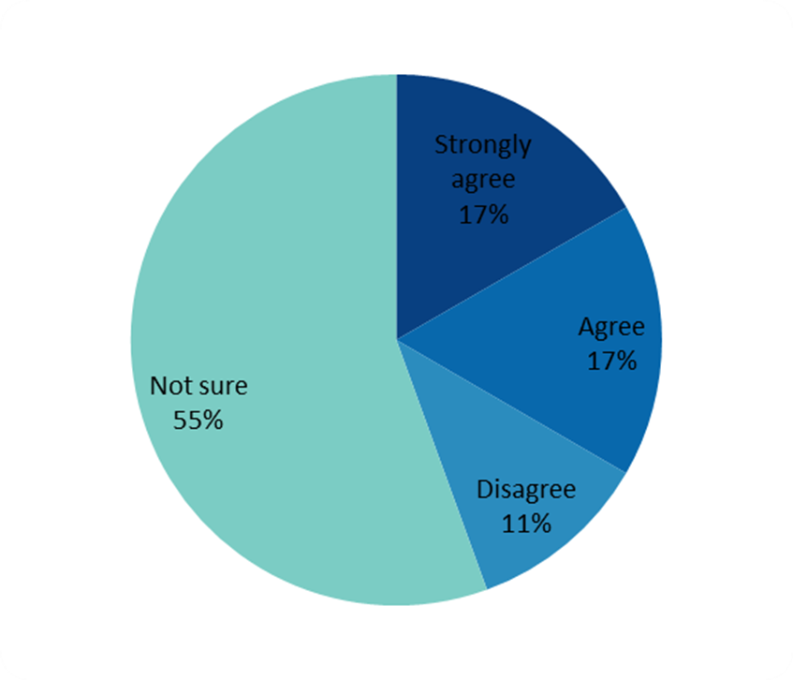
Results
Agree/disagree school boards use Jordan’s Principle to fund special education services normally funded through GSN:
Changes that can be made to improve Jordan’s Principle process at school boards:
Full time permanent point of contact
Communication
Improved wait times
Waive administration fees
Policies and procedures
Reconciliation and relationship building
Transparency and accountability
Notes:
Participants were asked to indicate if they agree/disagree with the following statement:
“School boards are using Jordan’s Principle to fund special education services that are normally funded through the Grants for Student Needs (GSN)”
55% “not sure”
17% “agree”
17% “strongly agree”
11% “disagree”
What changes can be made to improve Jordan’s Principle process at school boards:
establish a full time permanent point of contact;
a dedicated Jordan’s Principle worker at First Nation, school board, and ISC office
up-to-date contact information for point of contact that is easy to find
communication;
open communication and frequent consultation between school boards, First Nations, and ISC Jordan’s Principle staff
improved wait time;
waive administration fees;
eliminate or reimburse board administration fees charged to First Nations with each Jordan’s Principle application
policies and procedures;
establish Jordan’s Principle policies and procedures for school boards and ISC, including standard reporting requirements
professional development on Jordan’s Principle available to First Nations and school boards
reconciliation and relationship building; and
increase effort by school board and ISC toward reconciliation
transparency and accountability
school board disclose the receipt and use of Jordan’s Principle funding to the First Nation of the student on whose behalf the application was made
school board must not apply for Jordan’s Principle funding for supports and services normally covered under the GSN.

Slide 9
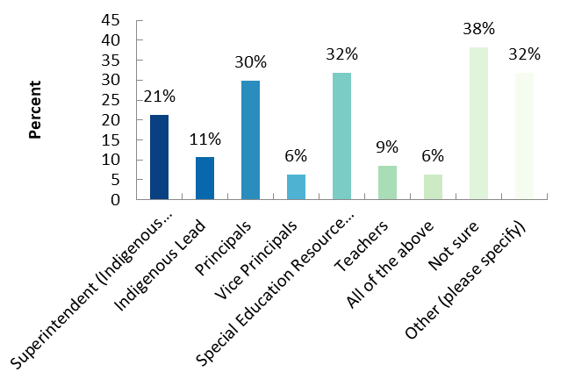
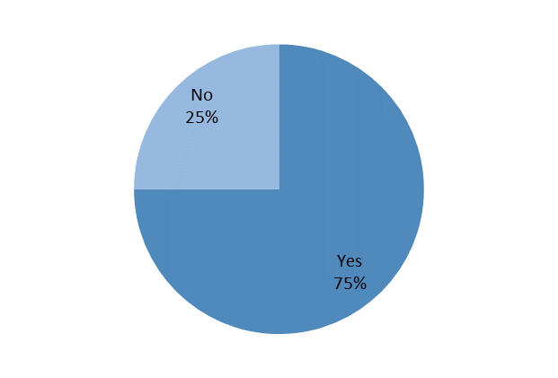
Results
Who handles Jordan’s Principle applications at school boards:
First Nation has a designated Jordan’s Principle contact at school boards:
Notes:
Who handles Jordan’s Principle applications at school boards:
The majority of respondents (38%) were unsure of who typically deals with Jordan’s Principle applications at the school board. The next top three responses were special education resource teachers (32%), other (32%), and principals (30%).
Does your First Nation have a designated school board contact for Jordan’s Principle?
Yes (75%)
No (25%)
If yes, respondents were asked to elaborate on the job title of the contact at school board:
Navigator
Director
Jordan’s Principle Coordinator
Principal
Superintendent of special education

Slide 10
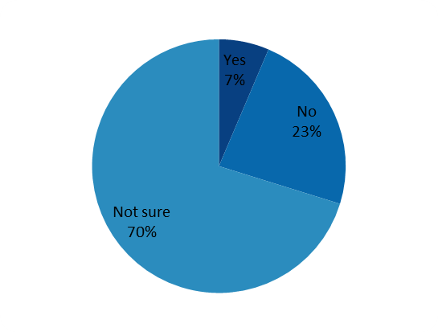
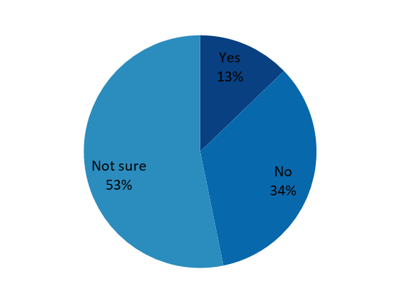
Results
Jordan’s Principle policies and procedures at school boards:
Jordan’s Principle communication protocols at school board to update First Nations:
Notes:
Do the school boards have policies and procedures in place for Jordan’s Principle?
70% “not sure”
23% “no”
7% “yes”
Does the school board have communication protocols to update your First Nations on new Jordan’s Principle applications?
53% “not sure”
34% “no”
13% “yes”

Slide 11
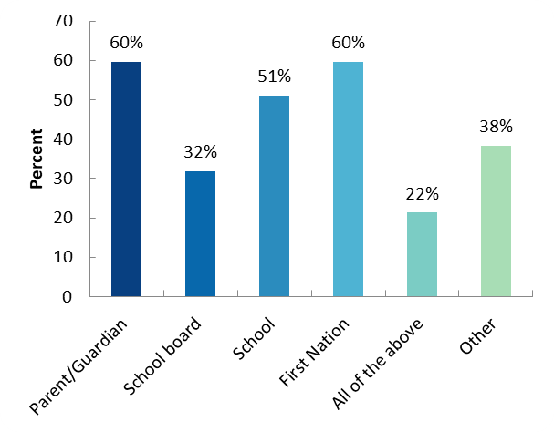
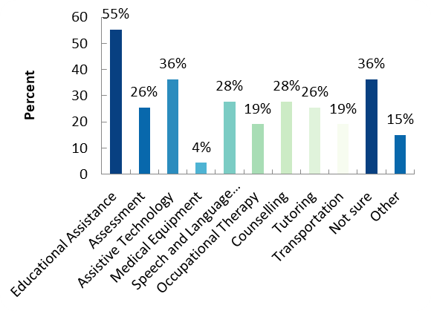
Results
Who initiates Jordan’s Principle applications:
Services accessed through Jordan’s Principle at school boards:
Notes:
Who initiates Jordan’s Principle applications
60% “parent/guardian”
60% “First Nation”
51% “school”
38% “other”
32% “school board”
22% “all of the above”
Services accessed through Jordan’s Principle at school boards:
55% Education Assistants
36% Assistive Tech
36% not sure
28% counselling
28% speech and language pathology
26% assessment
26% tutoring
19% occupational therapy
19% transportation
15% other
4% medical equipment

Slide 12
Q&A With COO Health
ⓘ Start presenting to display the audience questions on this slide.

Slide 13
What are the successes/challenges with Jordan's Principle in your school board?
ⓘ Start presenting to display the poll results on this slide.

Slide 14
Who should be responsible for handling Jordan's Principle requests?
ⓘ Start presenting to display the poll results on this slide.

Slide 15
How do we ensure accountability and transparency with school boards? Is a Jordan's Principle policy needed?
ⓘ Start presenting to display the poll results on this slide.

Slide 16
Group Discussion
Are the results of the First Nations Education survey surprising?
Do you have similar experiences as those represented in the survey?

Slide 17
Thank you!
Feel free to send any questions/comments to
Karleigh.palmer@coo.org

