Slide 1
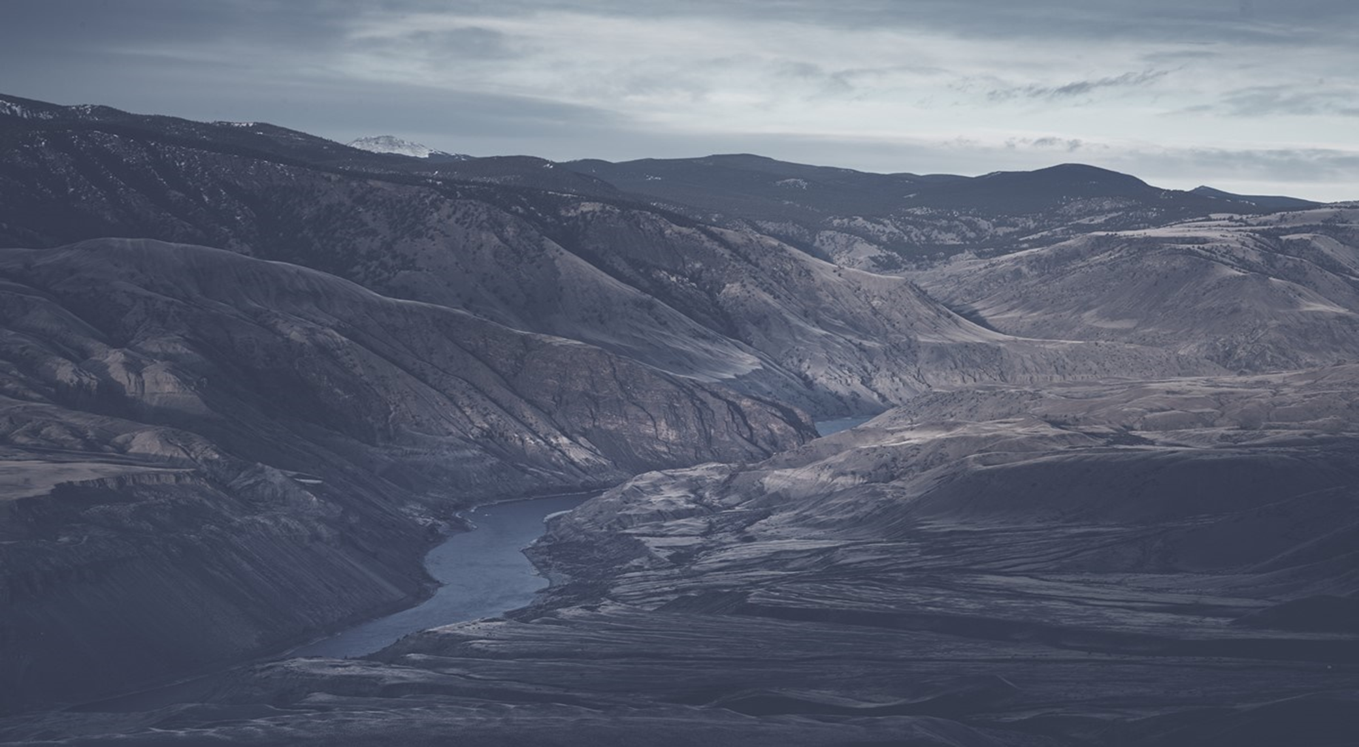
Treaty 9 Co-jurisdiction Case
Chiefs of Ontario – Annual Chiefs Assembly
June 14, 2023
LAWYERS LLP

Slide 2
Overview
What is the case about?
What does the evidence show?
What does the case ask for?
What challenges will we face?
Why push for shared decision-making now?
What are the next steps?
WOODWARD & COMPANY | LAWYERS LLP | BARRISTERS & SOLICITORS

Slide 3
What is the case about?

Slide 4
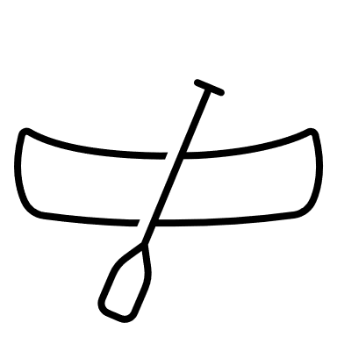

Goal of the Treaty 9 Co-jurisdiction Case
The goal of the case is to get Canadian law to recognize that:
  Treaty 9 First Nations have the right to make decisions about matters that affect their territory.
  Treaty 9 First Nations never agreed to “cede or surrender” their jurisdiction (their right to self-govern).
  Treaty 9 First Nations agreed to share the territory and decisions about it with the Crown.
  There are two orders of government in Canada – two canoes.
WOODWARD & COMPANY | LAWYERS LLP | BARRISTERS & SOLICITORS

Slide 5
What does the case argue?
The written Treaty does not reflect what Treaty 9 First Nations agreed to.
The real Treaty includes the oral promises that the parties agreed to.
The case does not argue that there is no Treaty.
Treaty 9 signatories agreed to share the land with the Crown.
In return, the Crown agreed that the Indigenous signatories had the right to maintain their way of life (their “Way of Life”).
Indigenous signatories’ right to a Way of Life includes harvesting rights, including hunting, fishing, and trapping (“Harvesting”) and the right to make decisions about the land (their “Jurisdiction”).
WOODWARD & COMPANY | LAWYERS LLP | BARRISTERS & SOLICITORS

Slide 6
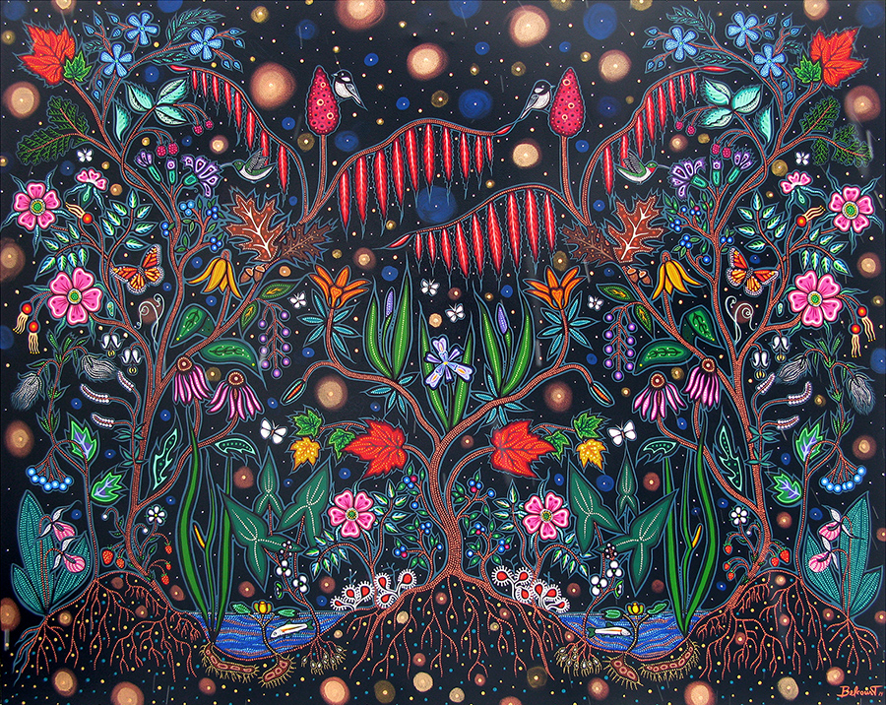
What does the case argue?
The statement of claim explains the relationship between the right to a Way of Life, Harvesting, and Jurisdiction at paragraph 8:
“Jurisdiction is an essential aspect of the Plaintiffs’ Way of Life. It is inseparable from Harvesting when viewed from the Indigenous perspective. From the Plaintiffs’ perspective, they had and have a sacred responsibility to protect the Land so as to ensure that it remained and remains in a viable and healthy state to support future generations of humans and other-than-humans. This reflects a relational, collective and holistic perspective. The Plaintiffs’ Way of Life requires that they manage and govern the Land and its uses, including Harvesting, in accordance with this responsibility and relational perspective.”
“Our Lives are in the Land”, Christie Belcourt
WOODWARD & COMPANY | LAWYERS LLP | BARRISTERS & SOLICITORS

Slide 7
What does the case argue?
Today, the oral promises of the Treaty means co-jurisdiction with the Crown – sharing decision-making about what happens to the land. This includes the right to give or withhold free, prior, and informed consent.
The Crown has breached its Treaty promises and has unjustifiably infringed the plaintiffs’ Treaty Rights when it unilaterally (and without seeking consent) makes decisions that have a serious affect on Treaty 9 territory.
  Example: Ontario’s mineral tenure regime.
WOODWARD & COMPANY | LAWYERS LLP | BARRISTERS & SOLICITORS

Slide 8
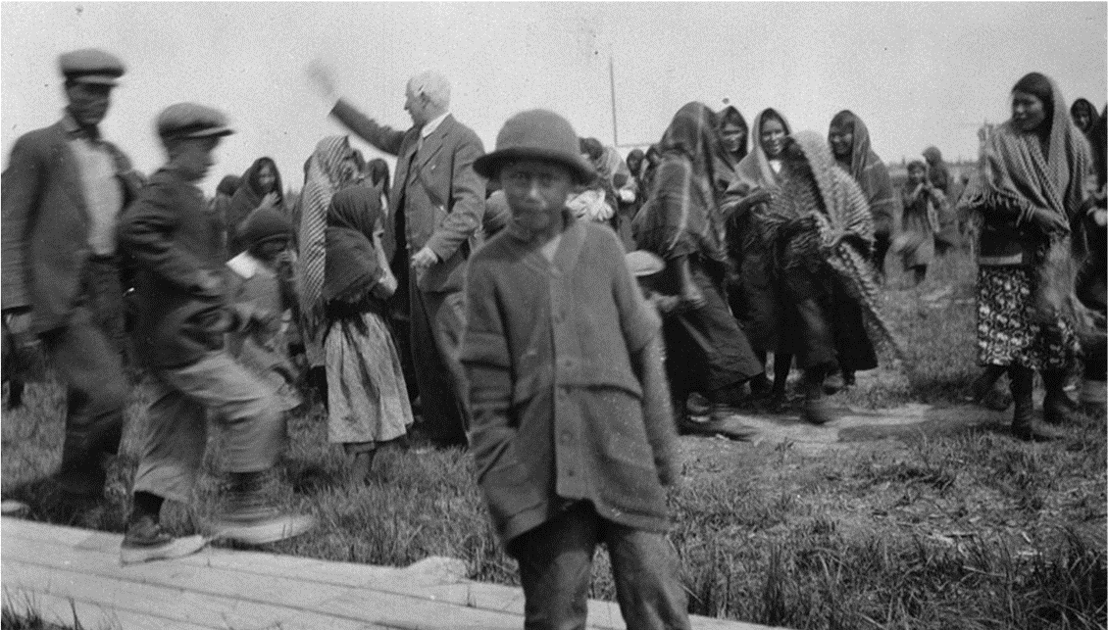
Treaty Right Principles
Canadian law has special principles for interpreting treaties. They say that:
The Crown will be held to its oral promises;
Those promises will be interpreted as the First Nations party would naturally have understood them;
The Court will not interpret the Crown’s promises in a way that empties them of their meaning;
Treaties should be interpreted with the goal of finding the common intention of the Crown and First Nations – the common intention should reconcile their competing interests; and,
Ambiguities should be resolved in favour of First Nations.
Folks from Attawapiskat, with Treaty Commissioner, 1929
WOODWARD & COMPANY | LAWYERS LLP | BARRISTERS & SOLICITORS

Slide 9
What does the evidence show?

Slide 10
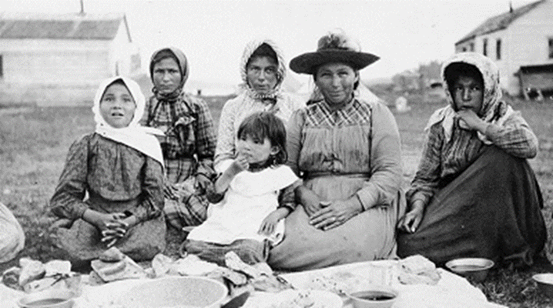
What does the evidence show?
Before Treaty 9 was signed, Treaty 9 First Nations exercised exclusive jurisdiction in Treaty 9 territory.
The Crown asserted sovereignty in Treaty 9 territory before the Treaty was signed, but this did not alter Treaty 9 First Nations’ jurisdiction.
Treaty 9 never gave exclusive jurisdiction to the Crown.
Folks at Mattagami Post in 1905
WOODWARD & COMPANY | LAWYERS LLP | BARRISTERS & SOLICITORS

Slide 11
What does the evidence show?
Indigenous Signatories entered Treaty 9 to protect their Way of Life.
Indigenous Signatories never agreed to sign away their Way of Life or their decision-making authority over the Lands. Their laws and responsibilities would not have allowed them to do so.
Oral history emphasizes that the real Treaty protects Indigenous signatories’ Way of Life and Jurisdiction.
In particular, the Crown agreed that the Indigenous signatories could maintain their relationship with their territories - including rights to make decisions about them.
WOODWARD & COMPANY | LAWYERS LLP | BARRISTERS & SOLICITORS

Slide 12
What does the evidence show?
Treaty 9 First Nations did not agree to cede, release, or surrender their jurisdiction.
Crown officials prepared the written text of Treaty 9 before meeting with Treaty 9 Nations and without their knowledge or consent.
Treaty Commissions did not explain or in most cases, even mention, the cede and surrender clause.
The Treaty Commissioners did not explain the taking up clause or the Crown’s purported right to regulate the Indigenous signatories’ harvesting rights.
WOODWARD & COMPANY | LAWYERS LLP | BARRISTERS & SOLICITORS

Slide 13
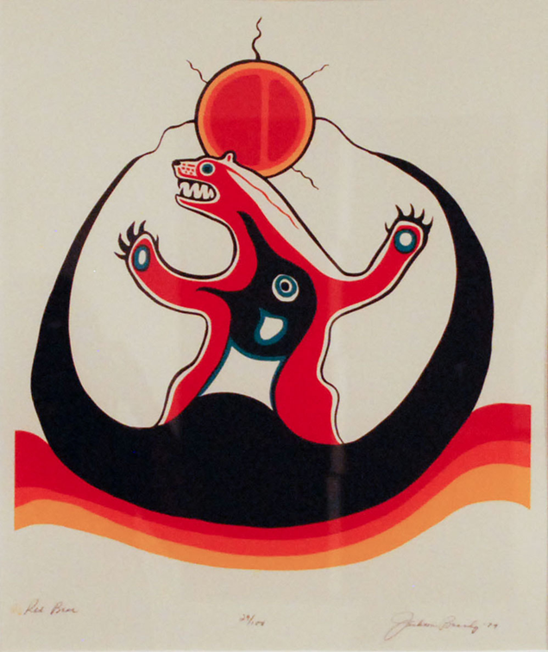
What does the evidence show?
The sceptical band members had been told that by signing the treaty they were agreeing not to interfere with the whites who were coming into their country for a variety of reasons. They do not seem to have been told that they were giving up all of their own rights to their traditional lands, with the exception of certain small “reserves”; that thenceforth they would have no say whatsoever in the management or development of those lands; that they would be prevented from hunting, fishing and trapping on any particular areas occupied by whites; or that their hunting, fishing and trapping could be regulated by government as it saw fit. Yet the text of the treaty states that the Indian people had thereby ceded ‘all their rights, titles and privileges whatsoever’ to the lands in questions.
Morrison, Treaty Research Report: Treaty No. ( (1905-1906), Treaties and Historical Research Centre, Indian and Northern Affairs Canada (1986) at PDF page 37-38.
Jackson Beardy “Red Bear” (1979)
WOODWARD & COMPANY | LAWYERS LLP | BARRISTERS & SOLICITORS

Slide 14
What does the evidence show?
The Indigenous Signatories likely contemplated that the Crown would undertake some governance, which would guard against incursions into the Treaty 9 Nations’ Way of Life.
They also likely understood that white people would be able to enter their lands, except for reserves, that they must obey the law, and that the Crown would play a role in taking care of their lands.
But this did not mean Crown would be “boss” of the territory.
The real Treaty guarantees co-jurisdiction between Treaty 9 First Nations and the Crown.
WOODWARD & COMPANY | LAWYERS LLP | BARRISTERS & SOLICITORS

Slide 15
What does the case ask for?

Slide 16
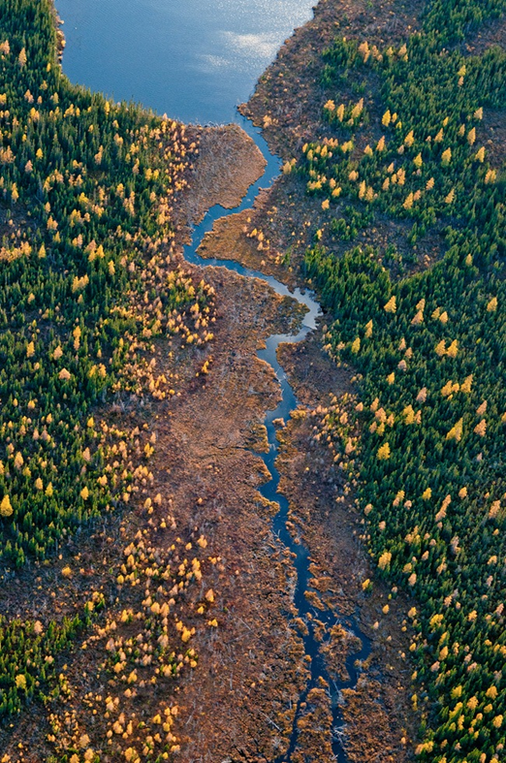
Best Outcome: Negotiated Co-jurisdiction Regime
We will fight this in court if we must, but Canada and Ontario know there are problems with how Treaty 9 was negotiated.
We hope the court case will push them to negotiate a co-jurisdiction (shared decision-making) regime. The goal is to work out how decision-making is shared through negotiations.
The regime would establish who gives consent in certain circumstances, which processes are used to obtain this consent, and how disputes are resolved when impasses arise (e.g., an independent dispute resolution mechanism similar to other bilateral or multilateral treaties).
WOODWARD & COMPANY | LAWYERS LLP | BARRISTERS & SOLICITORS

Slide 17
Court Imposed Remedies
Declarations that:
  The plaintiffs have jurisdiction (decision-making power) over Treaty 9 Territory;
  Treaty 9 confirms that the plaintiffs’ Way of Life, including jurisdiction, is to continue without interference;
  In the alternative to (b), the “cede, release, and surrender clause” does not affect the plaintiffs’ jurisdiction;
  Treaty 9 did not cede, release, or surrender jurisdiction – it resulted in co-jurisdiction, the nature of which is to be negotiated in accordance with the Crown’s duty to negotiate in good faith;
  The Crown has breached the Treaty by regulating Treaty 9 territory without the plaintiffs’ consent;
  The Crown has and will continue to unjustifiably infringe the plaintiffs’ treaty rights by regulating Treaty 9 territory without their consent;
  the Crown has breached its constitutional duties to protect the plaintiffs’ Treaty Rights by regulating the land without the Plaintiffs’ consent;
  by regulating the land without the Plaintiffs’ consent, the Crown has failed to act honourably;
  after the statement of claim is filed, permits, approvals, or other authorizations granted by Canada and Ontario that regulate the land without the plaintiffs’ consent unjustifiably infringe the plaintiffs’ jurisdiction and are of no force or effect;
  various provincial and federal legislation purporting to regulate the land is of no force and effect;
  declarations (i) and (j) are suspended for no more than five years for the parties to negotiate a co-jurisdiction regime.
WOODWARD & COMPANY | LAWYERS LLP | BARRISTERS & SOLICITORS

Slide 18
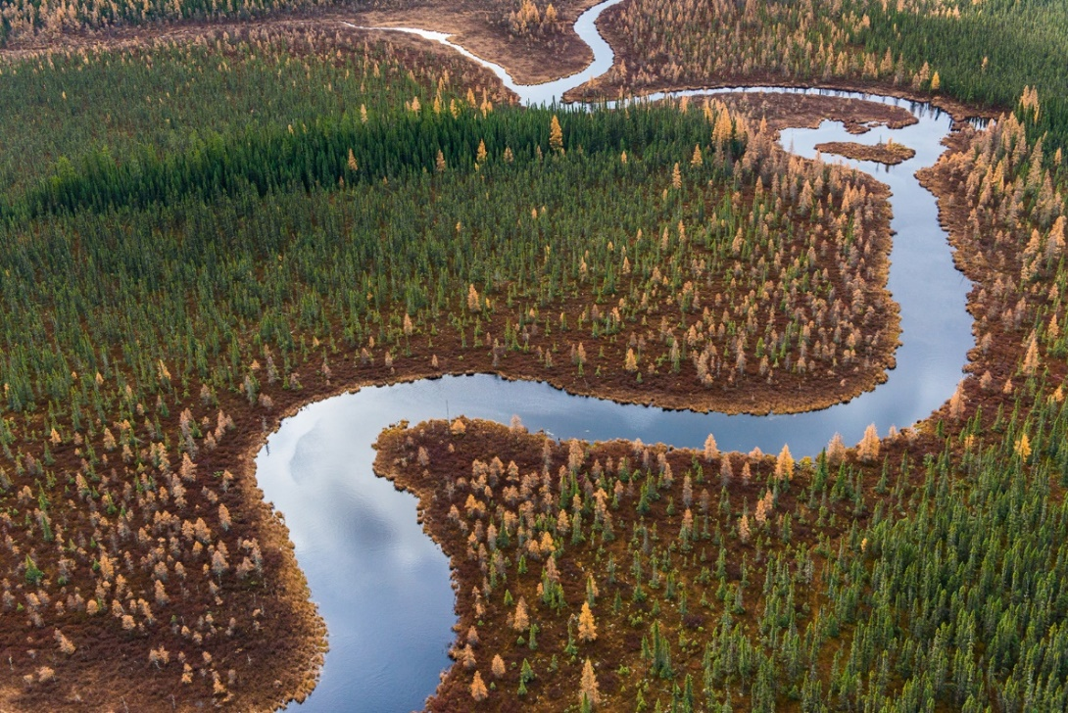
Court Imposed Remedies
An order that other Treaty 9 claims (i.e., TLE) shall not be adversely affected by this claim;
Injunctions restraining the Crown from regulating the land without the Plaintiffs’ consent;
Financial compensation from the Crown for breach of Treaty and breach of the Crown’s constitutional duties ($95,000,000,000 to be allocated based on a formula determined by the Court).
WOODWARD & COMPANY | LAWYERS LLP | BARRISTERS & SOLICITORS

Slide 19
What challenges will we face?

Slide 20
Challenges
This is an important case that could push Canadian law forward. There are always challenges to such big cases including:
  The Court may find that there was no treaty at all. If this happens, the landscape would be similar to BC (First Nations in BC generally have no treaties with the Crown and can more easily prove title to traditional land).
  There is a good argument that Treaty 9 promised to share jurisdiction, but the details about how to do so remain unclear. Therefore, we are asking the Court o order the Crown governments to negotiate a new co-jurisdiction regime.
  Case law from other historic treaties has found that the Indigenous signatories ceded and surrendered their rights and privileges in exchange for certain treaty rights. However, none of those cases directly challenged the cede, release, and surrender clause like this case.
  There are risks associated with taking the Treaty Relationship to a settler court. But even if we lost the case (which we do not intend) then the law on Treaty 9 would not be any worse than it is right now – the worse interpretation of Treaty 9 is being applied now.
  Overall, it is hard to imagine how this case could make things worse than they already are and thus the downside risks are minimal.
WOODWARD & COMPANY | LAWYERS LLP | BARRISTERS & SOLICITORS

Slide 21
Why push for shared decision-making now?

Slide 22
Why push for shared decision making now
Ontario and Canada are planning massive development in the Ring of Fire/James Bay Lowlands.
The James Bay Lowlands (also known as “the Breathing Lands”) are crucially important to:
  First Nations way of life, culture, and rights
  Regional environment, wildlife, and water systems
  Protecting the climate
First Nations in the region will be directly affected by what happens in the Ring of Fire – but Canada and Ontario want to make all the decisions.
The Treaty 9 case is a tool to push for shared decision-making in the Ring of Fire and beyond
  Should development happen?
  Which projects and how?
  How should First Nations benefit?
WOODWARD & COMPANY | LAWYERS LLP | BARRISTERS & SOLICITORS

Slide 23
What are the next steps?

Slide 24
Participation
  Treaty 9 First Nations are stronger when they stand together. All Treaty 9 First Nations that agree with the theory of the case are welcome to participate.
  To bring the case on behalf of all Treaty 9 beneficiaries, all Treaty 9 First Nations may need to participate in some manner (as plaintiffs, defendants, or by appointing a representative). Alternatively, they may be able to waive their right to participate in the case.
  We will not name Treaty 9 First Nations as defendants, but the Crown may ask the Court for this to happen.
  Currently, the confirmed plaintiffs include:
    Attawapiskat First Nation
    Aroland First Nation
    Apitipi Anicinapek Nation
    Kashechewan First Nation
    Ginoogaming First Nation
    Fort Albany First Nation
    Constance Lake First Nation
    Kitchenuhmaykoosib Inninuwug
    Eabametoong First Nation
    Neskantaga First Nation
WOODWARD & COMPANY | LAWYERS LLP | BARRISTERS & SOLICITORS

Slide 25
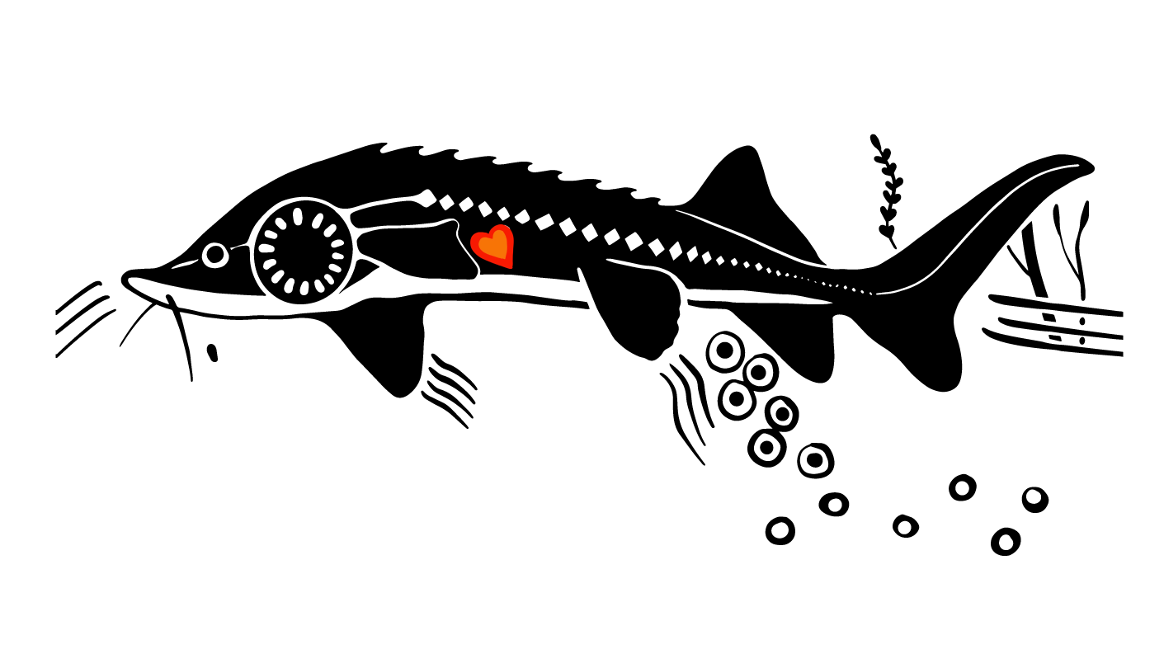
Timelines & Funding
  This is a big undertaking. If we have to, it will take many years to litigate it all the way to the end of trial and appeals.
  As with any large-scale litigation, the case will be expensive. However, First Nations costs will be relatively minimal because:
    RAVEN Trust is fundraising to support this case;
    Remaining costs will be split equally among the plaintiff First Nations; and
    If this matter proceeds to negotiations (our ideal outcome), the Crown may fund the negotiation table.
Artwork for RAVEN’s fundraising campaign, by Christie Belcourt
WOODWARD & COMPANY | LAWYERS LLP | BARRISTERS & SOLICITORS

Slide 26

Next Steps
The case was launched on April 26, 2023 in Toronto.
The statement of claim will be filed at the end of June.
If you wish to participate as a plaintiff, please contact Tara McDonald at tmcdonald@wodowardandcompany.com or 647-529-9474.
We are also happy to set up one-on-one meetings to discuss the case.
WOODWARD & COMPANY | LAWYERS LLP | BARRISTERS & SOLICITORS

Slide 27

WOODWARDANDCOMPANY.COM
VICTORIA OFFICE
200 - 1022 Government Street
Victoria, BC V8W 1X7
250 383 2356
WHITEHORSE OFFICE
201 - 3059 3rd Avenue
Whitehorse, YT Y1A 1E2
867 633 5940
LAWYERS LLP

